Slide 1
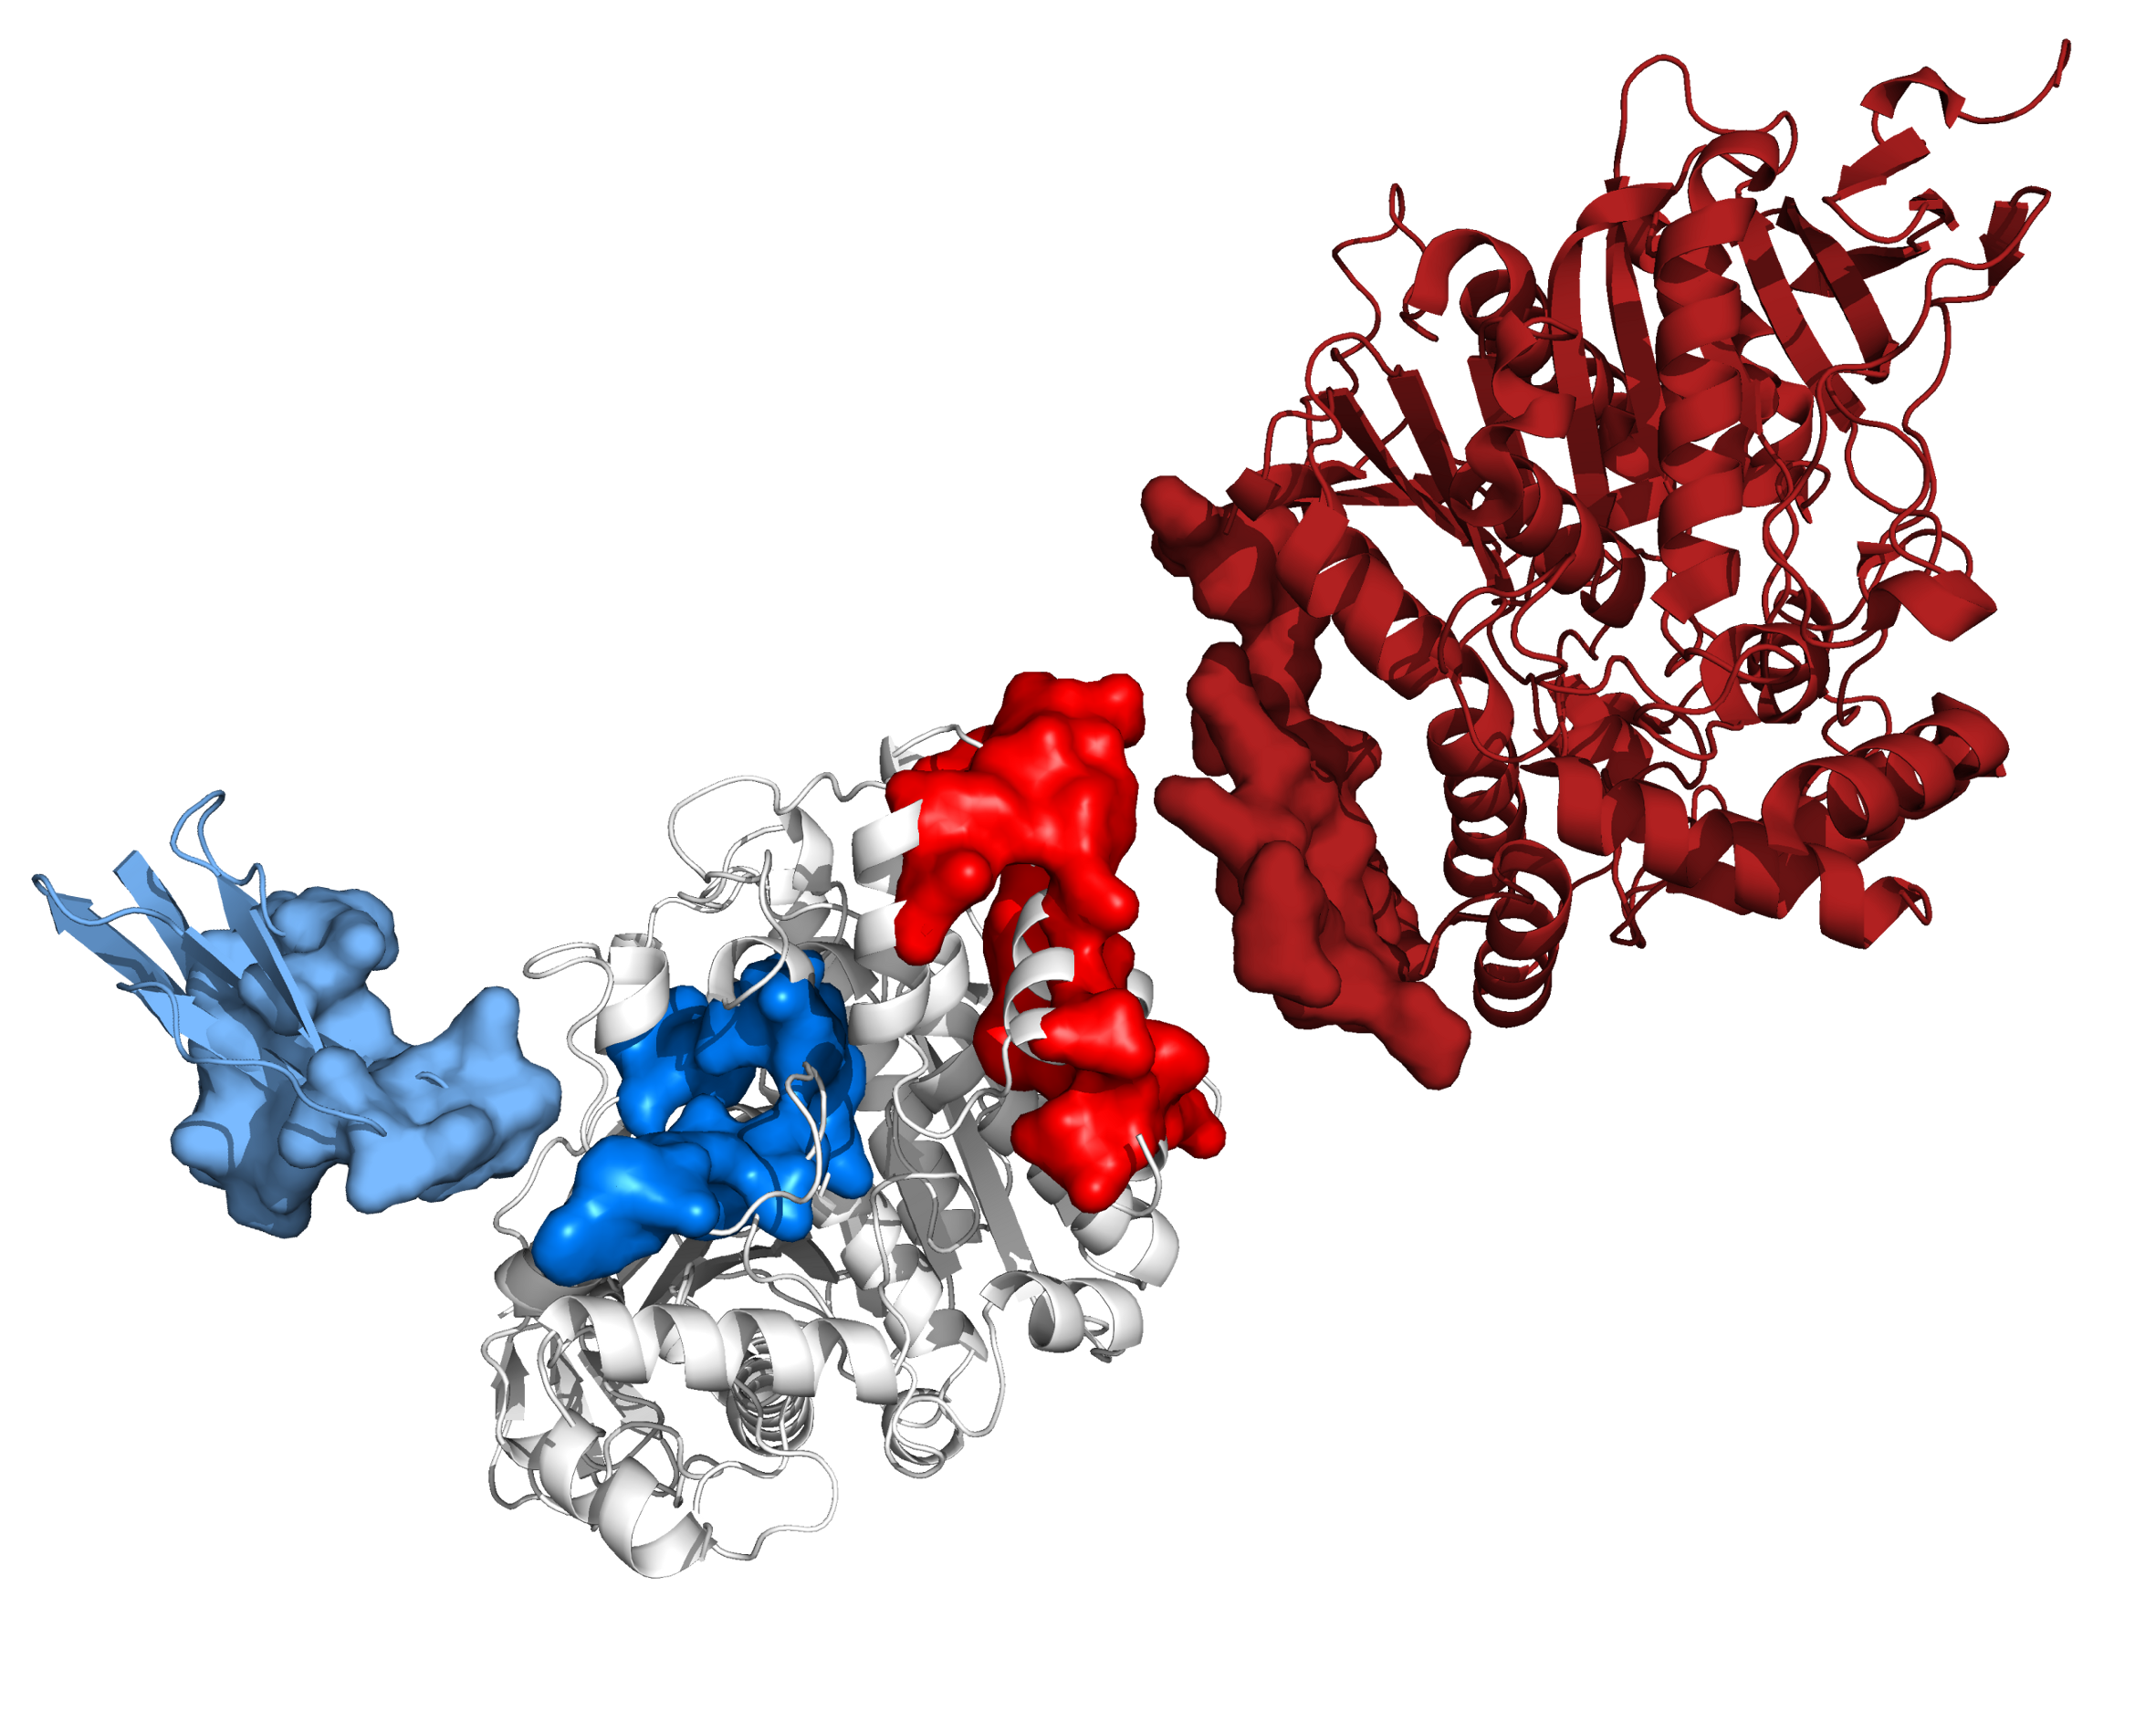
Learning about Protein-Molecules Interactions
Elodie Laine, Laboratory of Computational and Quantitative Biology,
Analytical Genomics (dir. A. Carbone), UPMC-CNRS

Slide 2
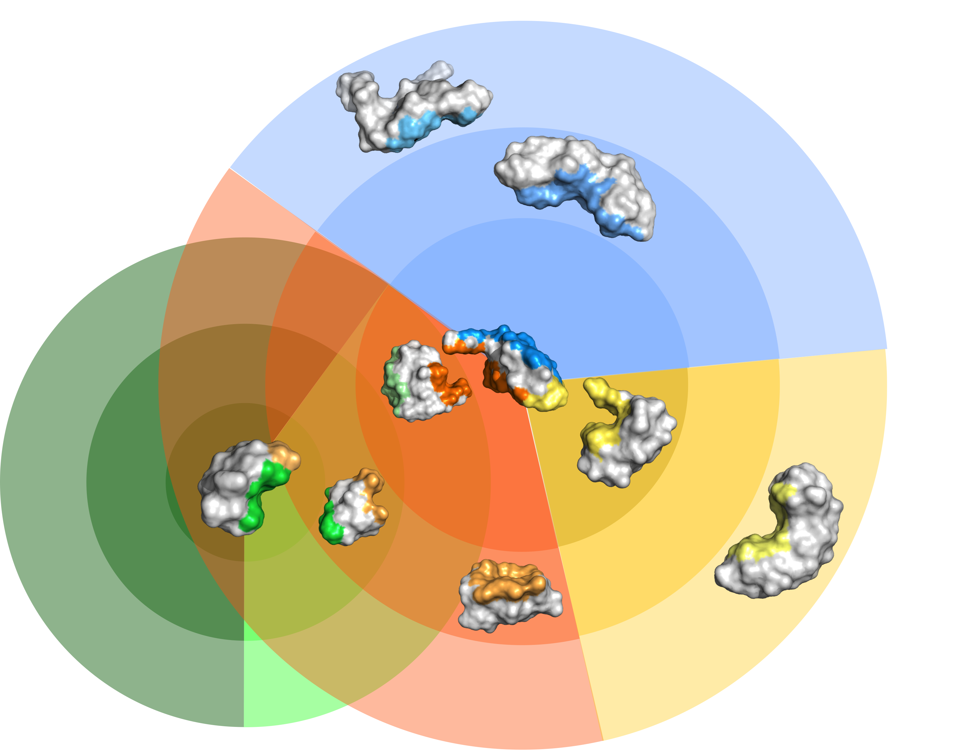
Which proteins interact in the cell, and how?

Slide 3
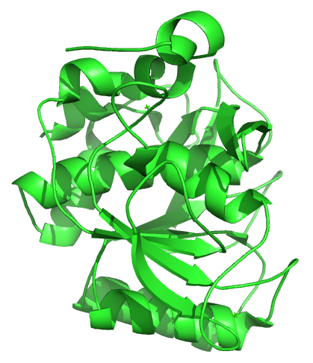
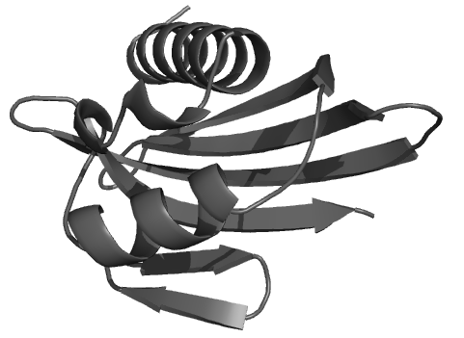
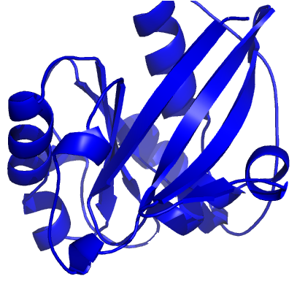
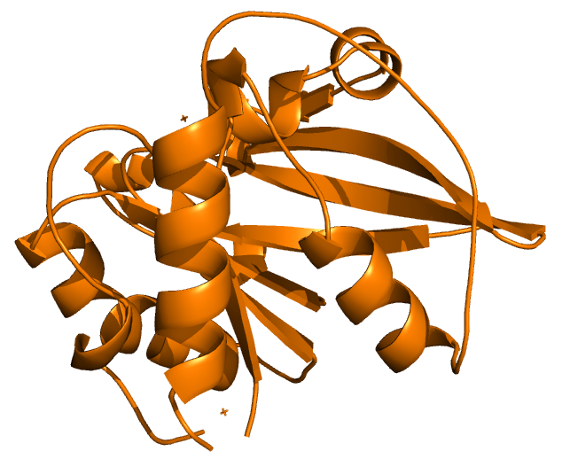
Molecular cross-docking
?

Slide 4
Molecular cross-docking
MAXDo - ATTRACT protocol
(Sacquin-Mora et al. 2009, Zaccharias 2003)

Slide 5
Molecular cross-docking
Selection of the "best" conformation(s) for each protein pair based on agreement with known/predicted interfaces and docking energy
Interaction Index: II(P₁,P₂) = max ( - FIR_{P1} * FIR_{P2} * Ene_{P1,P2} )

Slide 6
Molecular cross-docking
weak
strong
Computation of an Interaction Index (II) for each protein pair,
followed by normalization

Slide 7
Molecular cross-docking
true partners
weak
strong
Identification of cellular partners as protein pairs with the highest Normalized Interaction Indexes (NII)

Slide 8
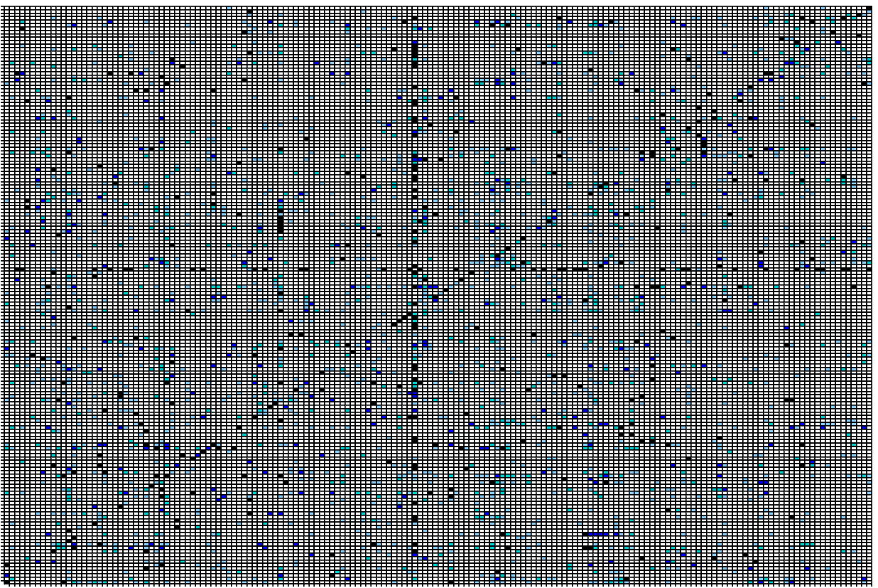

We do this at large scale!
no interaction
Normalized Interaction Indexes
strong interaction
168 proteins, 7 months on the World Community Grid.
Partners are retrieved with an AUC of 0.84. (Lopes et al. 2013)

Slide 9
Partner discrimination
Area under the ROC curve (1 = perfect prediction)
Functional Class | Experimental interfaces | Predicted Interfaces (Lopes et al. 2013) | Predicted interfaces (Dequeker et al., in prep)
All (168) | 0.84 | 0.60 | 0.68
AA (10) | 0.89 | 0.58 | 0.67
AbA (11) | 0.91 | 0.56 | 0.76
EI (42) | 0.80 | 0.74 | 0.76
ER (6) | 0.74 | 0.59 | 0.73
ES (10) | 0.95 | 0.78 | 0.94
OG (23) | 0.93 | 0.74 | 0.72
OR (14) | 0.91 | 0.51 | 0.82
OX (30) | 0.84 | 0.59 | 0.62
Protein-Protein Docking Benchmark (168 proteins).
Various functional classes and flexibility degrees.
Docking was performed on the unbound conformations.
+8
+9
+20
+2
+14
+16
-2
+31
+3

Slide 10
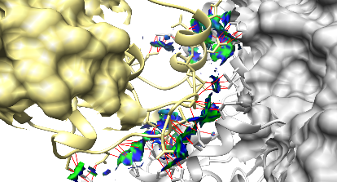
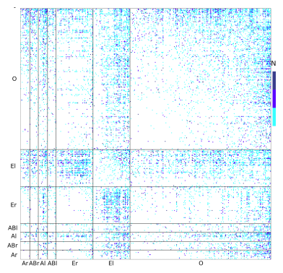
How to evaluate docking conformations?
Prediction of interaction sites
Protein social behavior
Prediction of
binding affinity

Slide 11
How to evaluate docking conformations?
Prediction of interaction sites
Protein social behavior
Prediction of
LISA
quantum-chemistry based scoring function
Raucci et al. submitted
binding affinity

Slide 12
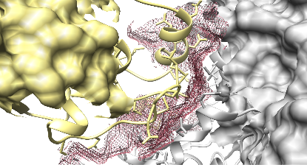
Local Interaction Signal Analysis
quantum mechanical electron density
NCI - Johnson
et al. 2010

Slide 13
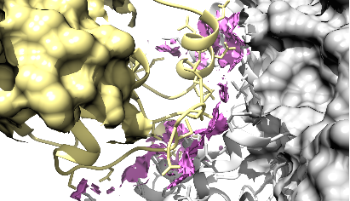
Local Interaction Signal Analysis
quantum mechanical electron density
reduced gradient density (RDG) isosurfaces
NCI - Johnson
et al. 2010

Slide 14
Local Interaction Signal Analysis
quantum mechanical electron density
reduced gradient density (RDG) isosurfaces
NCI - Johnson
et al. 2010
inter-atomic contacts
favorable contacts
RDG ≤ 1 & ρ < 0
unfavorable contacts
RDG ≤ 1 & ρ ≥ 0
signed electron density (ρ)

Slide 15
Local Interaction Signal Analysis
~200 descriptors (NCI, SCR, DSSP, NIS)
Feature selection and model training using Support Vector Regression
LISA outperforms 18 other state-of-the-art scoring functions, reaching a correlation of 0.81 with experimental measures on 125 complexes.
quantum mechanical electron density
reduced gradient density (RDG) isosurfaces
NCI - Johnson
et al. 2010
inter-atomic contacts
favorable contacts
RDG ≤ 1 & ρ < 0
unfavorable contacts
RDG ≤ 1 & ρ ≥ 0
signed electron density (ρ)

Slide 16
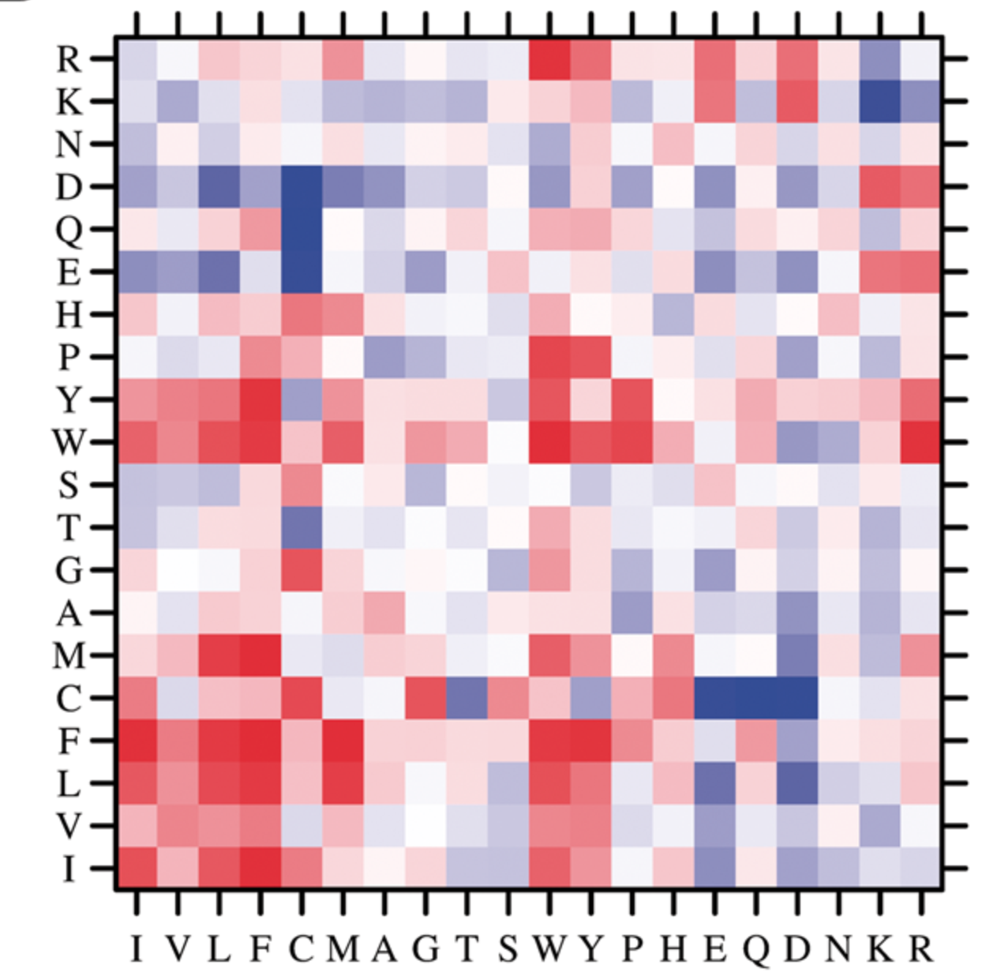
How to evaluate docking conformations?
Prediction of interaction sites
Protein social behavior
Prediction of
CIPS
pairwise statistical potential
Nadalin et al. Bioinformatics 2017
binding affinity

Slide 17
How to evaluate docking conformations?
Prediction of interaction sites
Protein social behavior
Prediction of
NII
normalized interaction index
Lopes et al.
PLoS CB 2013
Laine & Carbone Proteins 2016
binding affinity

Slide 18
How to evaluate docking conformations?
JET/JET2
Engelen et al. PLoS CB 2009
Laine & Carbone PLoS CB 2015
JET2Viewer
http://www.jet2viewer.upmc.fr
Ripoche et al. NAR DB 2017
Prediction of interaction sites
Protein social behavior
Prediction of
binding affinity

Slide 19
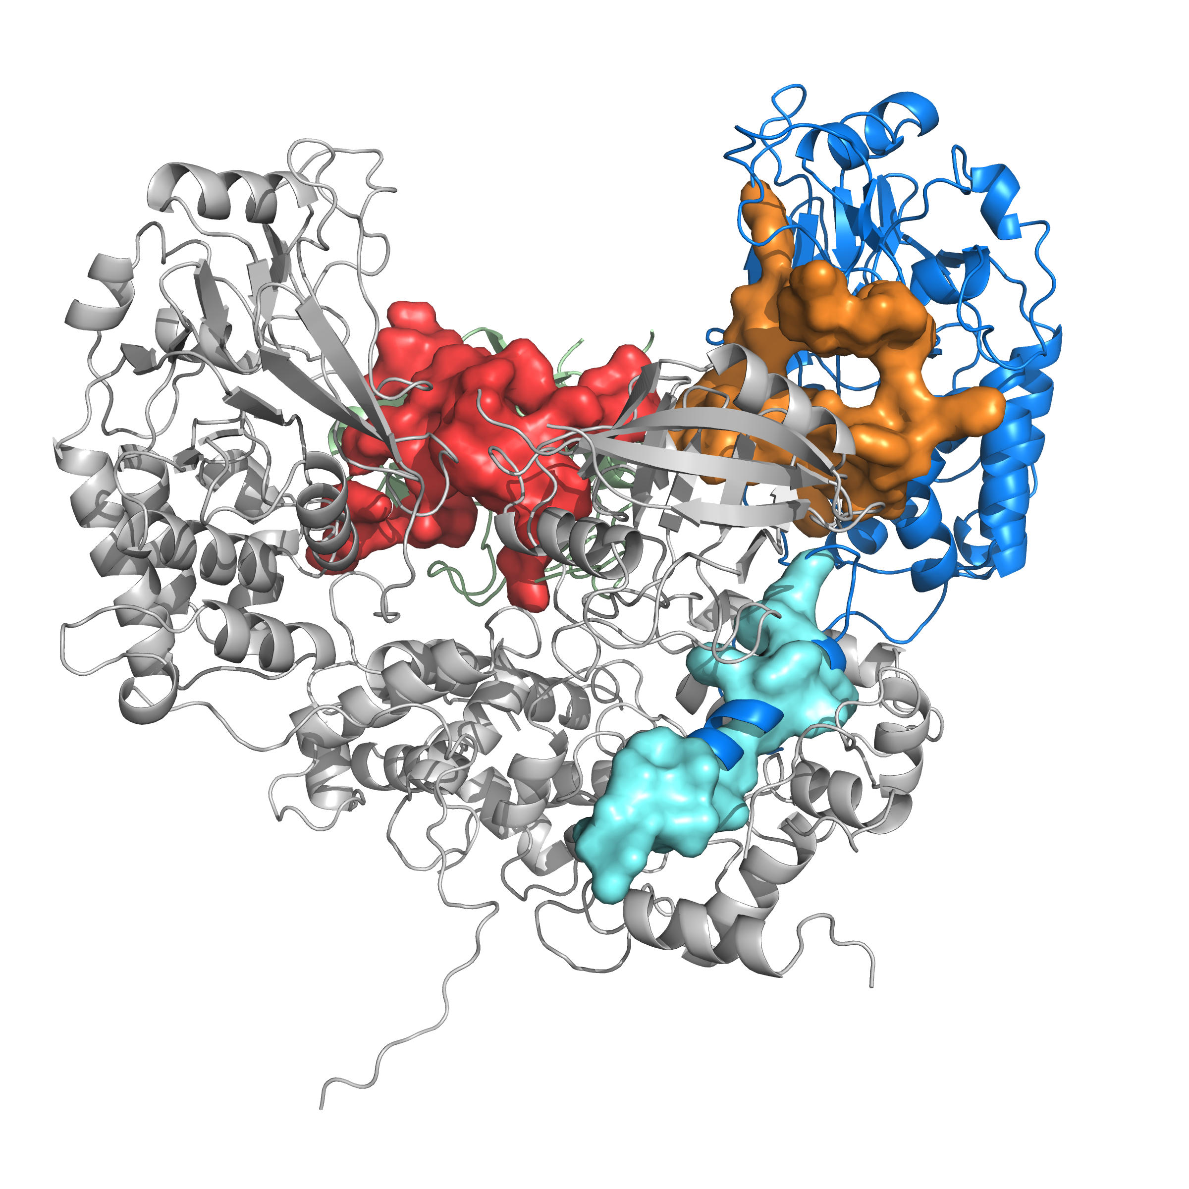
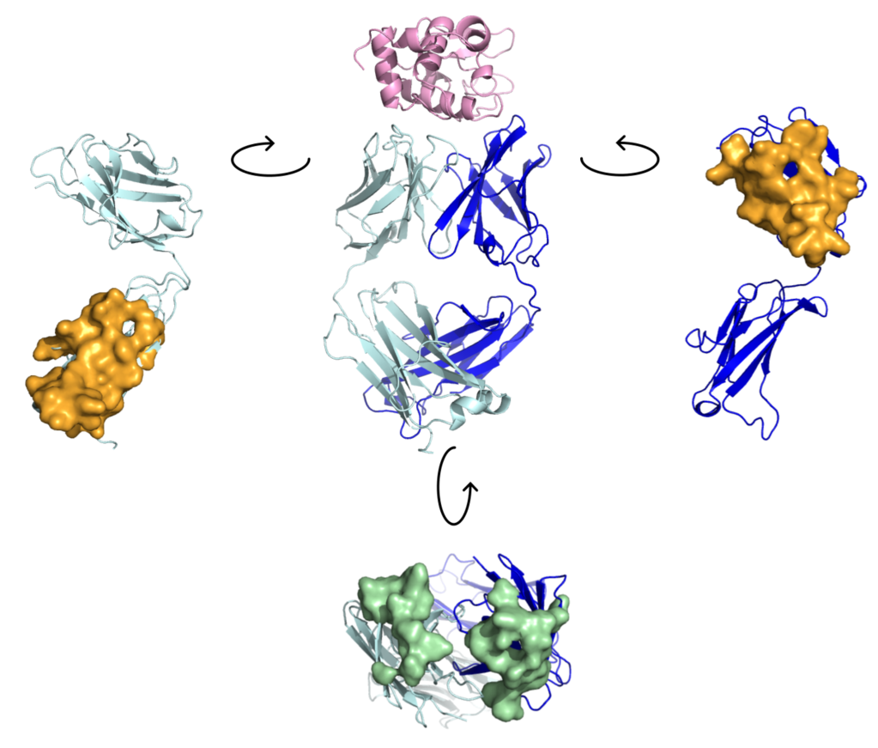
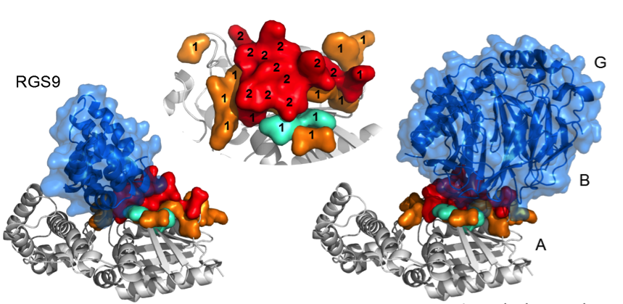
Prediction of binding sites
P2
JET2:
evolutionary conservation (TJET)
physico-chemical properties
local geometry
P1
NIP: binding propensities inferred from docking calculations
Multiple origins for multiple partners
Multiple usage of the same patch
conserved patch
protruding patch
Notes:
Lysozyme bound to its antibody on top
Transducin α bound to RGS9 and to transducin β-γ at the bottom

Slide 20
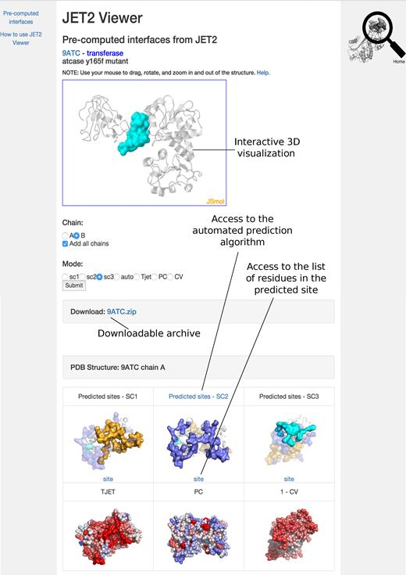
Prediction of binding sites
Notes:
Lysozyme bound to its antibody on top
Transducin α bound to RGS9 and to transducin β-γ at the bottom

Slide 21
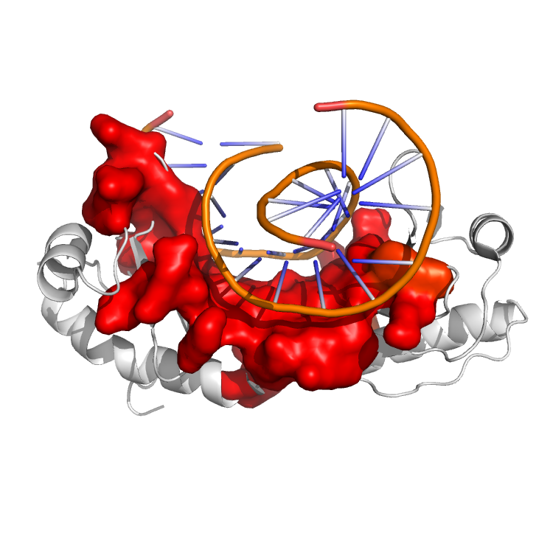
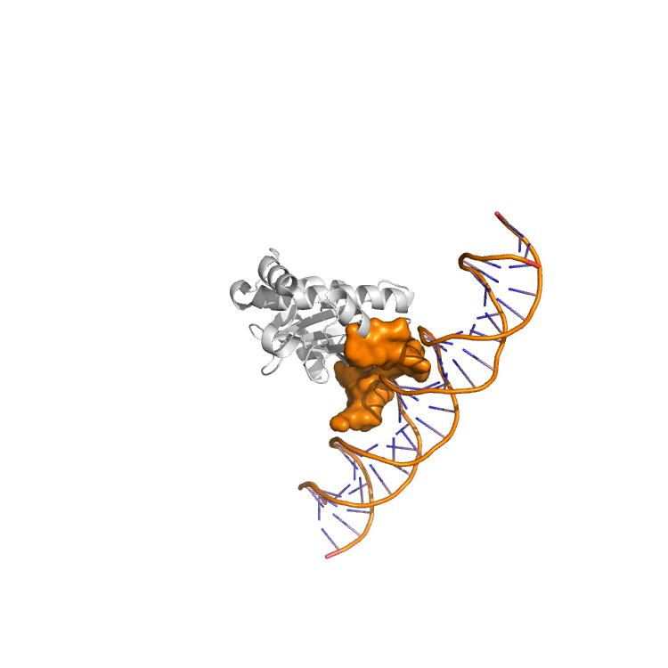
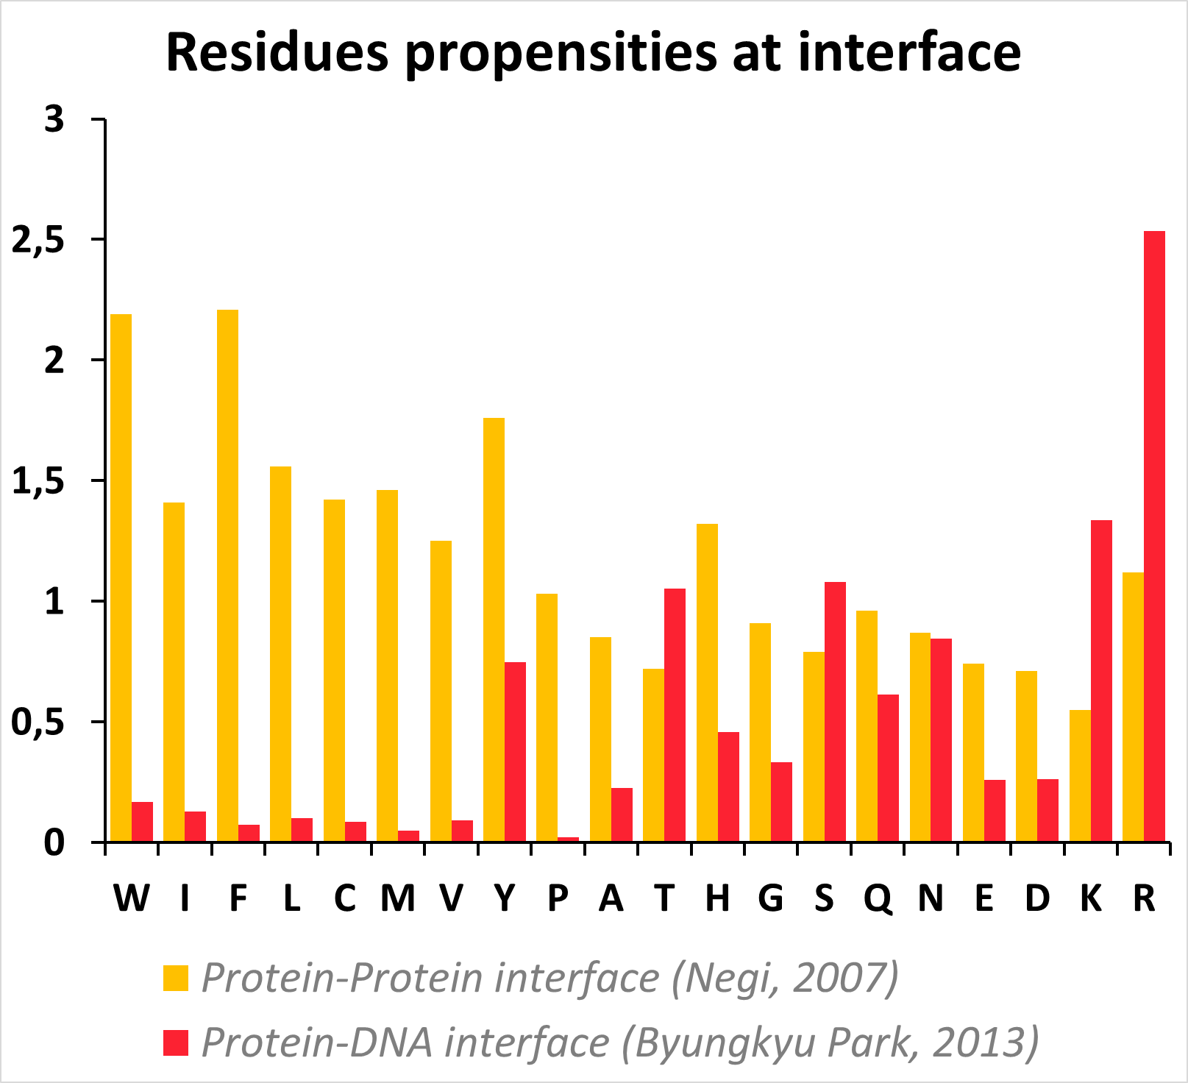
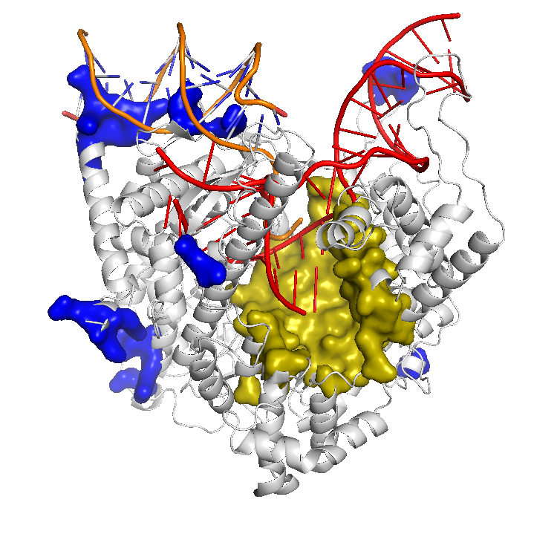
Prediction of binding sites
Extending JET2 to predict DNA-binding sites
JETDNA
Corsi et al. to be submitted
Notes:
Lysozyme bound to its antibody on top
Transducin α bound to RGS9 and to transducin β-γ at the bottom

Slide 22
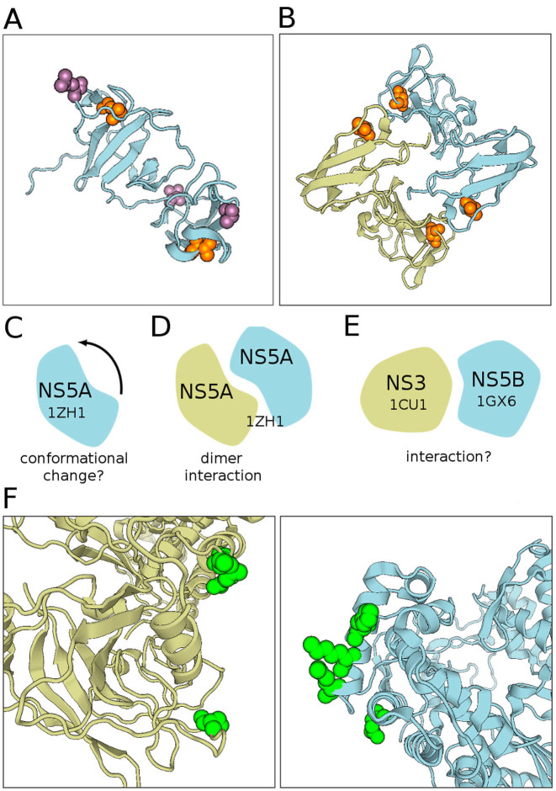
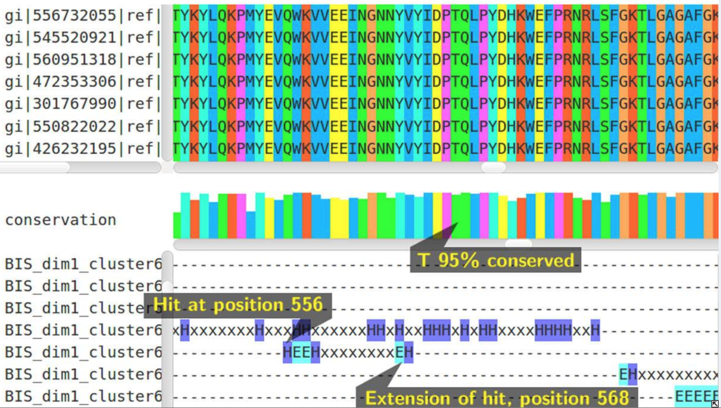
Predicting interactions with coevolution signals
Combinatorial methods to extract coevolution signals
MST
Baussand & Carbone 2009
BIS
Dib & Carbone 2012
BIS2Analyzer
http://www.BIS2Analyzer.upmc.fr
Oteri et al. 2017
Well adapted for small multiple sequence alignments and conserved protein families.
HCV proteins
Notes:
Lysozyme bound to its antibody on top
Transducin α bound to RGS9 and to transducin β-γ at the bottom

Slide 23
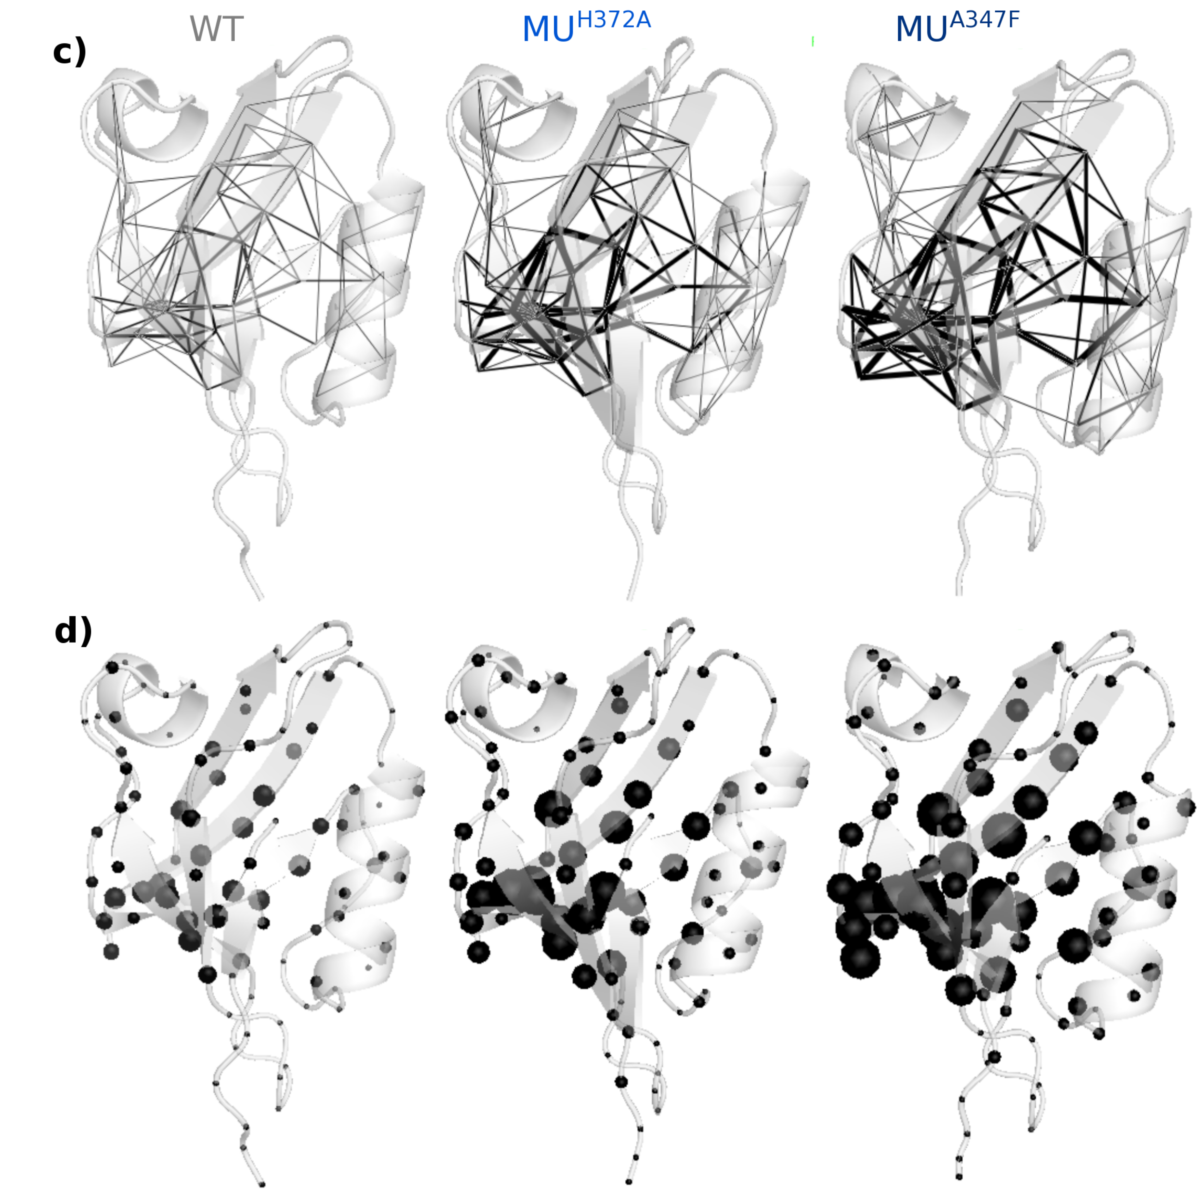
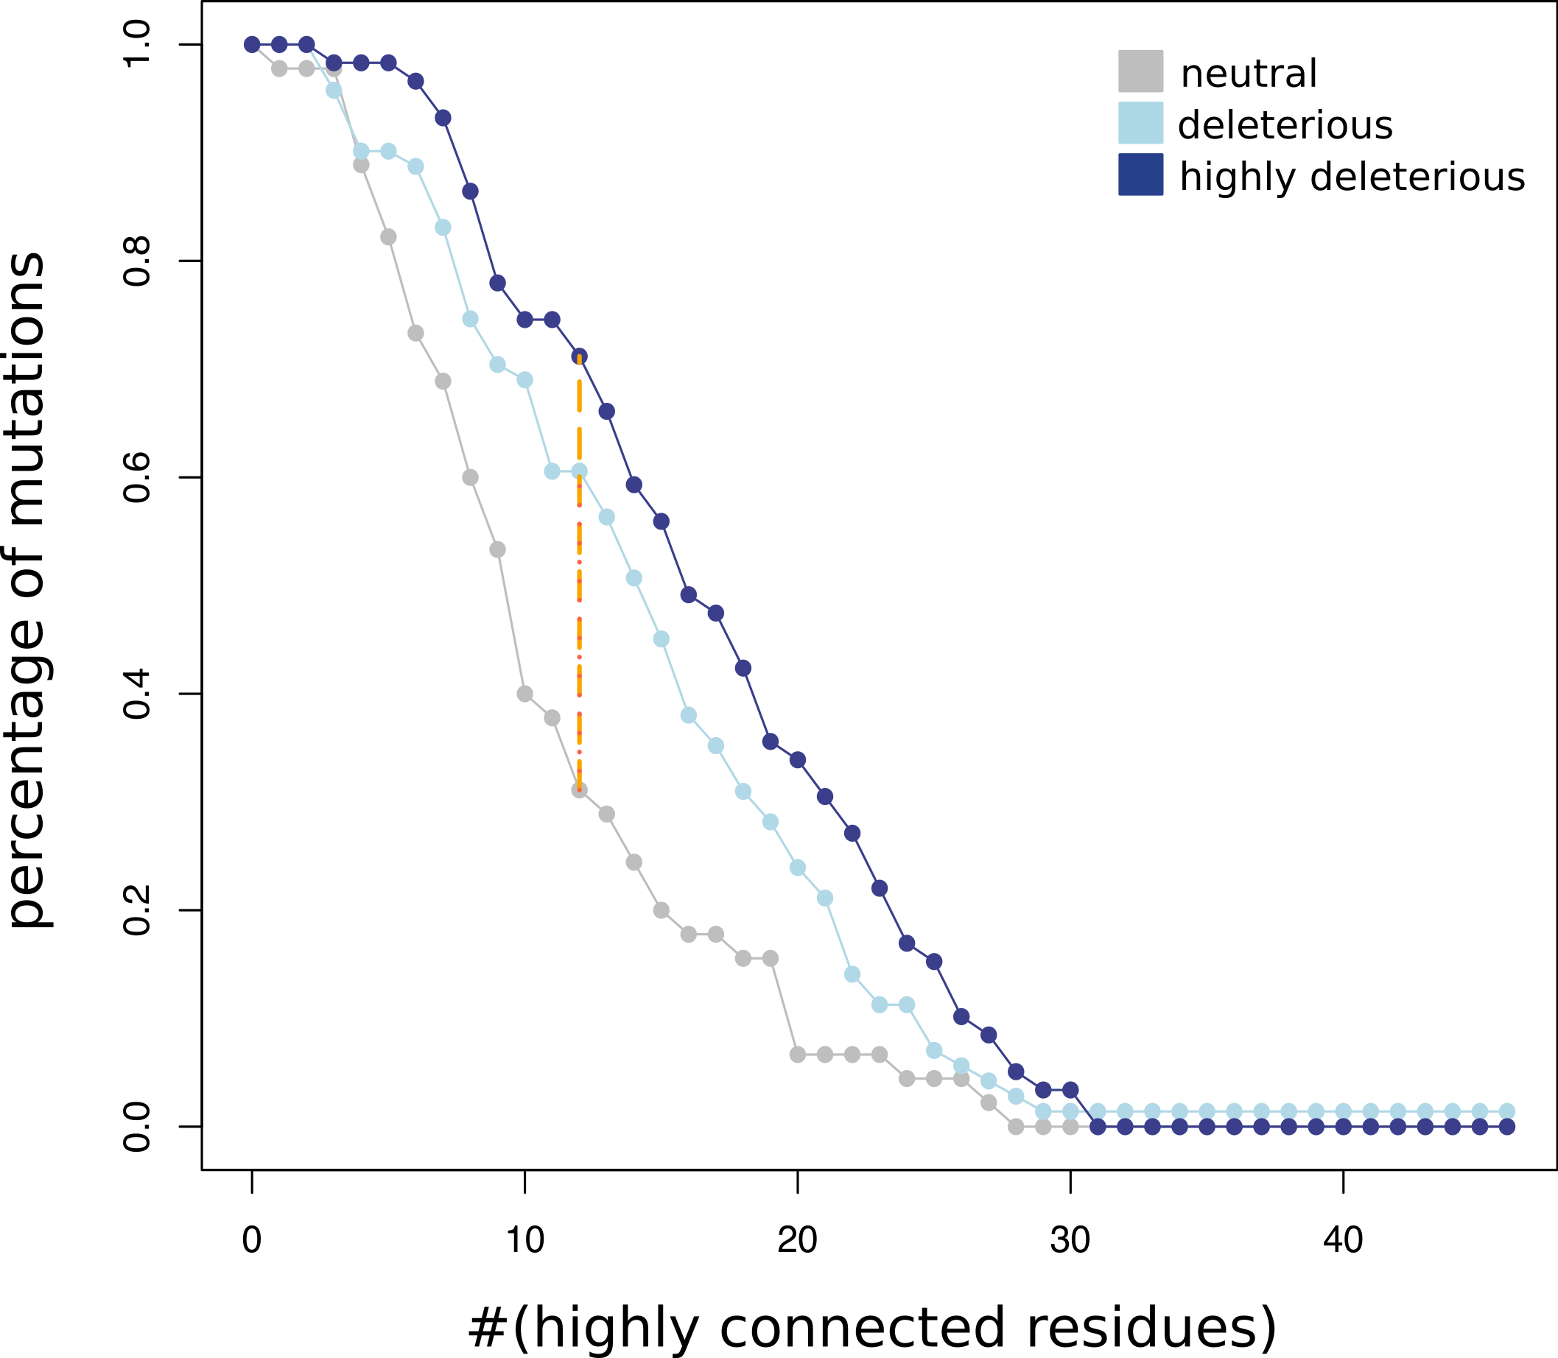
"Infostery" to predict mutational outcomes
Infostery: automatically extracting pertinent information from conformational ensembles
COMMA/COMMA2
Karami et al. 2016
Karami et al. submitted
Application to 175 mutants of PSD95^{PDZ3}
Notes:
Lysozyme bound to its antibody on top
Transducin α bound to RGS9 and to transducin β-γ at the bottom

Slide 24
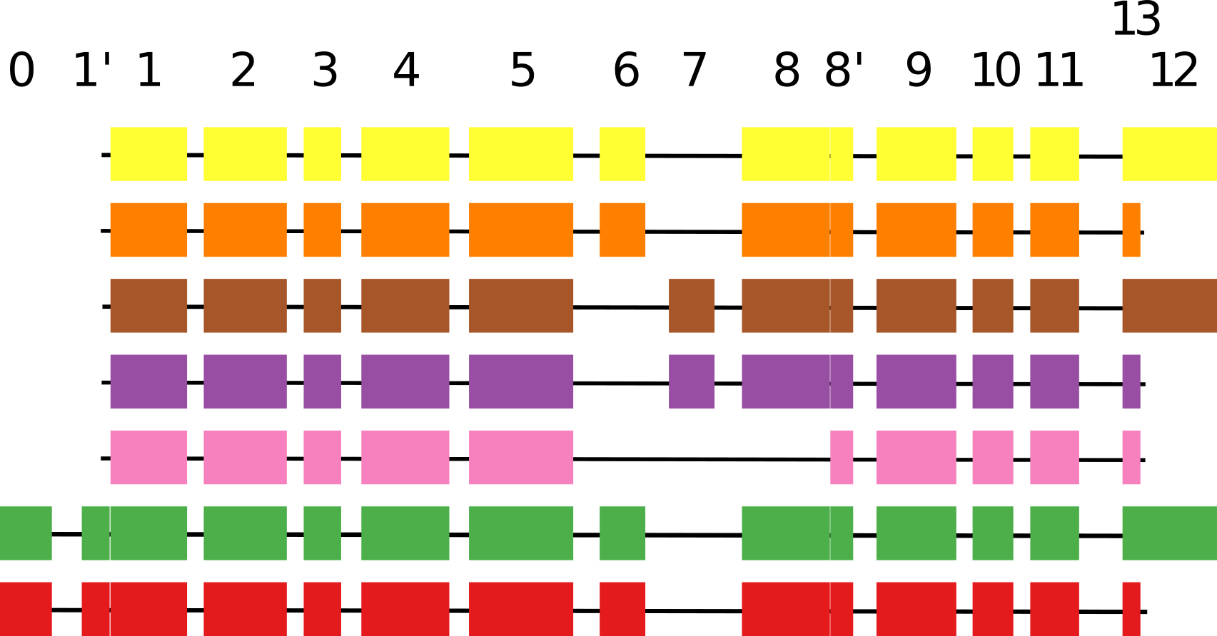
Structural impact of AS during evolution
Reconstruction of a transcript phylogenetic forest for the JNK family
PHYLOSOFS
Ait-hamlat et al. submitted
Notes:
Lysozyme bound to its antibody on top
Transducin α bound to RGS9 and to transducin β-γ at the bottom

Slide 25
Structural impact of AS during evolution
Modeling of the 3D structure of the corresponding isoforms
1 2 3 4 5 6 7 8 8' 9 10 11 13
PHYLOSOFS
Ait-hamlat et al. submitted
Notes:
Lysozyme bound to its antibody on top
Transducin α bound to RGS9 and to transducin β-γ at the bottom

Slide 26
Structural impact of AS during evolution
Modeling of the 3D structure of the corresponding isoforms
1 2 3 4 5 6 7 8 8' 9 10 11 13
We are looking for a postdoc!
http://www.lcqb.upmc.fr/sites/default/files/postdoc_MASSIV.pdf
PHYLOSOFS
Ait-hamlat et al. submitted
Notes:
Lysozyme bound to its antibody on top
Transducin α bound to RGS9 and to transducin β-γ at the bottom

Slide 27










Analytical Genomics Team, LCQB
Alessandra Carbone
Adel Ait-hamlat
Tristan Bitard-Feildel
Robert Clerc
Flavia Corsi
Laurent David
Chloé Dequeker
Elodie Laine
Hugues Richard
Hugues Ripoche
Elin Teppa
Riccardo Vicedomini

