Slide 1
RNA Bioinformatics beyond energy minimization
Yann PONTY
CNRS/Ecole Polytechnique/AMIB Inria Saclay
Slides http://goo.gl/1sc5MT [PDF]
http://goo.gl/fpwly4 [PDF]

Slide 2
Why (non-coding) RNAs?

Slide 3
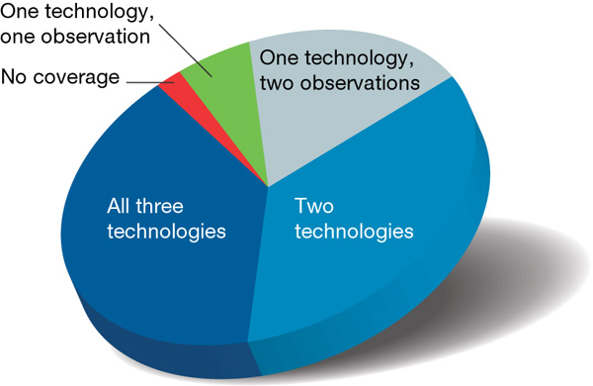
Why RNA is totally awesome!
Ubiquitous
Pervasively expressed
The human genome is pervasively transcribed, such that the majority of its bases are associated with at least one primary transcript and many transcripts link distal regions to established protein-coding loci.
ENCODE Analysis of 1% of the human genome Nature 2007

Slide 4
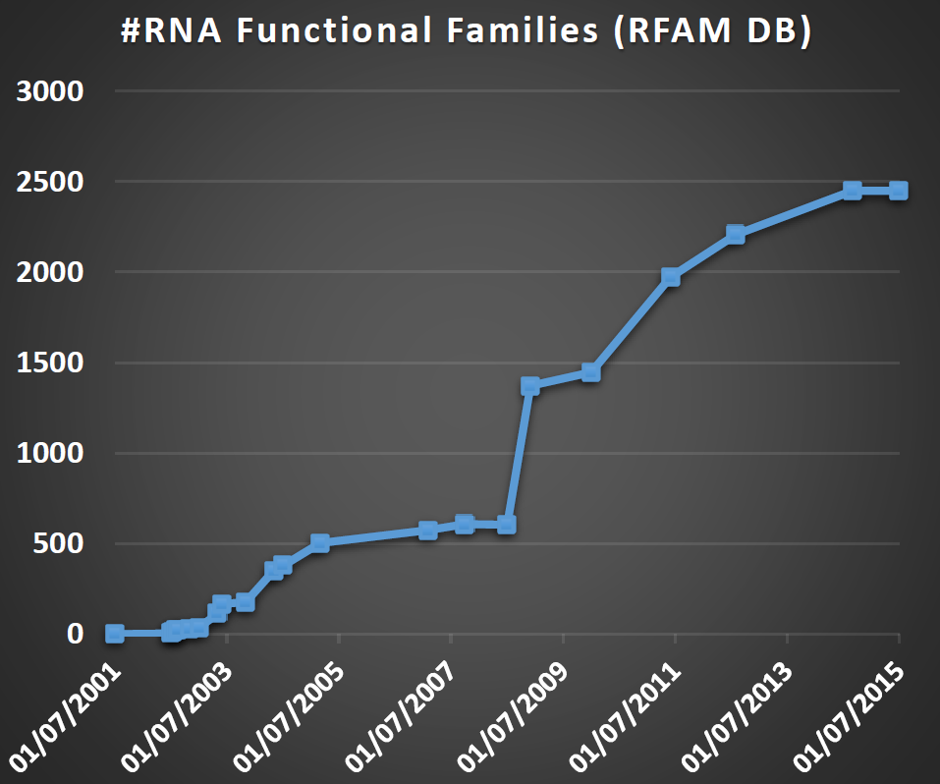
Why RNA is totally awesome!
Ubiquitous
Pervasively expressed
Versatile
Carriers
Transporter
Enzymatic
Processing
Regulatory
ssRNA genomes (HIV)
Immune system (CRISPR)
More soon… (lincRNAs)

Slide 5
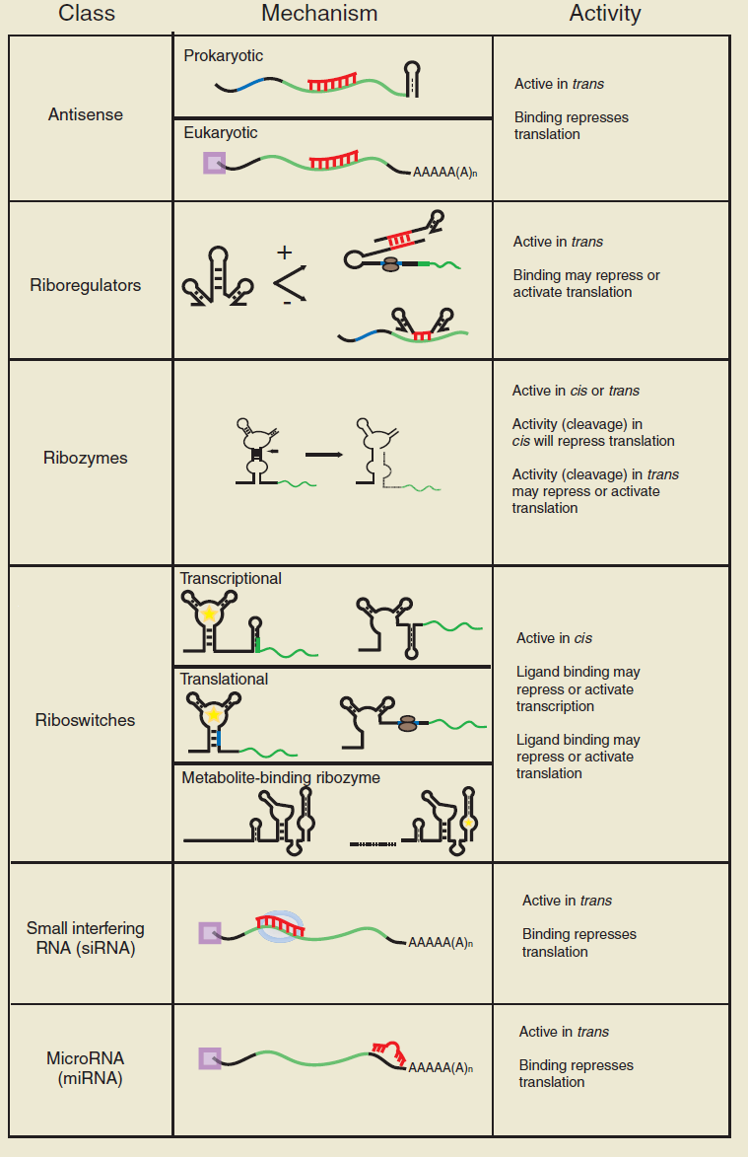
Why RNA is totally awesome!
[Isaacs, F J et al. Nature Biotech. 2006]
Ubiquitous
Pervasively expressed
Versatile
Easy to handle
Synthetic biology

Slide 6
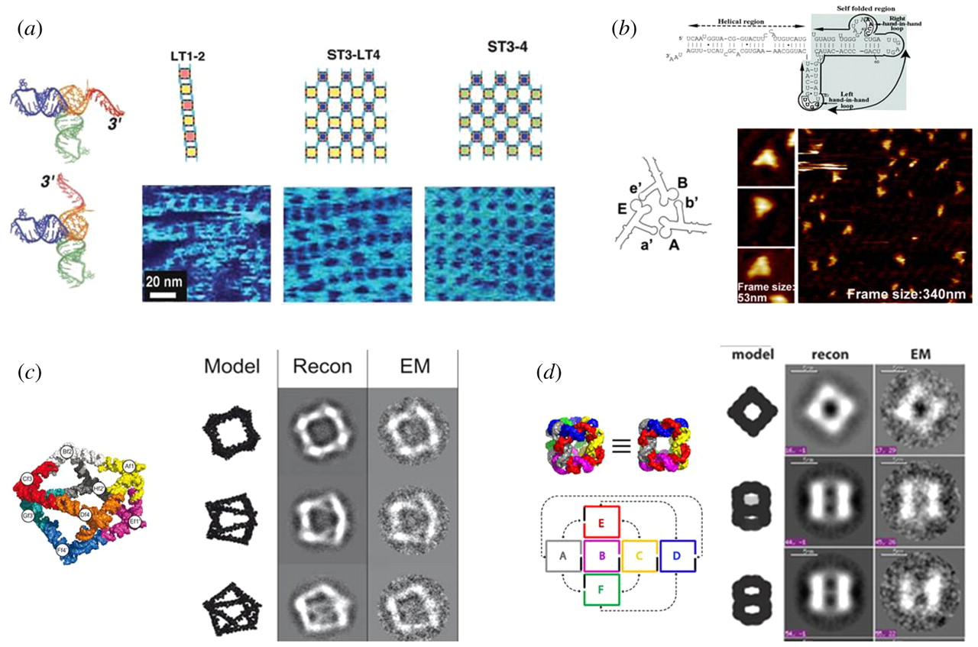
Why RNA is totally awesome!
Ubiquitous
Pervasively expressed
Versatile
Easy to handle
Synthetic biology
Nanotechs
RNA-based Nanoarchitectures
[Li H et al, Interface Focus 2011]

Slide 7
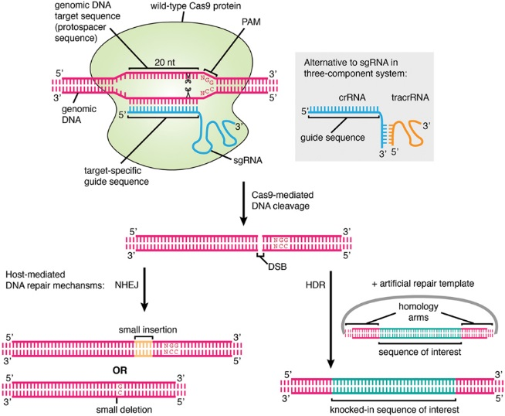
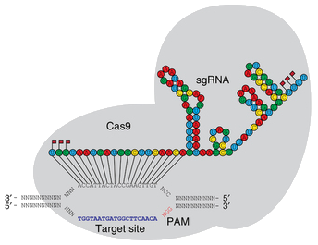
Why RNA is totally awesome!
Blooming therapeutic RNAi…
… making way for CRISPR!
Ubiquitous
Pervasively expressed
Versatile
Easy to handle
Synthetic biology
Nanotechs
Therapeutics and genetic engineering (CRISPR)
[Agrotis & Ketteler, Frontiers Genetics 2015]
[Hendel et al, Nature Biotech. 2015]

Slide 8
Why RNA is totally awesome!
PDB: 117,022 entries (March 2016)
Ubiquitous
Pervasively expressed
Versatile
Easy to handle
Synthetic biology
Nanotechs
Therapeutics and genetic engineering (CRISPR)
Computationally fun (but still challenging)
(Initial) lack of structural data
Experiment-based energy models
+ Secondary structure
+ Efficient combinatorial algorithms
Mature ab initio prediction tools
(Mfold, RNAfold…)

Slide 9
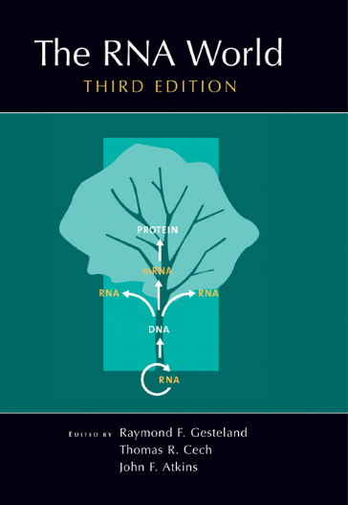
Why RNA is totally awesome!
The chicken vs egg paradox at the origin of life
Ubiquitous
Pervasively expressed
Versatile
Easy to handle
Synthetic biology
Nanotechs
Therapeutics and genetic engineering (CRISPR)
Computationally fun (but still challenging)
RNA at the origin of life!?
Gene
encodes
encodes
RNA
replicates
replicates
Enzyme
This is the RNA World.
[…] Proteins are good at being enzymes but bad at being replicators; […] DNA is good at replicating but bad at being an enzyme; […] RNA might just be good enough at both roles to break out of the Catch-22.
R. Dawkins. The Ancestor’s tale

Slide 10
RNA Structure

Slide 11
Why structure matters
Transcription: RNA is (mostly) single stranded
Structurally diverse
ncRNAs → Structure(s) typically more conserved than sequence
Functionally versatile
Use structure as a proxy for function, to explain functional behaviors

Slide 12
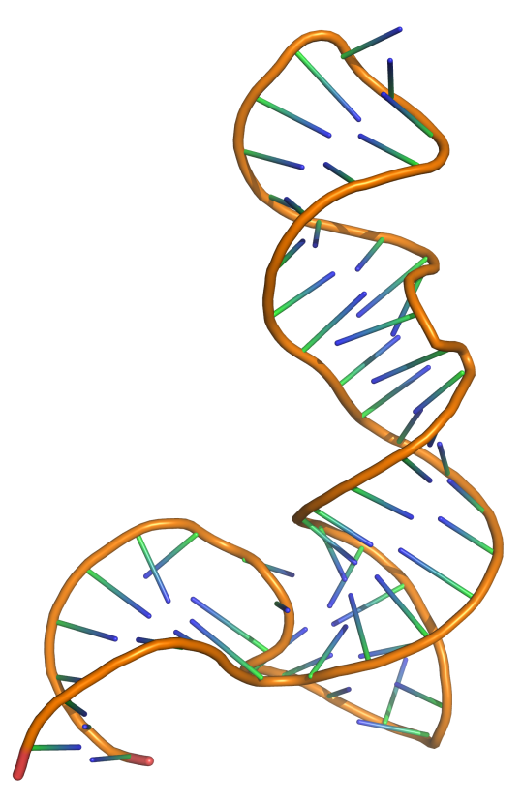
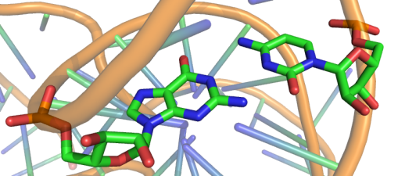
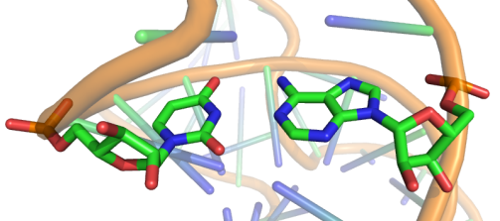
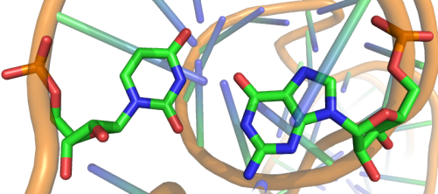
Why RNA folds
G/C
Canonical base-pairs
U/A
U/G
5s rRNA (PDB ID: 1UN6)
RNA folding = Hierarchical stochastic process driven by/resulting in the pairing (hydrogen bonds) of a subset of its bases.

Slide 13
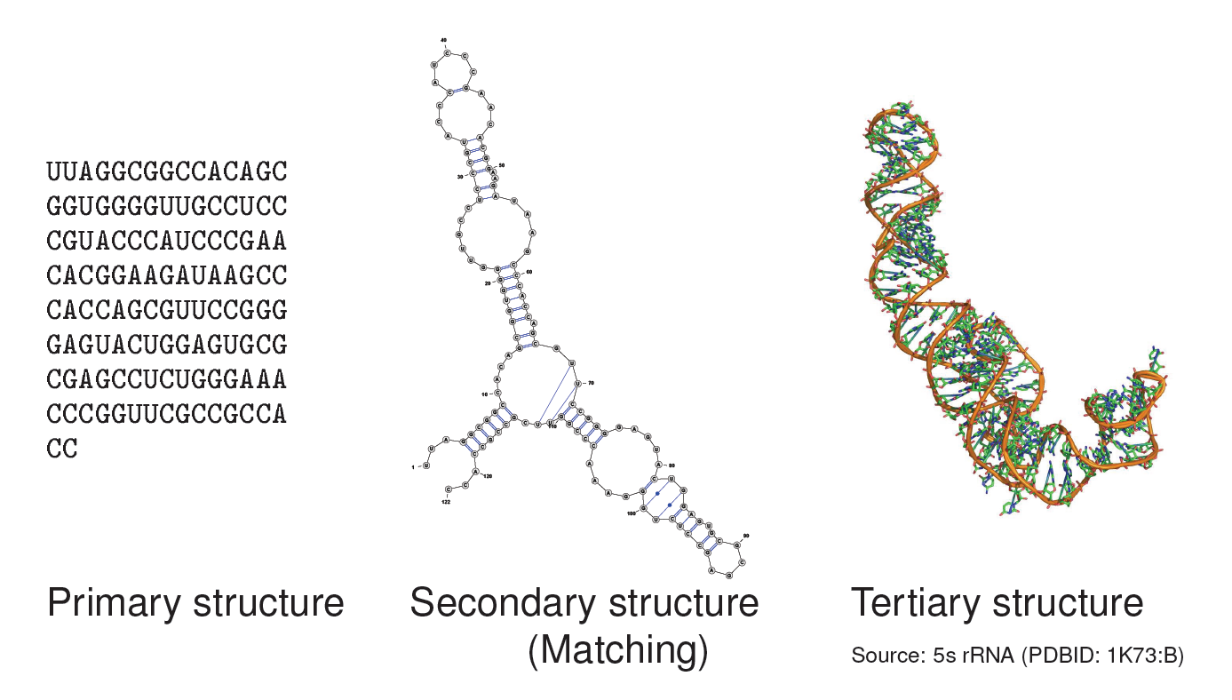
Three levels of RNA structure

Slide 14
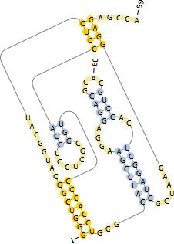
Pseudoknots
Pseudoknots are complex topological models indicated by crossing interactions.
Pseudoknots are largely ignored by computational prediction tools:
Lack of accepted energy model
Algorithmically challenging
Yet heuristics can be sometimes efficient
Pknots-RG offers a reasonable time/sensitivity tradeoff

Slide 15
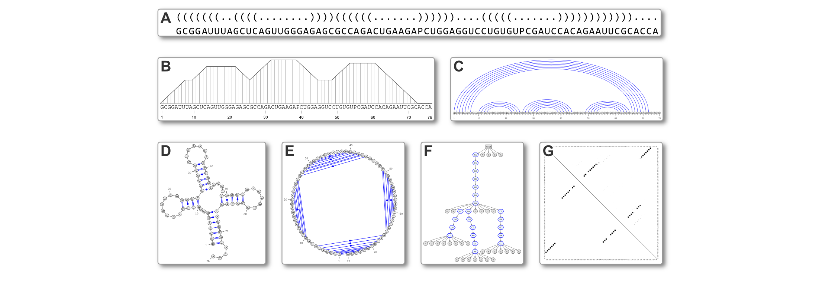
Secondary Structure representations
http://varna.lri.fr

Slide 16
ncRNA Data

Slide 17
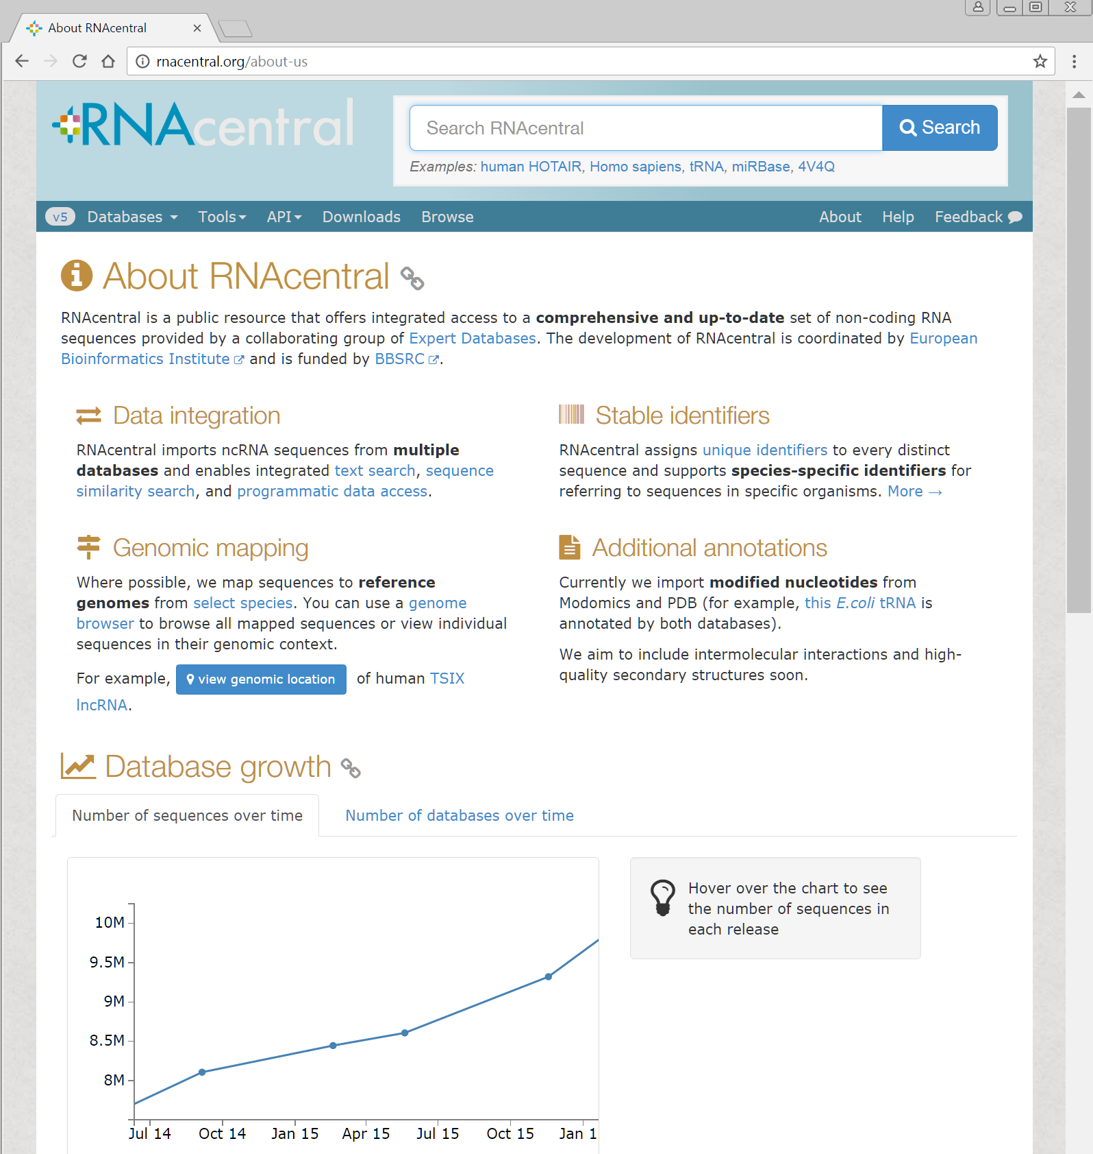
RNACentral.org: One ID to rule them all

Slide 18
Sources of RNA structural data
Name | Data type | Scope | Description | File formats | #Entries | URL
PDB | All-atoms | General | RCSB Protein Data Bank – Global repository for 3D molecular models | PDB | ~1,900 models | http://www.pdb.org
NDB | All-atoms, Secondary structures | General | Nucleic Acids Database – Nucleic acids models and structural annotations. | PDB, RNAML | ~2,000 models | http://bit.ly/rna-ndb
RFAM | Alignments, Secondary structures³ | General | RNA FAMilies – Multiple alignments of RNA as functional families. Features consensus secondary structures, either predicted and/or manually curated. | STOCKHOLM, FASTA | ~1,973 Alignments/ structures, 2,756,313 sequences | http://bit.ly/rfam-db
STRAND | Secondary structures | General | The RNA secondary STRucture and statistical ANalysis Database – Curated aggregation of several databases | CT, BPSEQ, RNAML, FASTA, Vienna | 4,666 structures | http://bit.ly/sstrand
PseudoBase | Secondary structures | Pseudoknotted RNAs | PseudoBase – Secondary structure of known pseudonotted RNAs. | Extended Vienna RNA | 359 structures | http://bit.ly/pkbase
CRW | Sequence alignments, Secondary structures | Ribosomal RNAs, Introns | Comparative RNA Web Site – Manually curated alignments and statistics of ribosomal RNAs. | FASTA, ALN, BPSEQ | 1,109 structures, 91,877 sequences | http://bit.ly/crw-rna
… |  |  | …
[2012 Snapshot]

Slide 19
RNA file formats: Sequences (alignments)

Slide 20
RNA file formats: Sequences (alignments)

Slide 21
RNA file formats: Secondary Structures

Slide 22
RNA file formats: Secondary Structures

Slide 23
RNA file formats: Secondary Structures

Slide 24
RNA file formats: Secondary Structures
<?xml version="1.0"?>
<!DOCTYPE rnaml SYSTEM "rnaml.dtd">
<rnaml version="1.0">
<molecule id=“xxx">
<sequence> ... </sequence>
<structure> ... </structure>
</molecule>
<interactions> ... </interactions>
</rnaml>

Slide 25
RNA file formats: Secondary Structures
<?xml version="1.0"?>
<!DOCTYPE rnaml SYSTEM "rnaml.dtd">
<rnaml version="1.0">
<molecule id=“xxx">
<sequence>
<numbering-system id="1" used-in-file="false">
<numbering-range>
<start>1</start><end>387</end>
</numbering-range>
</numbering-system>
<numbering-table length="387">
2 3 4 5 6 7 8...
</numbering-table>
<seq-data>
UGUGCCCGGC AUGGGUGCAG UCUAUAGGGU...
</seq-data>
...
</sequence>
<structure> ... </structure>
</molecule>
<interactions> ... </interactions>
</rnaml>

Slide 26
RNA file formats: Secondary Structures
<?xml version="1.0"?>
<!DOCTYPE rnaml SYSTEM "rnaml.dtd">
<rnaml version="1.0">
<molecule id=“xxx">
<sequence> ... </sequence>
<structure>
<model id=“yyy">
<base> ... </base> ...
<str-annotation>
...
<base-pair>
<base-id-5p><base-id><position>2</position></base-id></base-id-5p>
<base-id-3p><base-id><position>260</position></base-id></base-id-3p>
<edge-5p>+</edge-5p>
<edge-3p>+</edge-3p>
<bond-orientation>c</bond-orientation>
</base-pair>
<base-pair comment="?">
<base-id-5p><base-id><position>4</position></base-id></base-id-5p>
<base-id-3p><base-id><position>259</position></base-id></base-id-3p>
<edge-5p>S</edge-5p>
<edge-3p>W</edge-3p>
<bond-orientation>c</bond-orientation>
</base-pair>
...
</str-annotation>
</model>
</structure>
</molecule>
<interactions> ... </interactions>
</rnaml>

Slide 27
RNA Structure Prediction

Slide 28
RNA structure prediction: The big picture
Biophysics → Shifting paradigms in RNA structure prediction
1970s-1990s: Free-Energy Minimization → Maximizing stability
1990s-2010s: Thermodynamic equilibrium → Average picture
…CAGUAGCCGAUCGCAGCUAGCGUA…
RNAFold, MFold…

Slide 29
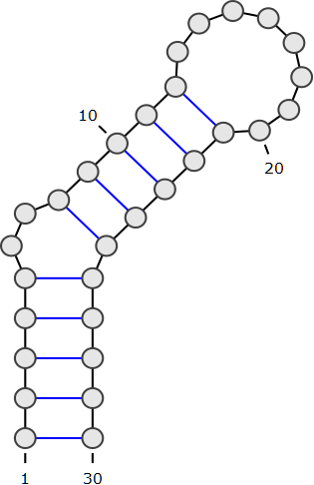
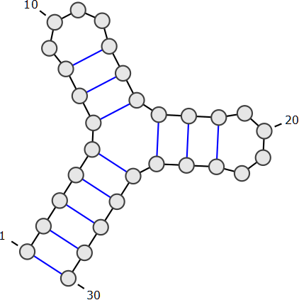
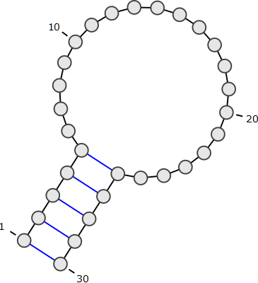
RNA kinetics: Why go through all the trouble?
Probability/Concentration
0
0.5
1
B
C
D
A
C
D
C
A
B
D
Time
A
B
D
C
RNA half life
B
Enzymatic degradation
A
B
C
D
A
B
C
D
A
Equilibrium
A
B
C
D
MFE

Slide 30
RNA structure prediction: The big picture
Biophysics → Shifting paradigms in RNA structure prediction
1970s-1990s: Free-Energy Minimization → Maximizing stability
1990s-2010s: Thermodynamic equilibrium → Average picture
2010s-???: Kinetics → RNA folding at finite time
…CAGUAGCCGAUCGCAGCUAGCGUA…
1
RNA half life
Equilibrium
MFE
Concentration
0.5
0
Time
Kinetics remains challenging physically and computationally

Slide 31
RNA Structure Prediction
Free-Energy Minimization (MFE)

Slide 32
Minimal Free-Energy (MFE) Folding
Goal: Predict the functional (aka native) conformation of an RNA
Absence of homologs/experimental evidences → Consider energy
Turner model associates free-energies to secondary structures
Vienna RNA package implements a O(n³) optimization algorithm for computing most stable (= min. free-energy) folding
…CAGUAGCCGAUCGCAGCUAGCGUA…
RNAFold, MFold…
[Nussinov & Jacobson, PNAS 1980; Zuker & Stiegler, NAR 1981]

Slide 33
Energetic and algorithmic considerations
http://goo.gl/TSu679

Slide 34
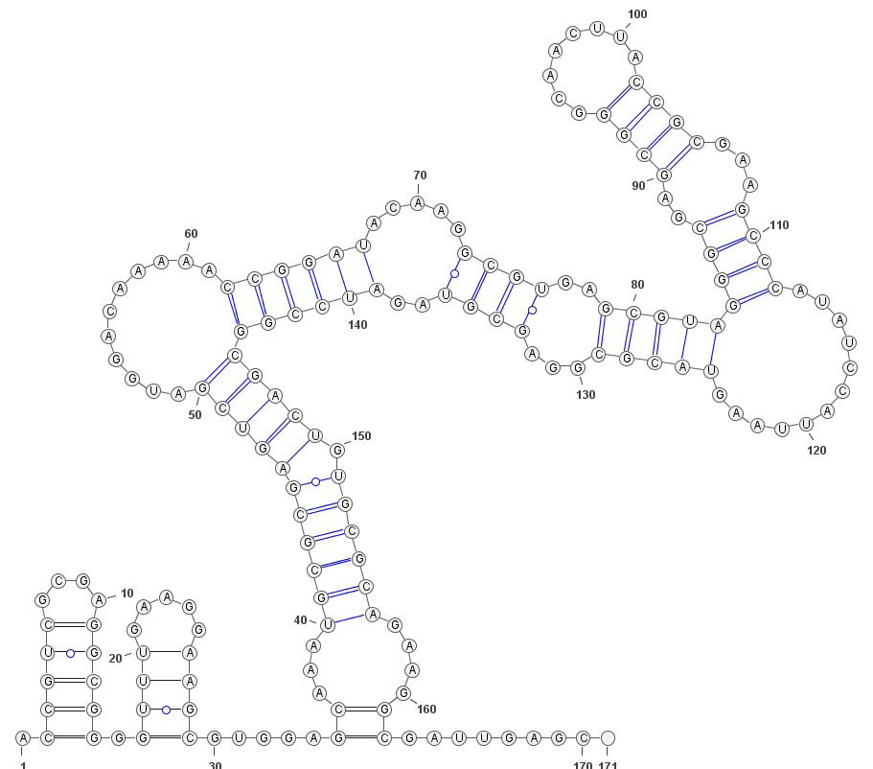
Optimization methods can be overly sensitive to fluctuations of the energy model
Example:
Get RFAM A. capsulatum D1-D4 domain of the Group II intron
Run RNAFold using default parameters (Turner 2004)
Rerun RNAFold using latest energy parameters
Turner 2004
Andronescu 2007

Slide 35
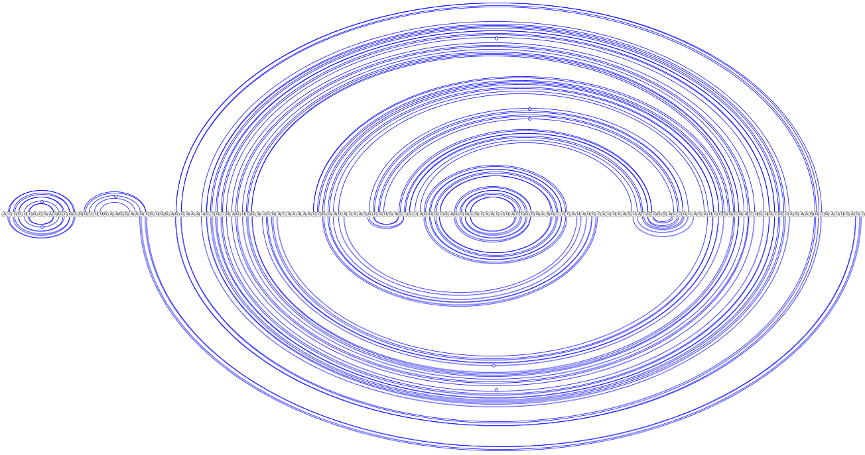
Optimization methods can be overly sensitive to fluctuations of the energy model
Example:
Get RFAM A. capsulatum D1-D4 domain of the Group II intron
Run RNAFold using default parameters (Turner 2004)
Rerun RNAFold using latest energy parameters
Turner 2004
Andronescu 2007
Discrepancy not as embarrassing as it first seemed…
… but still substantial!

Slide 36
Optimization methods can be overly sensitive to fluctuations of the energy model
Example:
Get RFAM A. capsulatum D1-D4 domain of the Group II intron
Run RNAFold using default parameters (Turner 2004)
Rerun RNAFold using latest energy parameters
<ε
Stability (Turner 2004)
RNA
ACGAUCGCGA CUACGUGCAU
CGCGGCACGA
CUGCGAUCUG
CAUCGGA...
Stability (Andronescu 2007)
Suboptimal structures (homogeneity, exponential growth)
Guiding predictions with low-res/high-throughput experimental evidences

Slide 37
Energy-based Ab initio folding: Does it really work?
Generally yes, but variable results for different studies
$$MCC=\frac{TP×TN−FP×FN}{\sqrt{\left(TP+FP\right)\left(TP+FN\right)\left(TN+FP\right)\left(TN+FN\right)}}$$
Program | Sensitivity | PPV | MCC | F-measure
RNAfold 2.1.9 | 0.742 | 0.795 | 0.767 | 0.765
RNAfold 2.1.8 | 0.740 | 0.792 | 0.764 | 0.762
RNAfold 1.8.5 | 0.711 | 0.773 | 0.740 | 0.737
UNAfold 3.8 | 0.693 | 0.767 | 0.727 | 0.725
RNAstructure 5.7 | 0.716 | 0.781 | 0.746 | 0.744
Benchmark: 1919 non-multimer/non-pseudoknotted sequence/structure pairs from the RNAstrand database (source Vienna Package web site)

Slide 38
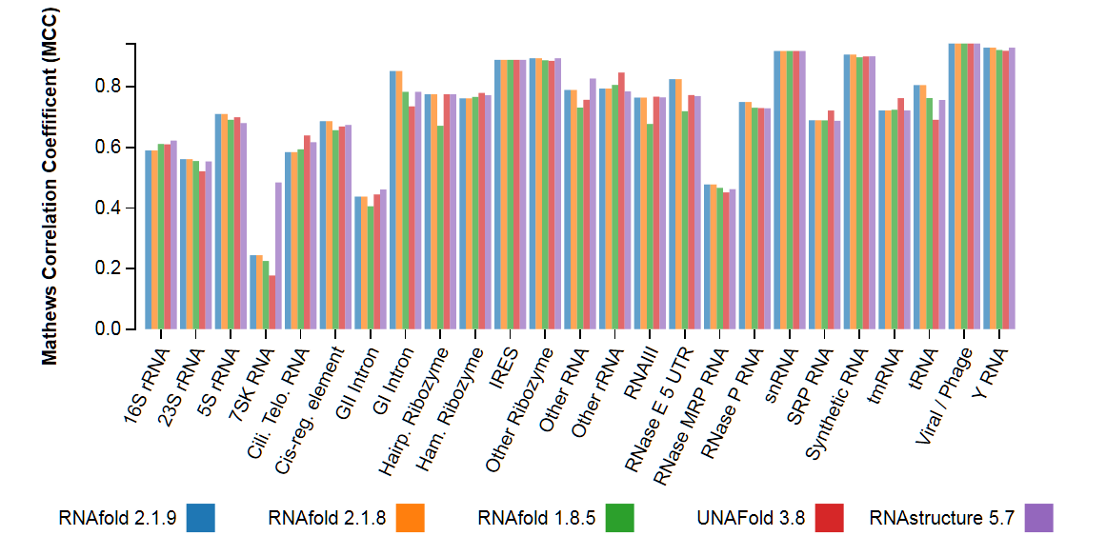
Energy-based Ab initio folding: Does it really work?
Generally yes, but variable results for different RNAs
$$MCC=\frac{TP×TN−FP×FN}{\sqrt{\left(TP+FP\right)\left(TP+FN\right)\left(TN+FP\right)\left(TN+FN\right)}}$$
Benchmark: 1919 non-multimer/non-pseudoknotted sequence/structure pairs from the RNAstrand database (source Vienna Package web site)

Slide 39
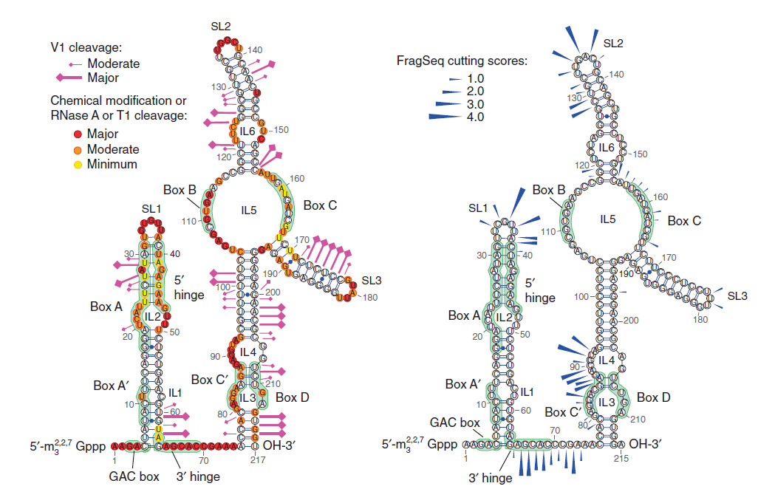
Chemical/enzymatic probing to model 2D
High-throughput secondary structure determination
Reactivity/accessibility guide manual modeling choices
FragSeq method [Underwood et al, Nature Methods 2010]
(Images: VARNA)
Inclusion as pseudo potentials within energy-models
[Lorenz et al, Bioinformatics 2015]

Slide 40
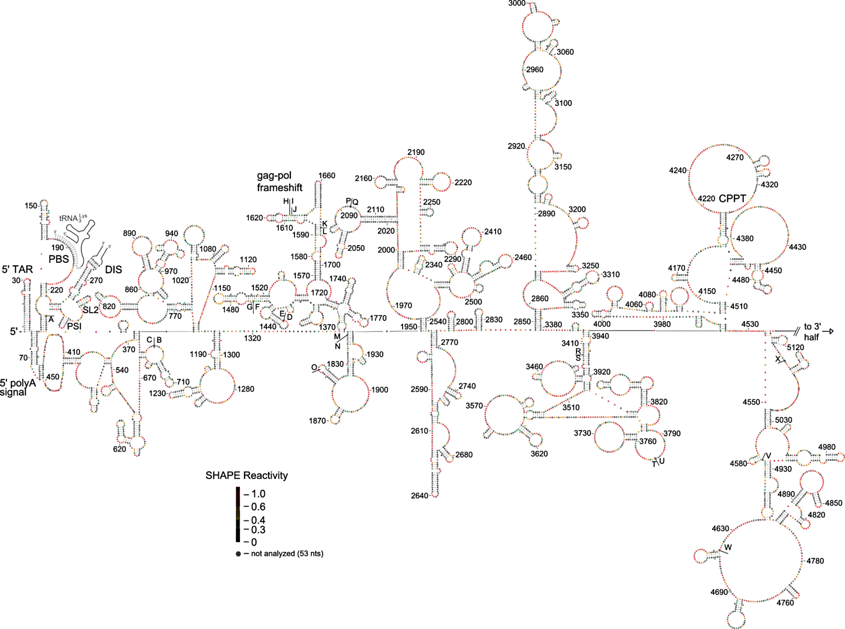
SHAPE probing to model 2D
HIV-1 virus secondary structure (1/2) [Watts JM et al, Nature 2010]

Slide 41
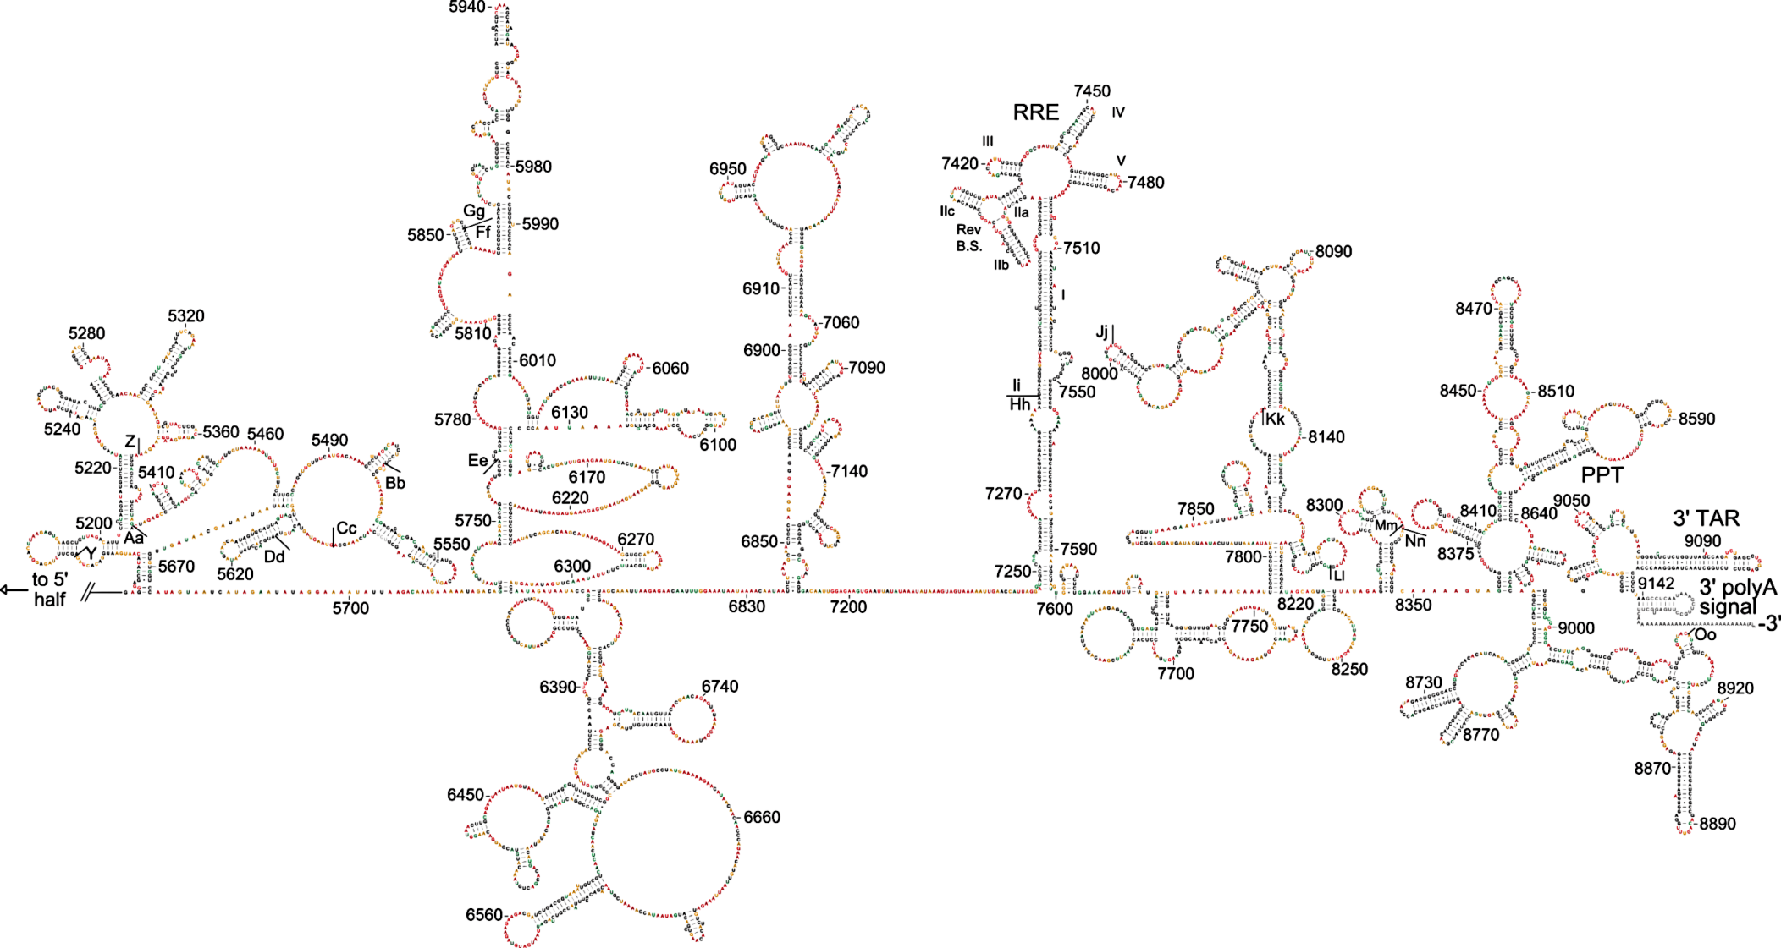
SHAPE probing to model 2D
HIV-1 virus secondary structure (2/2) [Watts JM et al, Nature 2010]

Slide 42
Lab 1: RNA folding basics
Write and test Python functions to:
Parse and print 2^{ary} structures
Dot-parenthesis notation ↔ List of base-pairs + length
Ex.: “((..)(.).)” ↔ ([(0,9),(1,4),(5,7)],10)
Compare alternative structures for a given RNA
Compute base-pair distance between two structures
Ex.: “(.).(.)(..)” + “((...))(..)” → 4
Run RNAfold and retrieve its MFE structure
Benchmark RNAfold
Download and save http://goo.gl/l0mx9c
For each sequence, predict MFE and compare to structure
Report average base-pair distance

Slide 43
RNA Structure Prediction
Boltzmann ensemble Partition function-based methods

Slide 44
Ensemble approaches in RNA folding
RNA in silico paradigm shift:
From single structure, minimal free-energy folding…
…CAGUAGCCGAUCGCAGCUAGCGUA…
MFold

Slide 45
Ensemble approaches in RNA folding
RNA in silico paradigm shift:
From single structure, minimal free-energy folding…
… to ensemble approaches.
…CAGUAGCCGAUCGCAGCUAGCGUA…
UnaFold, RNAFold, Sfold…
Thermodynamic equilibrium: Every secondary structure has probability
Boltzmann
Probability
$$Prob\left(S\right)=\frac{e^{−∆G(S)/kT}}{Z}$$
Partition Function
$$Z=\sum_{Struc S}{e^{−∆G(S)/kT}}$$
[McCaskill, Biopolymers 1990 ]
→ Ensemble diversity? Structure likelihood? Evolutionary robustness?

Slide 46
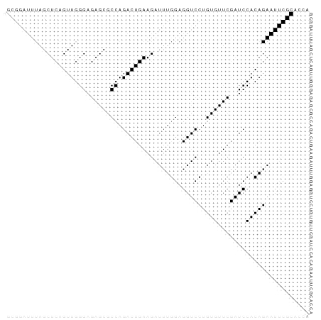
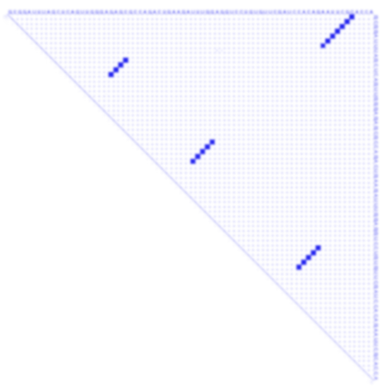
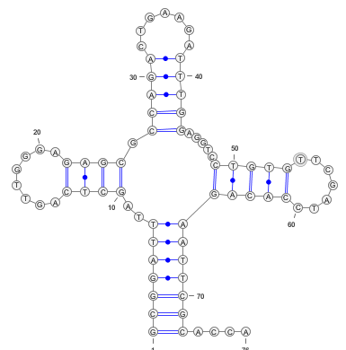
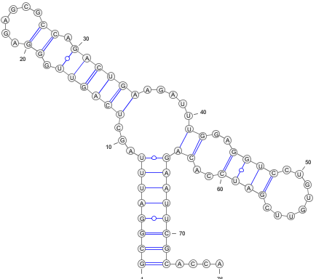
Ensemble approaches indicate uncertainty and suggest alternative conformations
Example:
>ENA|M10740|M10740.1 Saccharomyces cerevisiae Phe-tRNA. : Location:1..76 GCGGATTTAGCTCAGTTGGGAGAGCGCCAGACTGAAGATTTGGAGGTCCTGTGTTCGATCCACAGAATTCGCACCA
RNAFold -p
Native structure

Slide 47
Assessing the reliability of a prediction
D1-D4 group II intron RFAM ID: RF02001
RNAFold [Gruber AR et al. NAR 2008]

Slide 48
Assessing the reliability of a prediction
D1-D4 group II intron A. Capsulatum sequence
RNAFold [Gruber AR et al. NAR 2008]

Slide 49
Assessing the reliability of a prediction
D1-D4 group II intron A. Capsulatum sequence
Low BP probabilities indicate uncertain regions
BP>99% → PPV>90% (BP>90% → PPV>83%) [Mathews, RNA 2004]
Visualizing probs in the context of structure helps refining predicted structures.
RNAFold [Gruber AR et al. NAR 2008]

Slide 50
Sensitivity to (single-point) mutations
Boltzmann Sampling → Clustering (+PCA)
[Halvorsen M et al, PLOS Gen 2010]

Slide 51
Sensitivity to (single-point) mutations
Boltzmann Sampling → PCA → Clustering
?
[Halvorsen M et al, PLOS Gen 2010]
C10U associated with Hyperferritinemia cataract syndrome

Slide 52
Partition function and statistical sampling
http://goo.gl/RRo6mG

Slide 53
Lab 2: Partition function approaches
In Python, implement :
A Nussinov-style DP counting algorithm
Input: RNA sequence w + Min. base pair distance theta
Output: #Secondary structures compatible with (w,theta)
Ex.: “AU”,0 → 1 “AU”,1 → 0 “ACU”,1 → 1 “GGGAAACCC”,3 → 20
(Uniform) stochastic backtrack
Propose a validation procedure
Basic agglomerative clustering procedure
Repeatedly pick the two closest structures & merge them
Stop at k=10 clusters
Benchmark RNAsubopt -p (300 samples) + Clustering

Slide 54
Comparative methods and the pitfalls of benchmarks
The BRaliBase dent—a tale of benchmark design and interpretation
[Löwes, Chauve, Ponty, Giegerich, Brief Bioinfo 2016]

Slide 55
Evolution to the rescue: Comparative approaches for structured RNAs
…
…
…
RFAM Bacterial RNase P class B Alignment RF00011, rendered using JalView
Structure (=phenotype) more typically conserved than sequence
Covariations/compensatory mutations hint towards shared structure

Slide 56
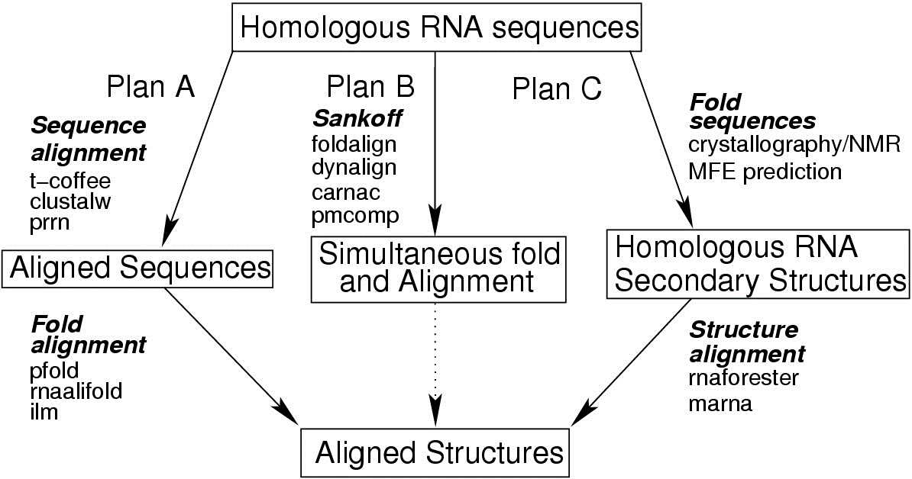
Evolution to the rescue: Comparative approaches for structured RNAs
Idea: If Sequence Alignment available, then fold columns!
From unaligned sequences, chicken and egg paradox (again!)
Align and then Fold
Fold and align simultaneously (Sankoff) → Θ(n^{3m})/Θ(n^{2m}) time/memory
Fold and then Align
RNAAlifold [Bernhardt et al, BMC Bioinfo 2008]
[Gardner & Giegerich, BMC Bioinfo 2004]

Slide 57
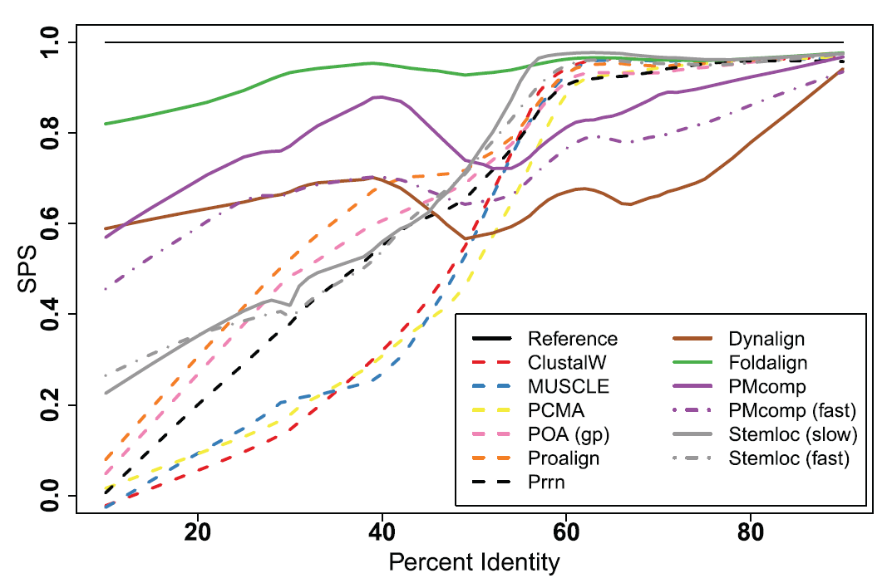
BRAliBase
[Gardner & Giegerich, BMC Bioinfo 2004]
[Gardner,Wilm & Washietl, NAR, 2005]
[Wilm, Mainz & Steger, Alg Mol Biol, 2006]
Benchmark of sequence/alignment since 2004-2005
Cited ~800 times, de facto standard for new tools
Based on sequence/structure alignments for several RNA families
The Dent
Quality Score: Sum-of-Pairs Score (SPS) =
#Correctly predicted chars pairs
#Chars pairs in curated alignments

Slide 58
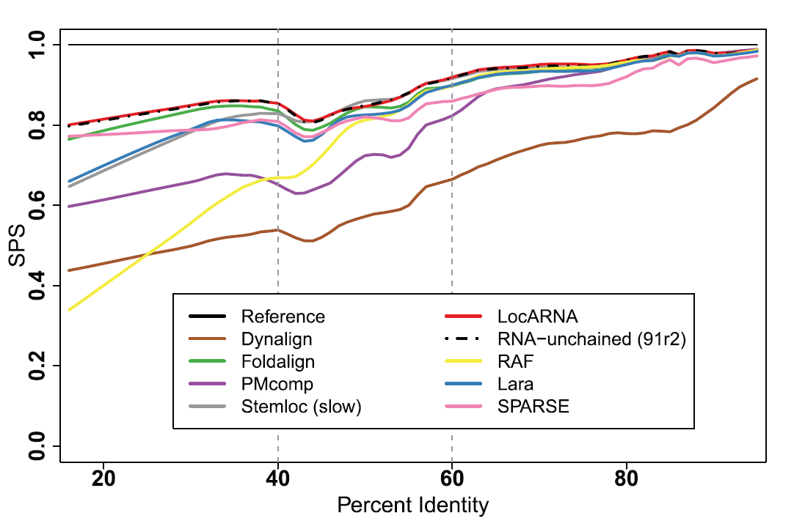
The BRAliBase dent
The Dent
SPS
The Dent = Quality drop in 40%-60% sequence identity
Tool-independent phenomenon found in 2005
Reproduced by following tools & improved benchmarks
Inspiration for new algorithms, creative conjectures…
40%
60%
%Identity
[Gardner,Wilm & Washietl, NAR, 2005]
[Wilm, Mainz & Steger, Alg Mol Biol, 2006]

Slide 59
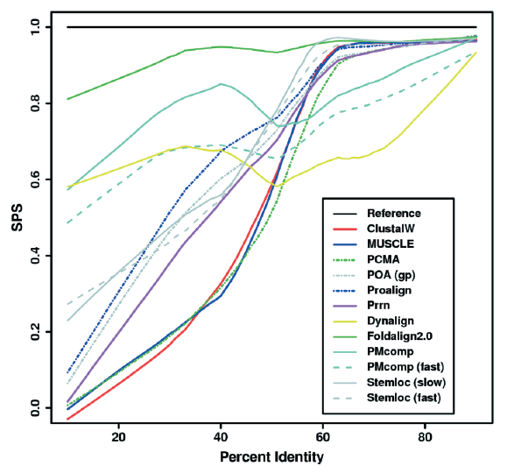
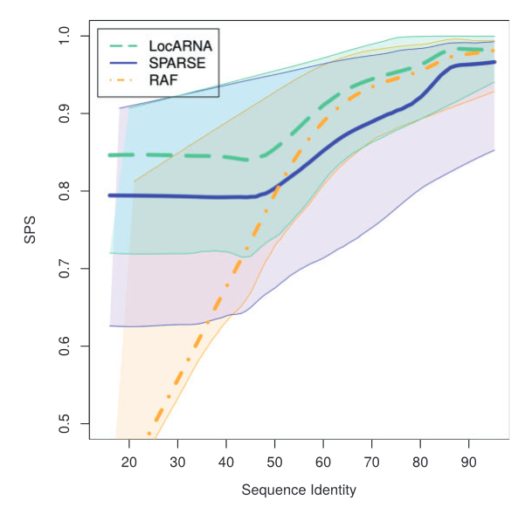
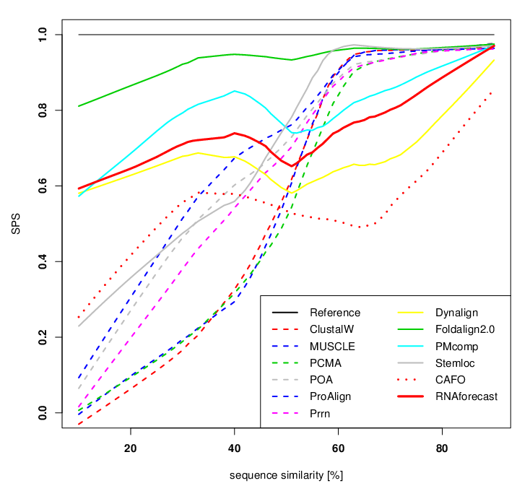
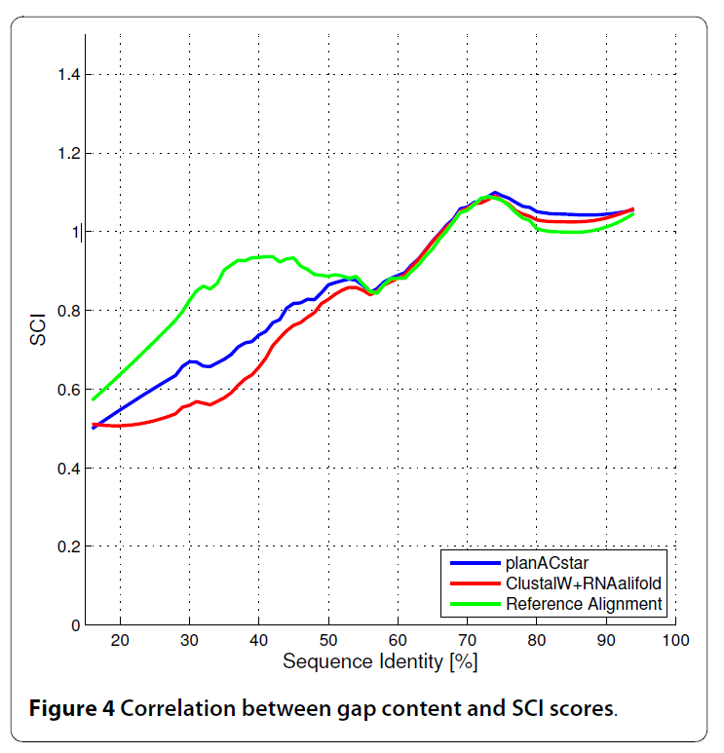
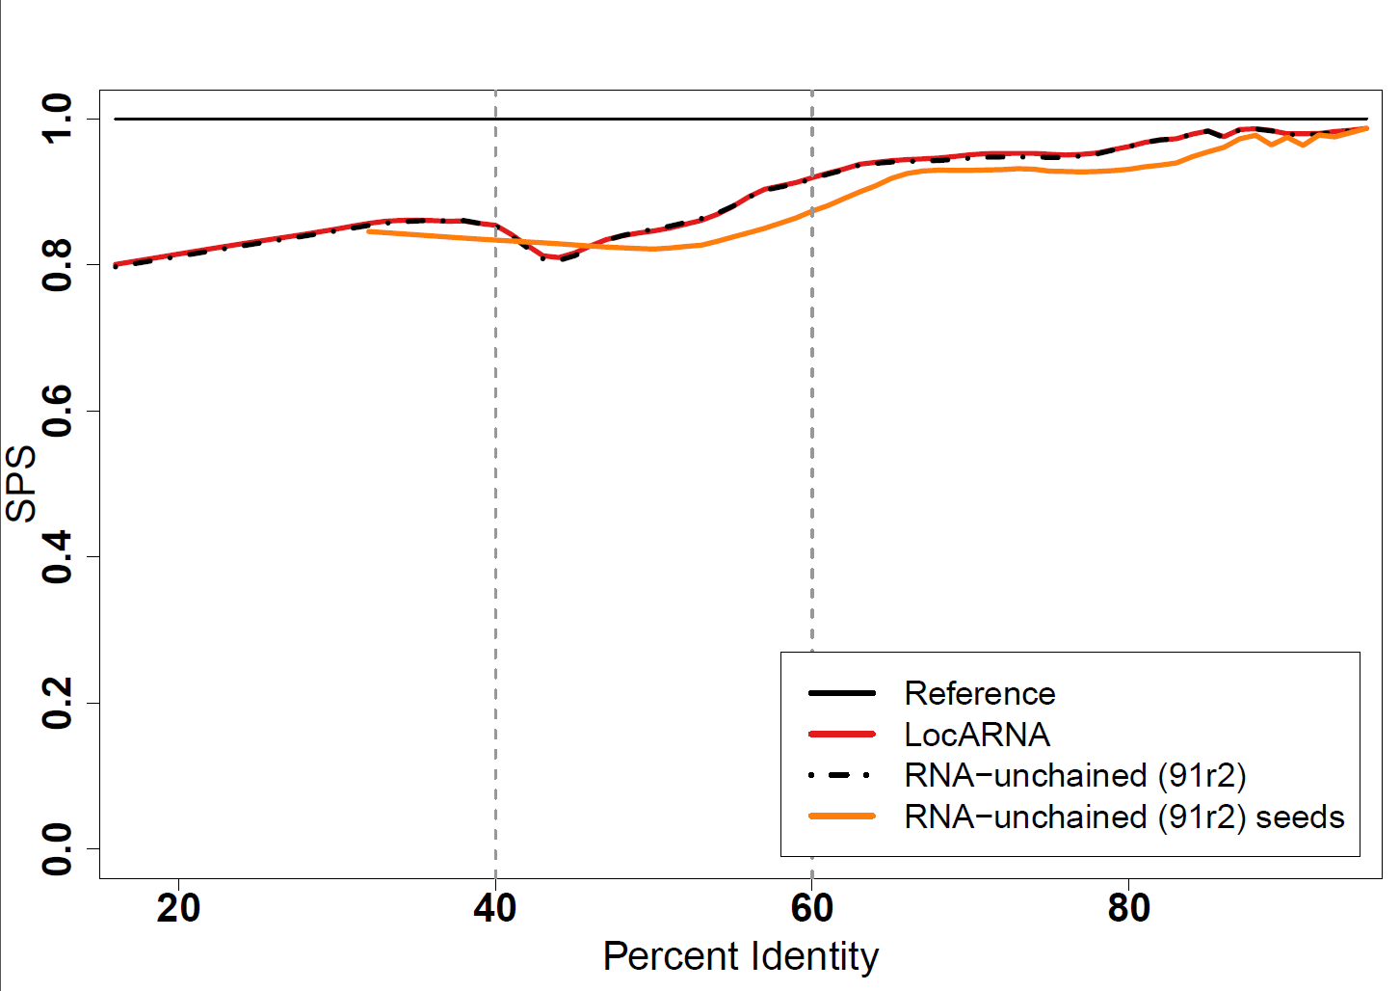
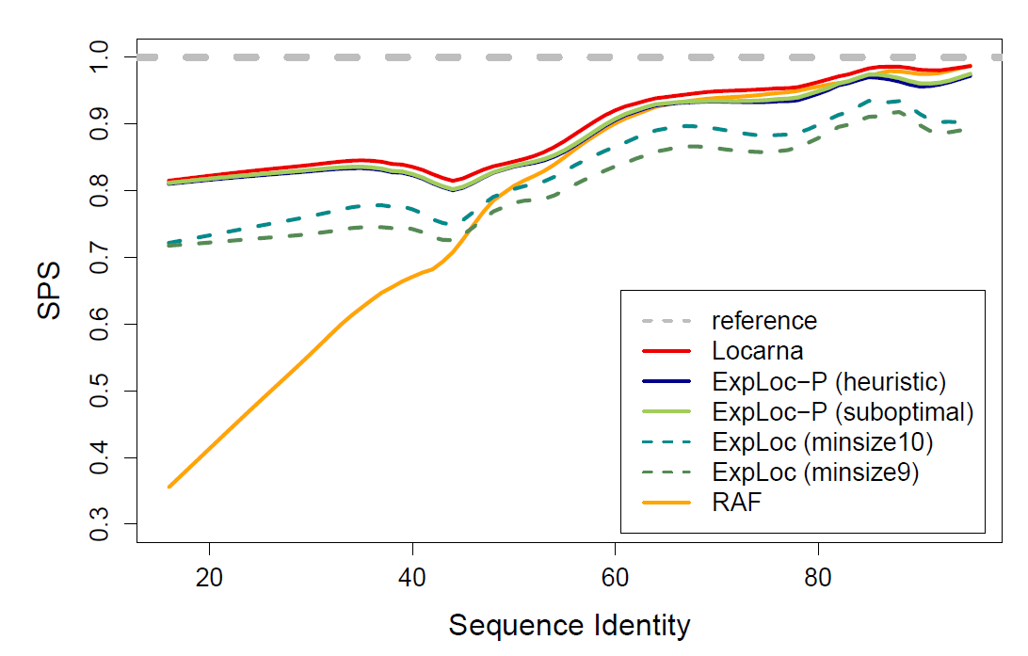
The BRAliBase dent
The Dent
SPS
The Dent = Quality drop in 40%-60% sequence identity
Tool-independent phenomenon found in 2005
Reproduced by following tools & improved benchmarks
Inspiration for new algorithms, creative conjectures…
40%
60%
%Identity
[Gardner et al, NAR 2005]
[Höchsmann et al, Unpublished]
[Will et al, Bioinformatics 2015]
[Bremges et al, BMC Bioinfo, 2010]
[Schmiedl et al, RECOMB 2012]
[Bourgeade et al, J Comp Biol, 2015]

Slide 60
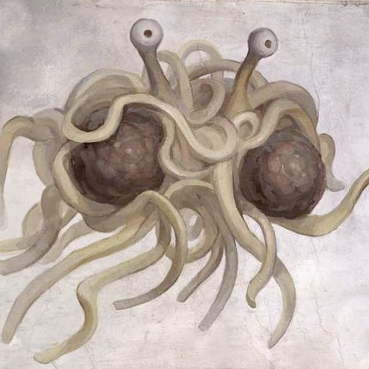
The BRAliBase dent
The Dent
SPS
The Dent = Quality drop in 40%-60% sequence identity
Tool-independent phenomenon found in 2005
Reproduced by following tools & improved benchmarks
Inspiration for new algorithms, creative conjectures…
40%
60%
%Identity
The dent marks the transition between sequence and structure-driven alignments
The dent identifies inconsistent practices by alignment curators
The dent undeniably proves the existence of the great spaghetti monster in the sky…
(Very) probably not…

Slide 61
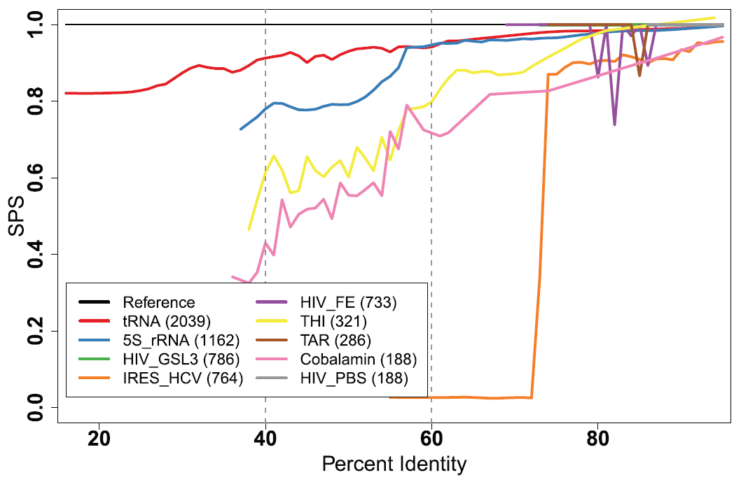
The BRAliBase dent
The Dent
SPS
The Dent = Quality drop in 40%-60% sequence identity
Tool-independent phenomenon found in 2005
Reproduced by following tools & improved benchmarks
Inspiration for new algorithms, creative conjectures…
40%
60%
%Identity
M’kay… so what?
(still no dent)

Slide 62
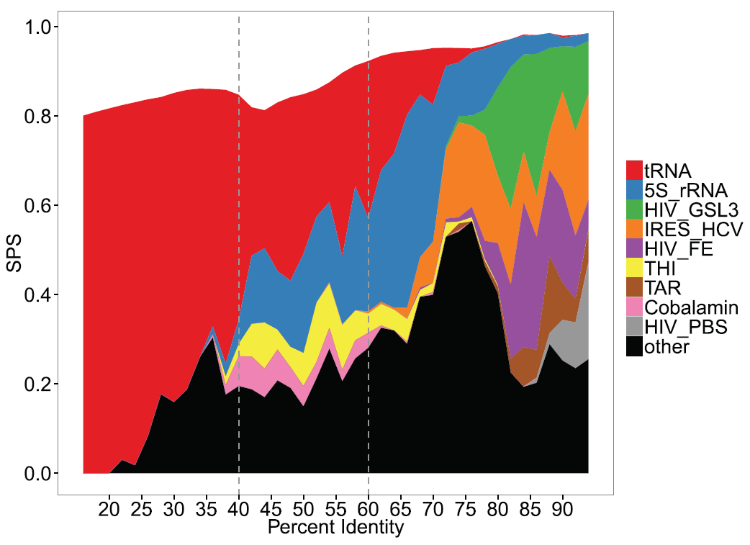
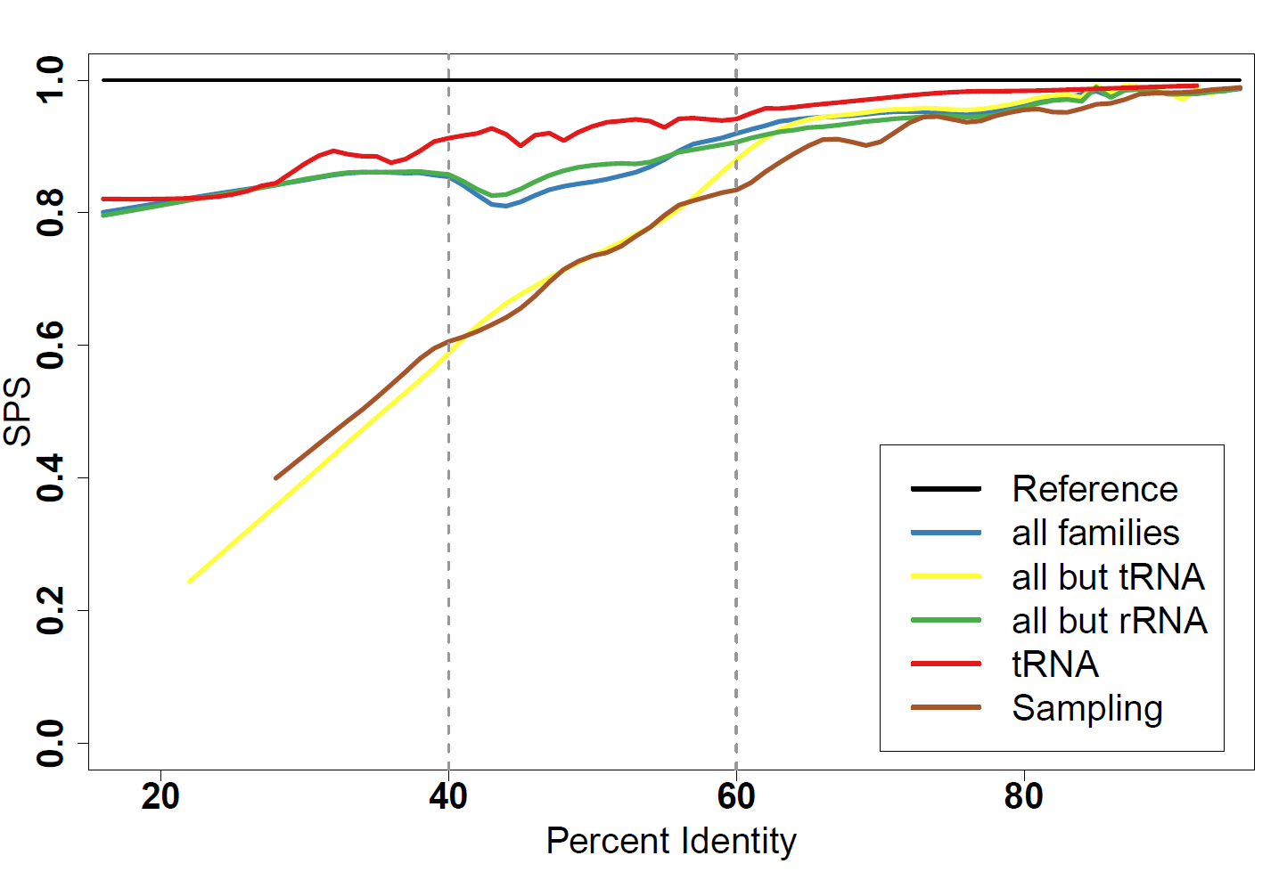
The BRAliBase dent
The Dent
SPS
The Dent = Quality drop in 40%-60% sequence identity
Tool-independent phenomenon found in 2005
Reproduced by following tools & improved benchmarks
Inspiration for new algorithms, creative conjectures…
… purely an artifact due to heavy bias towards well-predicted tRNAs!
40%
60%
%Identity
tRNAs are overly dominant for low identities and very well-predicted
The dent simply occurs when they cease to dominate.

Slide 63
Conclusion

Slide 64
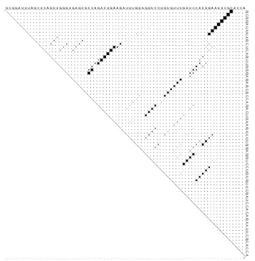
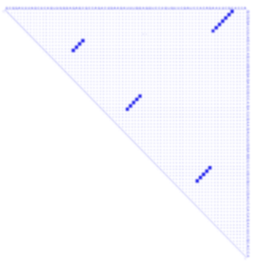
Conclusion
More to RNA than single-structure prediction methods
Most methods run in a few seconds, and are available online!
Thermodynamic equilibrium: Making statements about the complete (exponential) (sub)optimal space (in polynomial time)
Assess reliability (Boltzmann probability)
Detect presence of alternative conformers (Dot-plot)
Identify dominant structures (Boltzmann sampling + clustering)
Comparative approaches: Mature methods (LocARNA) significantly outperform single-sequence predictions
Avoid using structure-agnostic sequence MSAs
Benchmarks must be taken with a grain of salt…
… and should not be the sole driving force for methodological development!
The Dent
SPS
40%
60%
%Identity

Slide 65
The future
RNA Kinetics: Boltzmann ensemble approaches postulate equilibrium … but RNAs may have short life span (+co-transcriptional folding)
Probably no efficient ab initio combinatorial approaches (NP-hard problems)
Tools to study of RNA >100nts will require collaborations between App. Maths, biochemistry and computer science
RNA Design
Inverse folding = Synthesize RNA folding into a predefined structure
Gap between theory (almost nothing) and practice (design of regulatory networks)
Many software, hard to decide which one to choose for a given task

