Slide 1
Combining Time and Frequency Domain Specifications for Periodic Signals
Aleksandar Chakarov and Sriram Sankaranarayanan
University of Colorado Boulder
Georgios Fainekos
Arizona State University Tempe

Slide 2
Overview
Goal:
  Provide specification formalisms for
  - Analog Circuits
  - Digital Circuits
  - Mixed Signal Circuits
  - Control Systems
Challenge:
  How do we combine time and frequency domain specifications?

Slide 3
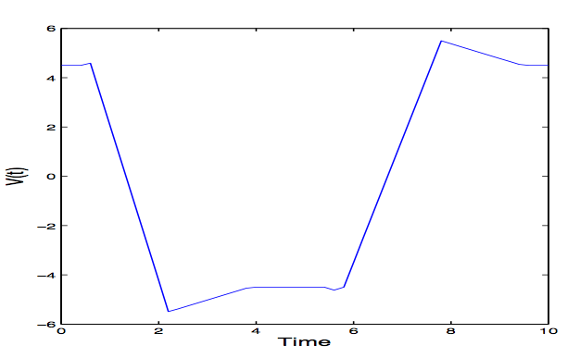
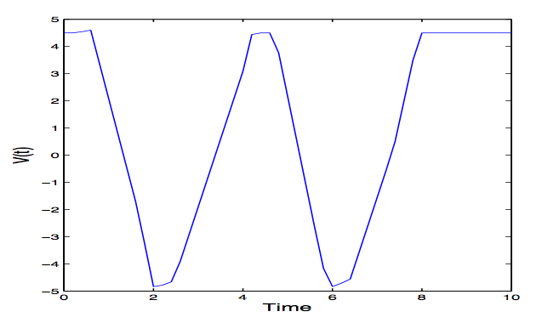
Time Domain Specifications
Two-phase signal:
  high (5 ± 0.5V) and low (-5 ± 0.5V)
  Rate of change is in
A minimum of 0.5 sec in each phase
Transitions:
  Initial value of v must be in [-4.6V, 4.6V]
  Low to High:
  High to Low:
( Example Figure1 )
( Example Figure2 )

Slide 4

Frequency Domain Specifications
Periodic Signals:
  Fourier Series Representation
General signals:
  Fourier Transform Representation
a₁
b₁
Current Work
a₂
b₂
Future Work
Notes:
Fourier Series Representation
good for specifying periodic signals
Emphasize Periodic Signals
(Example Figure)
Fourier Transform Representation
Future Work
(Example Figure)

Slide 5
Fourier Series
Let be a continuous, periodic signal.
  With “finite power”.
can be written as a Fourier series:
Amplitude at frequency is given by

Slide 6
General Testing Framework
Input Specification
Design
Output Specification
Model-Based Testing
Runtime Verification

Slide 7
Main Problems
Signal Generation Problem
Signal Recognition Problem

Slide 8
Time Domain Specifications
Signal Generation and Recognition

Slide 9
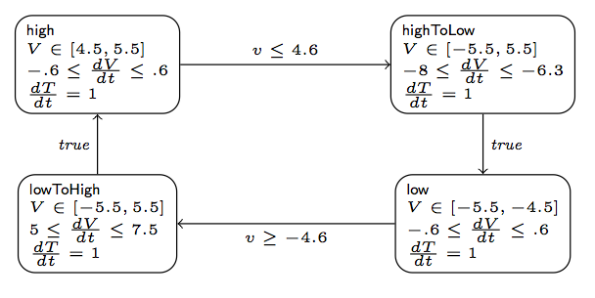
Time Domain Specifications
Continuous State of H
Output Function O
Hybrid Automaton H
Output Signal O(t)

Slide 10
Time Domain Encoding
Important primitive for signal generation/ recognition for time domain specifications.
Explore paths in the automaton (bounded depth search)
For each path, perform linear arithmetic encoding.
Time Domain Encoder
Linear
Arithmetic
Formula
Hybrid
Automaton

Slide 11
Time Domain Signal Generation
Use SMT encoding to perform signal generation.
Model
SMT
Solver
Hybrid
Automaton
Time Domain
Encoder
Formula
Model
Monte Carlo

Slide 12
Time Domain Signal Recognition
Use time domain encoding with run-signal matching.
  Matches up generated signal with automaton run.
Hybrid
Automaton
Time Domain
Encoder
LA
Formula
SMT
Solver
Accept
Input Signal
Reject
Run/Signal Matching
LA
Formula

Slide 13
Frequency Domain Specifications
Power spectra, signal generation and recognition.

Slide 14
Frequency Domain Specifications
Power Spectral Envelope Function
G(f)
Amplitude
Signal
Frequency

Slide 15
Frequency Domain Encoding
Sample input signal with fixed time period δ.
Generate a linear inequality constraint over the coefficients of Fourier series terms with tolerance ε. (linearize)
Input
Signal with
period T
Frequency Domain Encoder
Linear
Program
Power Spectral Envelope

Slide 16
Freq. Domain Signal Generation
Use SMT encoding to perform signal generation
Linear Program
Model
SMT Solver
Power Spectral Envelope
Frequency Domain Encoder
Model
Monte Carlo

Slide 17
Freq. Domain Signal Recognition
Use SMT encoding to perform signal recognition
  Use fixed time period sampling.
Input
Signal with
period T
Frequency Domain Encoder
Linear
Program
SMT
Solver
Accept
Power Spectral Envelope
Reject

Slide 18
Mixed Domain Specifications
Combining time + frequency domain specifications

Slide 19
Mixed Domain Specification
SMT
Solver
Formula
SMT
Solver
Formula
Time Domain
Encoder
Frequency Domain Encoder
Time
Domain
Models
Mixed
Domain
Models
Model
Model
Monte Carlo
Monte Carlo
Hybrid Automaton
Power Spectral Envelope

Slide 20
Implementation & Results
We have an implementation that uses Yices/Z3 SMT solvers.
Generates a single unified encoding.
Performs well on a set of benchmarks.
More details in paper (available upon request)

Slide 21
Thank you!

