Slide 1

Bioinformatics of structured RNAs beyond energy minimization
Yann PONTY
CNRS/Ecole Polytechnique/Inria AMIB/Univ. Paris Saclay

Slide 2
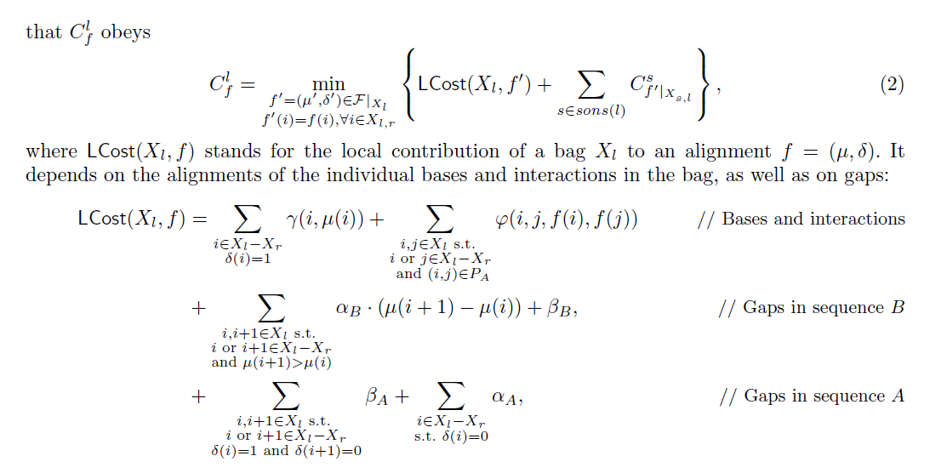
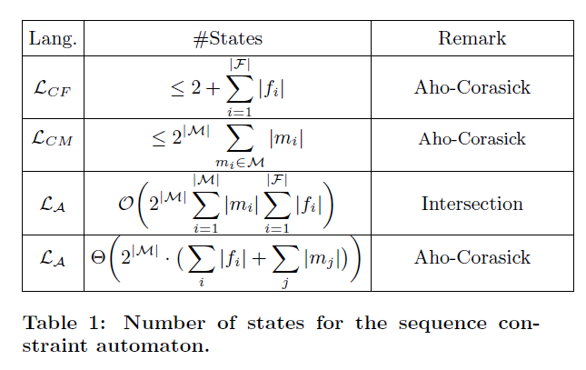
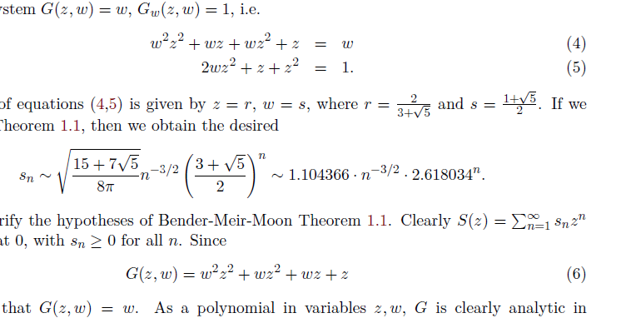
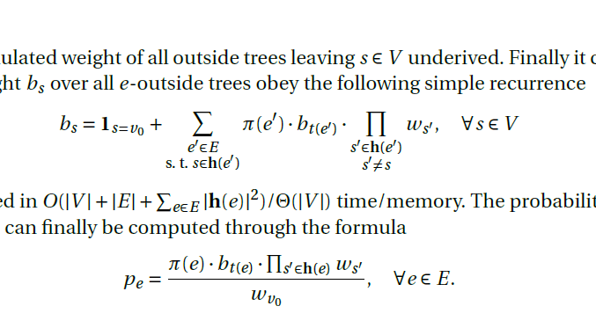
Disclaimer
This is NOT my typical talk!
(no algorithm, only a few equations…)
Goal: To let you know of several mature methods in RNA bioinformatics, and how they can be used.

Slide 3
Why ncRNAs?

Slide 4
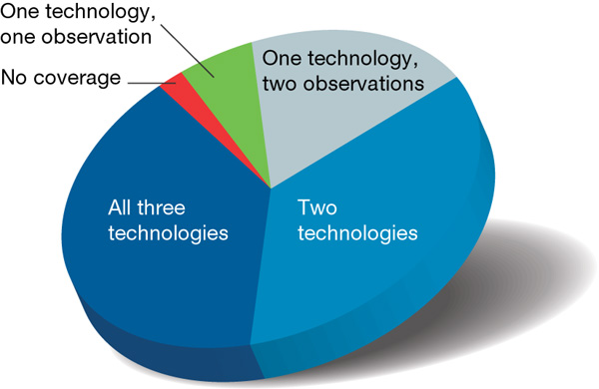
Why RNA is totally awesome!
Ubiquitous
Pervasively expressed
The human genome is pervasively transcribed, such that the majority of its bases are associated with at least one primary transcript and many transcripts link distal regions to established protein-coding loci.
ENCODE Analysis of 1% of the human genome Nature 2007

Slide 5
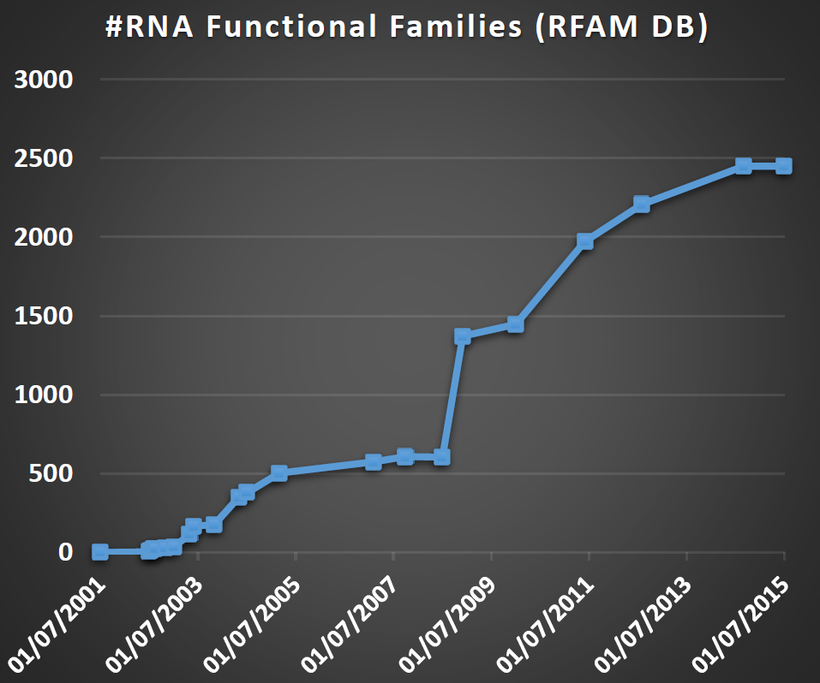
Why RNA is totally awesome!
Ubiquitous
Pervasively expressed
Versatile
Carriers
Transporter
Enzymatic
Processing
Regulatory
ssRNA genomes (HIV)
Immune system (CRISPR)
And more

Slide 6
Why RNA is totally awesome!
Ubiquitous
Pervasively expressed
Versatile
Easy to handle
  Synthetic biology
[Kushwaha et al, ACS Synthetic Bio. 2016]

Slide 7
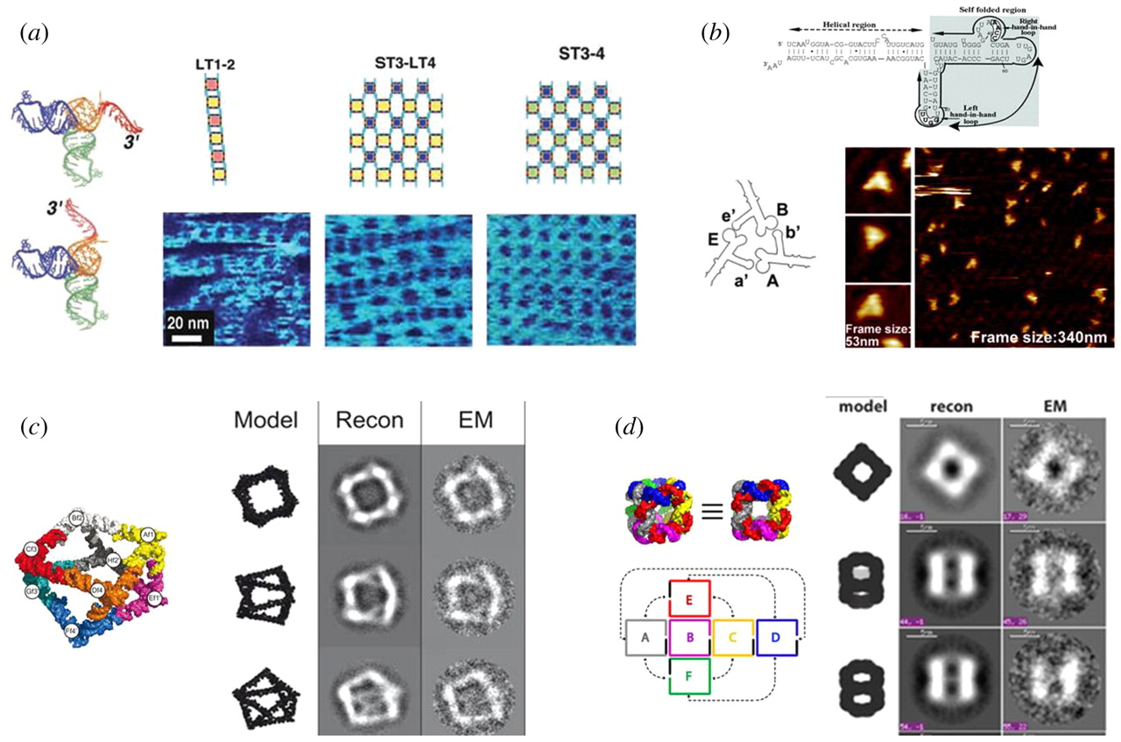
Why RNA is totally awesome!
Ubiquitous
Pervasively expressed
Versatile
Easy to handle
  Synthetic biology
  Nanotechs
RNA-based Nanoarchitectures
[Li H et al, Interface Focus 2011]

Slide 8
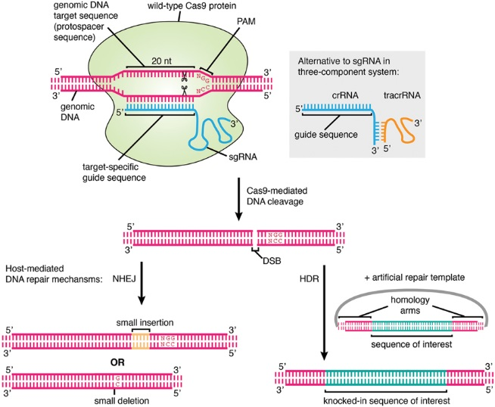
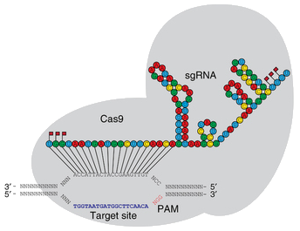
Why RNA is totally awesome!
Blooming therapeutic RNAi…
… making way for CRISPR!
Ubiquitous
Pervasively expressed
Versatile
Easy to handle
  Synthetic biology
  Nanotechs
  Genome editing (CRISPR)
[Agrotis & Ketteler, Frontiers Genetics 2015]
[Hendel et al, Nature Biotech. 2015]

Slide 9
Why RNA is totally awesome!
PDB: 117,022 entries (March 2016)
Ubiquitous
Pervasively expressed
Versatile
Easy to handle
  Synthetic biology
  Nanotechs
  Genome editing (CRISPR)
  Computationally fun
  (but still challenging enough)
(Initial) lack of structural data
Experiment-based energy models
+ Secondary structure
+ Efficient combinatorial algorithms
Mature ab initio prediction tools
(Mfold, RNAfold…)

Slide 10
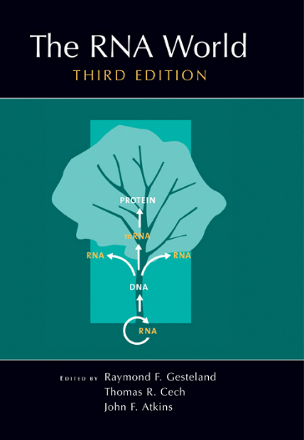
Why RNA is totally awesome!
Chicken vs egg paradox at the origin of life
Ubiquitous
Pervasively expressed
Versatile
Easy to handle
  Synthetic biology
  Nanotechs
  Therapeutics and genetic engineering (CRISPR)
  Computationally fun
  (but still challenging)
RNA at the origin of life!?
Gene
encodes
encodes
RNA
replicates
replicates
Enzyme
This is the RNA World.
[…] Proteins are good at being enzymes but bad at being replicators;
[…] DNA is good at replicating but bad at being an enzyme;
[…] RNA might just be good enough at both roles to break out of the Catch-22.
R. Dawkins. The Ancestor’s tale

Slide 11
RNA Structure prediction

Slide 12

Why structure matters
RNA is single stranded
Structurally diverse
Functionally versatile
ncRNAs:
→ Structure(s) typically more
conserved than sequence
Use structure as a proxy for function, favor mechanistic explanations

Slide 13
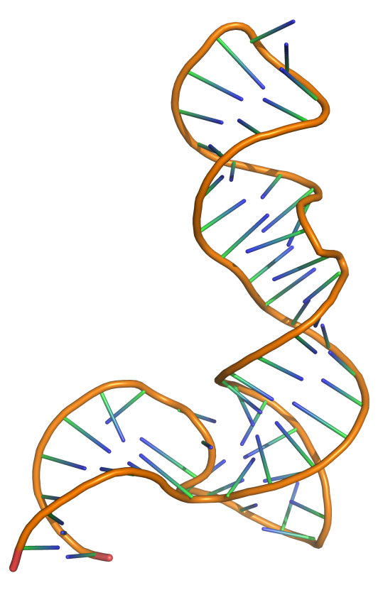
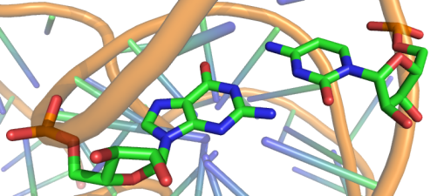
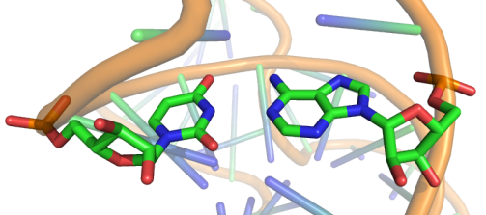
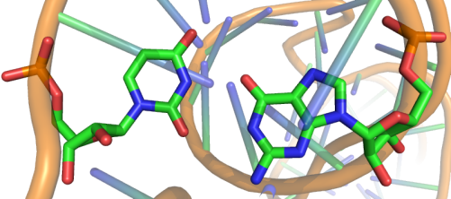
Why RNA folds
G/C
Canonical base-pairs
U/A
U/G
5s rRNA (PDB ID: 1UN6)
RNA folding = Hierarchical stochastic process driven by/resulting in the pairing (hydrogen bonds) of a subset of its bases.

Slide 14
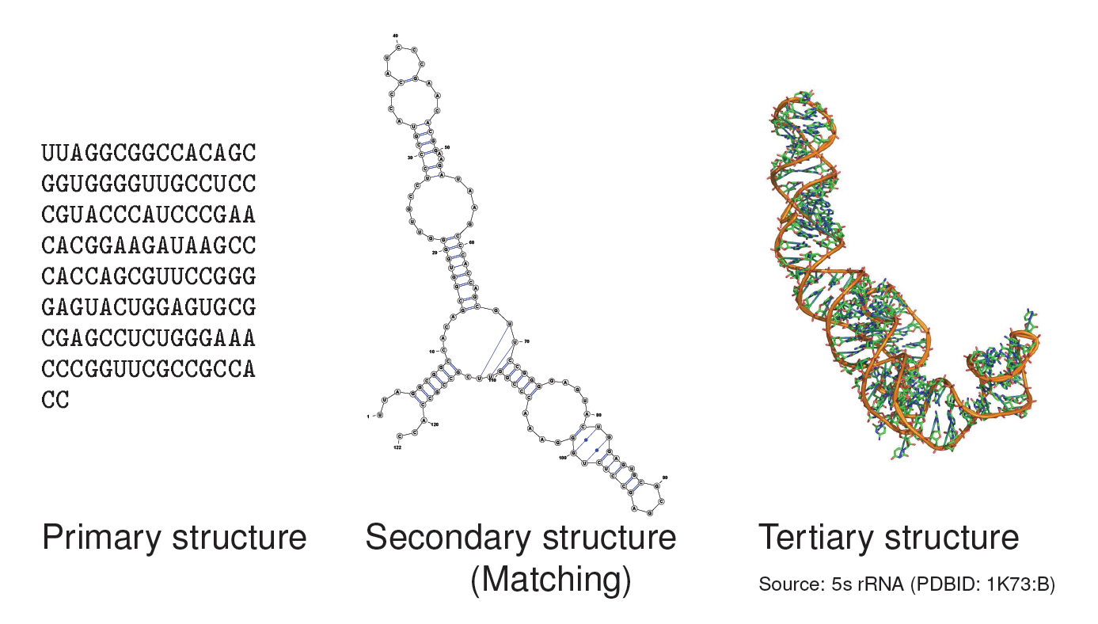
Three levels of RNA structure

Slide 15
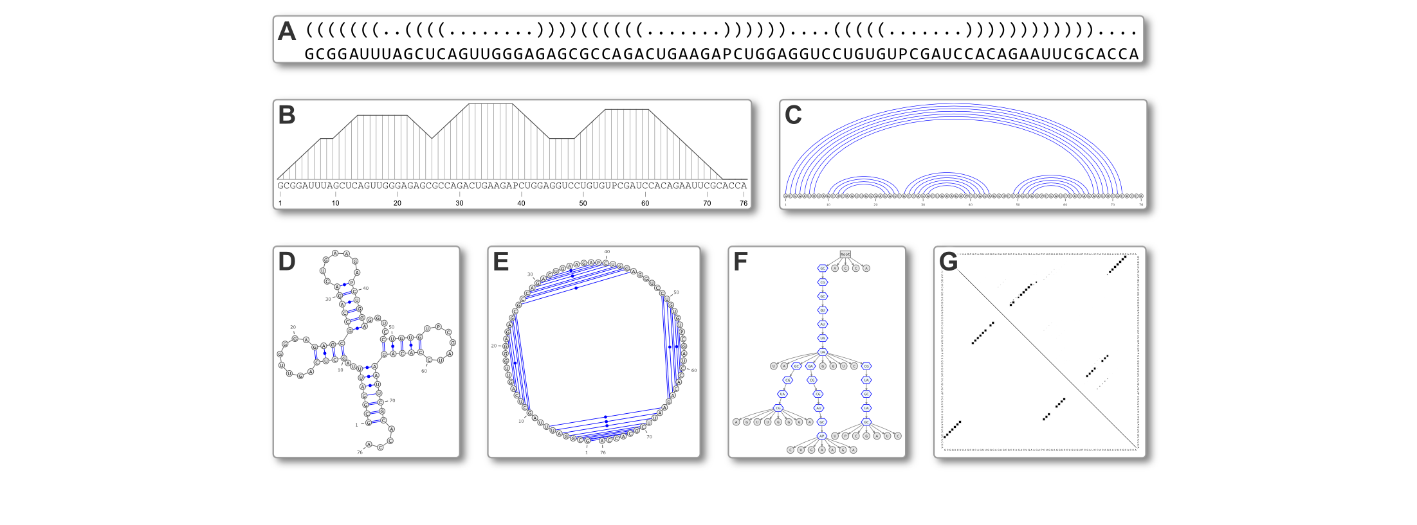
Secondary Structure representations
http://varna.lri.fr
[Darty, Denise & Ponty, Bioinformatics 2009]

Slide 16
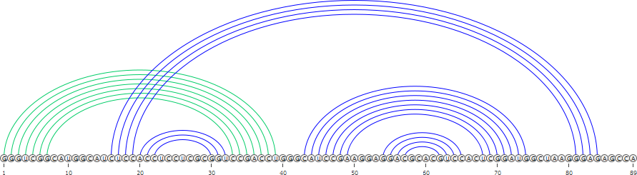
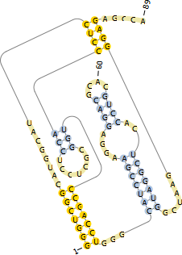
Pseudoknots
Pseudoknots are complex topological models indicated by crossing interactions.
Pseudoknots are largely ignored by computational prediction tools:
  Lack of accepted energy model
  Algorithmically challenging
Some tools consider restricted subsets of PKs
  Pknots-RG offers a reasonable tradeoff between
  computational demands and predictive performances
[Akutsu/Lyngsoe&Pedersen 2000]
[Sheikh S et al, CPM 2011]
[Janssen&Giegerich, Bioinformatics 2015]

Slide 17
Energy minimization

Slide 18
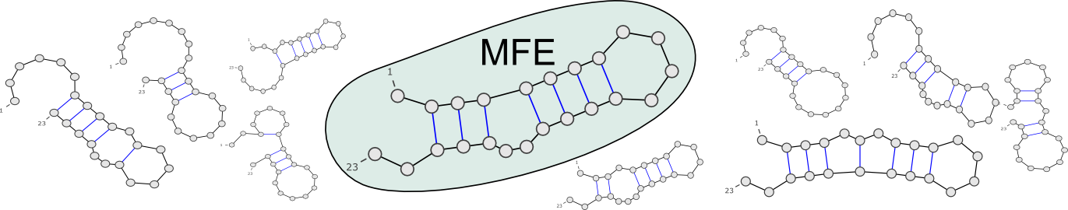
Minimal Free-Energy (MFE) Folding
Goal: Predict the functional (aka native) conformation of an RNA
Absence of homologs/experimental evidences → Consider energy
Turner model associates free-energies to secondary structures
Vienna RNA package implements a O(n³) optimization algorithm for computing most stable (= min. free-energy) folding
…CAGUAGCCGAUCGCAGCUAGCGUA…
RNAFold, MFold…
[Nussinov & Jacobson, PNAS 1980; Zuker & Stiegler, NAR 1981]

Slide 19
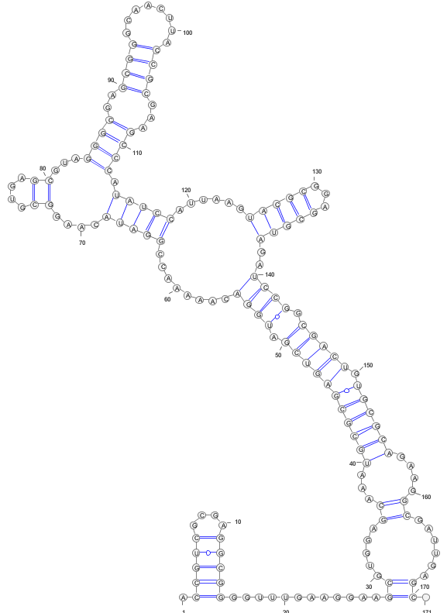
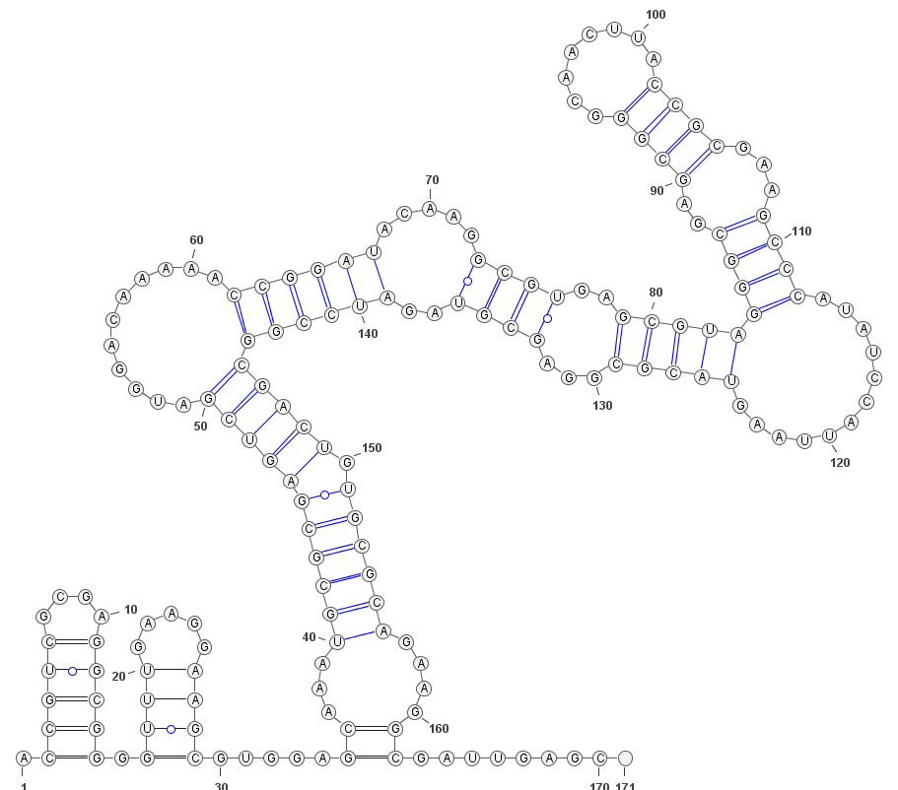
Optimization methods can be overly sensitive to fluctuations of the energy model
Example:
RFAM A. capsulatum D1-D4 domain of the Group II intron
Run RNAFold using:
  Default energy model (Turner 2004)
  Data-driven model (Andronescu 2007)
Turner 2004
Andronescu 2007

Slide 20
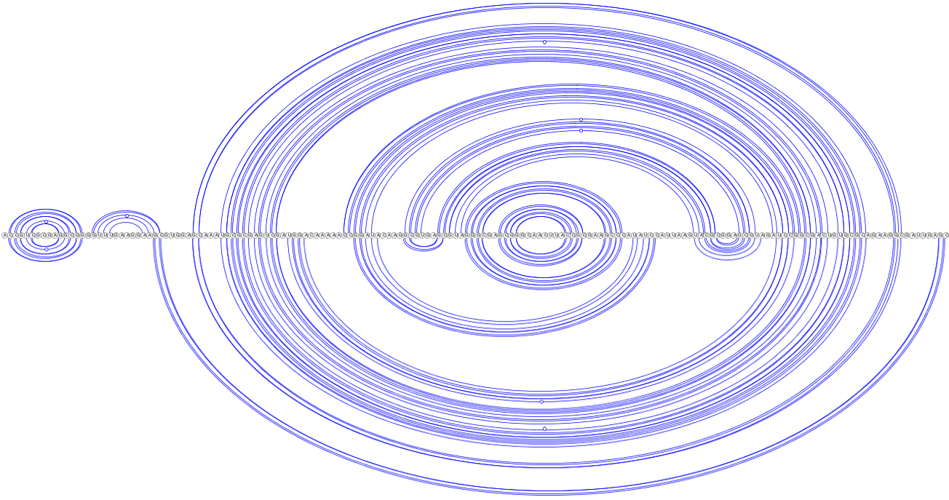
Optimization methods can be overly sensitive to fluctuations of the energy model
Example:
RFAM A. capsulatum D1-D4 domain of the Group II intron
Run RNAFold using:
  Default energy model (Turner 2004)
  Data-driven model (Andronescu 2007)
Turner 2004
Andronescu 2007
Discrepancy not as embarrassing as it first looks…
… still substantial!

Slide 21
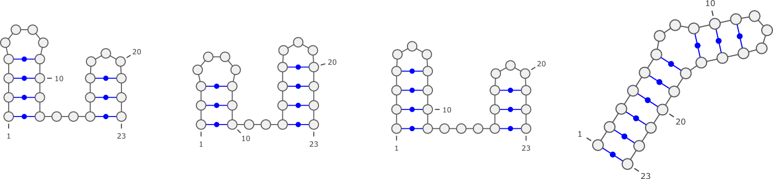
Optimization methods can be sensitive to fluctuations of the energy model
Why do different models provide different results?
<ε
Stability (Turner 2004)
RNA
ACGAUCGCGA
CUACGUGCAU
CGCGGCACGA
CUGCGAUCUG
CAUCGGA...
Stability (Andronescu 2007)
Workarounds:
Suboptimal structures (homogeneity, exponential growth)
Prediction driven by low-res/high-throughput experimental evidence
[Wuchty, Biopolymers 1999]
[Mathews et al, PNAS 2004]

Slide 22
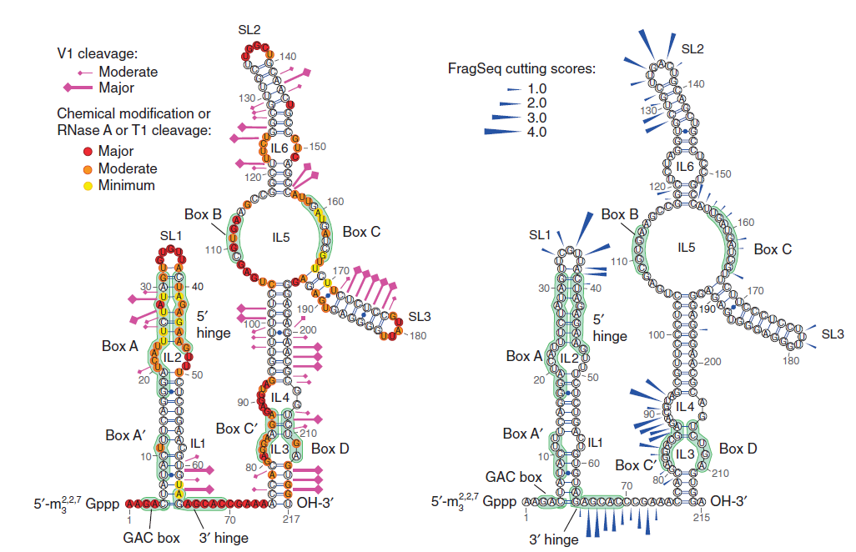
Chemical/enzymatic probing to model 2D
High-throughput secondary structure determination
Reactivity/accessibility guide manual modeling choices
FragSeq method [Underwood et al, Nature Methods 2010]
(Images: VARNA)
Inclusion as pseudo potentials within energy-models
[Lorenz et al, Bioinformatics 2015]

Slide 23
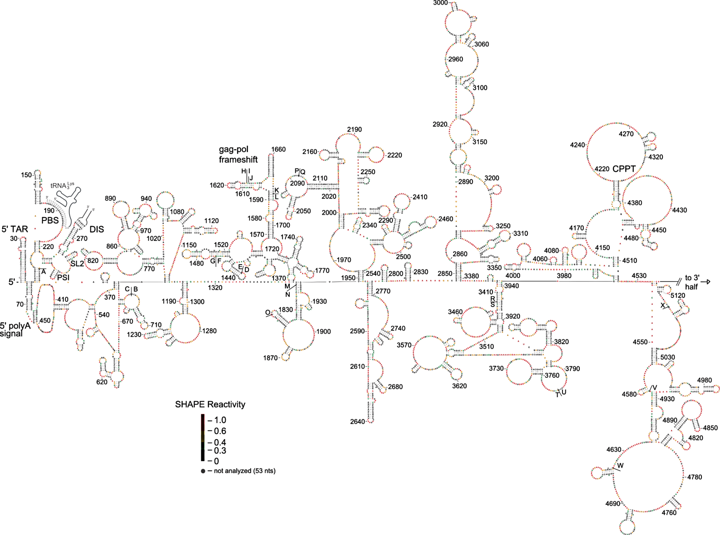
SHAPE probing to model 2D
HIV-1 virus secondary structure (1/2)
[Watts JM et al, Nature 2010]

Slide 24
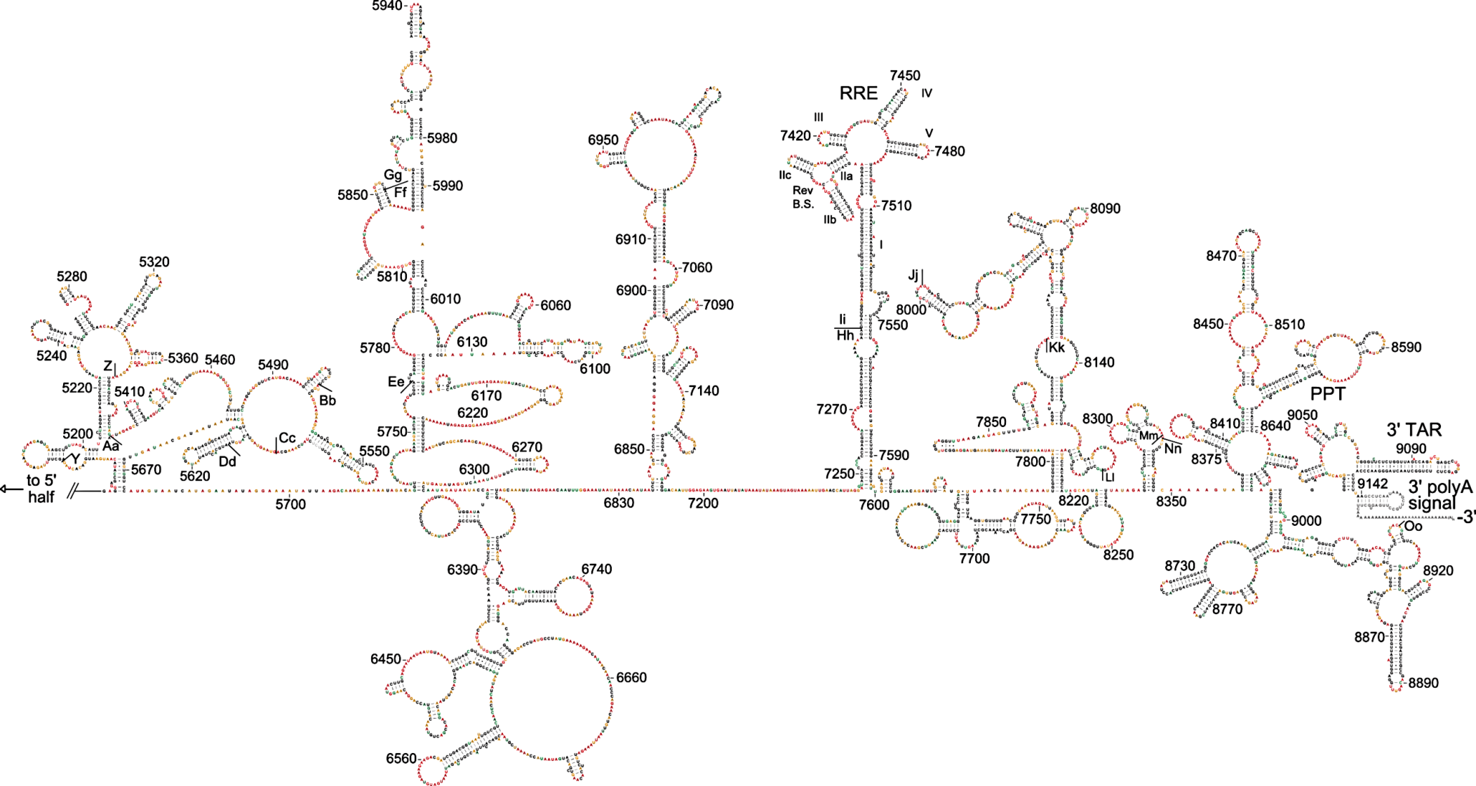
SHAPE probing to model 2D
HIV-1 virus secondary structure (2/2)
[Watts JM et al, Nature 2010]

Slide 25

Energy-based Ab initio folding methods:
Do they really work?
Generally yes, but some variations across studies
Benchmark: 1919 non-multimer/non-pseudoknotted structures from RNAstrand
[Andronescu et al, BMC Bioinformatics 2008]
$$MCC=\frac{TP×TN−FP×FN}{\sqrt{\left(TP+FP\right)\left(TP+FN\right)\left(TN+FP\right)\left(TN+FN\right)}}$$
Program | Sensitivity | PPV | MCC | F-measure
RNAfold 2.1.9 | 0.742 | 0.795 | 0.767 | 0.765
RNAfold 2.1.8 | 0.740 | 0.792 | 0.764 | 0.762
RNAfold 1.8.5 | 0.711 | 0.773 | 0.740 | 0.737
UNAfold 3.8 | 0.693 | 0.767 | 0.727 | 0.725
RNAstructure 5.7 | 0.716 | 0.781 | 0.746 | 0.744
[Lorenz et al, Algo Mol Biol 2011]

Slide 26
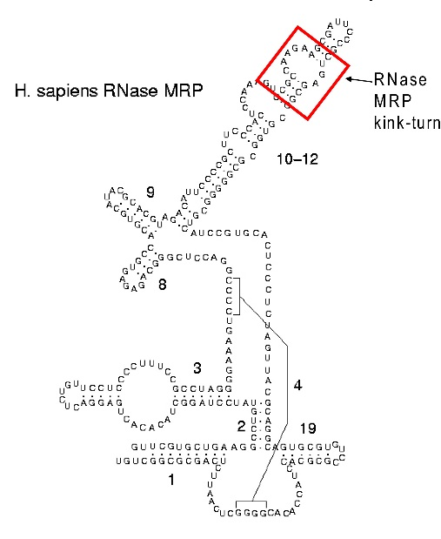
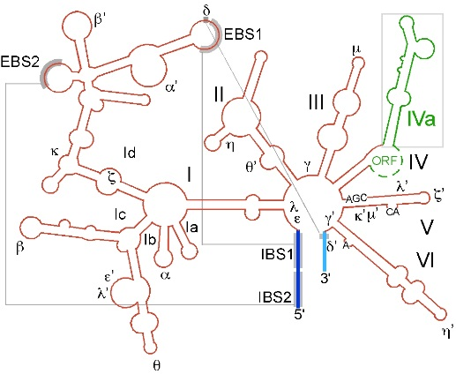
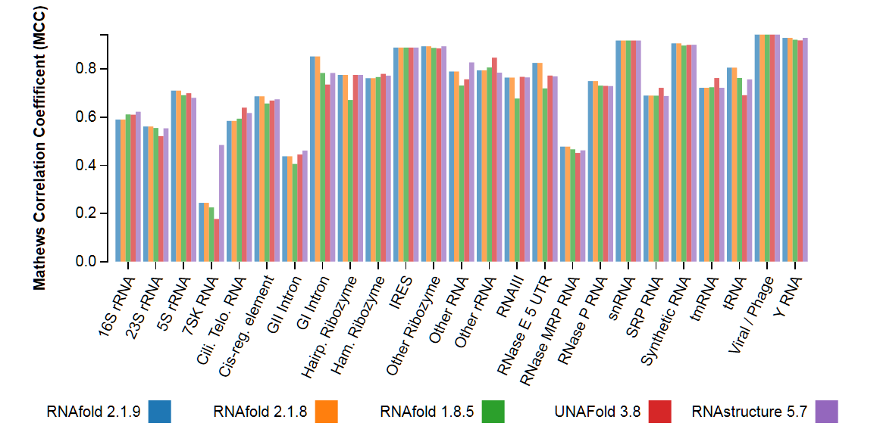
Energy-based Ab initio folding methods:
Do they really work?
Generally yes, but some variations across families
Benchmark: 1919 non-multimer/non-pseudoknotted structures from RNAstrand
[Andronescu et al, BMC Bioinformatics 2008]
$$MCC=\frac{TP×TN−FP×FN}{\sqrt{\left(TP+FP\right)\left(TP+FN\right)\left(TN+FP\right)\left(TN+FN\right)}}$$

Slide 27
Boltzmann ensemble
Partition function-based methods

Slide 28
Ensemble approaches in RNA folding
RNA in silico paradigm shift:
  From single structure, minimal free-energy folding…
...CAGUAGCCGAUCGCAGCUAGCGUA...
Mfold, RNAfold...

Slide 29
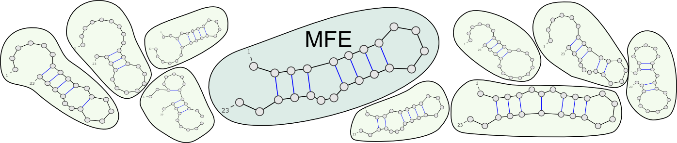


Ensemble approaches in RNA folding
RNA in silico paradigm shift:
  From single structure, minimal free-energy folding…
  … to ensemble approaches.
...CAGUAGCCGAUCGCAGCUAGCGUA...
UnaFold, RNAFold, Sfold…
Thermodynamic equilibrium: Each secondary structure has probability
Boltzmann
Probability
$$Prob\left(S\right)=\frac{e^{−∆G(S)/kT}}{Z}$$
Partition
Function
$$Z=\sum_{Struc S}{e^{−∆G(S)/kT}}$$
[McCaskill, Biopolymers 1990 ]

Slide 30
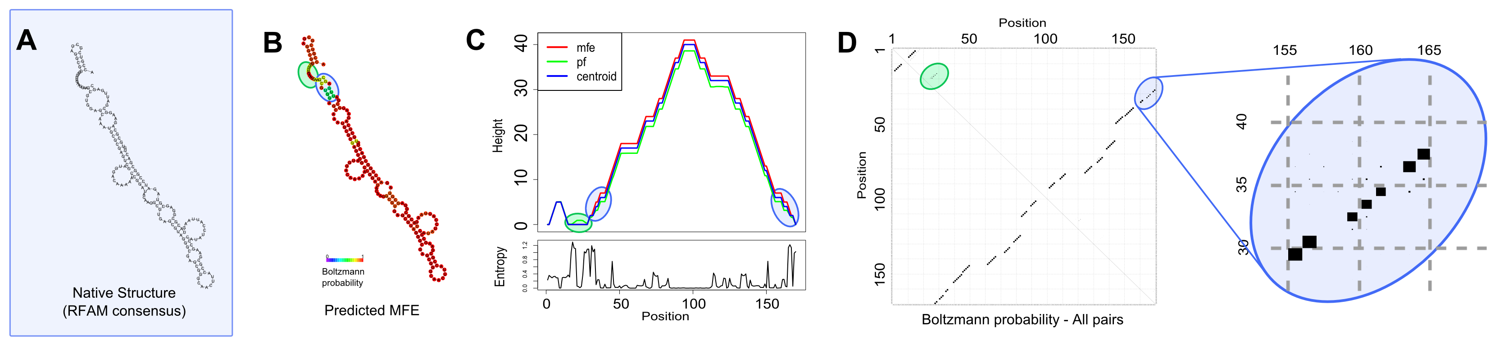
Assessing the reliability of a prediction
D1-D4 group II intron
RFAM ID: RF02001
RNAFold webserver [Gruber AR et al. NAR 2008]

Slide 31
Assessing the reliability of a prediction
D1-D4 group II intron
A. Capsulatum sequence
RNAFold webserver [Gruber AR et al. NAR 2008]

Slide 32
Assessing the reliability of a prediction
D1-D4 group II intron
A. Capsulatum sequence
Low BP probabilities indicate uncertain base pairs
BP>99% → PPV>90%
BP>90% → PPV>83%...
[Mathews, RNA 2004]

Slide 33
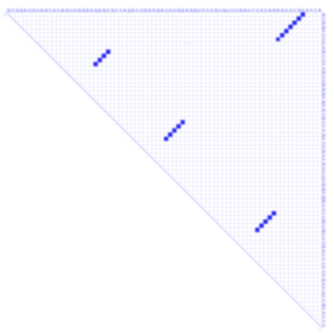
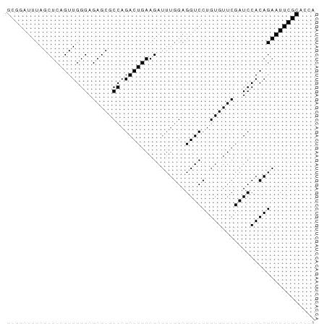
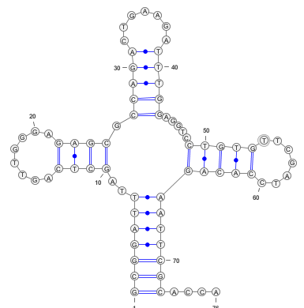
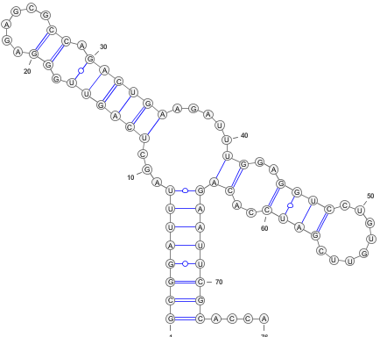
Ensemble approaches indicate uncertainty and suggest alternative conformations
Example:
>ENA|M10740|M10740.1 Saccharomyces cerevisiae Phe-tRNA. : Location:1..76 GCGGATTTAGCTCAGTTGGGAGAGCGCCAGACTGAAGATTTGGAGGTCCTGTGTTCGATCCACAGAATTCGCACCA
RNAFold -p
Native structure

Slide 34

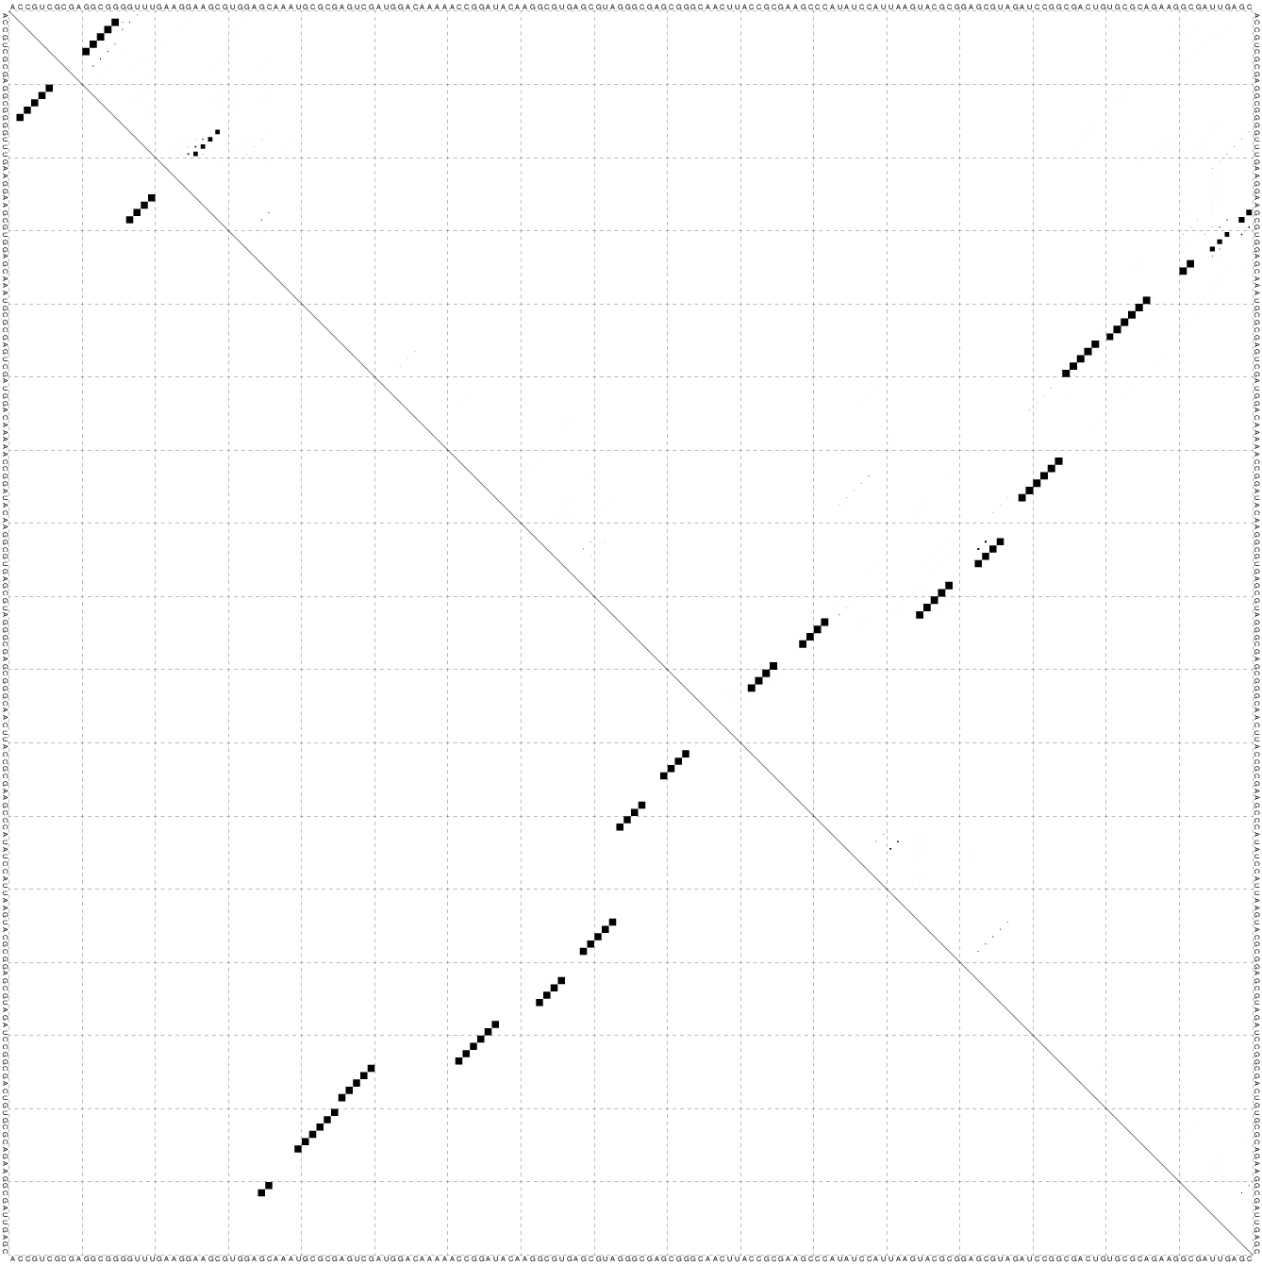


Ensemble-based methods are more robust than energy-minimizing approaches
Back to D1D4 example…
Turner 2004
Andronescu 2007

Slide 35
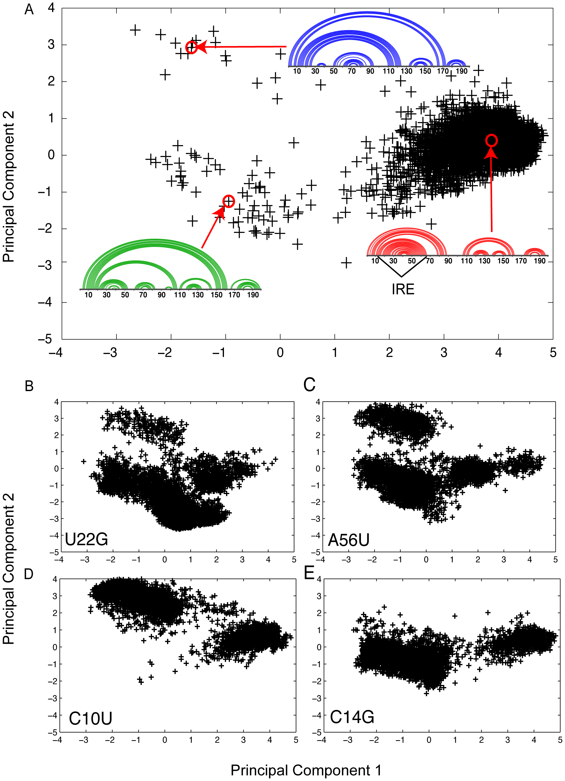
Sensitivity to (single-point) mutations
Method: Boltzmann Sampling → PCA → Clustering
[Halvorsen M et al, PLOS Gen 2010]

Slide 36
Sensitivity to (single-point) mutations
Method: Boltzmann Sampling → PCA → Clustering
?
[Halvorsen M et al, PLOS Gen 2010]
C10U associated with Hyperferritinemia cataract syndrome

Slide 37
Comparative methods and the pitfalls of benchmarks
The BRaliBase dent - a tale of benchmark design and interpretation
[Löwes, Chauve, Ponty & Giegerich, Briefings in Bioinformatics 2016]

Slide 38
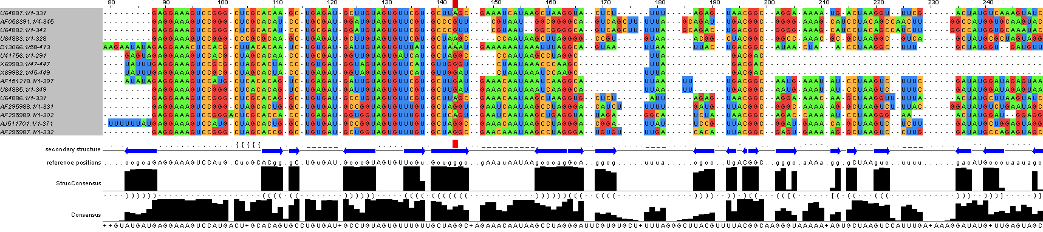
Evolution to the rescue: Comparative approaches for structured RNAs
…
…
…
RFAM Bacterial RNase P class B Alignment RF00011, rendered using JalView
Structure (≈ phenotype) typically more conserved than sequence
Covariations/compensatory mutations hint towards shared structure

Slide 39
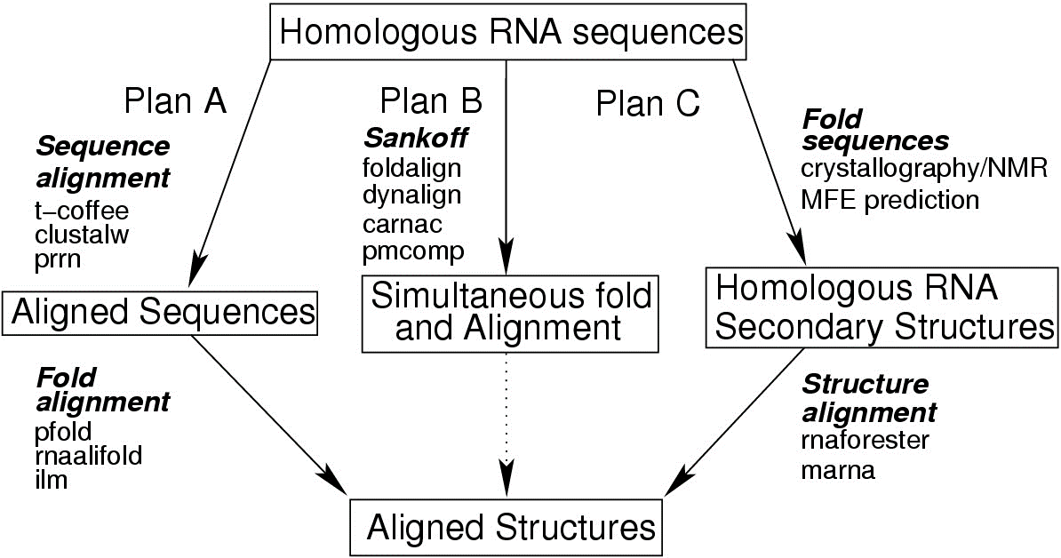
Evolution to the rescue: Comparative approaches for structured RNAs
Idea: If MSA is available and trusted, fold columns!
From unaligned sequences, chicken and egg paradox (again!)
  Plan A: Align sequences, then Fold columns
  Plan B: Fold/align simultaneously (Sankoff) → Θ(n^{3m})/Θ(n^{2m}) time/memory
  Plan C: Fold sequences, then Align structures
RNAAlifold [Bernhardt et al, BMC Bioinfo 2008]
[Gardner & Giegerich, BMC Bioinfo 2004]

Slide 40
Software for RNA comparative folding
Carnac
CentroidAlifold
CentroidAlign
CMfinder
CONSAN
DAFS
Dynalign
FoldalignM
FRUUT
GraphClust
KNetFold
LARA
LocaRNA
MASTR
Multilign
Murlet
MXSCARNA
pAliKiss
PARTS
Pfold
PETfold
PhyloQFold
PMcomp/PMmulti
RNAG
R-COFFEE
TurboFold
RNA123
RNAalishapes
RNAcast
RNAforester
RNASampler
SCARNA
SimulFold
Stemloc
StrAl
TFold
WAR
Xrate
…
[Will et al, Plos Computional Biology 2007]
Tools mostly differ by their algorithmic strategy
Some variations: phylogenetic tree, pseudoknots, helix-based…
LocaRNA is arguably the current gold standard
(Best efficiency/accuracy tradeoff)

Slide 41
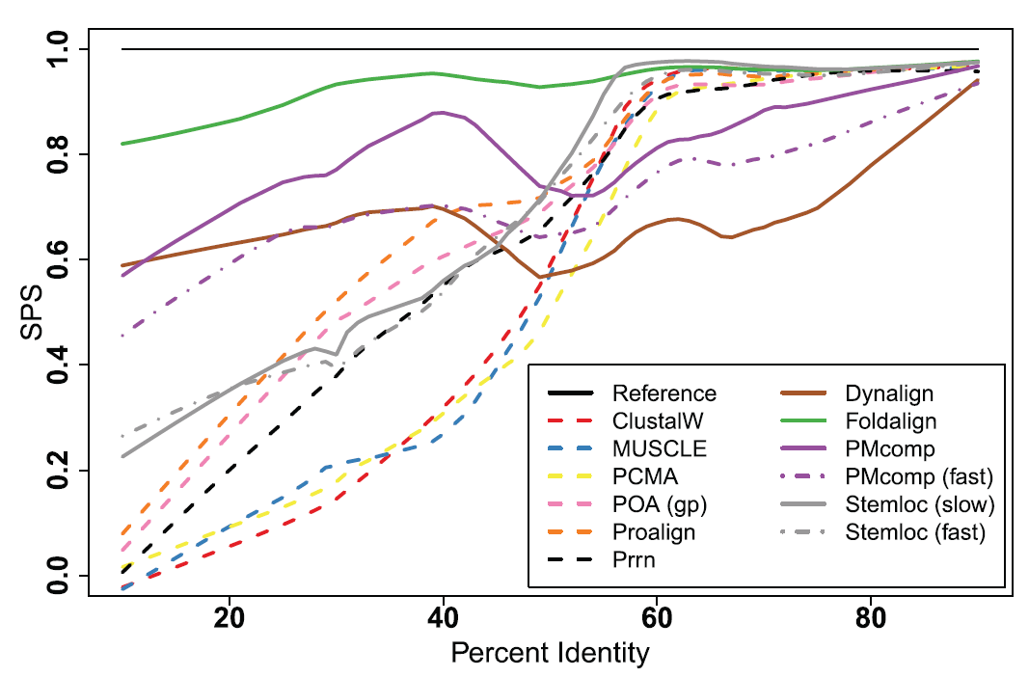
BRAliBase
[Gardner & Giegerich, BMC Bioinfo 2004]
[Gardner,Wilm & Washietl, NAR, 2005]
[Wilm, Mainz & Steger, Alg Mol Biol, 2006]
Benchmark(s) of sequence/alignment contributed in 2004-2005
Cited ~800 times, de facto standard for new tools
Based on accepted sequence/structure alignments from RFAM
[Griffiths-Jones et al, Nucleic Acids Res. 2003]
The Dent
Quality Score: Sum-of-Pairs Score (SPS) =
#Correctly predicted chars pairs
#Chars pairs in curated alignments

Slide 42
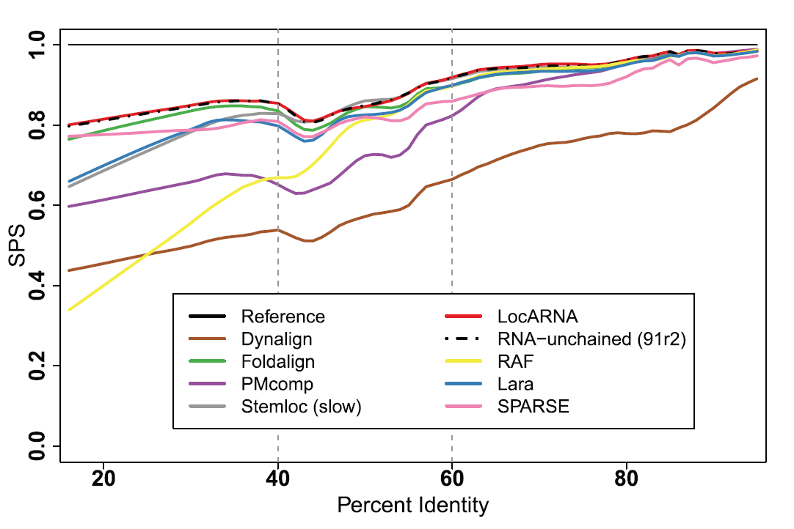
The BRAliBase dent
The Dent
SPS
The Dent = Quality drop in 40%-60% sequence identity
Tool-independent phenomenon first identified in 2005
Reproduced by following tools & improved benchmarks
Inspiration for new algorithms, creative conjectures…
40%
60%
%Identity
[Gardner,Wilm & Washietl, NAR, 2005]
[Wilm, Mainz & Steger, Alg Mol Biol, 2006]

Slide 43
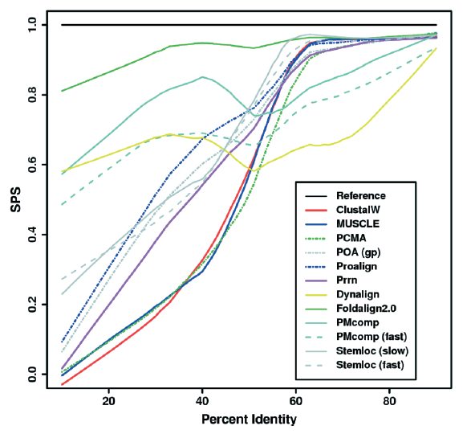
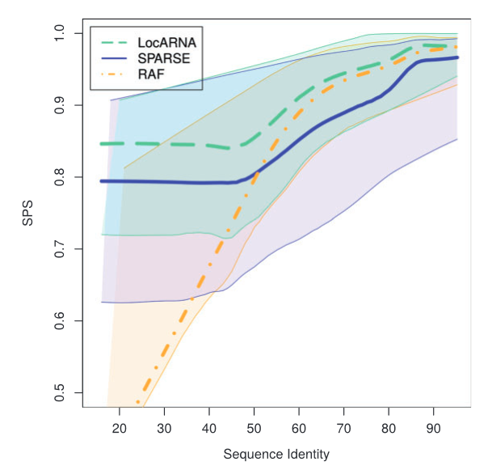
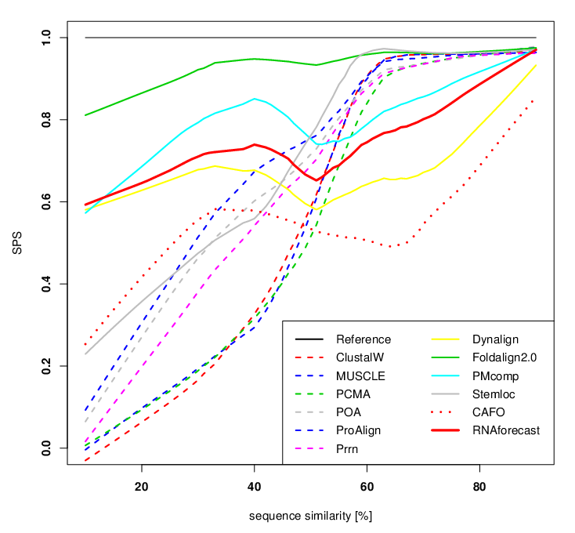
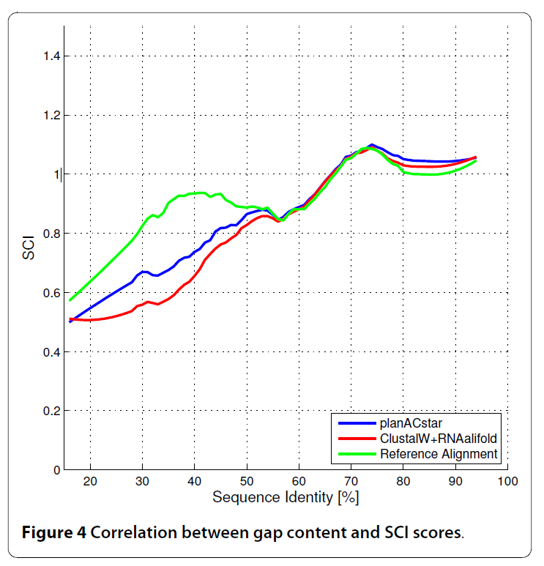
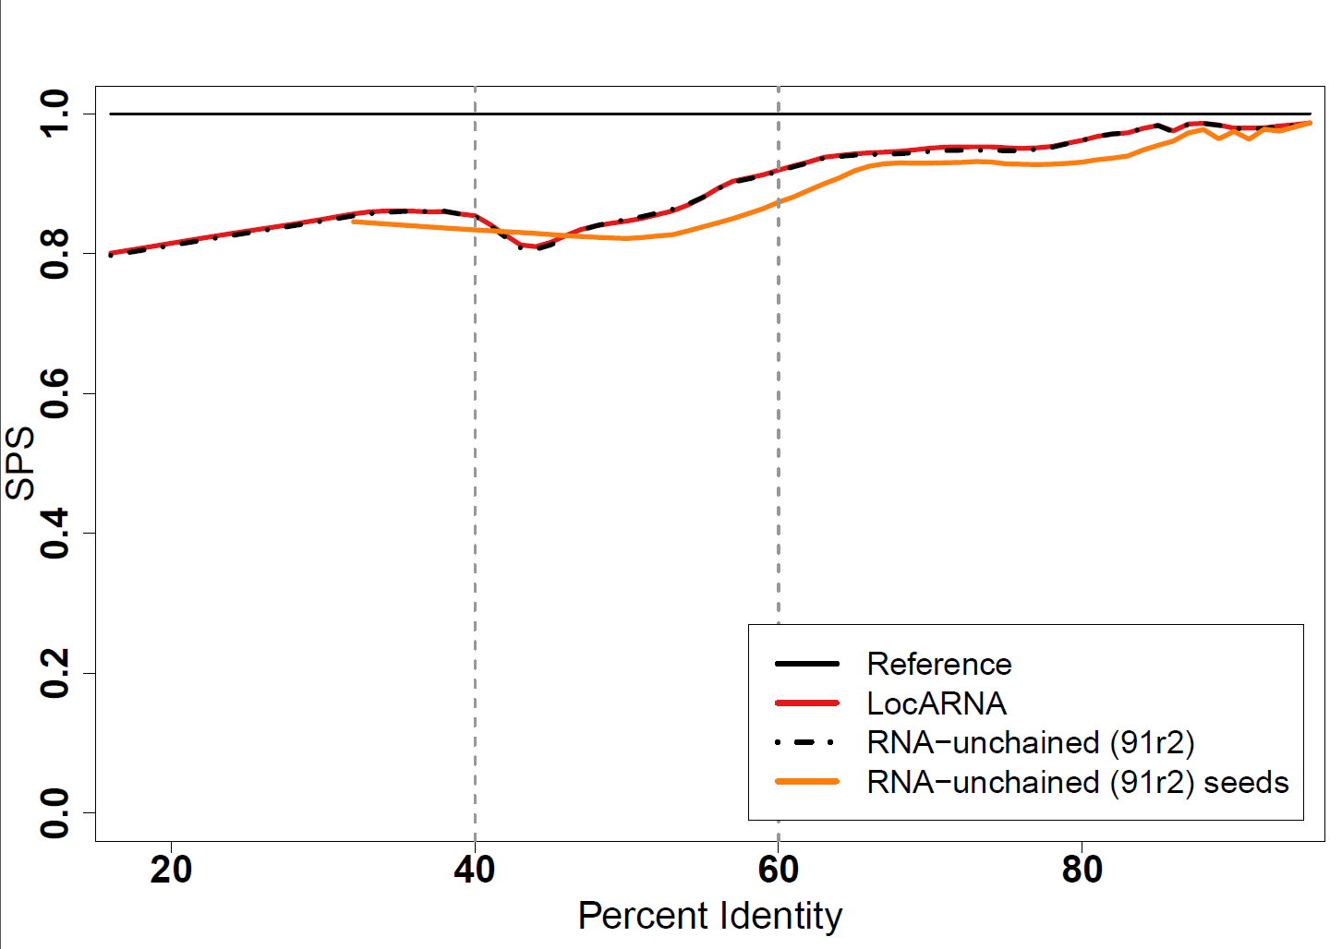
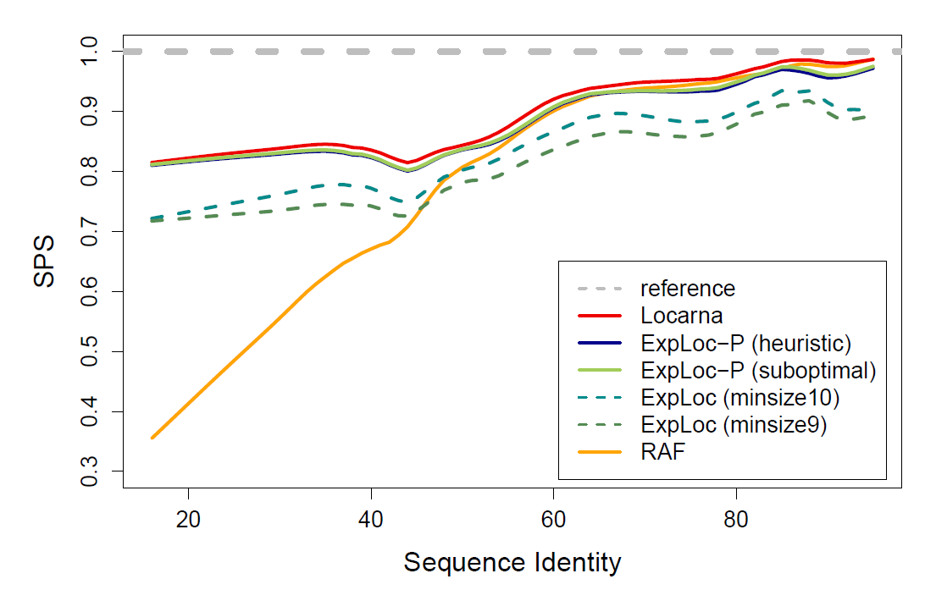
The BRAliBase dent
The Dent
SPS
The Dent = Quality drop in 40%-60% sequence identity
Tool-independent phenomenon first identified in 2005
Reproduced by following tools & improved benchmarks
Inspiration for new algorithms, creative conjectures…
40%
60%
%Identity
[Gardner et al, NAR 2005]
[Höchsmann et al, Unpublished]
[Will et al, Bioinformatics 2015]
[Bremges et al, BMC Bioinfo, 2010]
[Schmiedl et al, RECOMB 2012]
[Bourgeade et al, J Comp Biol, 2015]

Slide 44
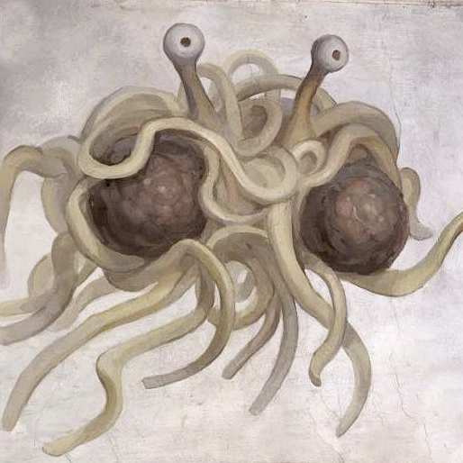
The BRAliBase dent
The Dent
SPS
The Dent = Quality drop in 40%-60% sequence identity
Tool-independent phenomenon first identified in 2005
Reproduced by following tools & improved benchmarks
Inspiration for new algorithms, creative conjectures…
40%
60%
%Identity
The dent marks the transition between sequence and structure-driven alignments
The dent identifies inconsistent practices by alignment curators
The dent undeniably proves the existence of the great spaghetti monster in the sky…
(Very) probably not…

Slide 45
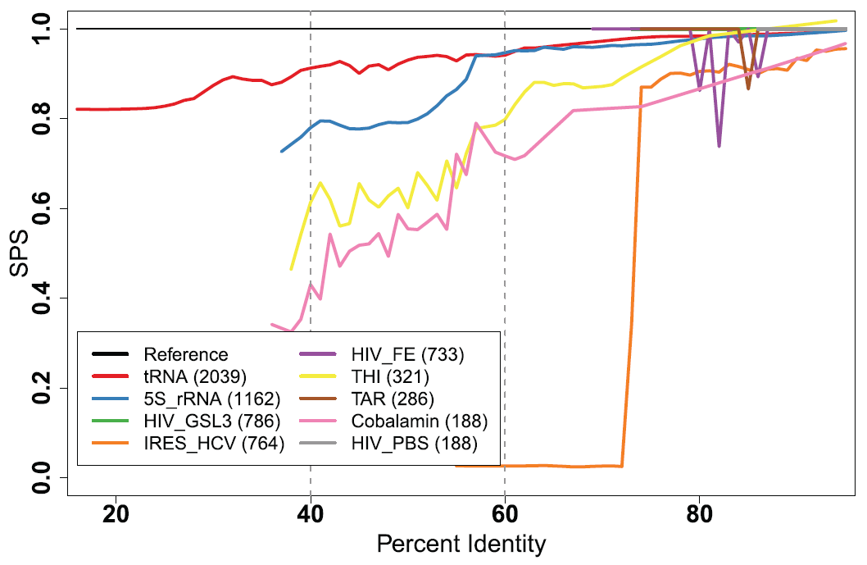
The BRAliBase dent
The Dent
SPS
The Dent = Quality drop in 40%-60% sequence identity
Tool-independent phenomenon first identified in 2005
Reproduced by following tools & improved benchmarks
Inspiration for new algorithms, creative conjectures…
40%
60%
%Identity
LocaRNA does not show a dent on any family…
… merging the results of several families is responsible for the dent!

Slide 46
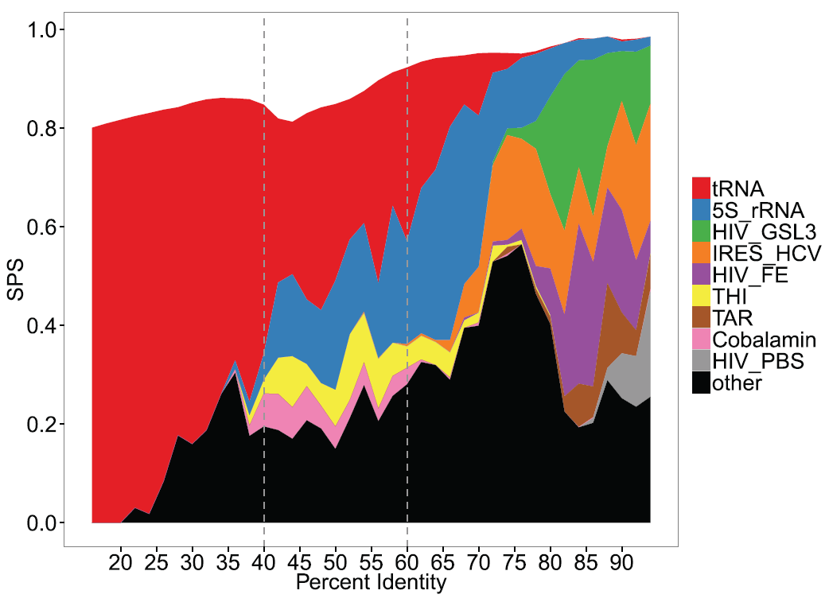

The BRAliBase dent
The Dent
SPS
The Dent = Quality drop in 40%-60% sequence identity
Tool-independent phenomenon first identified in 2005
Reproduced by following tools & improved benchmarks
Inspiration for new algorithms, creative conjectures…
… but artifact due to an heavy bias (>60%) towards well-predicted tRNAs!
40%
60%
%Identity
tRNAs pairs are overly dominant for low identities and very well-predicted
The dent simply occurs when they cease to dominate.

Slide 47
Conclusion

Slide 48


Conclusion
More to RNA than single-structure prediction methods
Most methods run in a few seconds on a laptop, and are available online!
Thermodynamic equilibrium: Making statements about the complete
(exponential) (sub)optimal space (in polynomial time)
  Assess reliability (Boltzmann probability)
  Detect presence of alternative conformers (Dot-plot)
  Identify dominant structures (Boltzmann sampling + clustering)
Comparative approaches: Mature methods (LocARNA) significantly outperform single-sequence predictions
  Avoid using structure-agnostic sequence MSAs
  Benchmarks must be taken with a grain of salt…
  … and should not be the sole driving force for
  methodological development!
The Dent
SPS
40%
60%
%Identity

Slide 49
The future
RNA Design
  Inverse folding = Synthesize RNA folding into a predefined structure
  Gap between theory (almost nothing)…
  … and practice (ab initio design of whole regulatory networks)
  Many software, hard to decide which one to choose for a given task
RNA Kinetics: Ensemble approaches postulate equilibrium
… but RNAs may have short life (+co-transcriptional folding)
  Probably no efficient ab initio combinatorial approaches (NP-hard problems)
  Tools to study RNAs beyond 100nts will require collaborations between App. Maths, biochemistry and computer science
[Churkin et al, Briefing in Bioinformatics 2017]

Slide 50

Thank you. Questions?
tRNA cloverleaf shape members (skating on a winter pond)
RNArt by S. Konermann in [Voss B et al, BMC Biology 2006]

