Slide 1
RNA 3D and 2D structure
Yann PONTY
CNRS/Ecole Polytechnique

Slide 2
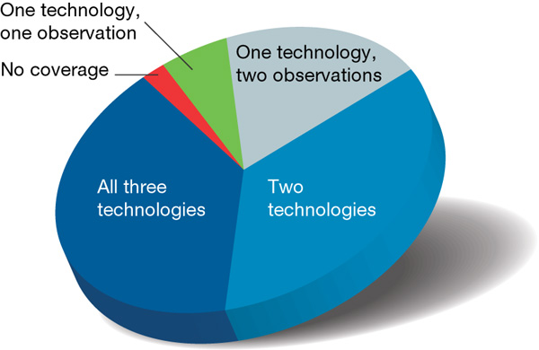
Why RNA is so COOL!
Ubiquitous
Pervasively expressed
The human genome is pervasively transcribed, such that the majority of its bases are associated with at least one primary transcript and many transcripts link distal regions to established protein-coding loci.
ENCODE Analysis of 1% of the human genome
Nature 2007

Slide 3
Why RNA is so COOL!
Ubiquitous
Pervasively expressed
Versatile
Carriers
Transporter
Enzymatic
Processing
Regulatory
ssRNA genomes (HIV)
Immune system?? (CRISPR)
More soon… (lncRNAs)
2002
2003
2005
2007
2011

Slide 4
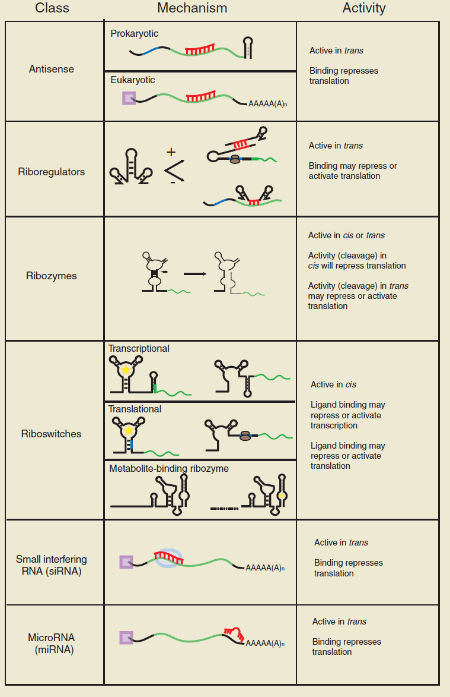
Why RNA is so COOL!
Ubiquitous
Pervasively expressed
Versatile
Easy to handle
  Synthetic biology
[Isaacs, F J et al. Nature Biotech. 2006]

Slide 5
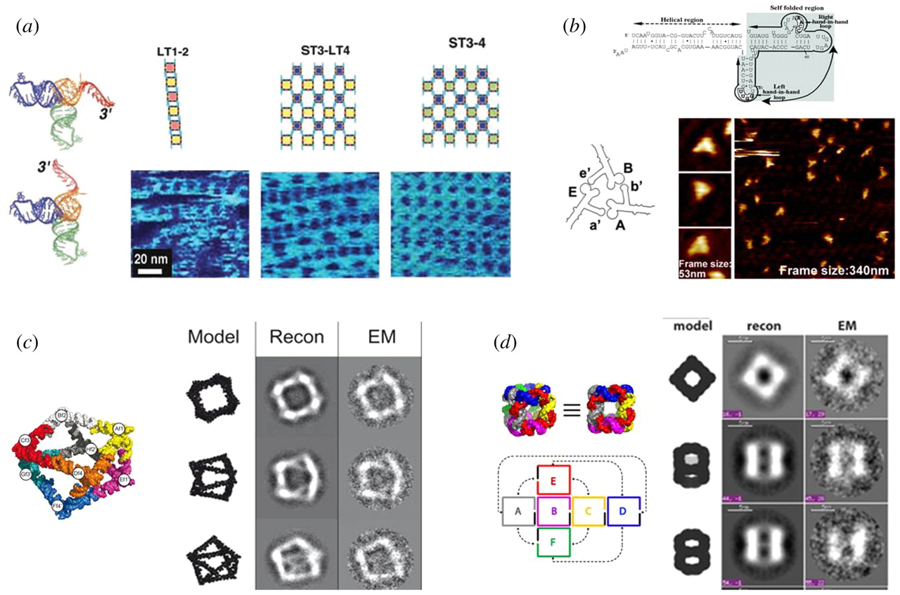
Why RNA is so COOL!
Ubiquitous
Pervasively expressed
Versatile
Easy to handle
  Synthetic biology
  Nanotechs
[Li H et al, Interface Focus 2011]

Slide 6
Why RNA is so COOL!
Ubiquitous
Pervasively expressed
Versatile
Easy to handle
  Synthetic biology
  Nanotechs
  Therapeutics (RNAi)
RNAi : Proof of concept
Injecting nanoparticle-vehicled siRNAs in solid-cancer patients:
siRNA enters tumorous cells
siRNA interacts with targeted mRNA
siRNA regulates protein expression
Davis M I et al, Nature 2010

Slide 7
Why RNA is so COOL!
PDB entries (Feb 2012)
Ubiquitous
Pervasively expressed
Versatile
Easy to handle
  Synthetic biology
  Nanotechs
  Therapeutics (RNAi)
  Computationally fun
  (but still challenging)
(Initial) lack of structural data
Experiment-based energy models
+ Secondary structure
+ Efficient combinatorial algorithms
Mature in silico prediction tools
(Mfold, RNAfold…)

Slide 8

Why structure is important
RNA is single stranded
Structurally diverse
Structure more conserved than sequence
Functionally versatile
Use structure as a proxy for function, favor mechanistic explanations.

Slide 9
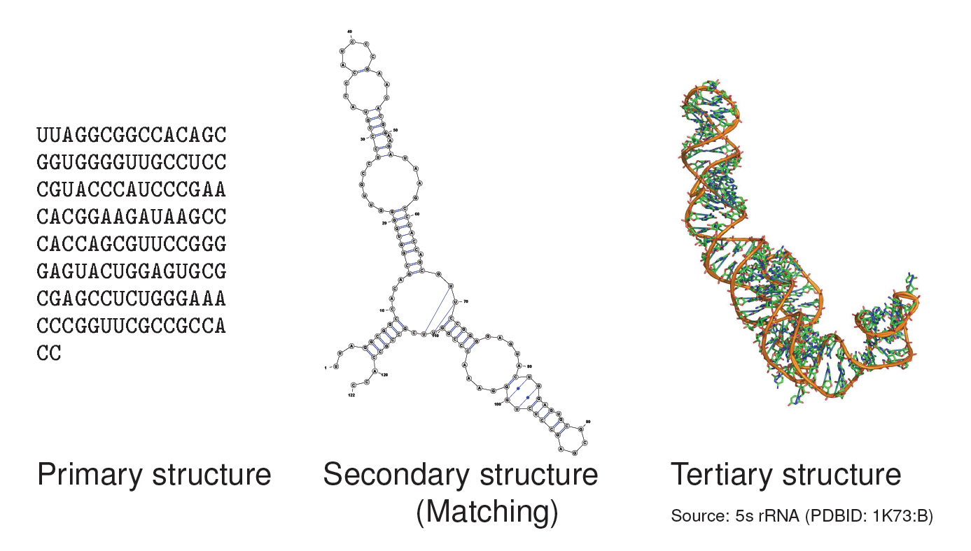
Three levels of RNA structure

Slide 10
Current visualization of RNA
Exemplary use cases

Slide 11
Visualization helps ncRNA scientists
Refine structural model based on experimental data
Assert reliability of predicted structures
Detect structural homology
Curate structure-informed alignments
Communicate functional hypotheses
…

Slide 12
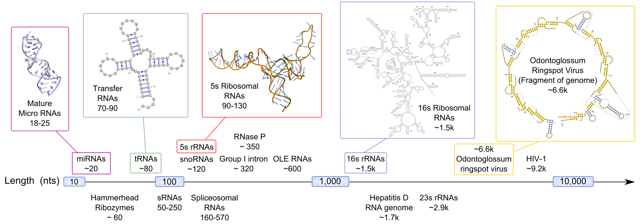
A challenging diversity of scale
Length of structured RNAs from 18 to over 9k nts.
2D schematics vs 3D objects (Top-down vs Bottom-up)
Local vs Global

Slide 13
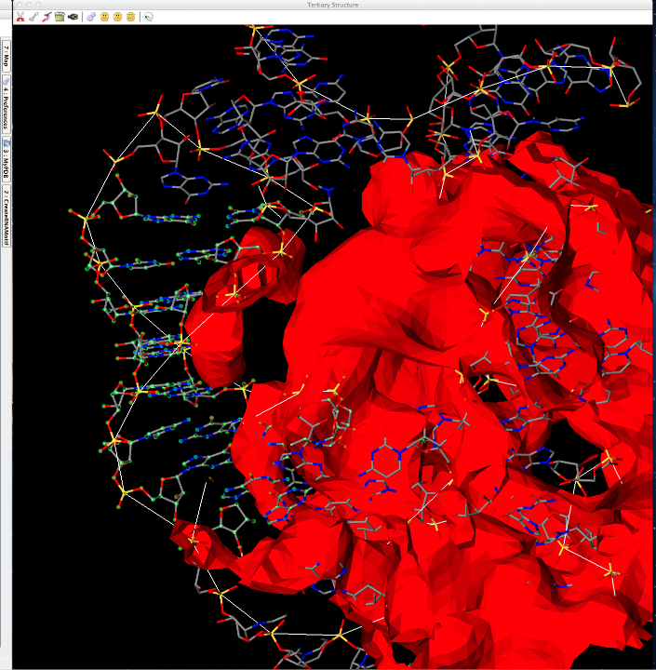
Fitting 3D model to density maps
Cryo-EM maps
  UCSF Chimera
  [Goddard et al, J Struct Biol 2006]
  Coot
  [Emsley P et al, Act Crys D 2010]
  Assemble
  [Jossinet et al, Bioinf. 2010]
Semi-automated
  rCrane [Keating et al, PNAS 2010]
[Assemble, Jossinet et al Bioinf. 2010]

Slide 14
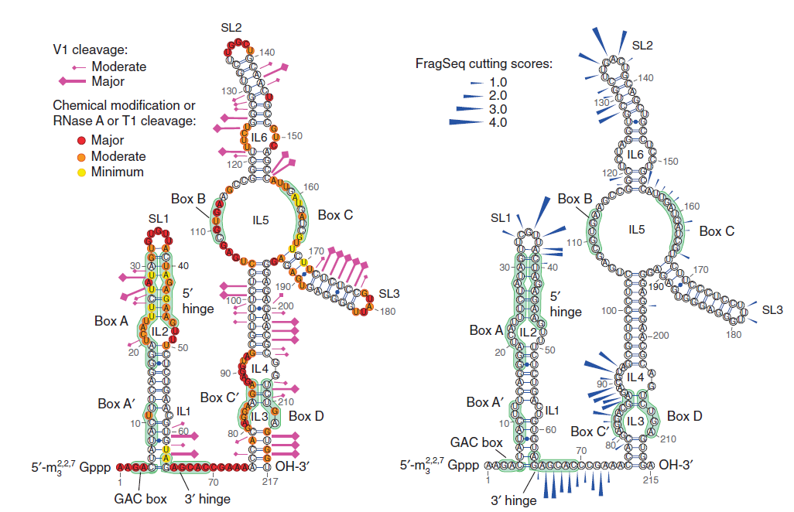
Fitting chemical probing data to 2D model
High-throughput secondary structure determination
Interactively visualize reactivity data within structural context
FragSeq method [Underwood et al, Nature Methods 2010]
(Images: VARNA)

Slide 15
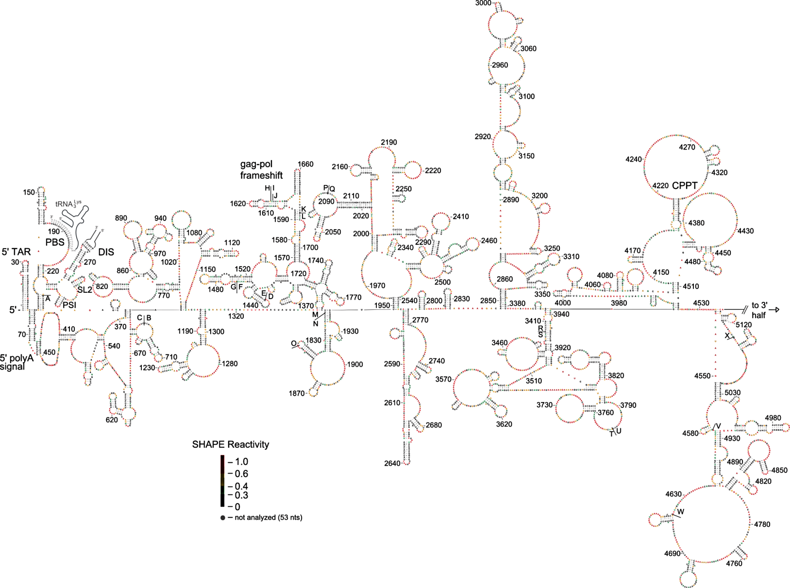
Fitting chemical probing data to 2D model
Scale challenge
HIV-1 virus secondary structure (1/2)
[Watts JM et al, Nature 2010]

Slide 16
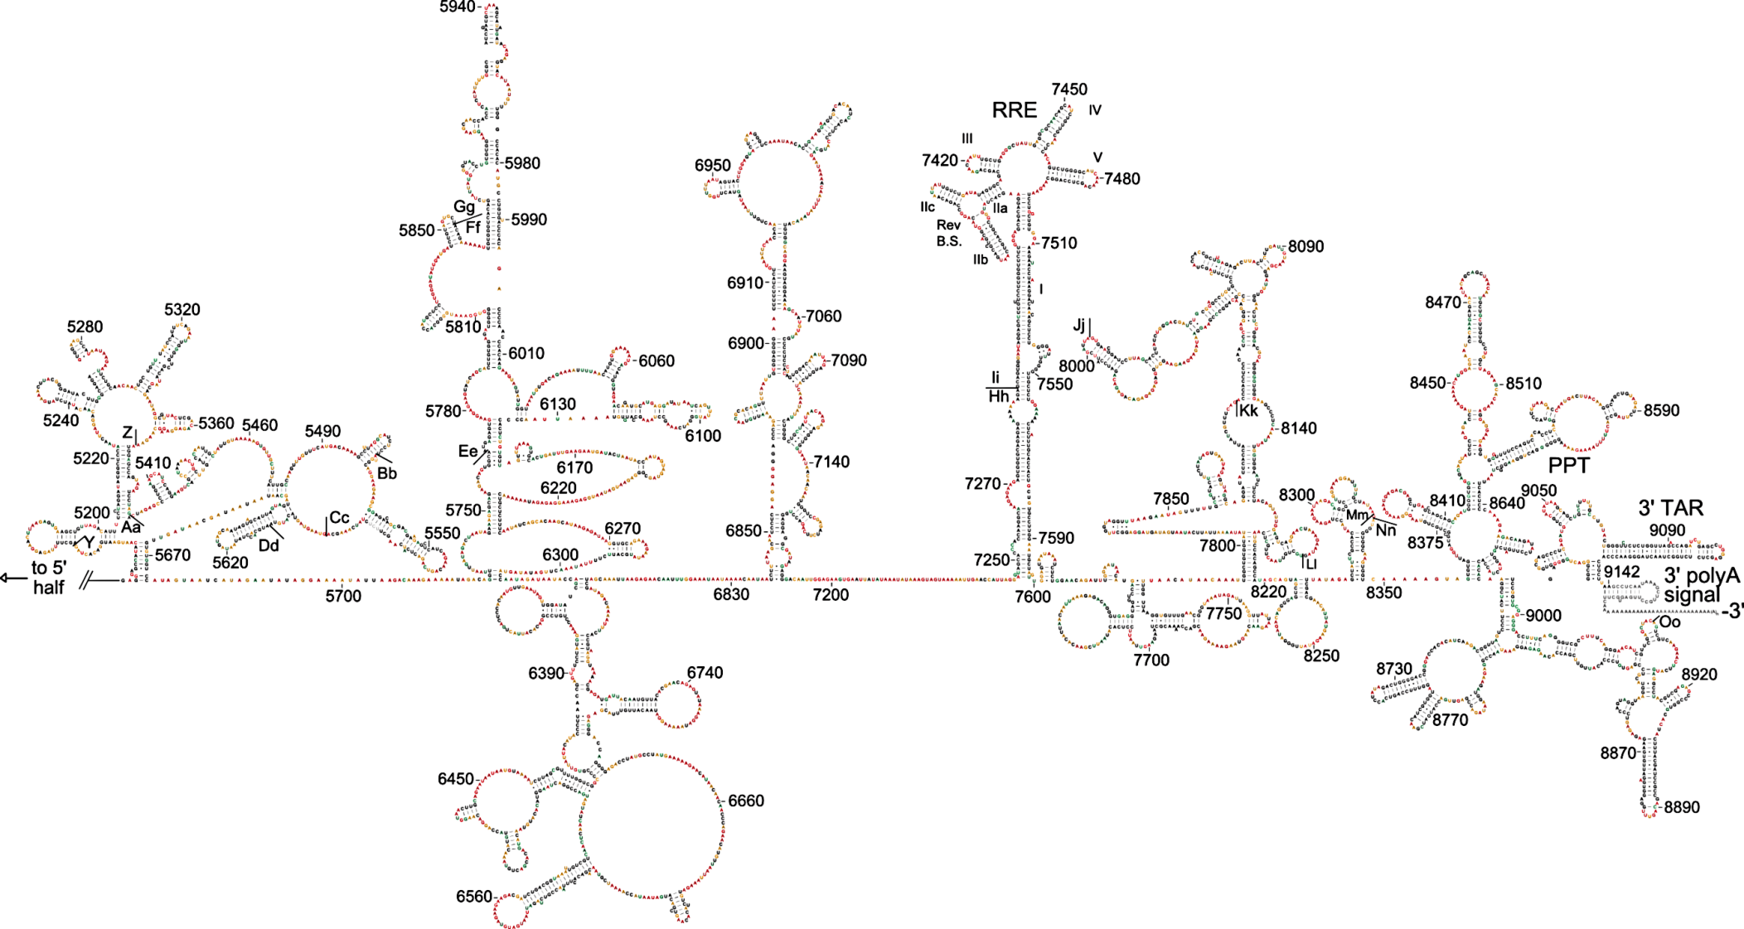
Fitting chemical probing data to 2D model
Scale challenge
HIV-1 virus secondary structure (2/2)
[Watts JM et al, Nature 2010]

Slide 17
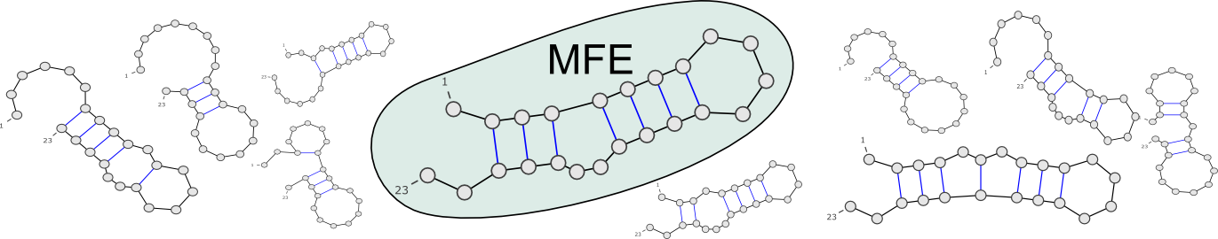
Ensemble approaches in RNA folding
RNA in silico paradigm shift:
  From single structure, minimal free-energy folding…
…CAGUAGCCGAUCGCAGCUAGCGUA…
MFold

Slide 18
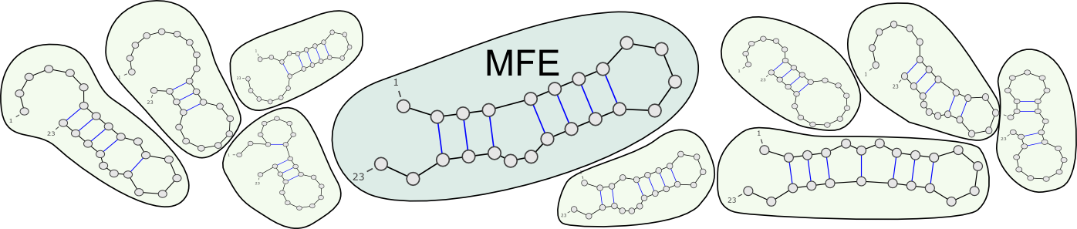
Ensemble approaches in RNA folding
RNA in silico paradigm shift:
  From single structure, minimal free-energy folding…
  … to ensemble approaches.
…CAGUAGCCGAUCGCAGCUAGCGUA…
UnaFold, RNAFold, Sfold…
Ensemble diversity? Structure likelihood? Evolutionary robustness?

Slide 19
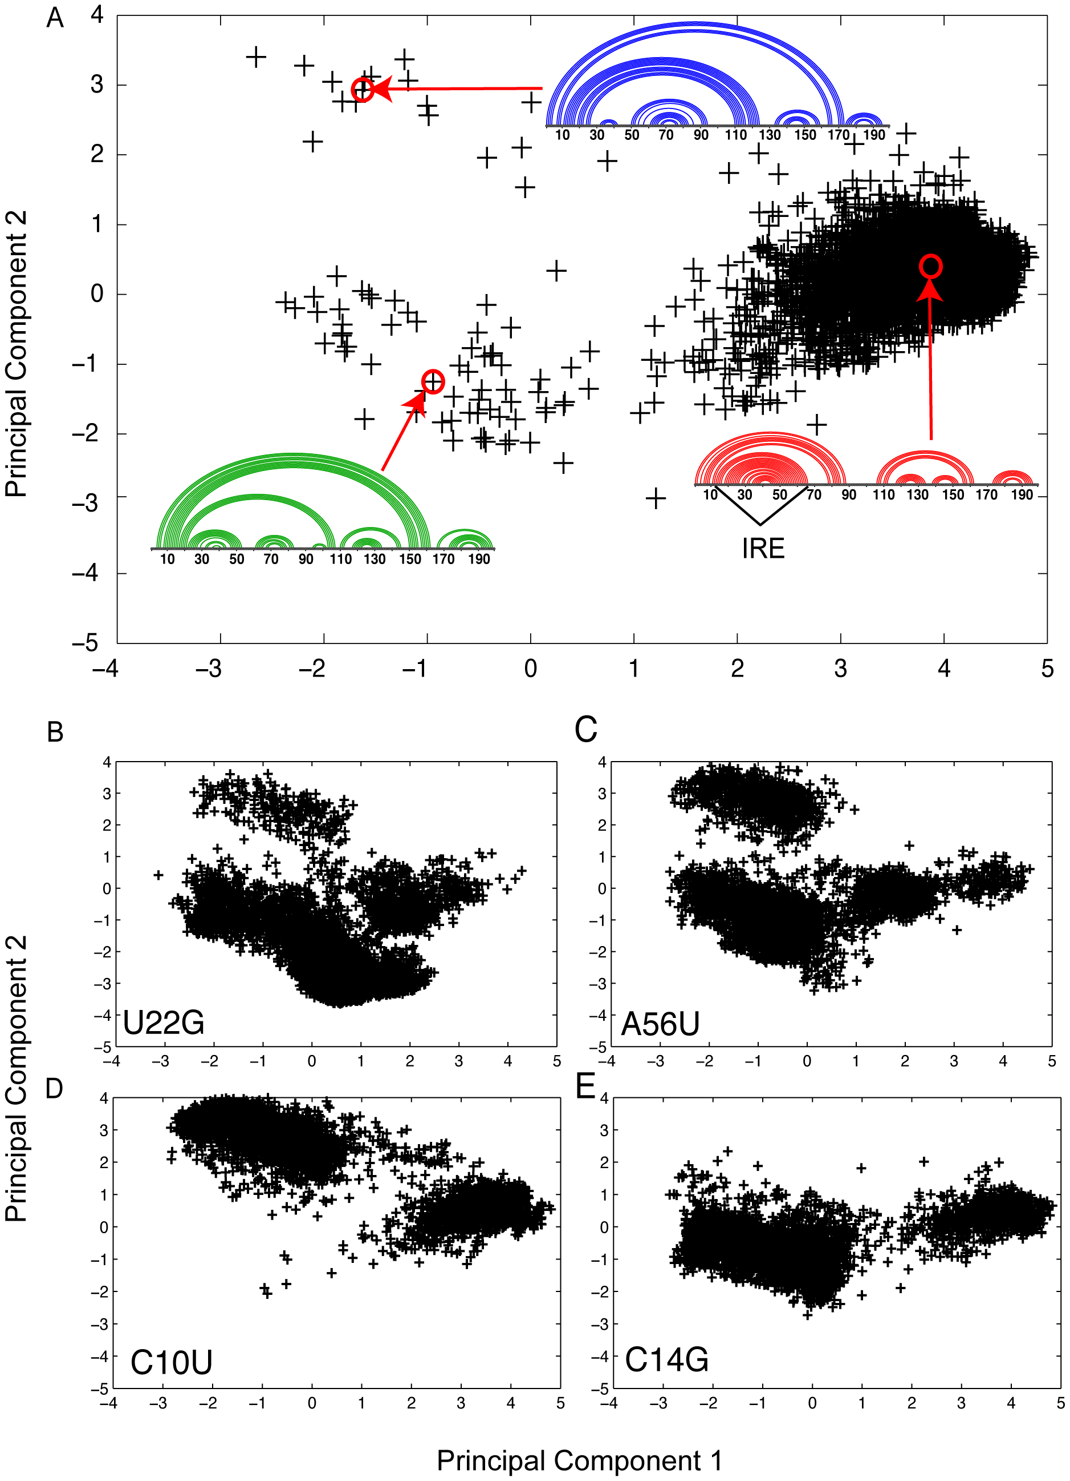
Sensitivity to mutations
Boltzmann Sampling → PCA → Clustering
[Halvorsen M et al, PLOS Gen 2010]

Slide 20
Sensitivity to mutations
Boltzmann Sampling → PCA → Clustering
?
[Halvorsen M et al, PLOS Gen 2010]

Slide 21
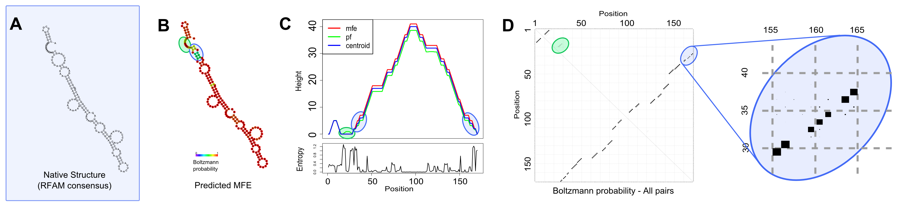
Assessing the reliability of a prediction
D1-D4 group II intron
RFAM ID: RF02001
RNAFold [Gruber AR et al. NAR 2008]

Slide 22
Assessing the reliability of a prediction
D1-D4 group II intron
A. Capsulatum sequence
RNAFold [Gruber AR et al. NAR 2008]

Slide 23
Assessing the reliability of a prediction
D1-D4 group II intron
A. Capsulatum sequence
Low BP probabilities indicate uncertain regions
BP>99% → Avg. PPV>90% (BP>90% → PPV>83%)
Visualizing probs in the context of structure helps refining predicted structures.
RNAFold [Gruber AR et al. NAR 2008]

Slide 24
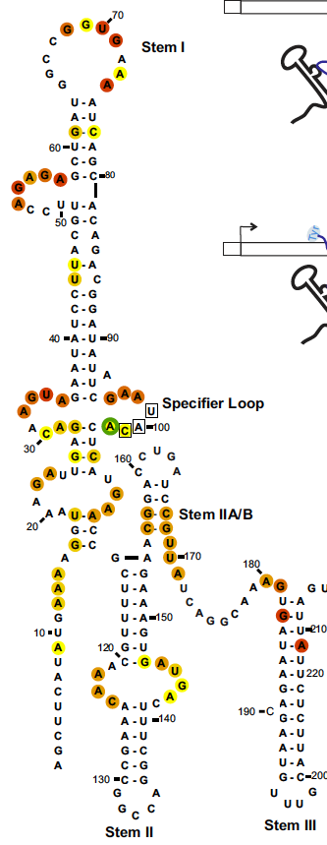
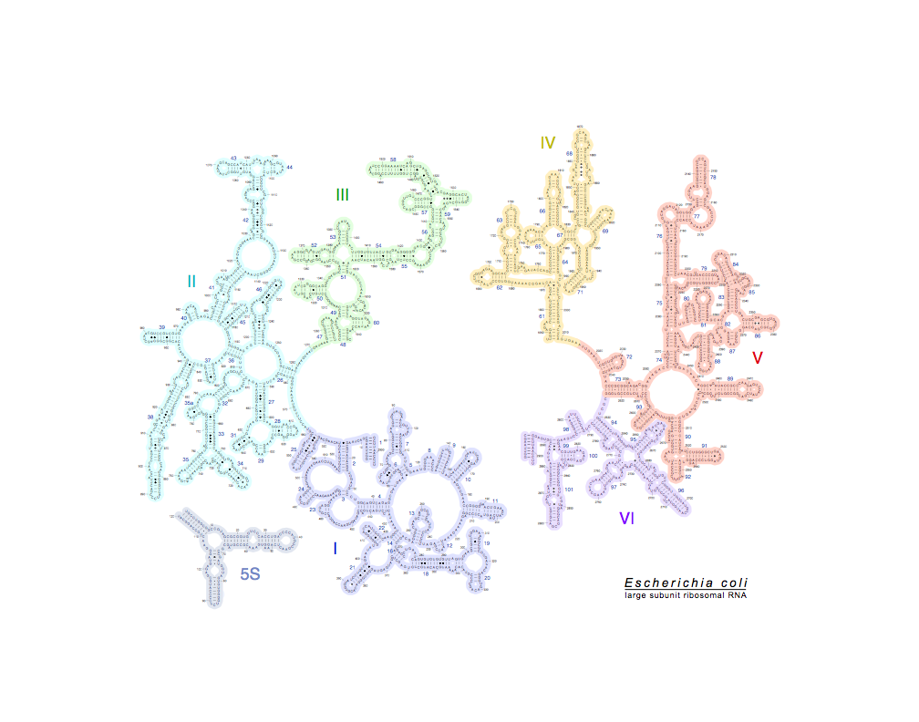
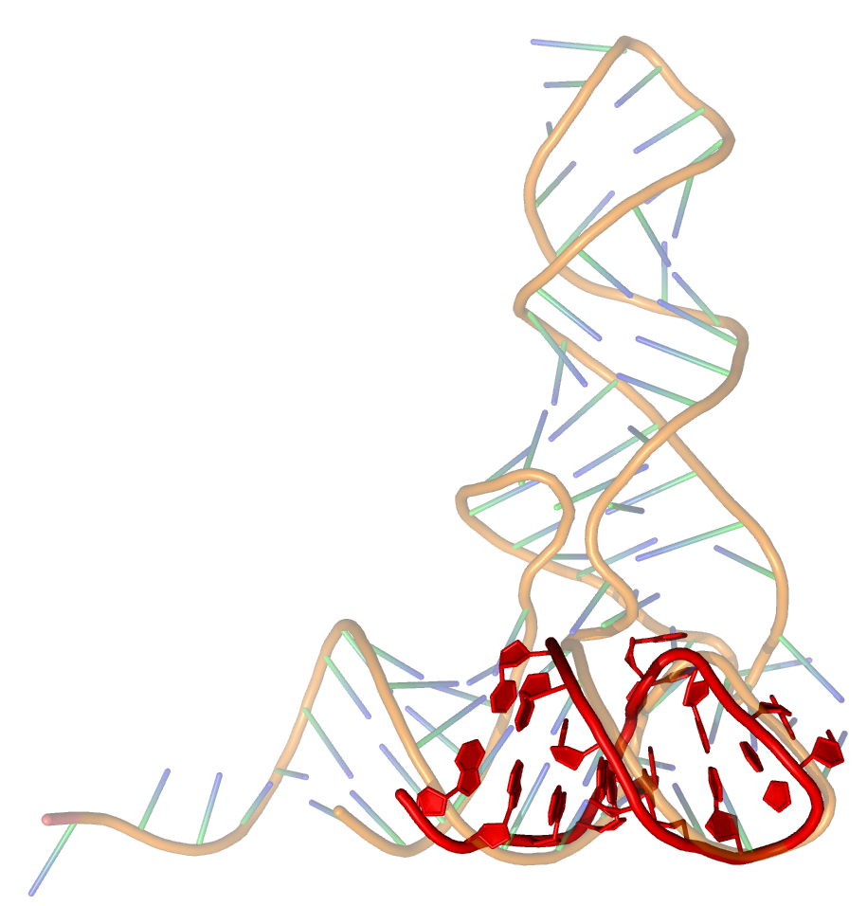
Comparing structures visually
Romantic search
Lehmann/Jossinet (Submitted)
Fragment of T thermophylus tRNA-Phe vs yeast’s
(PDB: 4TNA & 3BBV)
DARTS [Dror O et al, NAR 06] + Pymol

Slide 25
Towards novel representations

Slide 26
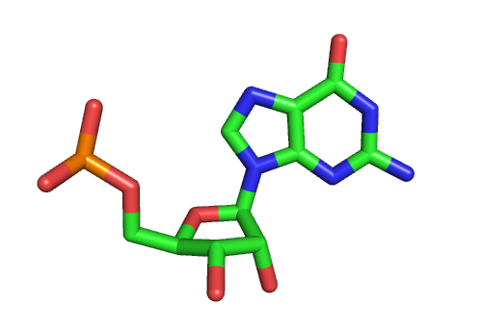
Non canonical/tertiary interactions
RNA nucleotides bind through edge/edge interactions.
Non canonical are weaker, but cluster into modules that are structurally constrained, evolutionarily conserved, and functionally essential.

Slide 27
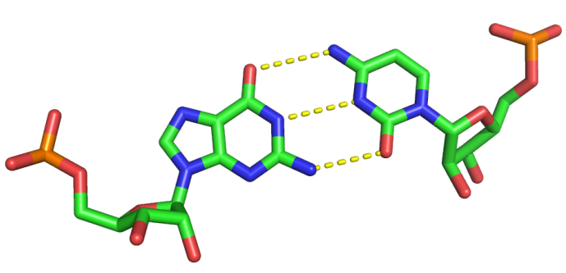
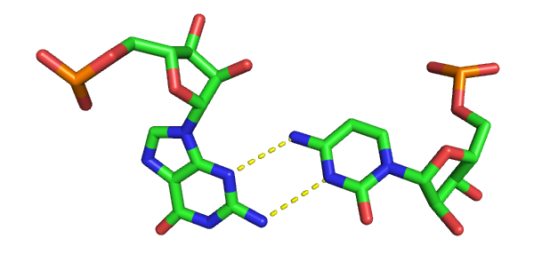
Non canonical/tertiary interactions
W-C
H
H
W-C
W-C
H
SUGAR
W-C
H
SUGAR
SUGAR
SUGAR
Canonical G/C pair
(WC/WC cis)
Non Canonical G/C pair
(Sugar/WC trans)
RNA nucleotides bind through edge/edge interactions.
Non canonical are weaker, but cluster into modules that are structurally constrained, evolutionarily conserved, and functionally essential.

Slide 28
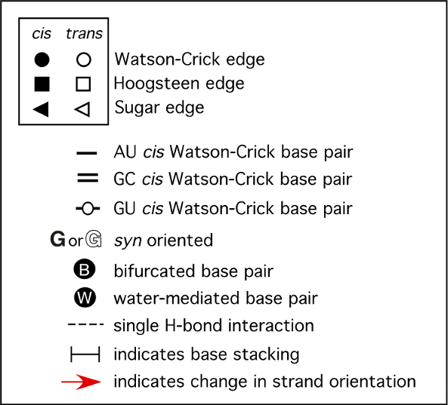
Leontis/Westhof nomenclature:
A visual grammar for tertiary motifs
[Leontis/Westhof, NAR 2002]

Slide 29
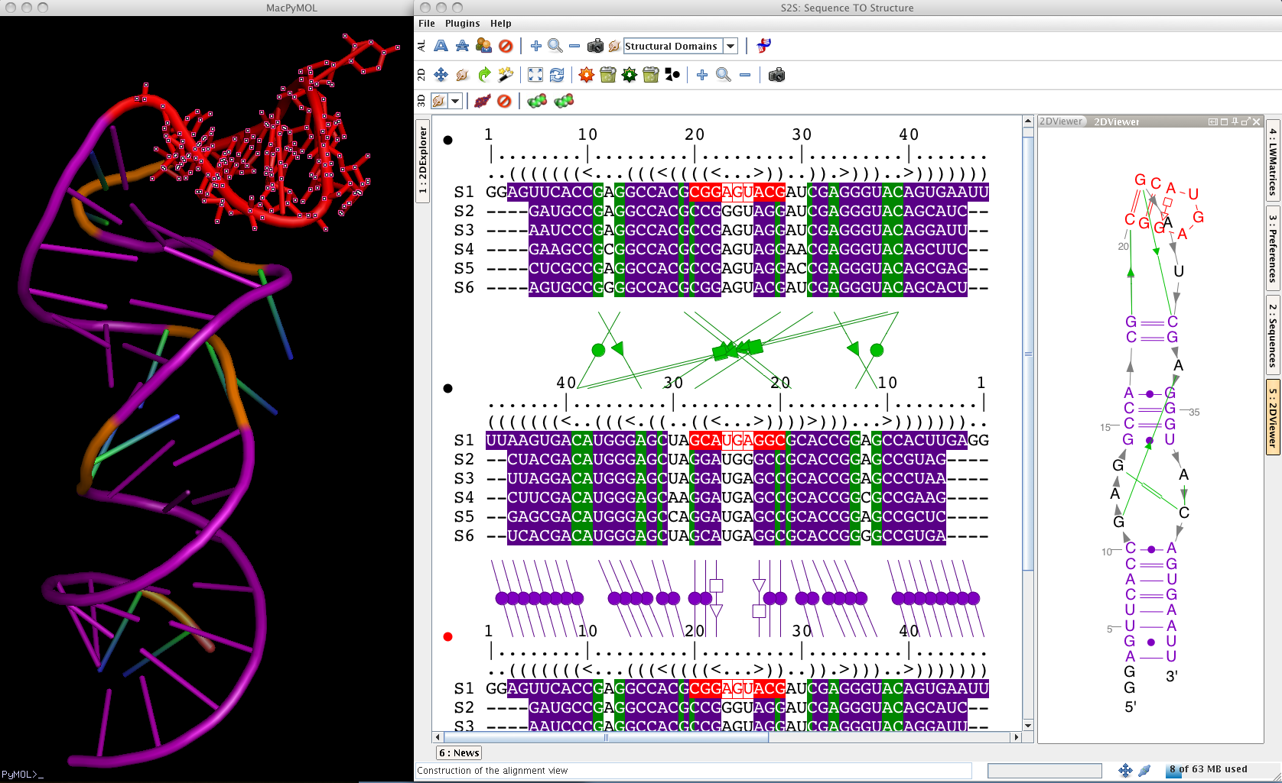
Leontis/Westhof nomenclature:
A visual grammar for tertiary motifs
S2S software [Jossinet/Westhof, RNA 2005]

Slide 30
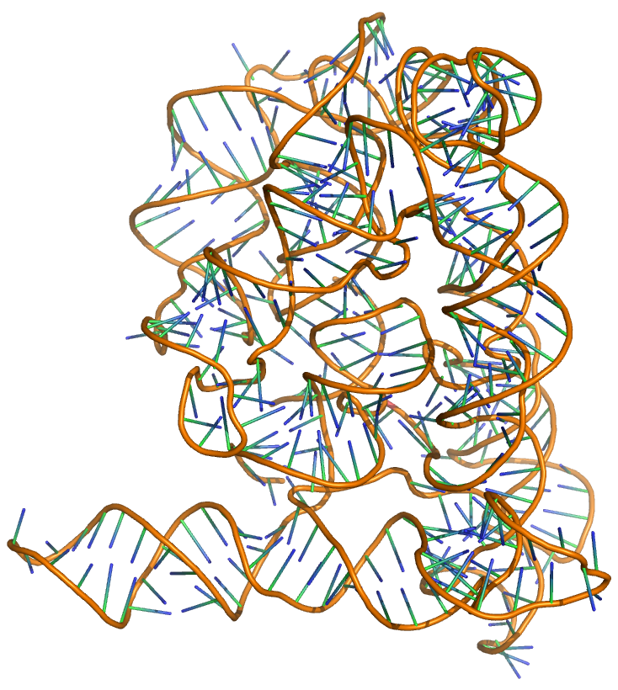
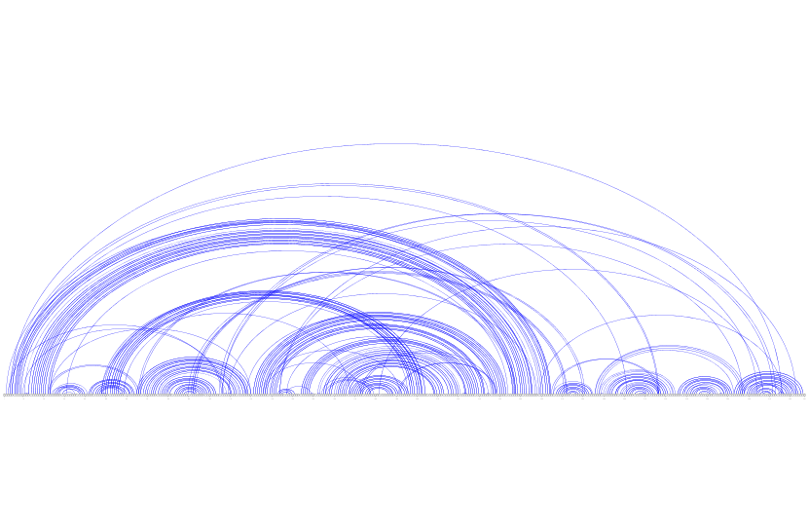
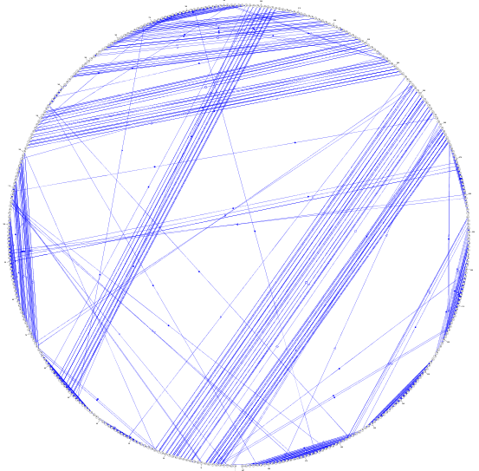
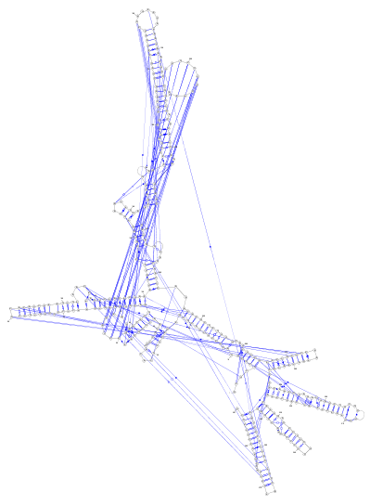
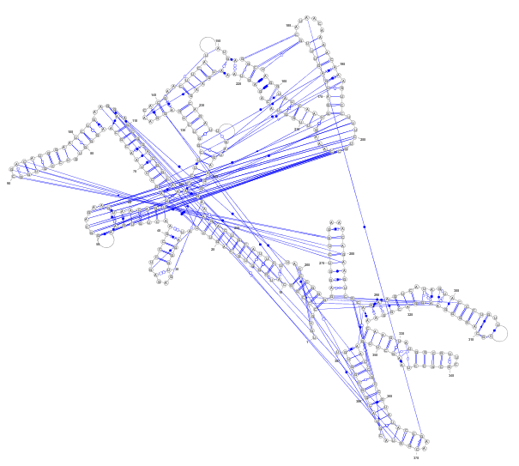
Layout algorithms are challenged by tertiary interactions
Group II Intron (PDB ID: 3GIS)
[Toor N et al, RNA 2010]
New layout algorithms are needed!
(Multiple views?)

Slide 31

Once upon a time…
I can draw graphs,
why not draw RNA 2^{ary} structures?

Slide 32

Once upon a time…
…

Slide 33
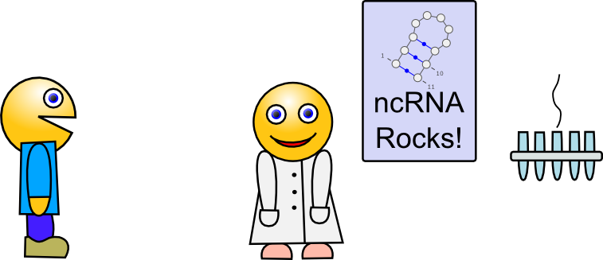
Once upon a time…
How would you like to see RNA?

Slide 34
Once upon a time…
… …

Slide 35
Once upon a time…
Common sense rules:
Layout should be non overlapping
Inner loops = Circular support
Helices = Straight lines
Consecutive bases = Equally distant
Satisfying these rules makes the problem NP-Hard, but we can still decently approximate it, assuming that …
… APX … greedy … dynamic programming … P=NP(?)…

Slide 36
Once upon a time…
… … …

Slide 37

Once upon a time…
Common sense rules:
Layout should be non overlapping
Inner loops = Circular support
Helices = Straight lines
Consecutive bases = Equally distant
+ Ninja algorithmic skills
+ Hard work
= Pretty decent algorithm

Slide 38
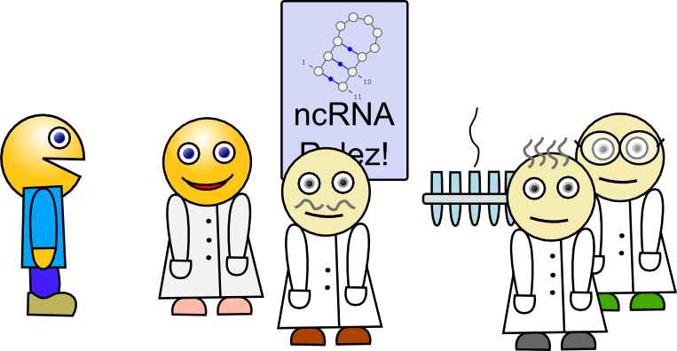
Once upon a time…
You guys are going to love my new algorithm!

Slide 39
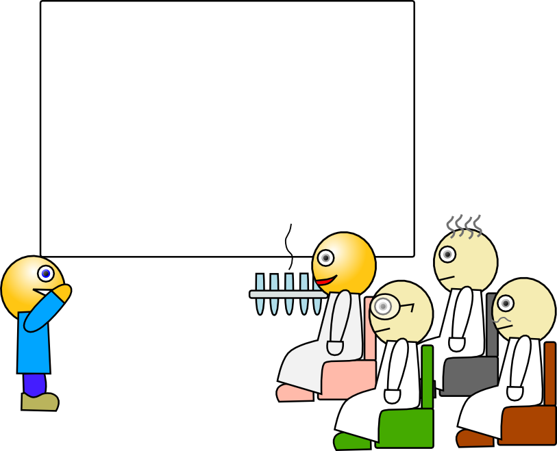
Once upon a time…
My model cognitively makes
so much more sense
than previous representations

Slide 40
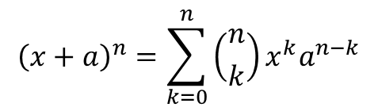
Once upon a time…
Theorem 35. The easy part
$${\left(x+a\right)}^{n}=\sum_{k=0}^{n}{\left({n \atop k}\right)x^{k}a^{n−k}}$$
And the rest follows trivially

Slide 41
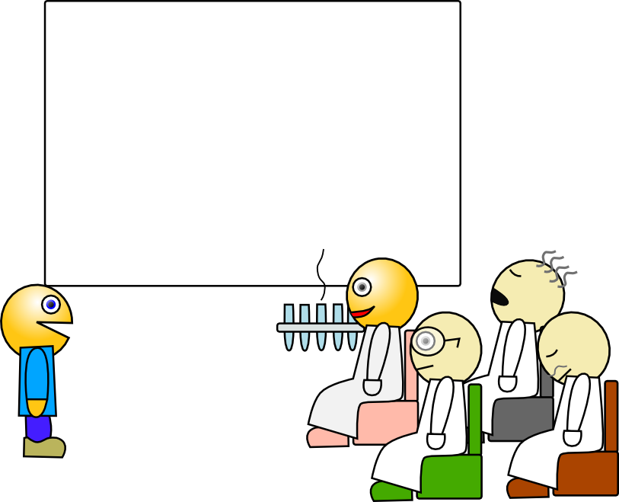
Once upon a time…
Thanks for listening.
Questions?
Zzzz…
Zzzz…

Slide 42
Once upon a time…
How would you draw our favorite tRNA?
The one we’ve studied during our PhDs and our first three postdocs, named all of our first child after…
Thanks for listening.
Questions?
Zzzz…
Zzzz…

Slide 43
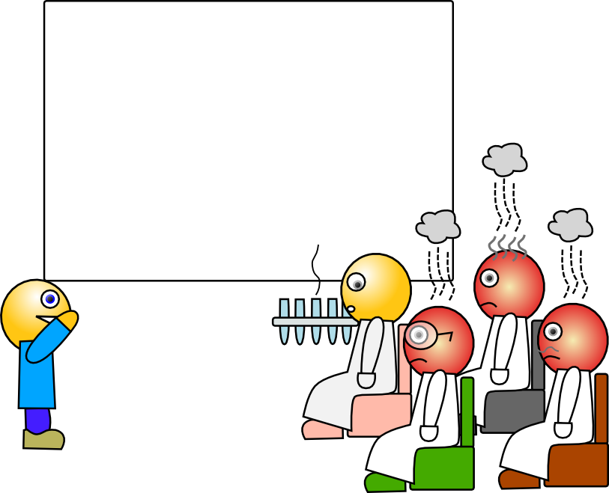
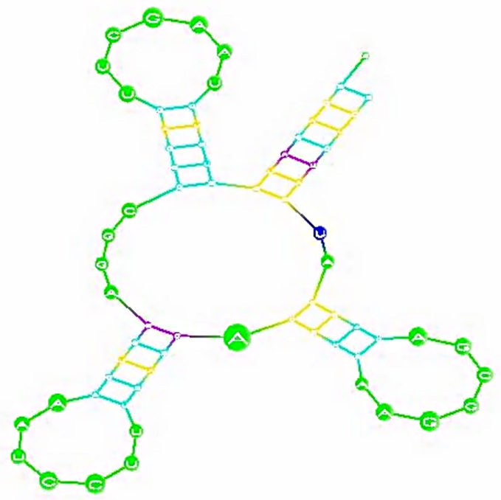
Once upon a time…
Tadah!

Slide 44
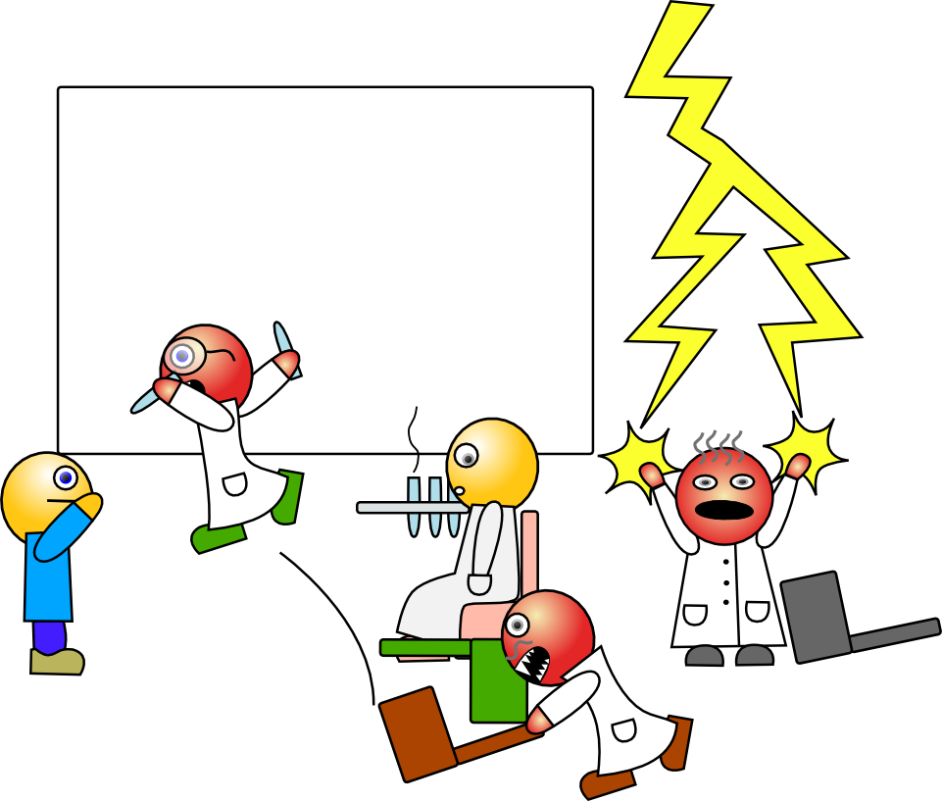
Once upon a time…
Uh…
Tadah?

Slide 45
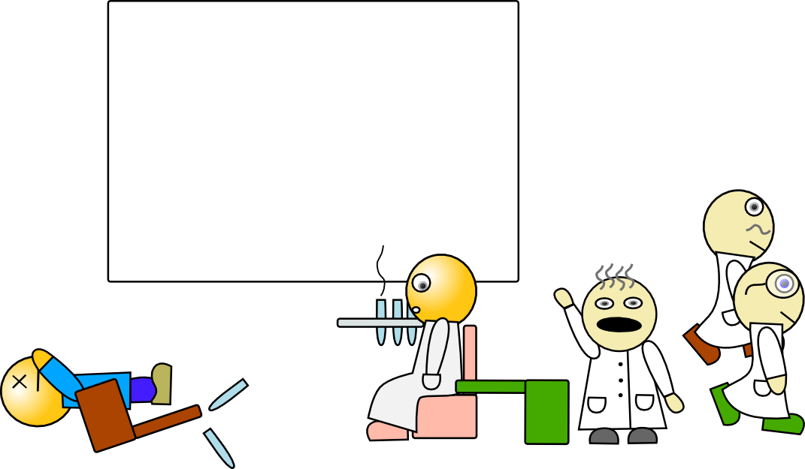
Once upon a time…
And don’t come back!
Ok guys, whose turn to make the coffee?

Slide 46
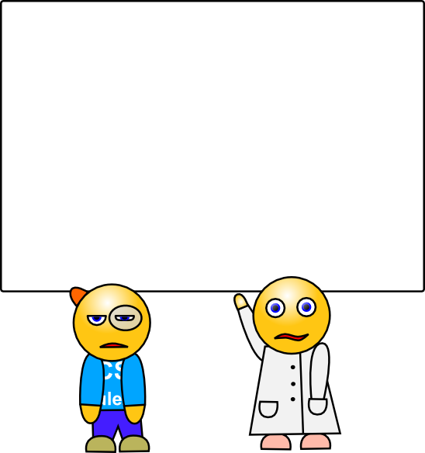
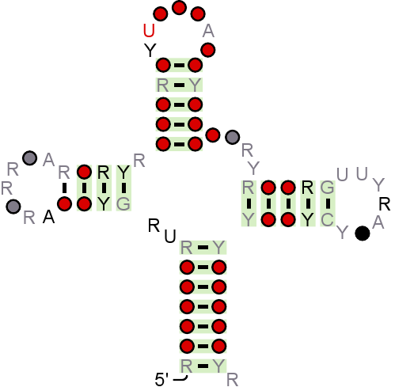

Once upon a time…

Slide 47

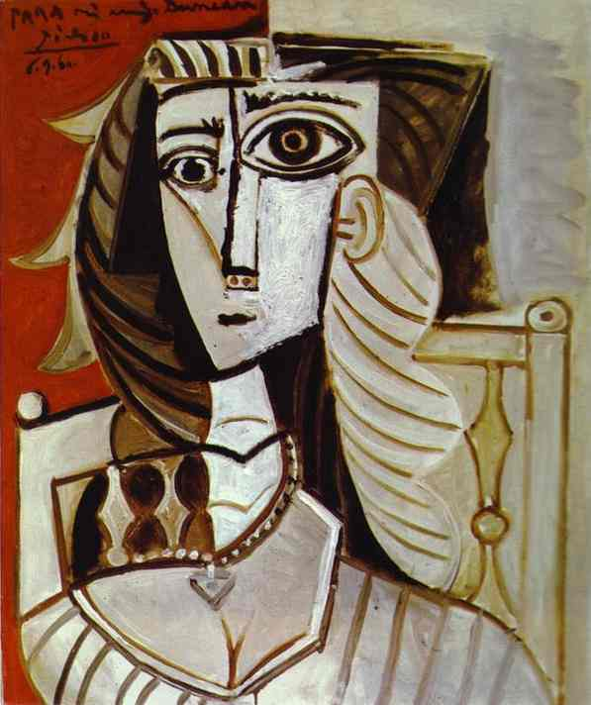
Once upon a time…

Slide 48
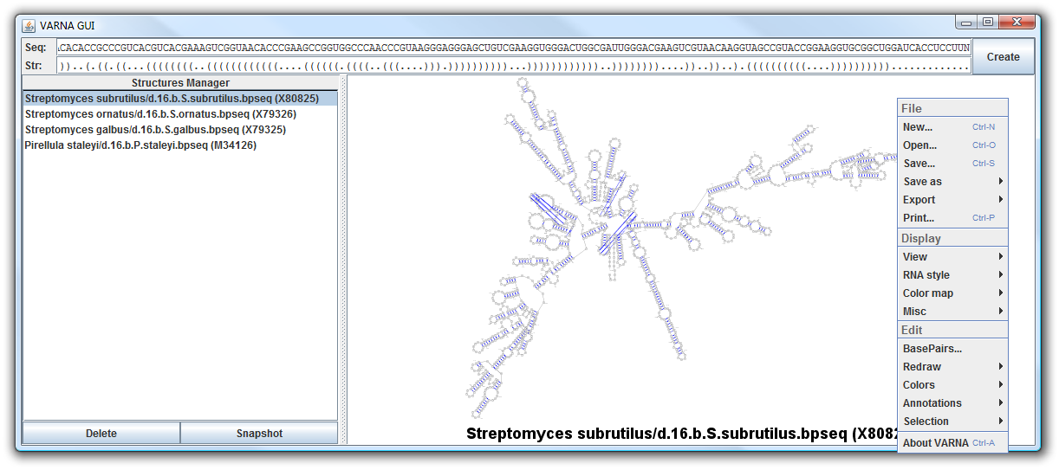
What I learned
Don’t mess with the RNA biologists:
Offer as many algorithms as humanly possible
Interactive editing gestures for “historical” layouts
Templating mechanisms
But indulge your inner geek:
Cross-platform
Open source
Generic component within third-party tool
Java applet for data bases…
VARNA software [Darty K et al, Bioinformatics 2009]
http://varna.lri.fr

Slide 49
Conclusion

Slide 50
Conclusion
Increasing need for visualization:
More and bigger structural models
Emerging need for interactive methods:
  Identification of functional modules
  Model fitting
Efficient RNA-specific visualization methods/tools lack for:
RNA/RNA Interactions
Automated layout of tertiary motifs (modules)
Qualitative visualization of structure ensembles
Kinetics, folding pathways
Structure/sequence evolution

Slide 51
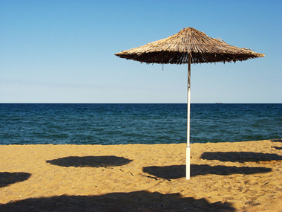
Acknowledgements
VARNA crew
Raphael Champeimont (U Paris 6)
Kevin Darty (U Paris Sud)
Alain Denise (U Paris Sud)
VIZBI conference
Jim Procter (+JalView)
Sean O’Donoghue
VIZBI RNA chapter crew
Kornelia Aigner (Uni Düsseldorf)
Fabian Dressen (Uni Düsseldorf)
Valérie Fritsch (Uni Strasbourg)
Tanja Gesell (Uni Vienna)
Fabrice Jossinet (Uni Strasbourg)
Gerhard Steger (Uni Düsseldorf)
Eric Westhof (Uni Strasbourg)
Every VARNA user out there…

Slide 52
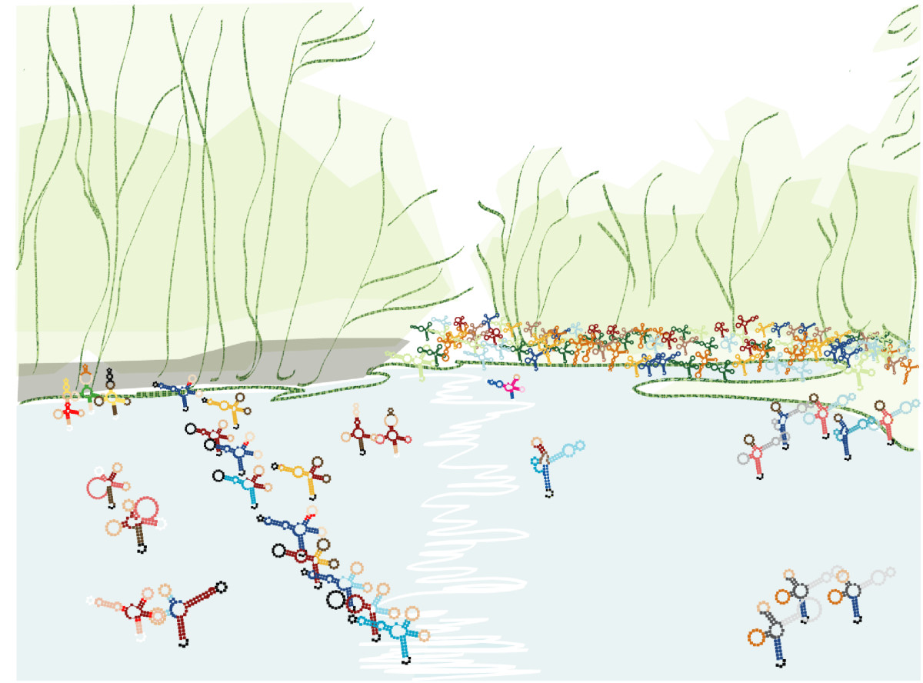
Questions?
tRNA cloverleaf shape members (skating on a winter pond)
RNArt by S. Konermann inVoss et al, BCM Biology 2006

