Slide 1
Curvature as a collective coordinate in enhanced sampling membrane simulations
Benjamin Bouvier
LG2A
UMR7378 CNRS/U. de Picardie Jules Verne
Amiens

Slide 2
MEMBRANES
Ubiquitous delimiters of cells and cell components
Combine plasticity and resilience
Membrane remodeling plays many functional roles

Slide 3
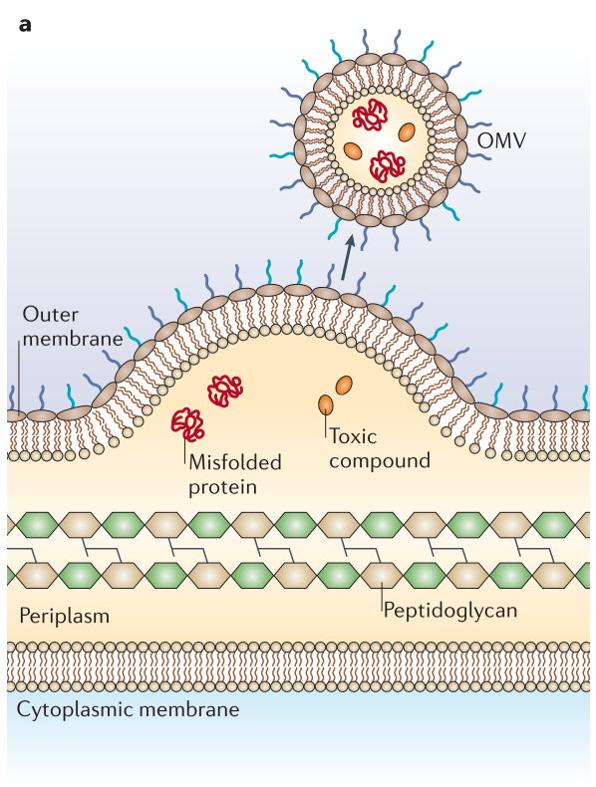
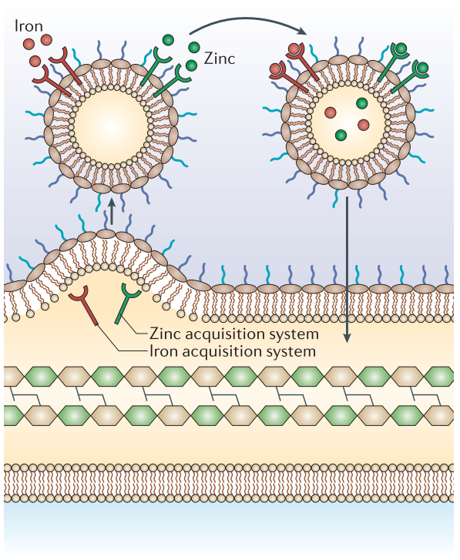
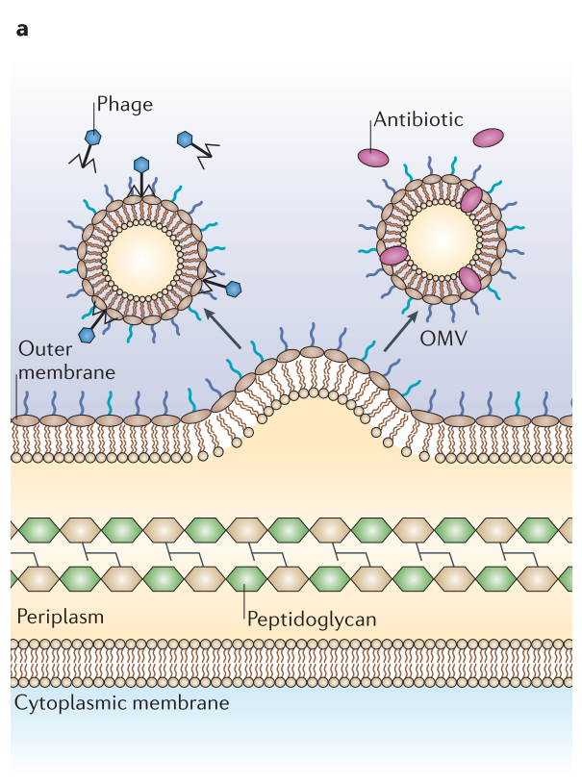
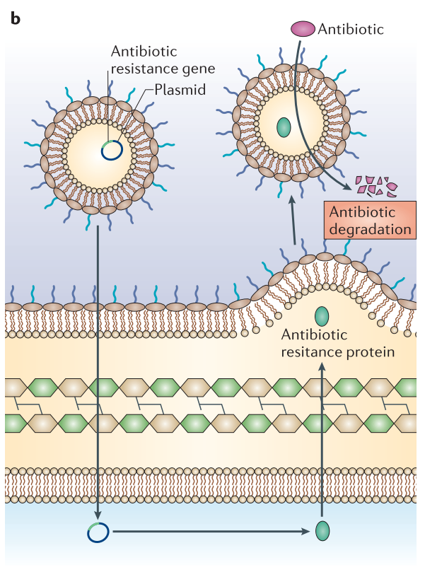
Example: Formation of OUTER MEMBRANE VESICLES (OMV) in gram-negative bacteria
Waste disposal
“Mobile bases” for the harvesting of metals
Decoys against antibiotics
Propagation of acquired resistance
Schwechheimer, Kuehn, Nat. Rev. Microbiol. 13, 605 (2015)

Slide 4
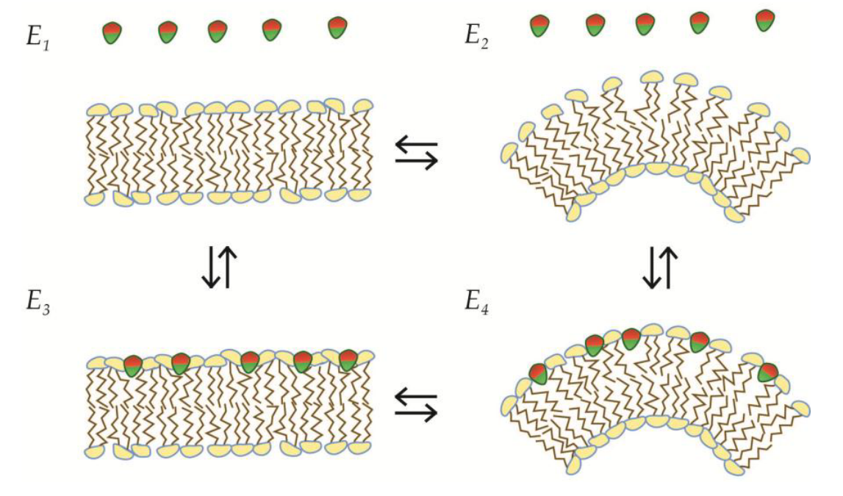
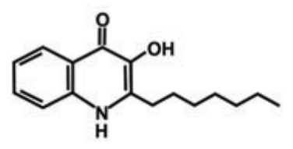
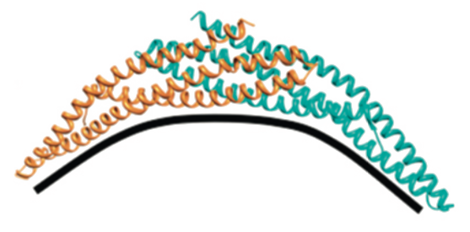
Actors of membrane bending
Amphiphilic molecules
Pseudomonas quinolone signal (PQS)
(multiple roles in intercellular signaling)
Applied force
Mashburn-Warren et al, Mol. Microbiol. 69, 491 (2008)
Scaffolding by the BAR proteins (Bin/Amphiphysin/Rvs)
Mim, Unger, Trends Biochem. Sci. 37, 526 (2012)
Mechanism ? Free energy cost ? Role in macromolecular recognition ?

Slide 5
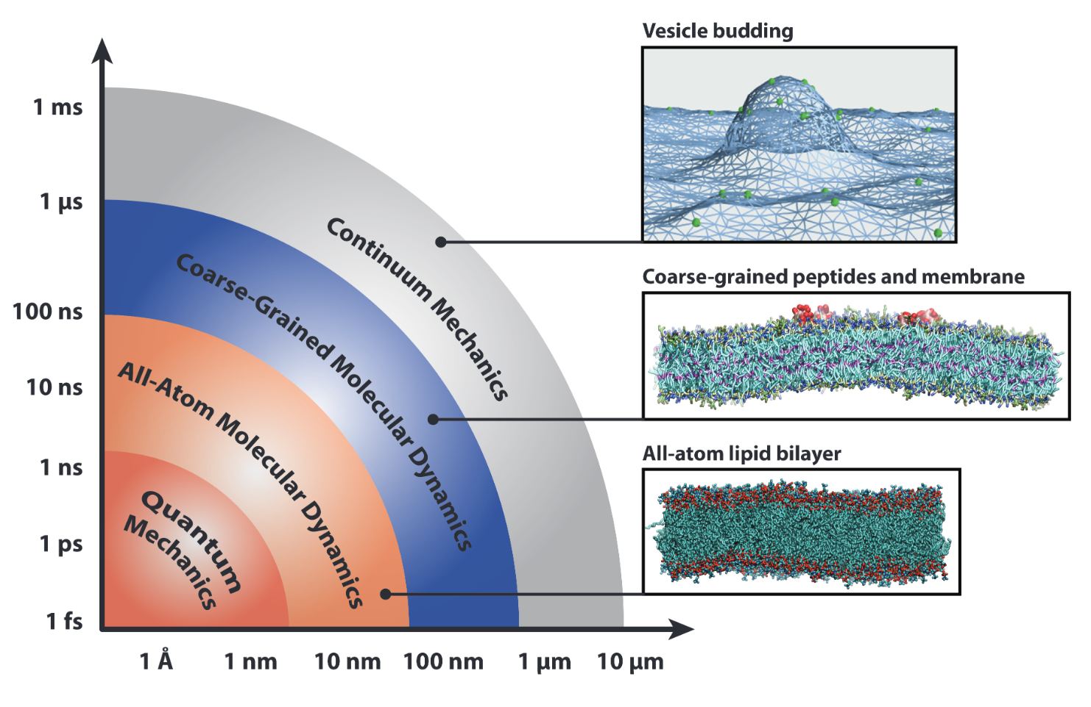
Scales of space and time
Major bending events are too costly to be spontaneously observed at the (pseudo)atomic level during a molecular dynamics simulation
Define a conformational coordinate related to curvature and act on it using a restraint force (“enhanced sampling” molecular dynamics simulation).

Slide 6
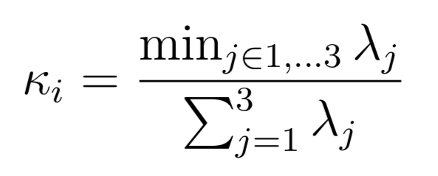
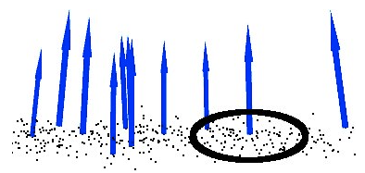
Estimating CURVATURE at atoms
Most existing methods manipulate curvature indirectly (for instance via local atomic densities)…
Masone et al, J. Chem. Theory Comput. 14, 2240 (2018).
Possible bias in the bending mechanisms, difficult interpretation of results…
= out-of-plane component of the local arrangement of atoms
where λ_{j} are the eigenvalues of the covariance matrix of atomic positions within a neighborhood of atom i
Find a suitable neighborhood
Efficiently compute eigenvalues and their gradients
Define a scalar conformational coordinate from the scalar field of atomic curvatures

Slide 7
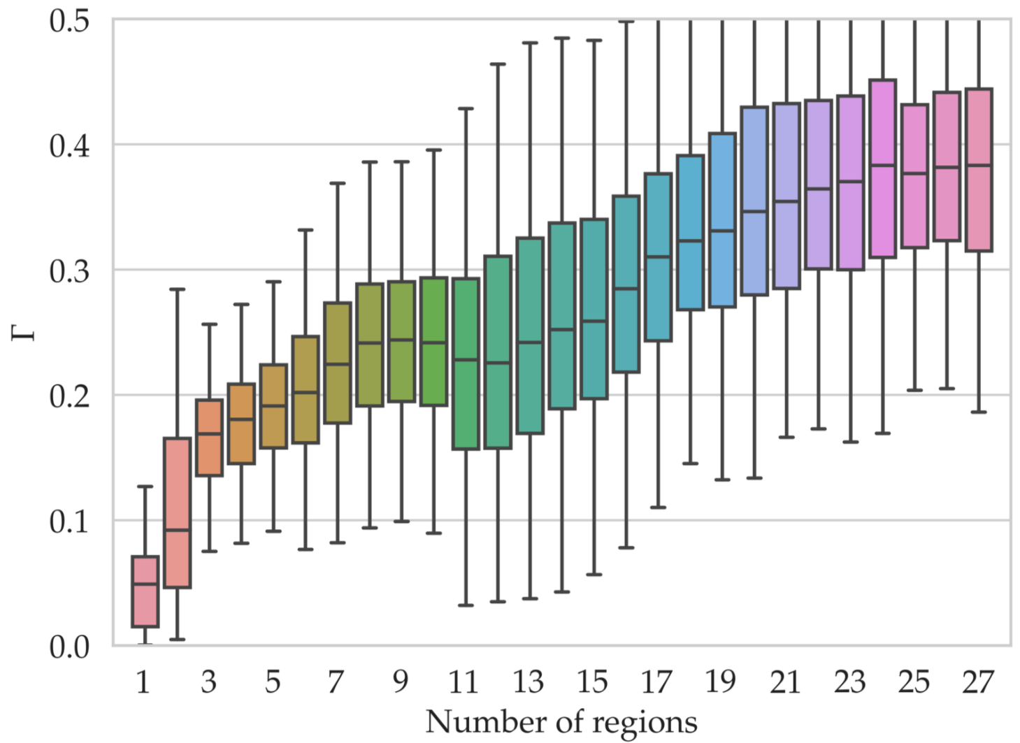
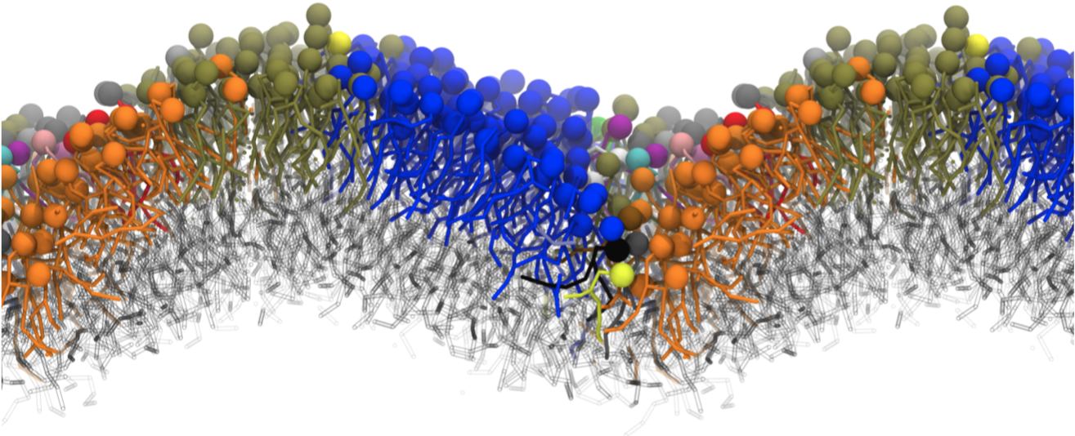
Finding a suitable neighborhood
A fixed number of neighbors or radius is OK for flat surfaces but not for regions with sharp features
What we want:
What we get:
Split membrane into “flat” regions
Start with fixed number of neighbors
Use plane residuals (deviation from planearity) to identify “seed” atoms
Grow regions from these seeds based on normal collinearity
Rabbani et al, Int. Arch. Phot. Rem. Sens. 36, 248 (2006).

Slide 8
Efficiently computing eigenvalues
Use constraint forces to accelerate conformational transitions to tractable timescales
Free energy landscape
Biasing potential
+
Conformational coordinate
<x>
x
The conformational coordinate and its gradient has to be evaluated at each simulation timestep (tens to hundreds of millions in a typical simulation).
Use Cardano’s (rather complex) closed-form expression of the eigenvalues of a 3x3 Hermitian matrix
Compute the gradient using automatic differentiation (recursive application of the chain rule)
Compute eigenvectors only when needed (update of regions).
Kopp, Int. J. Mod. Phys. C 19, 523 (2008).

Slide 9
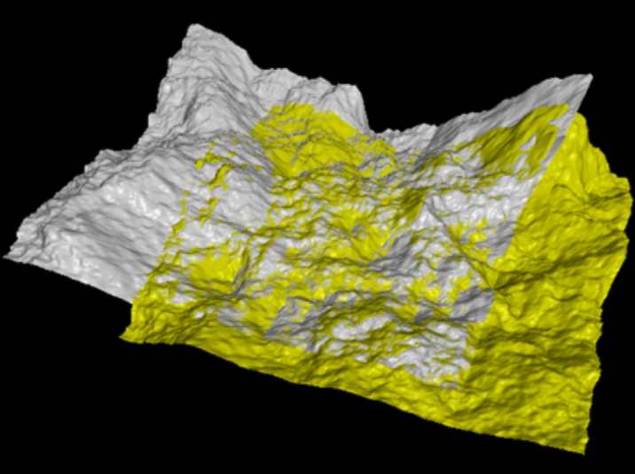
Defining a Conformational coordinate
Compare the curvature at “equivalent” atoms between a given conformation and a reference (~RMSD)
Mapping between atoms in each conformation
Problem: Lipids can migrate w.r.t one another over time…
At time t:
Use the iterative closest point (ICP) method to superimpose the current conformation with the one at time t-Δt
Map closest-lying atoms in superimposed conformations (bijectively).
Propagate the mapping back to the reference conformation:

Slide 10
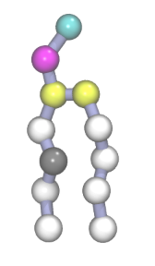
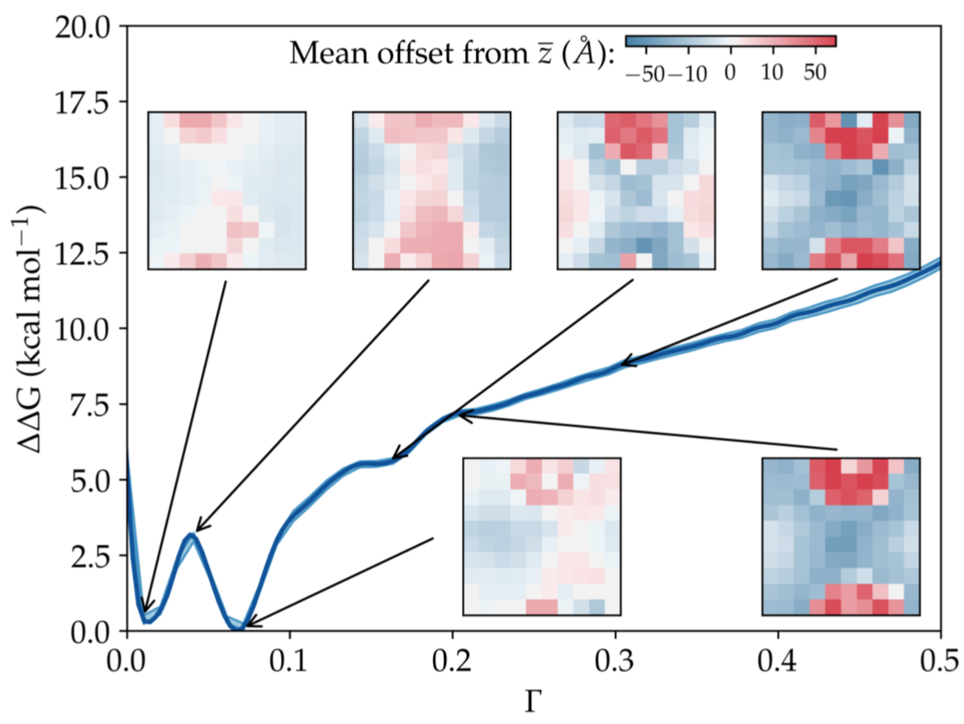
Toy system: POPE Membrane
(MARTINI coarse-grained representation)
Metadynamics simulation using curvature constraint
Detailed bending mechanism and free energy profile :
More complex and cheaper in free energy than expected…

Slide 11
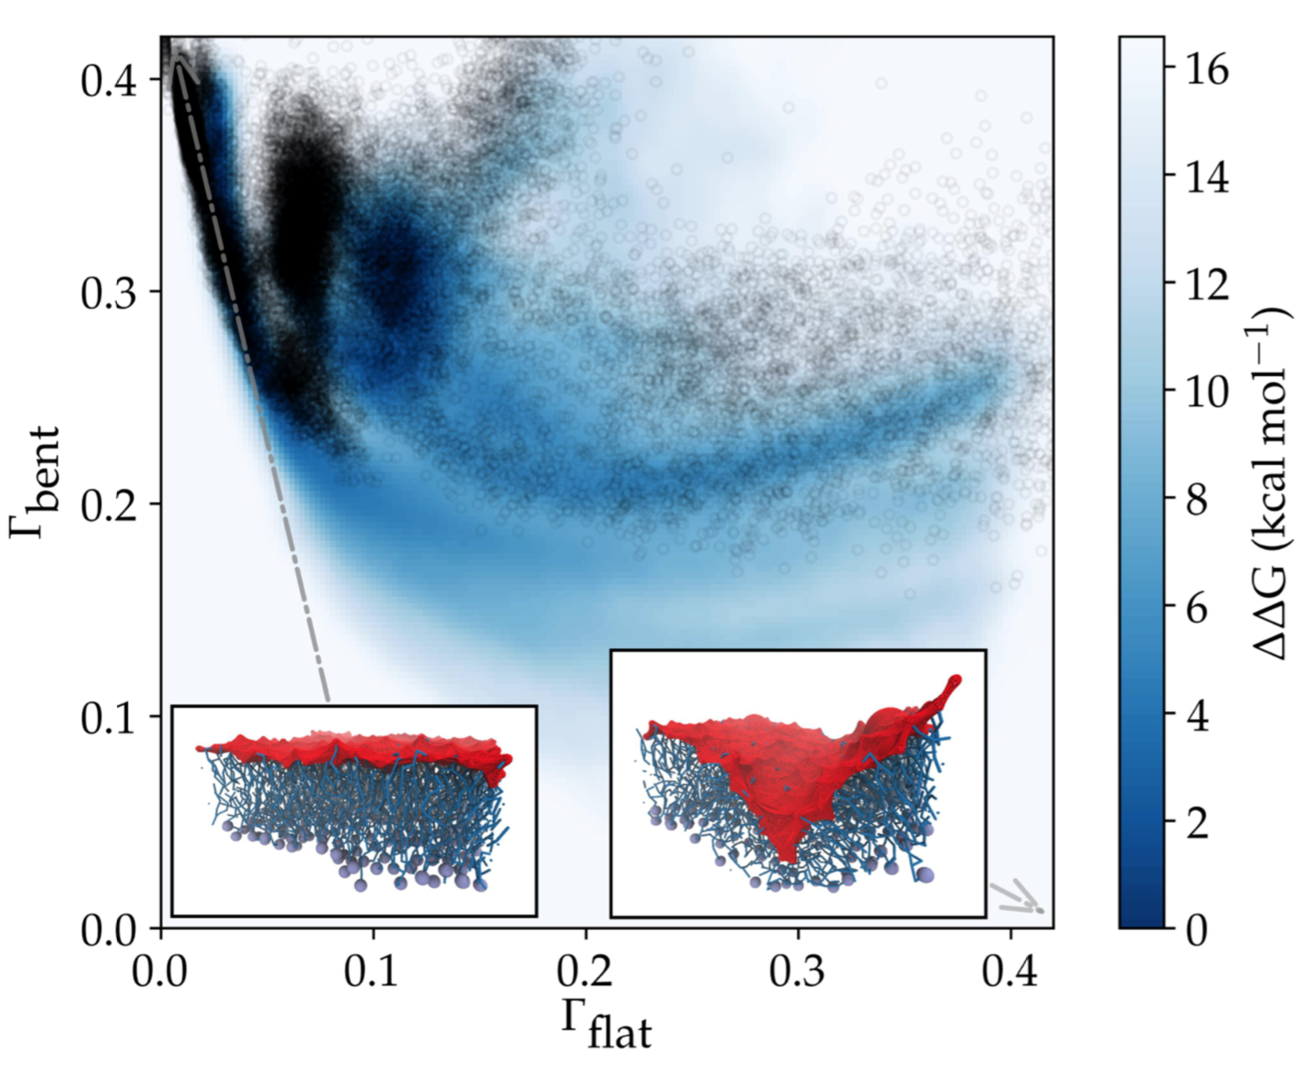
USING MULTIPLE REFERENCE CONFORMATIONS
As for RMSD, the volume of conformational space mapped to a given value of Γ “explodes” at large Γ values.
Sampling issue, affecting the calculation of free energies.
Using two reference conformations can help lift the degeneracy…

Slide 12
Application to system preparation
Quick and easy formation of bicelles or liposomes from flat patches :
Only the final conformation matters: the exhaustive sampling of pathways is not required here

Slide 13
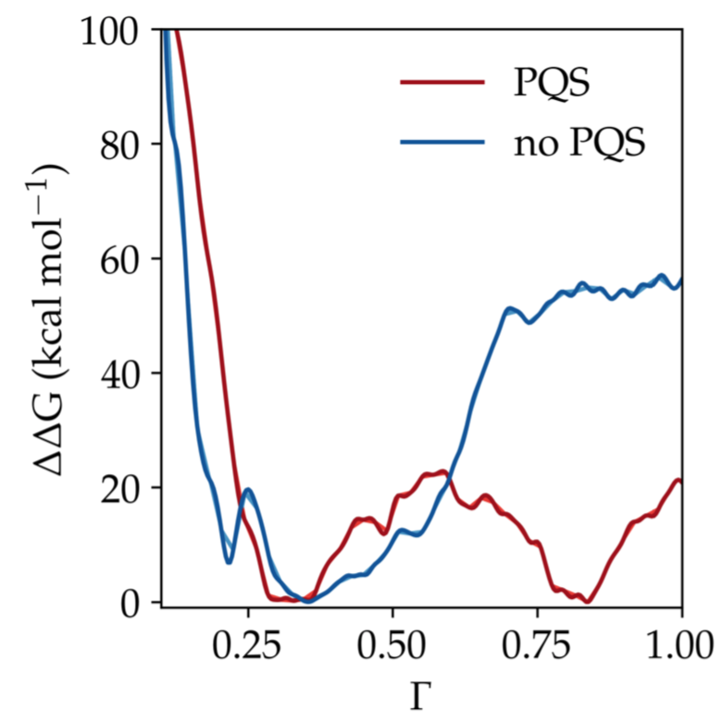
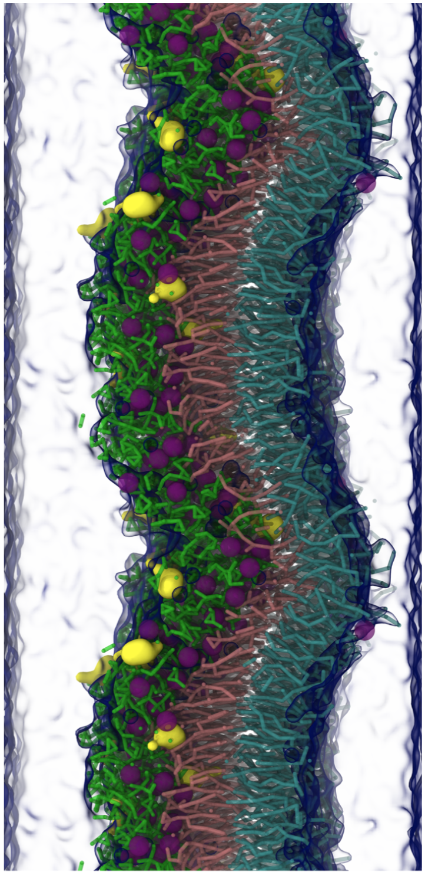
PQS-induced budding of the bacterial outer membrane
Pseudomonas quinolone signal (PQS)
Free energy profile of the onset of the budding mechanism of the Pseudomonas aeruginosa outer membrane with and without PQS.
PQS molecules congregate in flat areas and act as “pincers” to bend the membrane.

Slide 14
IMPLEMENTATION and possible extensions
Implemented in the PLUMED C++ library: available from within all popular MD codes.
Fast KNN used for efficient neighbor searching.
Paper accepted in J. Chem. Theory Comput.
Conformational degeneracy at large values of the conformational coordinate Γ
More intelligent way of deriving a scalar coordinate from a scalar field?
Registration of conformations : optimal bijective solution is 𝒪(N⁴) → approximation used
Smarter registration method, e.g. using Morse theory?

Slide 15
THANKS
Collaborators:
C. Cézard
Z. Bouchouireb
Funding and CPU time:

