Slide 1
Beyond ab initio modelling…
Comparative and Boltzmann equilibrium
Yann Ponty, CNRS/Ecole Polytechnique
with invaluable help from Alain Denise, LRI/IGM, Université Paris-Sud

Slide 2
Prediction by homology
Data : several homologous RNA sequences.
Output : a consensus structure for this set of sequences.

Slide 3
Prediction by Homology
From sequence alignment

Slide 4
Detecting covariations
We start from a sequence alignment:
GAGGACTGAGCTCAGTTAAAGTGCCTG
AAGGGCCCCGCTGGGCAAAG--GCTG-
AAGGGGTCGGCTGACCTAAAGTAGTTG
GAGGGGTGAG-GCAUCTAAAGTGTTTG
GAGGACTGTGCTCAGTTAAAGTGTTTG
Look for sequence covariations

Slide 5
Detecting covariations
We start from a sequence alignment:
GAGGACTGAGCTCAGTTAAAGTGCCTG
AAGGGCCCCGCTGGGCAAAG--GCTG
AAGGGGTCGGCTGACCTAAAGTAGTTG
GAGGGGTGAG-GCAUCTAAAGTGTTTG
GAGGACTGTGCTCAGTTAAAGTGTTTG
( )
We search for sequence covariations,
They come from compensatory mutations during the evolution

Slide 6
Detecting covariations
We start from a sequence alignment:
GAGGACTGAGCTCAGTTAAAGTGCCTG
AAGGGCCCCGCTGGGCAAAG--GCTG
AAGGGGTCGGCTGACCTAAAGTAGTTG
GAGGGGTGAG-GCAUCTAAAGTGTTTG
GAGGACTGTGCTCAGTTAAAGTGTTTG
....((((....))))...........
We search for sequence covariations
They come from compensatory mutations during the evolution

Slide 7
Detecting covariations
We start from a sequence alignment:
GAGGACTGAGCTCAGTTAAAGTGCCTG
AAGGGCCCCGCTGGGCAAAG--GCTG
AAGGGGTCGGCTGACCTAAAGTAGTTG
GAGGGGTGAG-GCAUCTAAAGTGTTTG
GAGGACTGTGCTCAGTTAAAGTGTTTG
....((((....))))...........
Measure : mutual information between positions i and j :
-∑ Pr(i=a) Pr(j=b) log(Pr(i=a|j=b))
a,b
where a and b are the different nucleotides.

Slide 8
Two softwares based on this approach
RNA-alifold (Hofacker et al. 2000)
http://rna.tbi.univie.ac.at/cgi-bin/RNAalifold.cgi
RNAz (Washietl et al. 2005)
http://rna.tbi.univie.ac.at/cgi-bin/RNAz.cgi

Slide 9
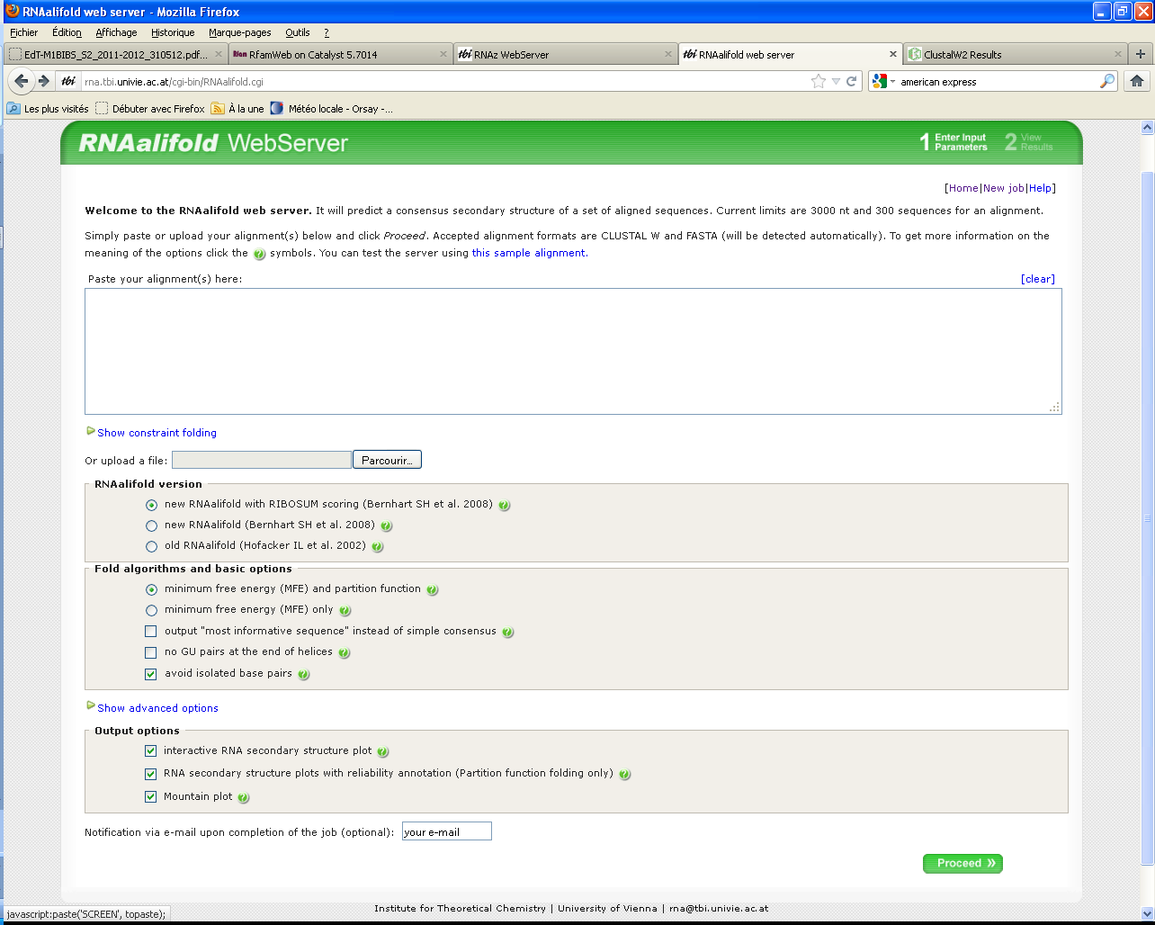
RNAalifold

Slide 10
Application : tRNA Alanine
>Artibeus_jamaicensis
AAGGGCTTAGCTTAATTAAAGTAGTTGATTTGCATTCAGCAGCTGTAGGATAAAGTCTTGCAGTCCTTA
>Balaenoptera_musculus
GAGGATTTAGCTTAATTAAAGTGTTTGATTTGCATTCAATTGATGTAAGATATAGTCTTGCAGTCCTTA
>Bos_taurus
GAGGATTTAGCTTAATTAAAGTGGTTGATTTGCATTCAATTGATGTAAGGTGTAGTCTTGCAATCCTTA
>Canis_familiaris
GAGGGCTTAGCTTAATTAAAGTGTTTGATTTGCATTCAATTGATGTAAGATAGATTCTTGCAGCCCTTA
>Ceratotherium_simum
GAGGGTTTAGCTTAATTAAAGTGTTTGATTTGCATTCAGTTGATGTAAGATAGAGTCTTGCAGCCCTTA
>Dasypus_novemcinctus
GAGGACTTAGCTTAATTAAAGTGCCTGATTTGCGTTCAGGAGATGTGGGGCTAAATCTTGCAGTCCTTA
>Equus_asinus
AAGGGCTTAGCTTAATGAAAGTGTTTGATTTGCGTTCAATTGATGTGAGATAGAGTCTTGCAGTCCTTA
>Erinaceus_europeus
GAGGATTTAGCTTAAAAAAAGTGGTTGATTTGCATTCAATTGATATAGGAAATATAATCTTGTAATCCTTA
>Felis_catus
GAGGACTTAGCTTAATTAAAGTGTTTGATTTGCAATCAATTGATGTAAGATAGATTCTTGCAGTCCTTA
>Hippopotamus_amphibius
AGGGACTTAGCTTAATAAAAGCAGTTGAGTTGCATTCAATTGATGTGAGGTGCGGTCTTGCAGTCTCTA
>Homo_sapiens
AAGGGCTTAGCTTAATTAAAGTGGCTGATTTGCGTTCAGTTGATGCAGAGTGGGGTTTTGCAGTCCTTA

Slide 11
Exercise
Compute an alignment of the previous sequences, by using MAFFT:
http://www.ebi.ac.uk/Tools/msa/mafft/
(do not forget to set the Nucleic Acid option)
Copy/paste the result in RNAalifold :
http://rna.tbi.univie.ac.at/cgi-bin/RNAalifold.cgi
Look at the result.

Slide 12
MAFFT alignment
>Artibeus_jamaicensis
AAGGGCTTAGCTTAATTAAAGTAGTTGATTTGCATTCAGCAGCTGTAGG--ATAAAGTCTTGCAGTCCTTA
>Balaenoptera_musculus
GAGGATTTAGCTTAATTAAAGTGTTTGATTTGCATTCAATTGATGTAAG--ATATAGTCTTGCAGTCCTTA
>Bos_taurus
GAGGATTTAGCTTAATTAAAGTGGTTGATTTGCATTCAATTGATGTAAG--GTGTAGTCTTGCAATCCTTA
>Canis_familiaris
GAGGGCTTAGCTTAATTAAAGTGTTTGATTTGCATTCAATTGATGTAAG--ATAGATTCTTGCAGCCCTTA
>Ceratotherium_simum
GAGGGTTTAGCTTAATTAAAGTGTTTGATTTGCATTCAGTTGATGTAAG--ATAGAGTCTTGCAGCCCTTA
>Felis_catus
GAGGACTTAGCTTAATTAAAGTGTTTGATTTGCAATCAATTGATGTAAG--ATAGATTCTTGCAGTCCTTA
>Equus_asinus
AAGGGCTTAGCTTAATGAAAGTGTTTGATTTGCGTTCAATTGATGTGAG--ATAGAGTCTTGCAGTCCTTA
>Homo_sapiens
AAGGGCTTAGCTTAATTAAAGTGGCTGATTTGCGTTCAGTTGATGCAGA--GTGGGGTTTTGCAGTCCTTA
>Hippopotamus_amphibius
AGGGACTTAGCTTAATAAAAGCAGTTGAGTTGCATTCAATTGATGTGAG--GTGCGGTCTTGCAGTCTCTA
>Dasypus_novemcinctus
GAGGACTTAGCTTAATTAAAGTGCCTGATTTGCGTTCAGGAGATGTGGG--GCTAAATCTTGCAGTCCTTA
>Erinaceus_europeus
GAGGATTTAGCTTAAAAAAAGTGGTTGATTTGCATTCAATTGATATAGGAAATATAATCTTGTAATCCTTA

Slide 13
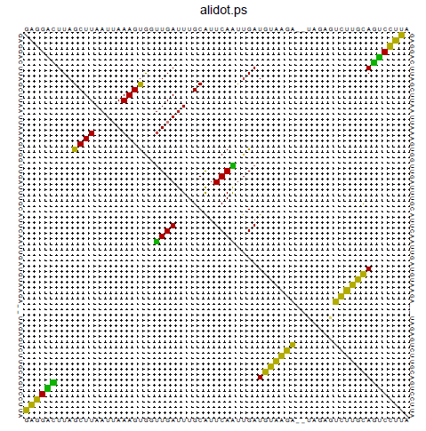
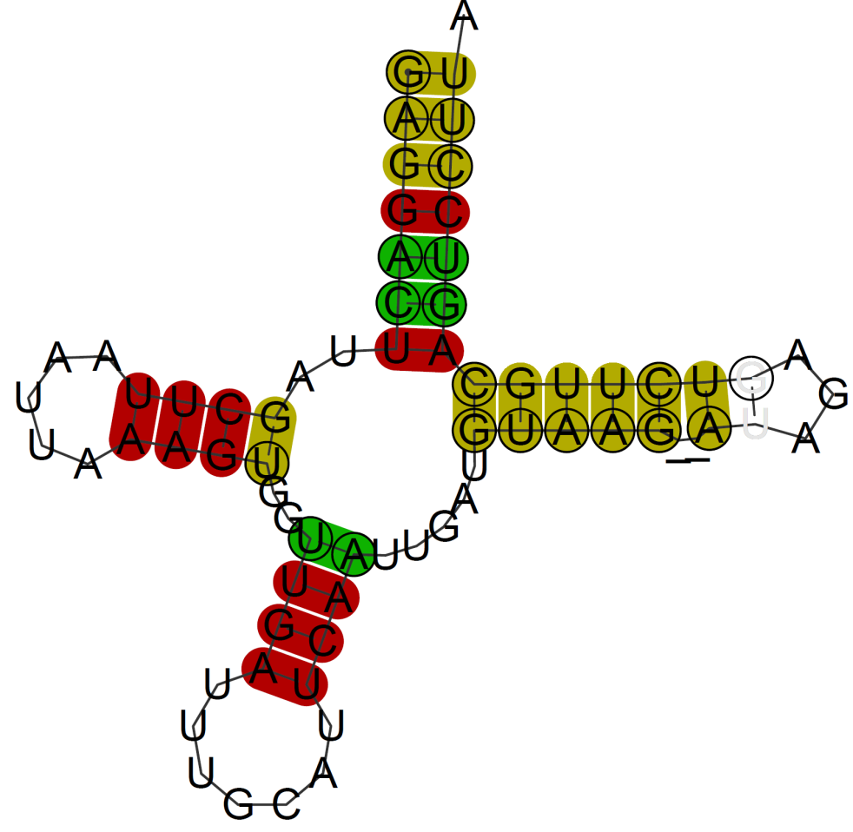
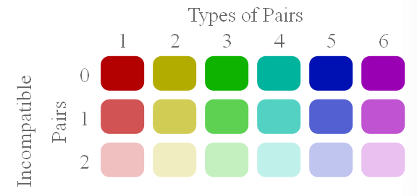
RNAalifold

Slide 14
Application : tRNA H.sapiens
>Homo_sapiensArg
TGGTATATAGTTTAAACAAAACGAATGATTTCGACTCATTAAATTATGATAATCATATTTACCAA
>Homo_sapiensAsn
TAGATTGAAGCCAGTTGATTAGGGTGCTTAGCTGTTAACTAAGTGTTTGTGGGTTTAAGTCCCATTGGTCTAG
>Homo_sapiensAsp
AAGGTATTAGAAAAACCATTTCATAACTTTGTCAAAGTTAAATTATAGGCTAAATCCTATATATCTTA
>Homo_sapiensCys
AGCTCCGAGGTGATTTTCATATTGAATTGCAAATTCGAAGAAGCAGCTTCAAACCTGCCGGGGCTT
>Homo_sapiensGln
TAGGATGGGGTGTGATAGGTGGCACGGAGAATTTTGGATTCTCAGGGATGGGTTCGATTCTCATAGTCCTAG
>Homo_sapiensGlu
GTTCTTGTAGTTGAAATACAACGATGGTTTTTCATATCATTGGTCGTGGTTGTAGTCCGTGCGAGAATA
>Homo_sapiensGly
ACTCTTTTAGTATAAATAGTACCGTTAACTTCCAATTAACTAGTTTTGACAACATTCAAAAAAGAGTA
>Homo_sapiensHis
GTAAATATAGTTTAACCAAAACATCAGATTGTGAATCTGACAACAGAGGCTTACGACCCCTTATTTACC
>Homo_sapiensIso
AGAAATATGTCTGATAAAAGAGTTACTTTGATAGAGTAAATAATAGGAGCTTAAACCCCCTTATTTCTA
>Homo_sapiensLeuCun
ACTTTTAAAGGATAACAGCTATCCATTGGTCTTAGGCCCCAAAAATTTTGGTGCAACTCCAAATAAAAGTA
Notes:
>Homo sapiens Arg, True Structure
TGGTATATAGTTTAAACAAAACGAATGATTTCGACTCATTAAATTATGATAATCATATTTACCAA
(((((.(..((((.....)))).(((((.......)))))....(((((...)))))).))))).

Slide 15
Exercise
The same as previously, but with these new sequences.
Compute an alignment of the previous sequences, by using ClustalW or ClustalO: http://www.ebi.ac.uk/Tools/msa/clustalw2/
(do not forget to put the « DNA » option)
Copy/paste the result in RNAalifold :
http://rna.tbi.univie.ac.at/cgi-bin/RNAalifold.cgi
Look at the result. What happened ? Why ?

Slide 16
MAFFT alignment
>Homo_sapiensArg
TGGTATATAGT---TTAAACAAAACGAATGATTTCGACTCATTAAAT---TATGATAA---TCATATTTACCAA
>Homo_sapiensGly
ACTCTTTTAGT---ATAAATAGTACCGTTAACTTCCAATTAACTAGT---TTTGACAACATTCAAAAAAGAGTA
>Homo_sapiensHis
GTAAATATAGT---TTAACCAAAACATCAGATTGTGAATCTGACAAC--AGAGGCTTACGACCCCTTATTTACC
>Homo_sapiensIso
AGAAATATGTC---TGATAAAAGAGTTACTTTGATAGAGTAAATAAT--AGGAGCTTAAACCCCCTTATTTCTA
>Homo_sapiensGlu
GTTCTTGTAGT---TGAAATACAACGATGGTTTTTCATATCATTGGT--CGTGGTTGTAGTCCGTGCGAGAATA
>Homo_sapiensLeuCun
ACTTTTAAAGG---ATAACAGCTATCCATTGGTCTTAGGCCCCAAAAATTTTGGTGCAACTCCAAATAAAAGTA
>Homo_sapiensAsn
TAGATTGAAGCCAGTTGATTAGGGTGCTTAGCTGTTAACTAAGTGTT-TGTGGGTTTAAGTCCCATTGGTCTAG
>Homo_sapiensGln
TAGGATGGGGTGTGATAGGTGGCACGGAGAATTTTGGATTCTCAGGG--ATGGGTTCGATTCTCATAGTCCTAG
>Homo_sapiensCys
AGCTCCGAGGT-----GATTTTCATATTGAATTGCAAATTCGAAGAA---GCAGCTTCAAACCTGCCGGGGCTT
>Homo_sapiensAsp
AAGGTATTAGA---AAAACCATTTCATAACTTTGTCAAAGTTAAATT---ATAGGCTAAATCCTATATATCTTA

Slide 17
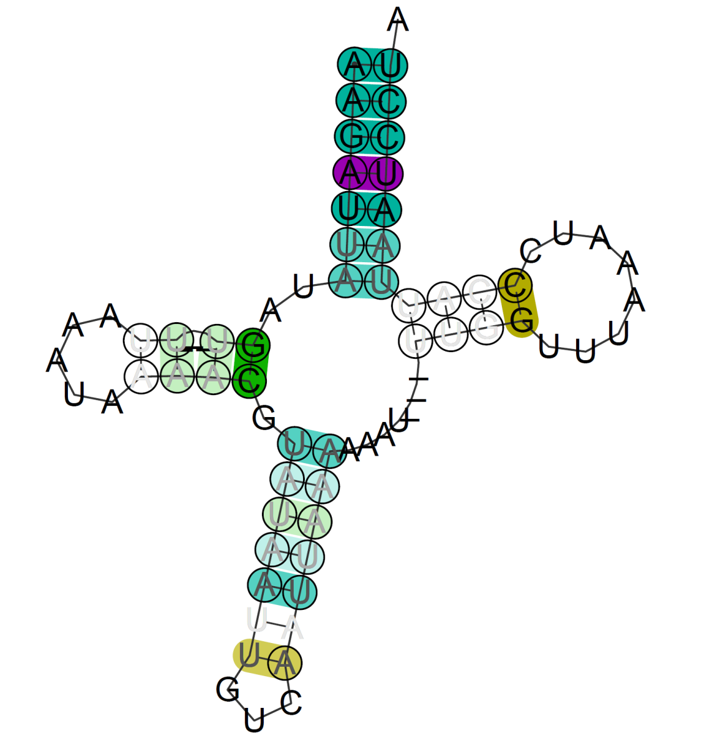
RNAalifold
RNAalifold finds a common but much less conserved structure.

Slide 18
Prediction by Homology
Simultaneous folding and alignment

Slide 19
Problem specification
Data : a set of sequences
Output : a sequence alignment, and a common secondary structure.

Slide 20
Approaches
The reference approach: Sankoff’s algorithm (1985)
  Algorithmic approach: dynamic programming
  Complexity : n^{3k} for k sequences of length n
There are several implementatons, herer are two of them (with constraints):
  Foldalign (Gorodkin, Heyer, Stormo 1997, Havgaard, Lyngso, Stormo, Gorodkin 2005).
  Dynalign (Mathews, Turner 2002)
Heuristics based on this algorithm :
  LocaRNA (http://rna.informatik.uni-freiburg.de:8080/LocARNA.jsp).

Slide 21
Exercise
Take the two previous sets of sequences (one after the other) and run LocARNA.
http://rna.informatik.uni-freiburg.de:8080/LocARNA/Input.jsp
Look at the results.
Consider the first set only. Run LocARNA with the first two sequences, then the first three, and so on. How many sequences do you need to get the right tRNA structure?

Slide 22
Sankoff’s algorithm in a few words :
Data : a set of sequences
Parameters : a score matrix, giving a score S_{ij,kl} for each alignment of pairs of nucleotides.
Output : a sequence alignment, and a common secondary structure.
Method : dynamic programming. ☺
It is a bit complicated, so we will study a simplified version of the algorithm : Foldalign.
  Two sequences only
  No multiloop allowed in the secondary structure
  Simplified score matrix

Slide 24
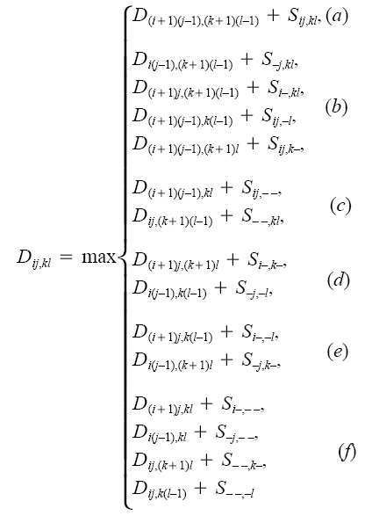
Recurrence relation for Foldalign

Slide 26
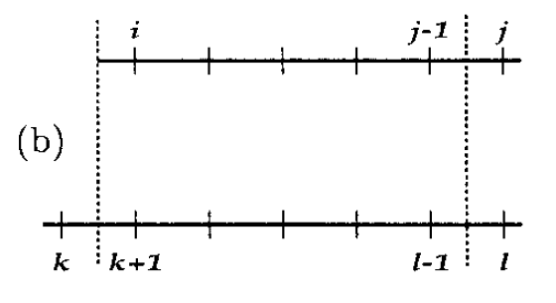

Slide 27
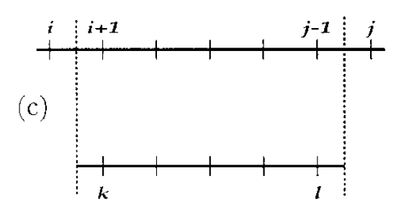

Slide 29
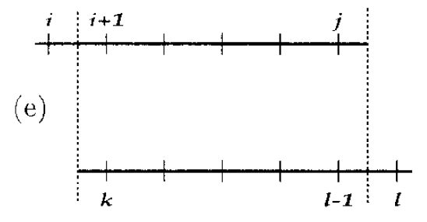

Slide 31
From energy minimization to Boltzmann equilibrium?

Slide 32
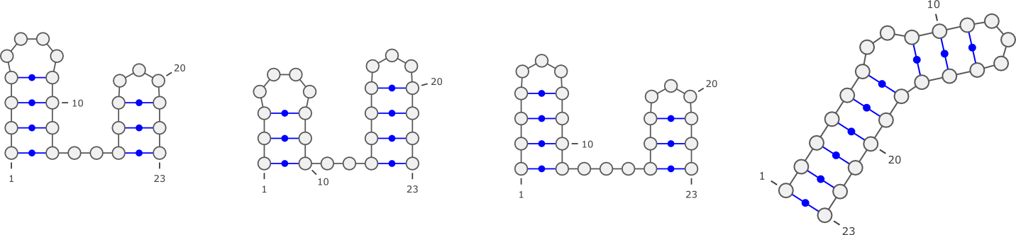
Optimization methods can be overly sensitive to fluctuations of the energy model
Example:
Get RFAM seed alignment for D1-D4 domain of the Group II intron
Extract A. capsulatum (Acidobacterium_capsu.1) sequence
Run RNAFold on sequence using default parameters
Rerun RNAFold using latest energy parameters
<ε
Stability (Turner 1999)
RNA
ACGAUCGCGA
CUACGUGCAU
CGCGGCACGA
CUGCGAUCUG
CAUCGGA...
Stability (Turner 2004)

Slide 33
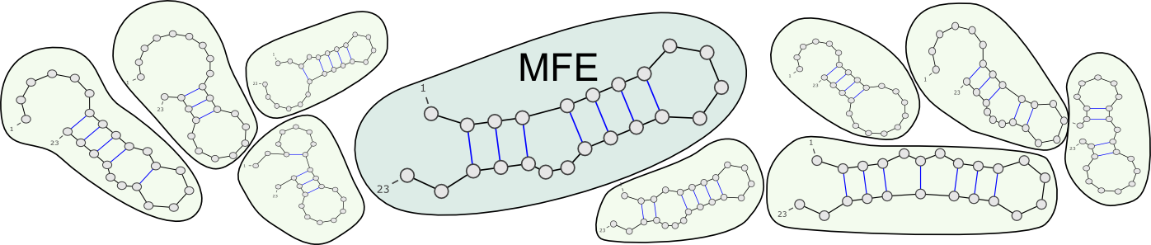
Probabilistic approaches in RNA folding
RNA in silico paradigm shift:
  From single structure, minimal free-energy folding…
  … to ensemble approaches.
…CAGUAGCCGAUCGCAGCUAGCGUA…
UnaFold, RNAFold, Sfold…
Ensemble diversity? Structure likelihood? Evolutionary robustness?

Slide 34
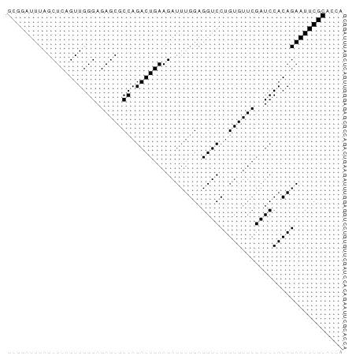
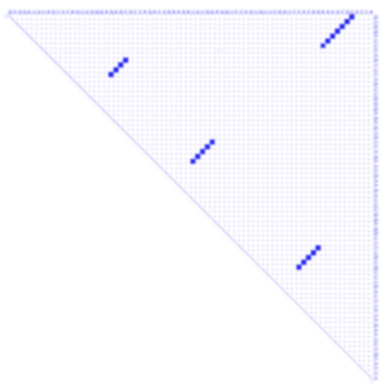
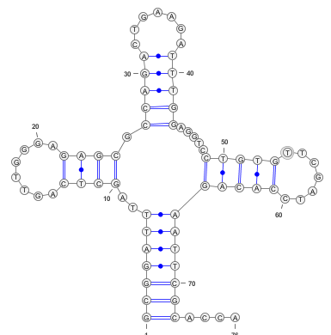
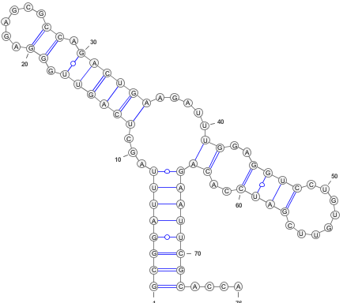
Probabilistic approaches indicate uncertainty and suggest alternative conformations
Example:
>ENA|M10740|M10740.1 Saccharomyces cerevisiae Phe-tRNA. : Location:1..76 GCGGATTTAGCTCAGTTGGGAGAGCGCCAGACTGAAGATTTGGAGGTCCTGTGTTCGATCCACAGAATTCGCACCA
RNAFold -p
Native structure
« dot-plot »

Slide 35
Nussinov’s algorithm (1978)
i+1
j-1
j
i+1
j-1
j
i
i
2.
i
j
1.
3.
Partition function algorithms can be
adapted from non-ambiguous* DP scheme
Is this decomposition ambiguous?
* Ambiguous = Multiple ways to generate a structure
4.
k
k+1
i
j

