Slide 1


Quantitative Analysis of
Information Leakage in Probabilistic and Nondeterministic Systems
Miguel E. Andrés
Notes:
Thank you very much all for being here. In the following 10 minutes I will give you a general idea of what is me thesis about.
I plan to 1) put this work in context by explaining the titlte 2) give you an intuition of what are the contributions of the thesis

Slide 2



Quantitative Analysis of
Information Leakage
in Probabilistic and Nondeterministic Systems
What is information leakage?
An incident where the confidentiality of information has been compromised.
Examples
[2010] Gmail accounts of Chinese dissidents and human rights activists were hacked.
[2011] Passwords of U.S. White House officials, Chinese political activists, officials in several Asian countries, and others were hacked.
Result: After cross acusation with the Chinese goverment because the source of the cyber attacks, Google moved all its servers out of China.
Notes:
So, lets just start explaining the meaning of the title. The keyword here is « Information Leakage ».
But, what does information leakage means? Well, one possible way to define it at a very hight level would be: ….
INFORMATION LEAKAGE PLAYS AN IMPORTANT ROLE NOWADAYS
So, lets see some examples of information leakage
GMAIL: so, we all know gmail, its the email service of google. I would guess most of the people in this room have a gmail account.
READ
Google performed an investigation and concluded that the attacks were initiated from Chinese territory and decided to shut down their chinesse website
[That cyber attack set off a series of events that eventually led to Google ending its agreement with the Chinese government to censor certain search results, and the company physically moved its servers out of the country.]
Suggest vulnerabilities with cloud technology

Slide 3
Quantitative Analysis of
Information Leakage
in Probabilistic and Nondeterministic Systems
What is information leakage?
An incident where the confidentiality of information has been compromised.
Examples
International non-profit organization that publishes submissions of private secret and classified media from anonymous news sources
Released 92 000 US confidential documents about war in Afghanistan
Released 260 000 US diplomatic cables
Released 400 000 US confidential documents about the war in Irak
Result: one of the biggest diplomatic crisis in the history of the U.S.
Notes:
WIKILEAKS: Does it ring a bell? Last year this name was (for several weekes) the term with highest number of hits in websites like google, guardian-newspaper, etc.
The information leaked lead to one of the biggest diplomatic crisis in the history of united states.

Slide 4
Quantitative Analysis of
Information Leakage
in Probabilistic and Nondeterministic Systems
What is information leakage?
An incident where the confidentiality of information has been compromised.
Examples
Online multiplayer gaming and media service for use with the PS 3
[April 2011] The service was hacked and led to information leakage of 100 million users. The information leaked includes users’ name, home address, email, birthday, passwords, credit card information and more confidential data
Result: Reputation damage + millionaire economic losses (due to the shut down of the service and multiple sues for negligence)
Notes:
SONY: The consequences were terrible for the company at many different levels:
Reputation (lost of trust)
Economical losses for the time the service has been down (in some contries the service is still not restablished).
Sony is facing several sues for negligence, if they loss the costs on compensation will be huge.
POINT OUT THAT (AS SEEN IN THE EXAMPLES) INFORMATION LEAKAGE IS A VERY IMPORTANT ISSUE NOWADAYS (LINK TO DIGITAL ERA)

Slide 5
Quantitative Analysis of
Information Leakage
in Probabilistic and Nondeterministic Systems
What is information leakage?
An incident where the confidentiality of information has been compromised.
What kind of incident?
Human ``negligence’’ (phishing scams, infected computer, etc)
Acts of sabotage (for example from an insider)
Bugs in the system (either intended or unintended)

Slide 6

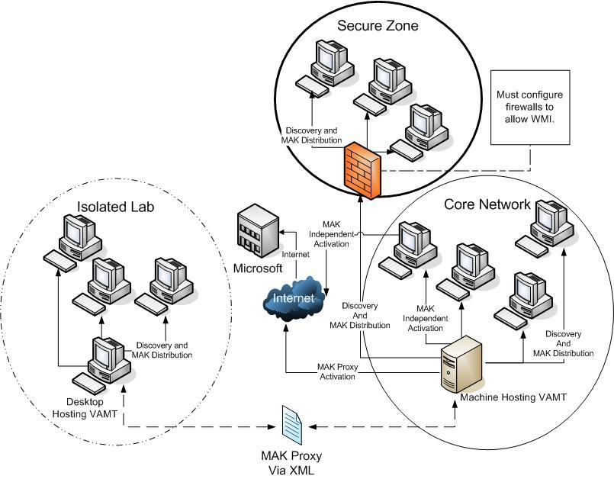
Quantitative Analysis of
Information Leakage
in Probabilistic and Nondeterministic Systems
Quantitative Analysis
In practice all systems leak some information.
The challenge is to determine how much.
Probab & Nondeterm Systems
Mathematical models required for the
formal analysis of complex systems.
Notes:
QUANTITATIVE ANALYSIS: Consider for example a password checker. Say that I want to learn the password Kostas’s gmail account. His username is not really confidential, all his freinds know his email account. So what I can do is just to go to the gmail webpage, write his username and try, for instance, my own password. The password checker of gmail will (most likely) announce that the password is incorrect. But this means that some information is being leaked, before I knew nothing about Kostas’s password and now I know that its different than mine. This is information leakage but it does not mean that the system does not work correcttly. SO, in order to asses the digree of correctnes (or protection) provided by a system its important to quantify the amount of information leaked by the system. In the password checker example, the information leaked will be very small (because even if i know that catuscia’s password is different than mine, there are still million of options to try).
PROB AND NONDETERMINISTIC SYSTEMS: in order to be able to asses the exact degree of pretection provided by a system we use some formal mathematical techniques that allow us to write the (very complex) « real life » system in terms of mathematical structures.

Slide 7








Information Leakage example: Anonymity
What is anonymity?
The term anonymity is often used to express the fact that the identity of an individual is unkown.
> Mr Burns sucks!
> Mr Burns sucks!
Internet
> Mr burns sucks
Crowds | Tor | Anonymizer
<Mr. Burns sucks>
200.68.91.93
<Mr. Burns sucks>
204.45.119.130
Notes:
The term anonymity is often used to express the fact that the identity of an individual is unkown. So, the confidential information in this case is the identity of an individual.
LETS CONSIDER A SIMLPE EXAMPLE IN ORDER TO ILLUSTRATE HOW CAN ANONYMITY BE PROVIDED IN THE INTERNET
Let me present an example on which anonymity plays a role.
Crowds, Tor, and anonymizer Mix based systems. Roighly, these protocols help homer hiding his identity by receiving his message, replacing the IP number of homer by their own and forwarding the message to either another computer helping homer to hide his identity or to the final receiver (mrs burns in this case).

Slide 8
Contributions
Internet
Crowds | Tor | Anonymizer
Specification & Verification
Develop techniques that help specifying and verifying anonymity properties
Does ???
Strong Anonymity
Probable Innocence
…
provide
Anonymity
satisfy
Notes:
I will try now to explain at a very high level what are the contributions of my thesis. For that purpose please keep in mind the example i just show you.
The first contribution is to develop techniques that help on specifing and verify anonymity properties.

Slide 9


Contributions
Internet
Crowds | Tor | Anonymizer
(2) Measuring Leakage
How much information
is the system leaking???
Tor
Crowds
?
Notes:
So, this is cool and a good first step towards analysis of information leakage (in this case with application in anonymity). But it is still a bit limited in the sense that we only gte answers of the kind yes/no. We may also be interested (and indeed this is the approach used nowadays) in measunring the degree of information leakage

Slide 10
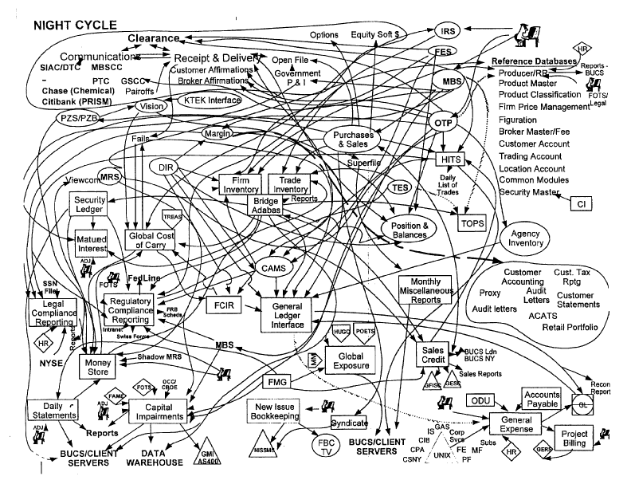

Contributions
Internet
Crowds | Tor | Anonymizer
(3) Debugging
Something went wrong
What was it???

Slide 11
Summary of Contributions
Chapter II [TACAS 08]
Conditional Probabilities over
probabilistic and nondeterministic systems
SPECIFICATION & VERIFICATION
Chapter III [TACAS 10]
Computing the Leakage of Information Hiding Systems
MEASURING LEAKAGE
Chapter IV [QEST 10 & Journal TCS]
Information hiding in concurrent systems
SPECIFICATION & VERIFICATION
Chapter V [HVC 08]
Significant diagnostic counterexample generation
DEBUGGING
Chapter VI [CONCUR 10 & LICS 10 & TCS 10 & Journal Computer Security]
Extensions (overview)
Notes:
So, let me provide a high level overview of the structure of the thesis and contributions

Slide 12
The end…
Thank you for your attention!!!

