Slide 1
Sampling/searching in simple generative models: A details-oriented CS perspective
Yann Ponty
LIX, Ecole Polytechnique, France

Slide 2
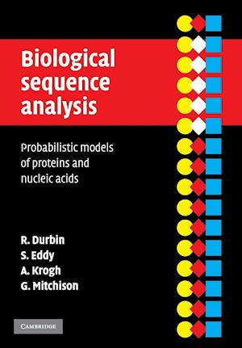
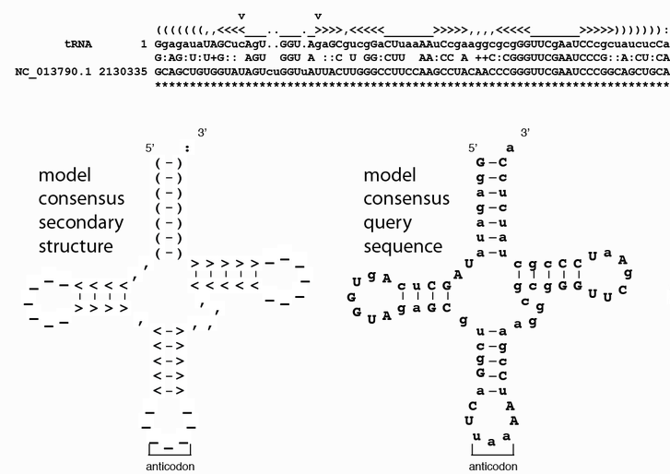
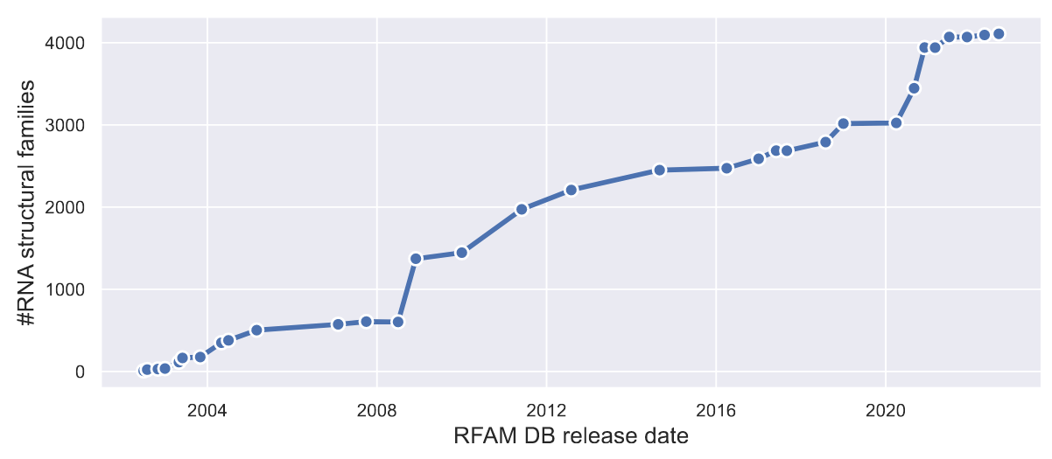
Generative models for RNA design/modeling
1998: Covariance Models (CMs)
InfeRNAl is the workhorse underlying RFAM
CMs can be used to search novel ncRNAs, but also as generative models
[Nawrocki et al 2009]

Slide 3
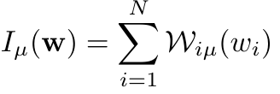
Modern physics-inspired generative models
Potts model (DCA)
Restricted Boltzmann Machines
1
5
10
N
1
1
M
$$≠0$$
1
5
10
N
N
$$≠0$$

Slide 4
Generative models as (hyper)graphs
CS perspective: Weighted CSP ([W]CSP), aka graphical models
(Hyper)Graph model G=(V,E): V → sequence positions E → Informative pairs
+ Evaluation functions
$$f_{1},f_{2}…:v∈V∪V^{2}↦ℝ$$
Potts model (DCA)
1
5
10
N
1
11
N
1
10
2
9
3
8
4
N
7
5
6

Slide 5
Generative models as (hyper)graphs
CS perspective: Weighted CSP ([W]CSP), aka graphical models
Hypergraph model G=(V,H): V → sequence positions H → Informative subsets
+ Evaluation functions
$$f_{1},f_{2}…:v⊆V↦ℝ$$
Restricted Boltzmann Machine
11
N
1
1
M
10
2
$$≠0$$
9
3
1
N
8
4
5
10
7
5
6

Slide 6
Generative models: Algorithmic problems
Hypergraph model G=(V,H): V → sequence positions H → Informative subsets
+ Evaluation functions
$$f_{1},f_{2}…:v⊆V↦ℝ$$
Algorithmic questions/problems (fixed h for RBMs):
OPT: Find most likely sequence (alt centroid sequence)
Partition function: Compute
Sampling: Generate sequence from
Searching: Given large sequence (genome), find ML match

Slide 7
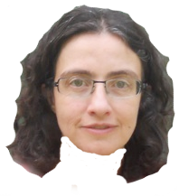
Generating from physics-inspired models
Ask a physicist
Ask a Computer Scientist
OPT generalizes SAT, MIS… → decision NP-hard!
Partition function #P hard & APX!!
Markov Chain may be disconnected!!!
Mixing time could be exponential!!!!
Monte Carlo for the win!
If you feel paranoid,
check stats for convergence
THINK OF THE CHILDREN!!!!!!!
TADAH!
But wait a minute…
If hypergraph is sparse/tree-like, why not use exact FPT dynamic programming?

Slide 8
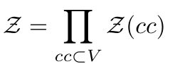
Computing the partition function
Goal: Compute PF
Brute force
Product over connected components
PF of path computable in linear time by dyn. prog.
Complexity dominated by largest card. hyperedge
11
N
1
10
2
9
3
8
4
7
5
6

Slide 9
Computing the partition function
Goal: Compute PF
Brute force
Product over connected components
PF of path computable in linear time by dyn. prog.
Cycles can be broken through variable elimination
11
N
1
10
2
9
3
8
4
7
5
6

Slide 10
Divide and conquer-ing the partition function
Rem: Given values for separator {4,5,7}, Left and Right contributions become independent
N
N
11
11
1
Work sequentially through Right
1
10
10
2
2
9
9
3
3
Work sequentially through Left
8
4
8
7
5
6
6

Slide 11
Tree decomposition (TD)
Definition :
A tree decomposition for G = (V, E) is a tree T of bags B₁, B₂, …, B_{i} ⊆ V, such that :
Each vertex v ∈ V is represented in some bag/node B of T (v ∈ B)
Each edge e = (v, v’) ∈ E is represented in some bag/node B of T (e ⊆ B)
Consistency: For all v ∈ V, the bags featuring v are connected in T
tw=3
∅
tw=5
4,5,7 | ∅
11
N
1
11
N
1
10
1 | ∅
2 | ∅
3,4,5 |∅
10
2
8 | 4,5,7
1 | 4,5,7
2
N | 1
11 | 2
N | 4,5,8
2 | 1,4,5,7
9
3
9
3
8 | 11
9 | 4,5,8,N
8
4
9 | N
8
4
6 | 2,4,5,7
7
5
7 | 8
10 | 4,9,N
6
7
6
5
10 | 9
6 | 7
11 | 9,10,N
3 | 2,4,6
Tree width tw of a tree decomposition = Size (#indices) of largest bag
Partition function computed in time using dyn. prog.
+ Computing an optimal (min tw) TD → NP-hard, but Fixed Parameter Tractable for tw
[Boedlander 1992]

Slide 12
Meta algorithm – Partition function
Input. Trained generative model M
Convert M to (hyper)graph instance G
Run external algorithm to get (approx.) optimal TD, having treewidth tw, for G
Precompute partition function (bottom-up dyn. prog.) through:
v: Assignments to variables shared with parent; F(B): Functions assigned to bag
Output. Return Complexity: + Tree decomposer (O(N), exp. on tw )
+ Sampling: k i.i.d. sequences through Stochastic Backtrack, starting from root:
Choose w ∈ with probability contribution to . Recurse until leaves.
Complexity: (+ part. fun.) for sampling k i.i.d. sequences
+ OPT: Max. probability/min. energy sequence for free

Slide 13
InfraRed – A practical implementation
https://gitlab.inria.fr/amibio/Infrared/
Python/C++ declarative framework (constraints and pseudo-energies)
Runs tree decomp.; Reports part. fun.; Samples Boltzmann distr.; Optimal sequence
Bonus: Autolearns weights to target expected features (ΔG, GC%...)
Use-cases:
RNA multiple design - RNARedPrint [Hammer et al, RECOMB 2018; BMC Bioinfo 2019]
RNA inverse folding - RNAPond [Yao et al, RECOMB 2021]

Slide 14
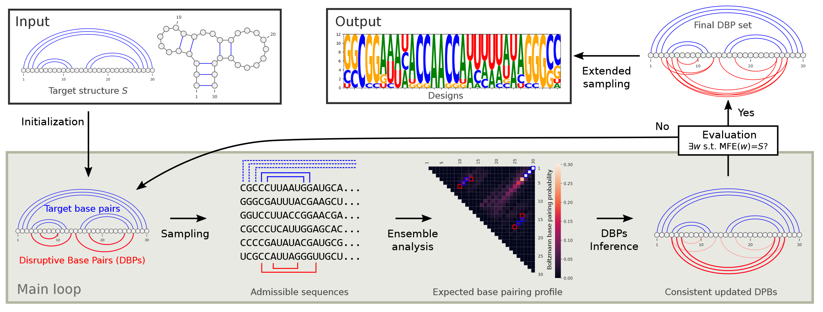
RNAPoND – Positive and Negative Design
[Yao et al, RECOMB 2021]
Obeys positive constraints but learns disruptive BPs and cancels them
Naïve infrared (tw < 10) implementation competitive with state of the art

Slide 15
Treewidths of actual RNAs (PDB)
Treewidth of generative models???

Slide 16
TreeDiet – Simplifying tree decompositions
[Marchand et al, BMC Bioinfo 2022]
Goal: Remove few (weighted) edges from treewidth tw input graph, to reach tw’ < tw
Theory: FPT on tw; Practice: No reasonable tractable algorithm known
Idea: Start from tree decomposition, rephrase as coloring on tree (practically FPT on tw)
Correct induced error through rejection sampling, subopts or progressive filtering (search)

Slide 17
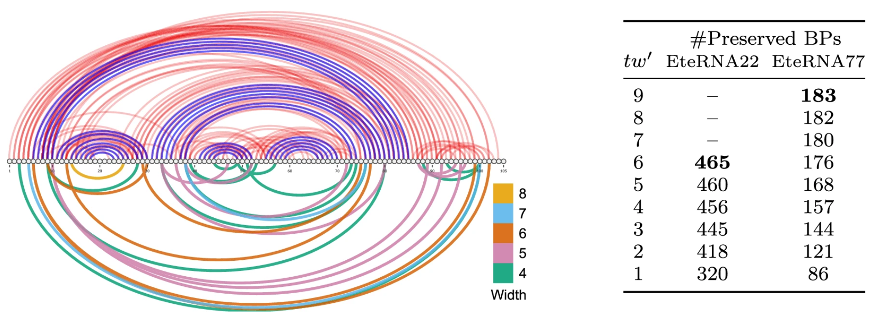
Treewidth can be reduced w/o much information loss

Slide 18
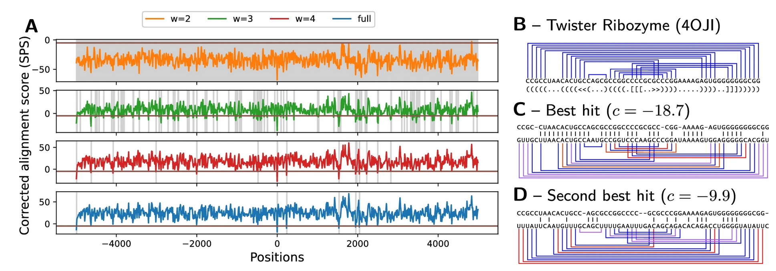
Treewidth can be reduced w/o much information loss

Slide 19
Conclusion
To a hammer, everything is a nail
Build it and they will come
Avenues to apply parameterized complexity to bio* generative models
Purely declarative, exact sampling
Low complexity post precomputation
Additional assets:
Derivatives/moments/correlations exactly computable (same complexity)
Genomic search for occurrences of gen model (Σ → [1,M], XP comp.)
Limitation (possibly):
Assumes that tw $≪$ N
Sparseness in generative models: structure prediction vs design
[Saule et al, WABI 2011]
[Rinaudo et al, WABI 2012]
https://gitlab.inria.fr/amibio/Infrared/

Slide 20
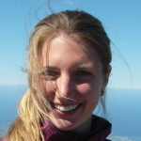
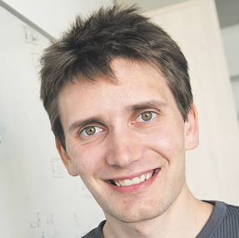
Acknowledgements
Sebastian Will
Sarah Berkemer
Hua-Ting Yao
Stefan Hammer
Alain Denise
Bertrand Marchand
Laurent Bulteau
Philippe Rinaudo
https://gitlab.inria.fr/amibio/Infrared/

