Slide 1
A brief tutorial on RNA folding methods and resources…
Yann Ponty, CNRS/Ecole Polytechnique
Alain Denise, LRI/IGM, Université Paris-Sud

Slide 2
Goals
To help your work your way through the RNA data jungle.
To introduce mature structure prediction/annotation tools.
To convince you to look beyond Mfold ☺
Locate structural data
Energy minimization
Boltzmann Ensemble
Pseudoknots
Structural annotation
Comparative methods

Slide 3
Ever heard of RNA?

Slide 4
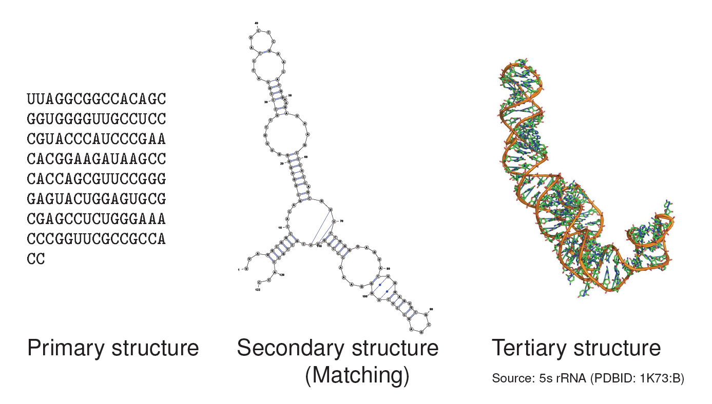
RNA structure(s)

Slide 5
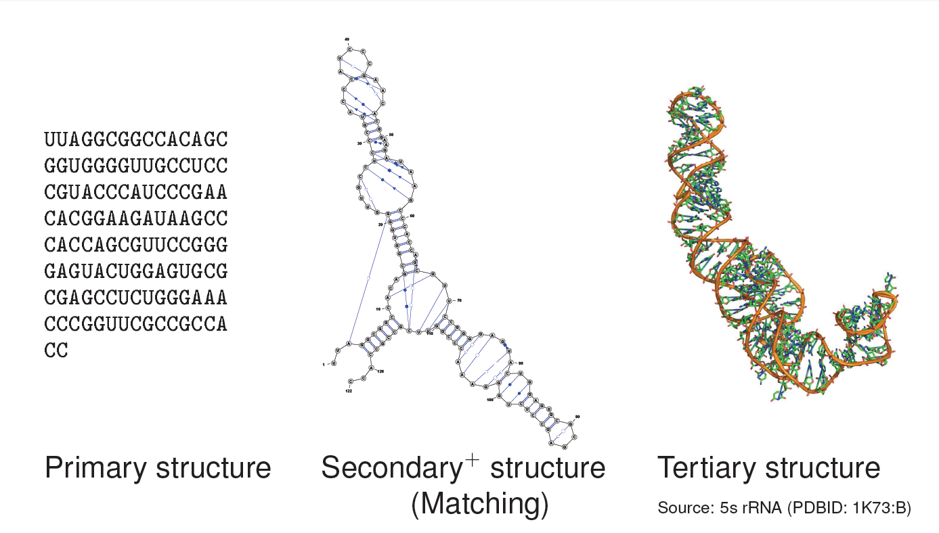
RNA structure(s)

Slide 6
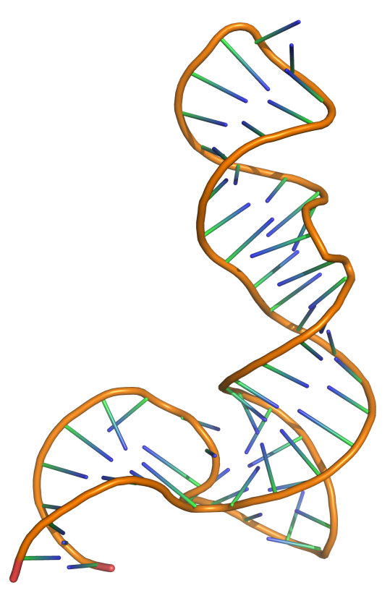
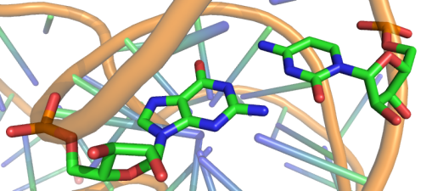
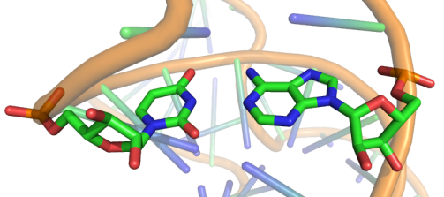
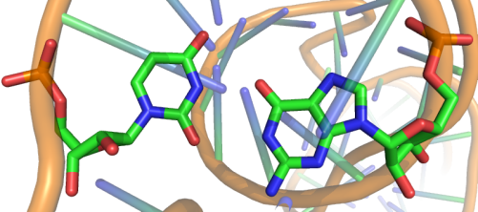
How RNA folds
G/C
Canonical base-pairs
U/A
U/G
5s rRNA (PDB ID: 1UN6)
RNA folding = Hierarchical stochastic process driven by/resulting in the pairing (hydrogen bonds) of a subset of its bases.

Slide 7
Ground truths
Main sources of RNA structural data

Slide 8
Sources of RNA structural data
Name | Data type | Scope | Description | File formats | #Entries | URL
PDB | All-atoms | General | RCSB Protein Data Bank – Global repository for 3D molecular models | PDB | ~1,900 models | http://www.pdb.org
NDB | All-atoms, Secondary structures | General | Nucleic Acids Database – Nucleic acids models and structural annotations. | PDB, RNAML | ~2,000 models | http://bit.ly/rna-ndb
RFAM | Alignments, Secondary structures³ | General | RNA FAMilies – Multiple alignments of RNA as functional families. Features consensus secondary structures, either predicted and/or manually curated. | STOCKHOLM, FASTA | ~1,973 Alignments/ structures, 2,756,313 sequences | http://bit.ly/rfam-db
STRAND | Secondary structures | General | The RNA secondary STRucture and statistical ANalysis Database – Curated aggregation of several databases | CT, BPSEQ, RNAML, FASTA, Vienna | 4,666 structures | http://bit.ly/sstrand
PseudoBase | Secondary structures | Pseudoknotted RNAs | PseudoBase – Secondary structure of known pseudonotted RNAs. | Extended Vienna RNA | 359 structures | http://bit.ly/pkbase
CRW | Sequence alignments, Secondary structures | Ribosomal RNAs, Introns | Comparative RNA Web Site – Manually curated alignments and statistics of ribosomal RNAs. | FASTA, ALN, BPSEQ | 1,109 structures, 91,877 sequences | http://bit.ly/crw-rna
…

Slide 9
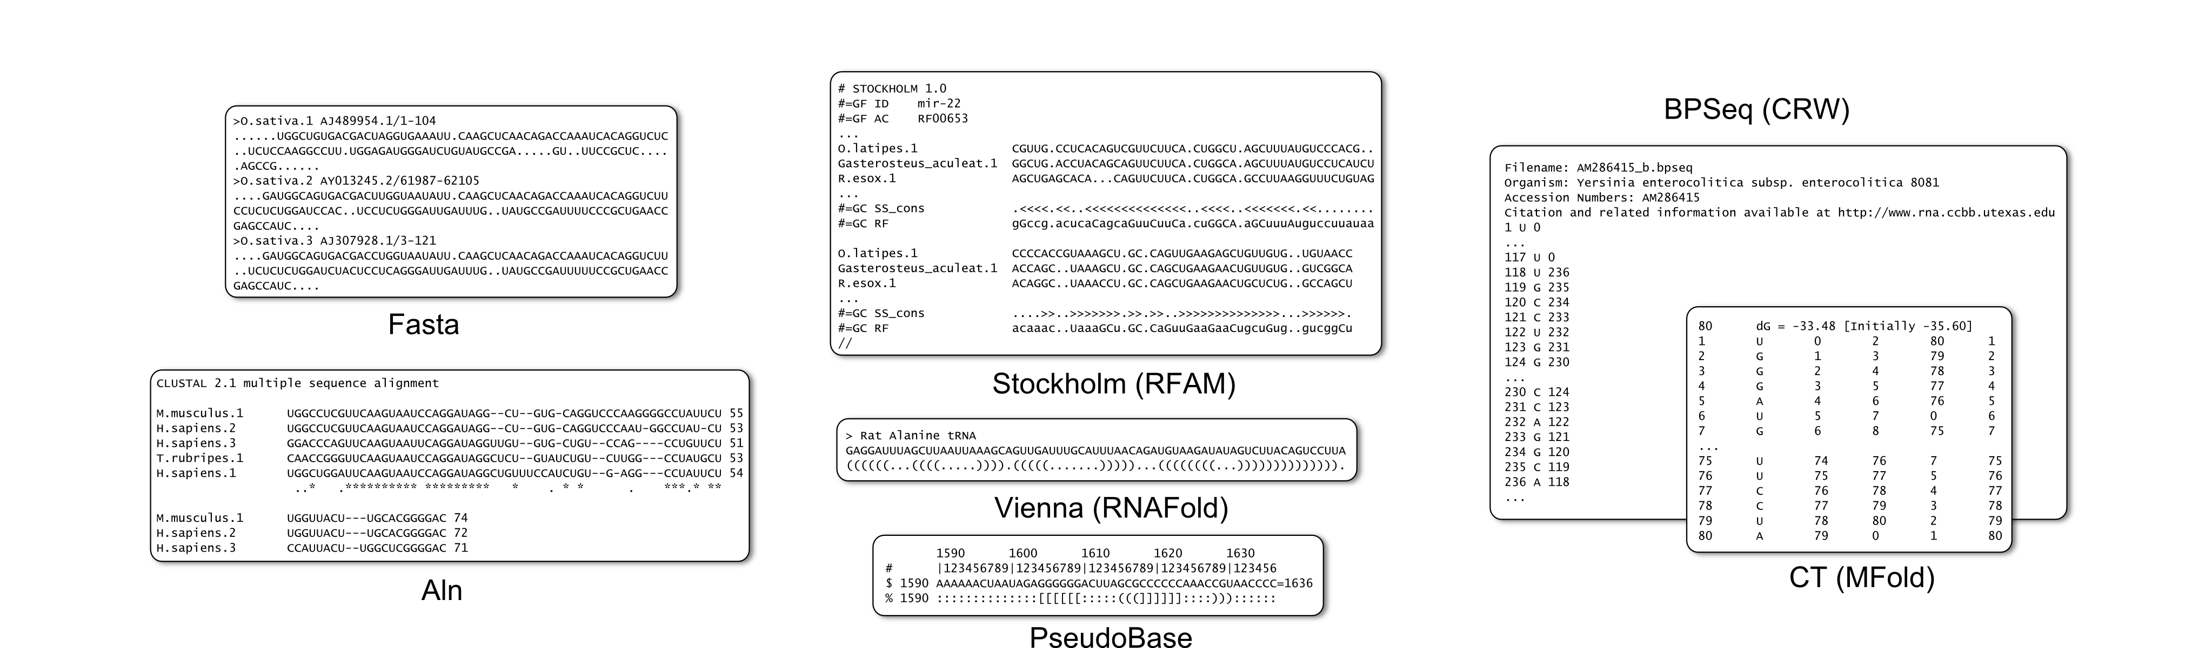
RNA file formats: Sequences (alignments)

Slide 10
RNA file formats: Sequences (alignments)

Slide 11
RNA file formats: Secondary Structures

Slide 12
RNA file formats: Secondary Structures

Slide 13
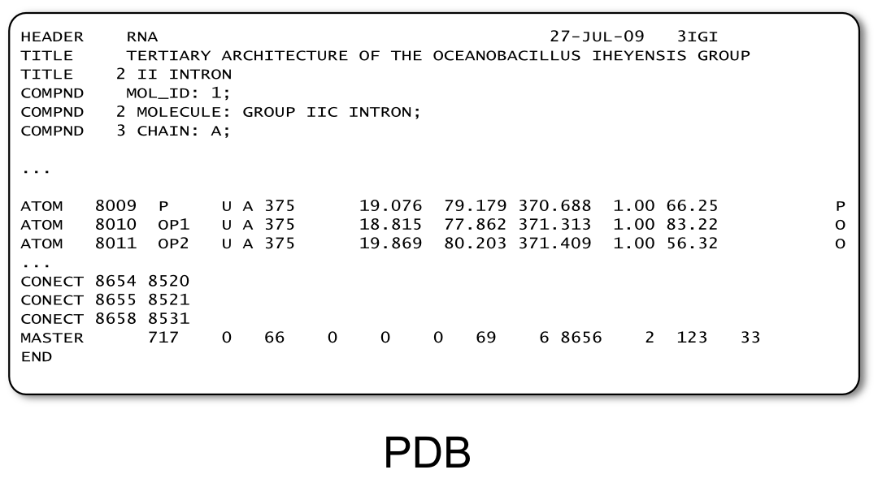
RNA file formats: Secondary Structures

Slide 14
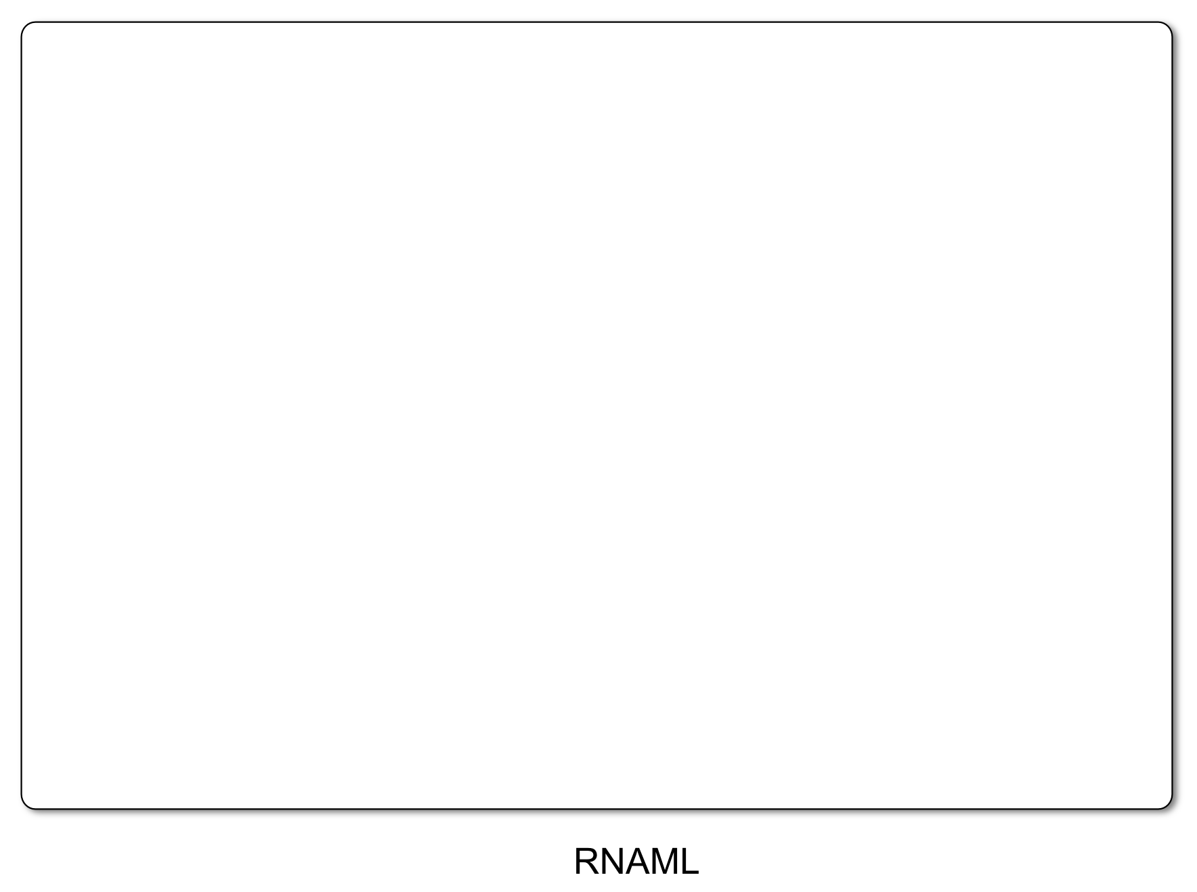
RNA file formats: Secondary Structures
<?xml version="1.0"?>
<!DOCTYPE rnaml SYSTEM "rnaml.dtd">
<rnaml version="1.0">
<molecule id=“xxx">
<sequence> ... </sequence>
<structure> ... </structure>
</molecule>
<interactions> ... </interactions>
</rnaml>

Slide 15
RNA file formats: Secondary Structures
<?xml version="1.0"?>
<!DOCTYPE rnaml SYSTEM "rnaml.dtd">
<rnaml version="1.0">
<molecule id=“xxx">
<sequence>
<numbering-system id="1" used-in-file="false">
<numbering-range>
<start>1</start><end>387</end>
</numbering-range>
</numbering-system>
<numbering-table length="387">
2 3 4 5 6 7 8...
</numbering-table>
<seq-data>
UGUGCCCGGC AUGGGUGCAG UCUAUAGGGU...
</seq-data>
...
</sequence>
<structure> ... </structure>
</molecule>
<interactions> ... </interactions>
</rnaml>

Slide 16
RNA file formats: Secondary Structures
<?xml version="1.0"?>
<!DOCTYPE rnaml SYSTEM "rnaml.dtd">
<rnaml version="1.0">
<molecule id=“xxx">
<sequence> ... </sequence>
<structure>
<model id=“yyy">
<base> ... </base> ...
<str-annotation>
...
<base-pair>
<base-id-5p><base-id><position>2</position></base-id></base-id-5p>
<base-id-3p><base-id><position>260</position></base-id></base-id-3p>
<edge-5p>+</edge-5p>
<edge-3p>+</edge-3p>
<bond-orientation>c</bond-orientation>
</base-pair>
<base-pair comment="?">
<base-id-5p><base-id><position>4</position></base-id></base-id-5p>
<base-id-3p><base-id><position>259</position></base-id></base-id-3p>
<edge-5p>S</edge-5p>
<edge-3p>W</edge-3p>
<bond-orientation>c</bond-orientation>
</base-pair>
...
</str-annotation>
</model>
</structure>
</molecule>
<interactions> ... </interactions>
</rnaml>

Slide 17
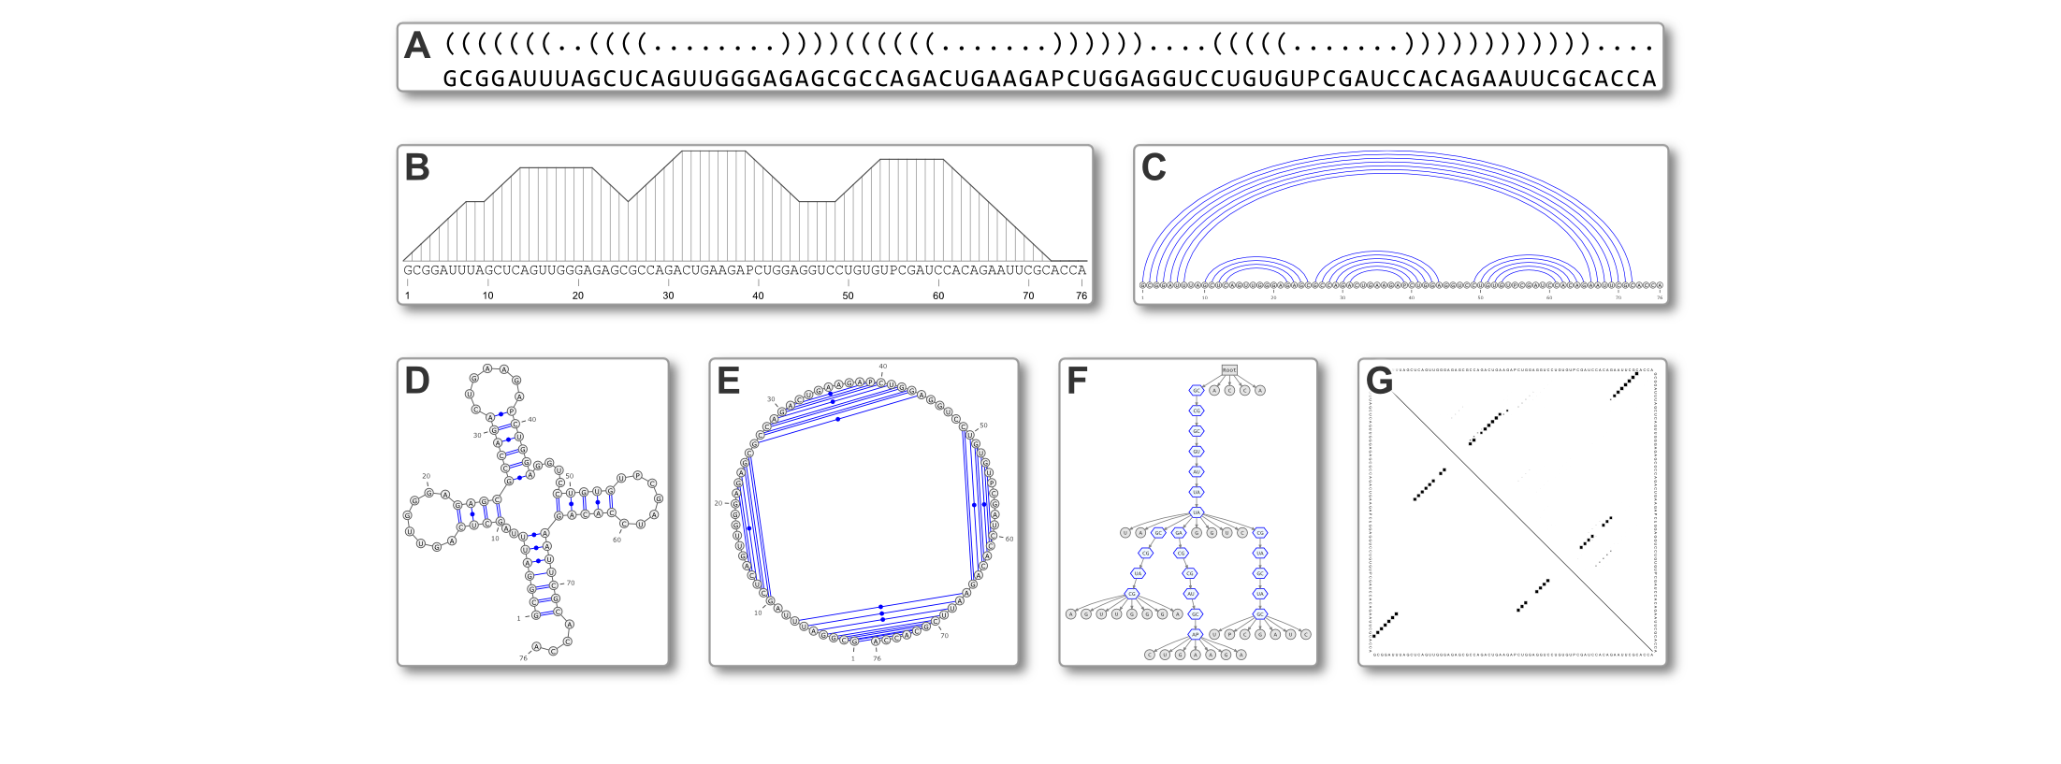
Secondary Structure representations
http://varna.lri.fr

Slide 18
Basic prediction
Minimal free-energy folding

Slide 19
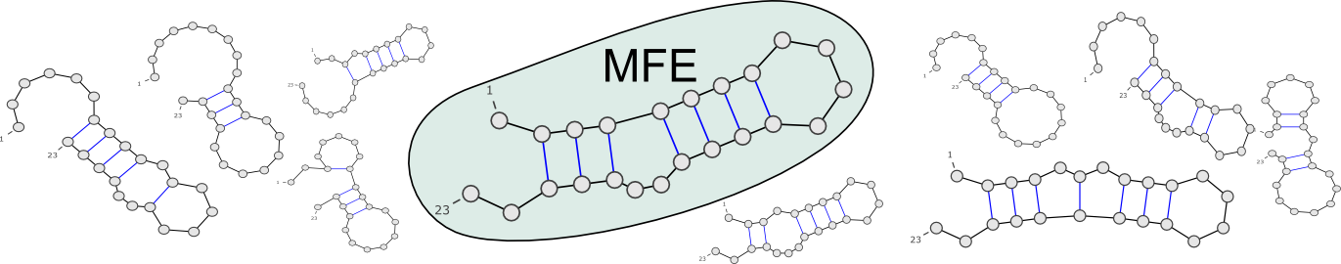
Minimal Free-Energy (MFE) Folding
Goal: Predict the functional (aka native) conformation of an RNA
Absence of experimental evidence → Consider energy
Turner model associates free-energies to secondary structures
Vienna RNA package implements a O(n³) optimization algorithm for computing most stable (= min. free-energy) folding
…CAGUAGCCGAUCGCAGCUAGCGUA…
RNAFold, MFold…

Slide 20
Optimization methods can be overly sensitive to fluctuations of the energy model
Example:
Get RFAM seed alignment for D1-D4 domain of the Group II intron
Extract A. capsulatum (Acidobacterium_capsu.1) sequence
Run RNAFold on sequence using default parameters
Rerun RNAFold using latest energy parameters

Slide 21
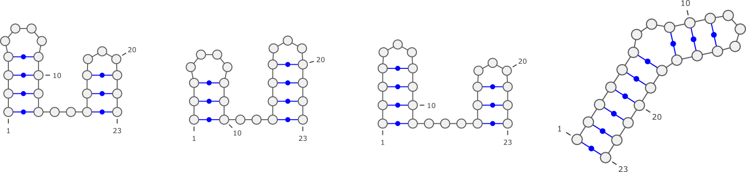
Optimization methods can be overly sensitive to fluctuations of the energy model
Example:
Get RFAM seed alignment for D1-D4 domain of the Group II intron
Extract A. capsulatum (Acidobacterium_capsu.1) sequence
Run RNAFold on sequence using default parameters
Rerun RNAFold using latest energy parameters
<ε
Stability (Turner 1999)
RNA
ACGAUCGCGA
CUACGUGCAU
CGCGGCACGA
CUGCGAUCUG
CAUCGGA...
Stability (Turner 2004)

Slide 22
Ensemble properties
Boltzmann partition function

Slide 23
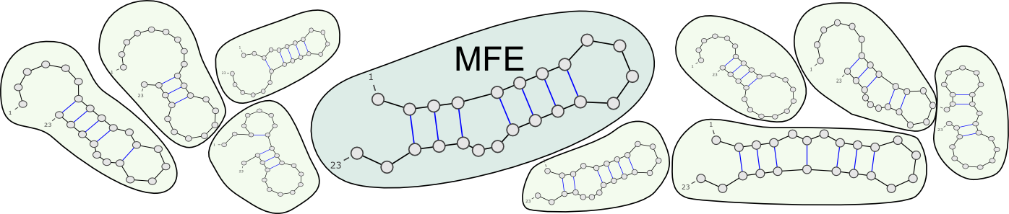
Ensemble approaches in RNA folding
RNA in silico paradigm shift:
  From single structure, minimal free-energy folding…
  … to ensemble approaches.
…CAGUAGCCGAUCGCAGCUAGCGUA…
UnaFold, RNAFold, Sfold…
Ensemble diversity? Structure likelihood? Evolutionary robustness?

Slide 24
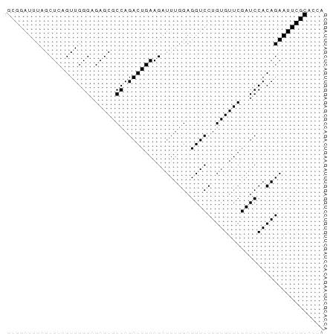
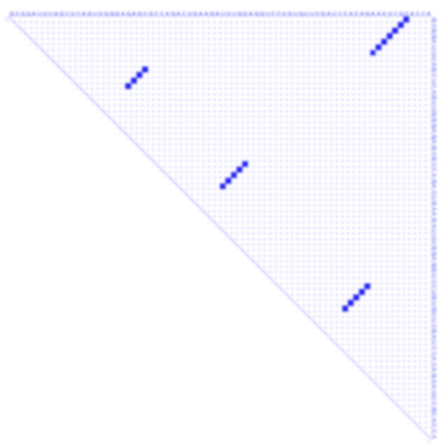
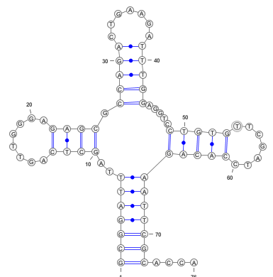
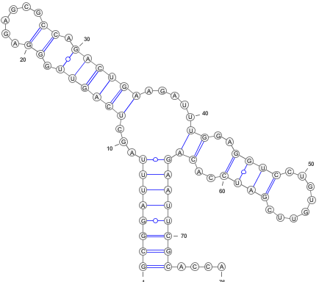
Ensemble approaches indicate uncertainty and suggest alternative conformations
Example:
>ENA|M10740|M10740.1 Saccharomyces cerevisiae Phe-tRNA. : Location:1..76 GCGGATTTAGCTCAGTTGGGAGAGCGCCAGACTGAAGATTTGGAGGTCCTGTGTTCGATCCACAGAATTCGCACCA
RNAFold -p
Structure native

Slide 25
Pseudoknots
New practical tools (at last!)

Slide 26
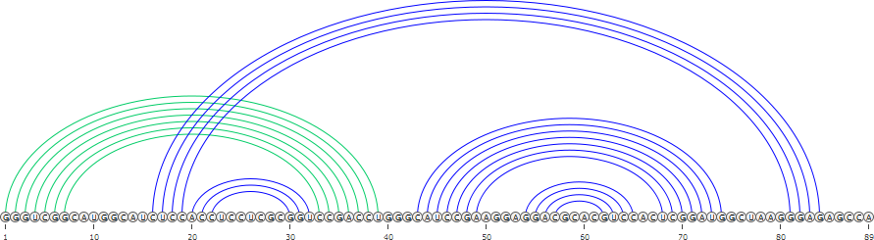
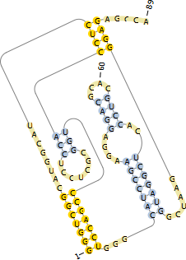
Pseudoknots
Pseudoknots are complex topological models indicated by crossing interactions.
Pseudoknots are largely ignored by computational prediction tools:
  Lack of accepted energy model
  Algorithmically challenging
Yet heuristics can be sometimes efficient.
Visualizing of secondary structure with pseudoknots
is supported by:
  PseudoViewer
  VARNA

Slide 27
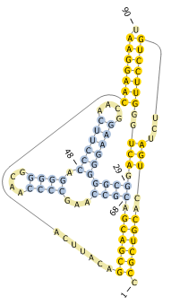
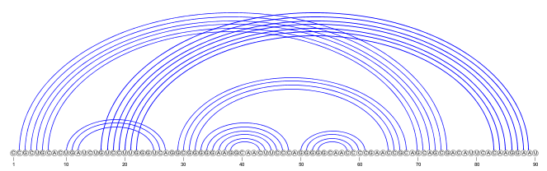
Predicting and visualizing Pseudoknots
Get seq./struct. data for a pseudoknot tmRNA the PseudoBase (ID: PKB210)
CCGCUGCACUGAUCUGUCCUUGGGUCAGGCGGGGGAAGGCAACUUCCCAGGGGGCAACCCCGAACCGCAGCAGCGACAUUCACAAGGAAU
:((((((::(((:::[[[[[[[::))):((((((((((::::)))))):((((::::)))):::)))):)))))):::::::]]]]]]]:
Fold this sequence using RNAFold and compare the result to the native structure
Fold this sequence using Pknots-RG (Program type: Enforcing PK)
http://bibiserv.techfak.uni-bielefeld.de/pknotsrg/

Slide 28
Advanced structural features
Tertiary motifs

Slide 29
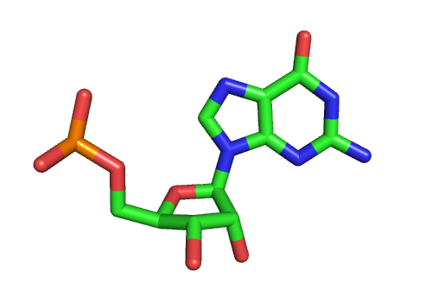
Non canonical interactions
RNA nucleotides bind through edge/edge interactions.
Non canonical are weaker, but cluster into modules that are structurally constrained, evolutionarily conserved, and functionally essential.

Slide 30
Non canonical interactions
RNA nucleotides bind through edge/edge interactions.
Non canonical are weaker, but cluster into modules that are structurally constrained, evolutionarily conserved, and functionally essential.

Slide 31
Non canonical interactions
RNA nucleotides bind through edge/edge interactions.
Non canonical are weaker, but cluster into modules that are structurally constrained, evolutionarily conserved, and functionally essential.

Slide 32
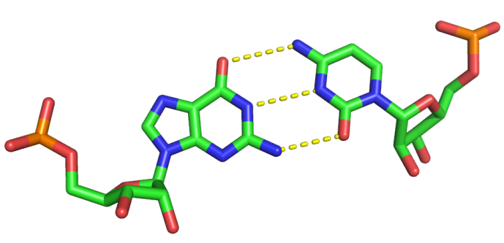
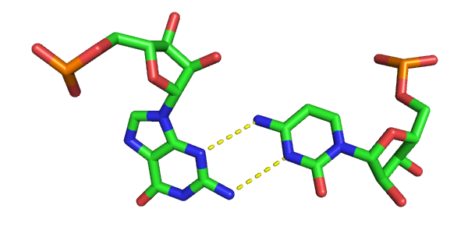
Non canonical interactions
W-C
H
H
W-C
W-C
H
SUGAR
W-C
H
SUGAR
SUGAR
SUGAR
Canonical G/C pair
(WC/WC cis)
Non Canonical G/C pair
(Sugar/WC trans)
RNA nucleotides bind through edge/edge interactions.
Non canonical are weaker, but cluster into modules that are structurally constrained, evolutionarily conserved, and functionally essential.

Slide 33
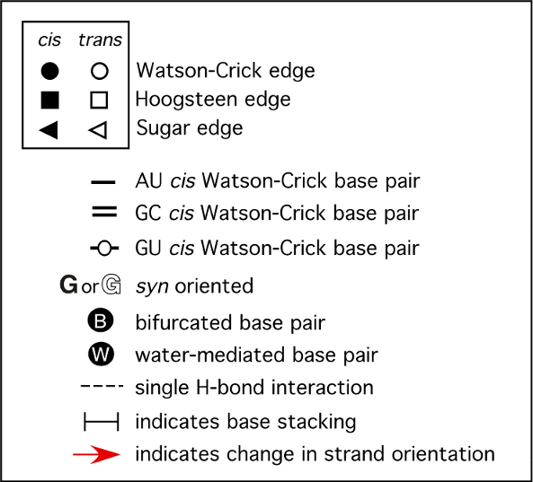
Leontis/Westhof nomenclature:
A visual grammar for tertiary motifs
Leontis/Westhof,
NAR 2002
+ Tools to infer base-pairs from experimentally-derived 3D models
RNAView, MC-Annotate…

Slide 34
Automated annotation of 3D RNA models
Get RNAView from http://ndbserver.rutgers.edu/services/download/
Retrieve 3IGI model from RSCB PDB as a PDB file.
Annotate it using RNAview (-p option) to create a RNAML file
Visualize the output RNAML file (within VARNA)
Run RNAFold (default options) on the sequence and compare the prediction with the one inferred from the 3D model.

Slide 35
Prediction by Homology

Slide 36
The 3 main strategies
Gardner, Giegerich 2004

Slide 37
1. From sequence alignment

Slide 38
Détecting covariations
i j
GCCUUCGGGC
GACUUCGGUC
GGCU-CGGCC
RNA-alifold (Hofacker et al. 2000)
http://rna.tbi.univie.ac.at/cgi-bin/RNAalifold.cgi
RNAz (Washietl et al. 2005)
http://rna.tbi.univie.ac.at/cgi-bin/RNAz.cgi

Slide 39
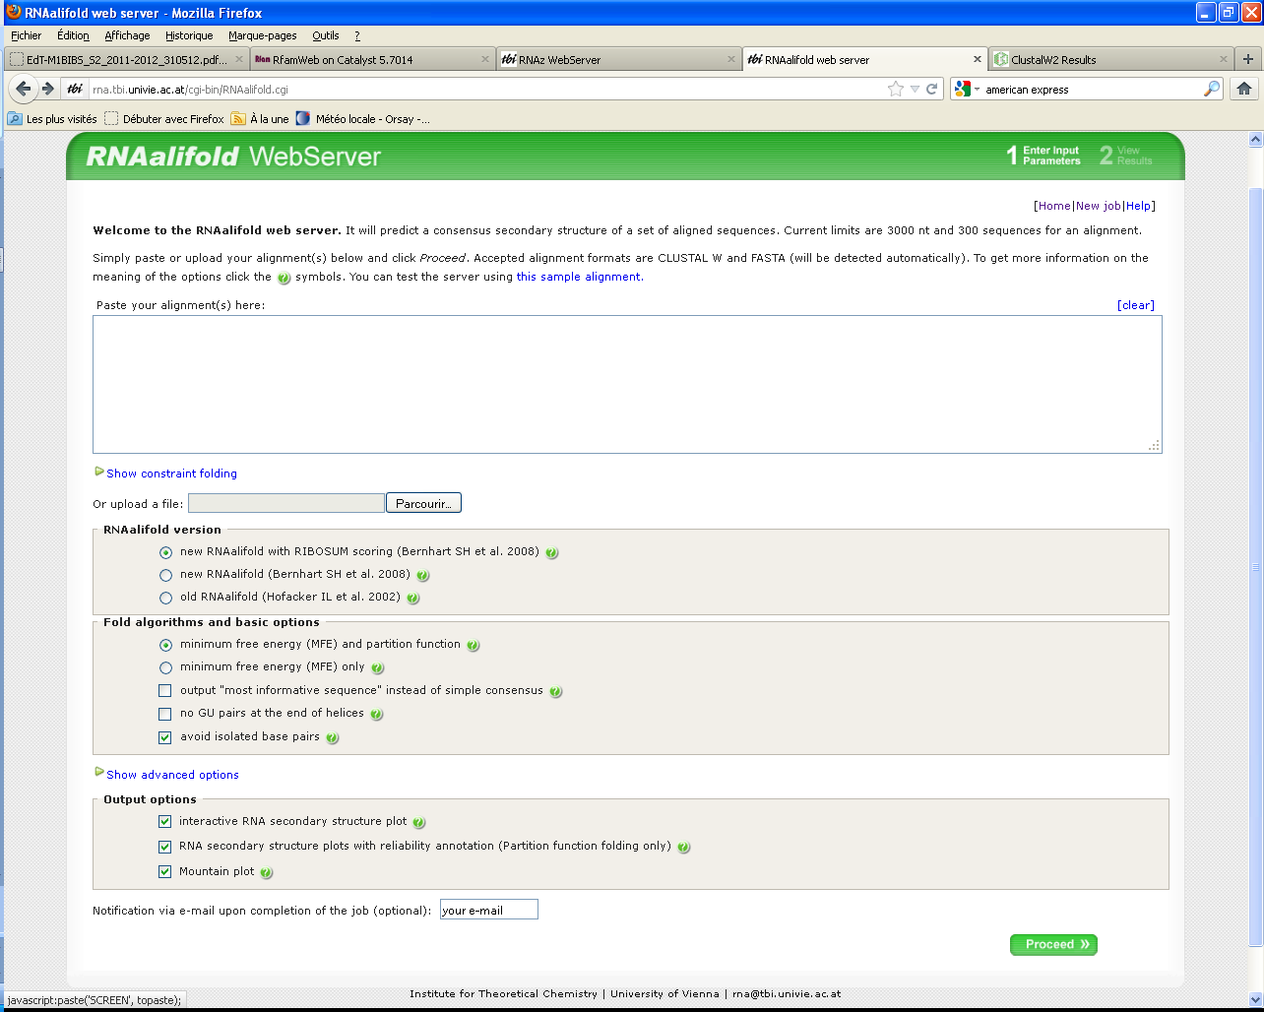
RNAalifold

Slide 40
Application : tRNA Alanine
>Artibeus_jamaicensis
AAGGGCTTAGCTTAATTAAAGTAGTTGATTTGCATTCAGCAGCTGTAGGATAAAGTCTTGCAGTCCTTA
>Balaenoptera_musculus
GAGGATTTAGCTTAATTAAAGTGTTTGATTTGCATTCAATTGATGTAAGATATAGTCTTGCAGTCCTTA
>Bos_taurus
GAGGATTTAGCTTAATTAAAGTGGTTGATTTGCATTCAATTGATGTAAGGTGTAGTCTTGCAATCCTTA
>Canis_familiaris
GAGGGCTTAGCTTAATTAAAGTGTTTGATTTGCATTCAATTGATGTAAGATAGATTCTTGCAGCCCTTA
>Ceratotherium_simum
GAGGGTTTAGCTTAATTAAAGTGTTTGATTTGCATTCAGTTGATGTAAGATAGAGTCTTGCAGCCCTTA
>Dasypus_novemcinctus
GAGGACTTAGCTTAATTAAAGTGCCTGATTTGCGTTCAGGAGATGTGGGGCTAAATCTTGCAGTCCTTA
>Equus_asinus
AAGGGCTTAGCTTAATGAAAGTGTTTGATTTGCGTTCAATTGATGTGAGATAGAGTCTTGCAGTCCTTA
>Erinaceus_europeus
GAGGATTTAGCTTAAAAAAAGTGGTTGATTTGCATTCAATTGATATAGGAAATATAATCTTGTAATCCTTA
>Felis_catus
GAGGACTTAGCTTAATTAAAGTGTTTGATTTGCAATCAATTGATGTAAGATAGATTCTTGCAGTCCTTA
>Hippopotamus_amphibius
AGGGACTTAGCTTAATAAAAGCAGTTGAGTTGCATTCAATTGATGTGAGGTGCGGTCTTGCAGTCTCTA
>Homo_sapiens
AAGGGCTTAGCTTAATTAAAGTGGCTGATTTGCGTTCAGTTGATGCAGAGTGGGGTTTTGCAGTCCTTA

Slide 41
ClustalW alignment
CLUSTAL 2.1 multiple sequence alignment
Dasypus_novemcinctus GAGGACTTAGCTTAATTAAAGTGCCTGATTTGCGTTCAGGAGATGTGGGG 50
Homo_sapiens AAGGGCTTAGCTTAATTAAAGTGGCTGATTTGCGTTCAGTTGATGCAGAG 50
Artibeus_jamaicensis AAGGGCTTAGCTTAATTAAAGTAGTTGATTTGCATTCAGCAGCTGTAGGA 50
Canis_familiaris GAGGGCTTAGCTTAATTAAAGTGTTTGATTTGCATTCAATTGATGTAAGA 50
Felis_catus GAGGACTTAGCTTAATTAAAGTGTTTGATTTGCAATCAATTGATGTAAGA 50
Ceratotherium_simum GAGGGTTTAGCTTAATTAAAGTGTTTGATTTGCATTCAGTTGATGTAAGA 50
Bos_taurus GAGGATTTAGCTTAATTAAAGTGGTTGATTTGCATTCAATTGATGTAAGG 50
Erinaceus_europeus GAGGATTTAGCTTAAAAAAAGTGGTTGATTTGCATTCAATTGATATAGGA 50
Balaenoptera_musculus GAGGATTTAGCTTAATTAAAGTGTTTGATTTGCATTCAATTGATGTAAGA 50
Equus_asinus AAGGGCTTAGCTTAATGAAAGTGTTTGATTTGCGTTCAATTGATGTGAGA 50
Hippopotamus_amphibius AGGGACTTAGCTTAATAAAAGCAGTTGAGTTGCATTCAATTGATGTGAGG 50
** ********* **** *** **** *** * *
Dasypus_novemcinctus --CTAAATCTTGCAGTCCTTA 69
Homo_sapiens --TGGGGTTTTGCAGTCCTTA 69
Artibeus_jamaicensis --TAAAGTCTTGCAGTCCTTA 69
Canis_familiaris --TAGATTCTTGCAGCCCTTA 69
Felis_catus --TAGATTCTTGCAGTCCTTA 69
Ceratotherium_simum --TAGAGTCTTGCAGCCCTTA 69
Bos_taurus --TGTAGTCTTGCAATCCTTA 69
Erinaceus_europeus AATATAATCTTGTAATCCTTA 71
Balaenoptera_musculus --TATAGTCTTGCAGTCCTTA 69
Equus_asinus --TAGAGTCTTGCAGTCCTTA 69
Hippopotamus_amphibius --TGCGGTCTTGCAGTCTCTA 69
* *** * * **

Slide 42
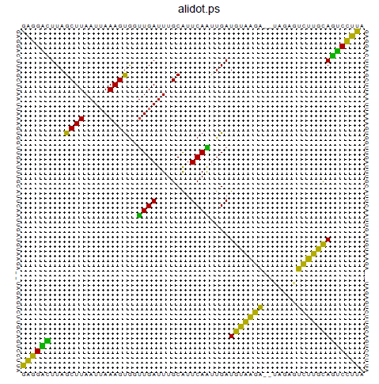
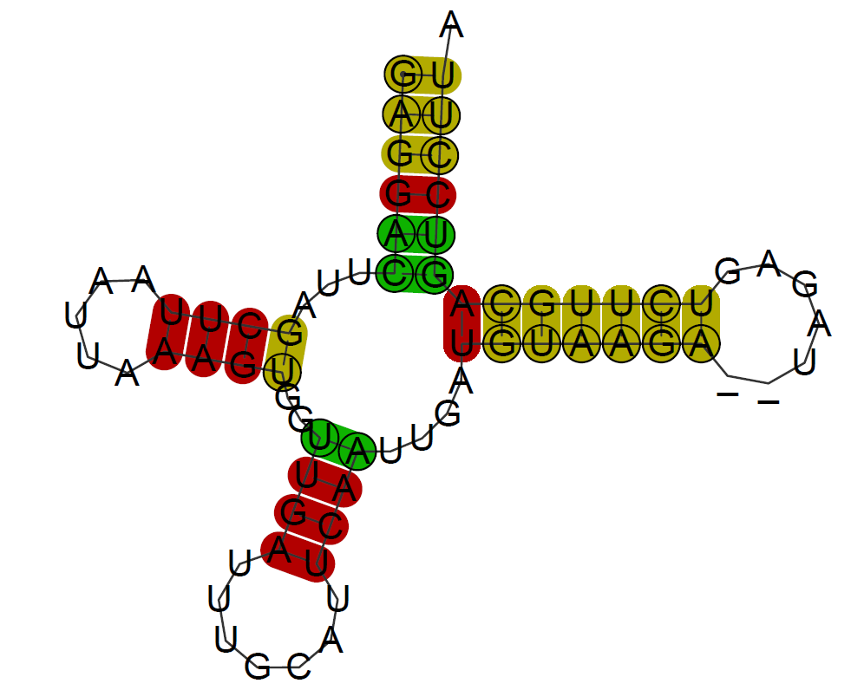
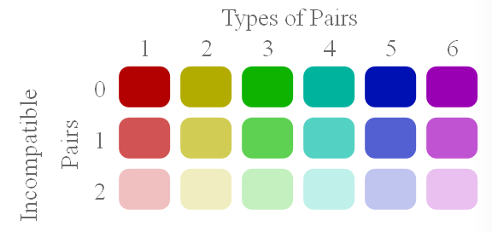
RNAalifold

Slide 43
Application : tRNA H.sapiens
>Homo sapiens Arg, True Structure
TGGTATATAGTTTAAACAAAACGAATGATTTCGACTCATTAAATTATGATAATCATATTTACCAA
(((((.(..((((.....)))).(((((.......)))))....(((((...)))))).))))).
>Homo sapiensArg TGGTATATAGTTTAAACAAAACGAATGATTTCGACTCATTAAATTATGATAATCATATTTACCAA
>Homo sapiensAsn
TAGATTGAAGCCAGTTGATTAGGGTGCTTAGCTGTTAACTAAGTGTTTGTGGGTTTAAGTCCCATTGGTCTAG
>Homo sapiensAsp
AAGGTATTAGAAAAACCATTTCATAACTTTGTCAAAGTTAAATTATAGGCTAAATCCTATATATCTTA
>Homo sapiensCys
AGCTCCGAGGTGATTTTCATATTGAATTGCAAATTCGAAGAAGCAGCTTCAAACCTGCCGGGGCTT
>Homo sapiensGln
TAGGATGGGGTGTGATAGGTGGCACGGAGAATTTTGGATTCTCAGGGATGGGTTCGATTCTCATAGTCCTAG
>Homo sapiensGlu
GTTCTTGTAGTTGAAATACAACGATGGTTTTTCATATCATTGGTCGTGGTTGTAGTCCGTGCGAGAATA
>Homo sapiensGly
ACTCTTTTAGTATAAATAGTACCGTTAACTTCCAATTAACTAGTTTTGACAACATTCAAAAAAGAGTA
>Homo sapiensHis
GTAAATATAGTTTAACCAAAACATCAGATTGTGAATCTGACAACAGAGGCTTACGACCCCTTATTTACC
>Homo sapiensIso
AGAAATATGTCTGATAAAAGAGTTACTTTGATAGAGTAAATAATAGGAGCTTAAACCCCCTTATTTCTA
>Homo sapiensLeuCun
ACTTTTAAAGGATAACAGCTATCCATTGGTCTTAGGCCCCAAAAATTTTGGTGCAACTCCAAATAAAAGTA

Slide 44
ClustalW alignment
CLUSTAL 2.1 multiple sequence alignment
Homo_sapiensAsn ----TAGATTGAAGCCAGTTGATTAGGG--TGCTTA-GCTGTTAA--CTA-AGTGTTTGT 50
Homo_sapiensGln ----TAGGATGGGGTGTGATAGGTGGCA--CGGAGA-ATTTTGGATTCTC-AGGG---AT 49
Homo_sapiensArg ----TGGTATA---TAGTTTAAACAAAA--CGAATG-ATTTCGACTC----ATTA---AA 43
Homo_sapiensHis ---GTAA-ATA---TAGTTTAACCAAAA--CATCAG-ATTGTGAATCTGACAACA---GA 47
Homo_sapiensCys ------AGCTC---CGAGGTGATTTTCA--TATTGA-ATTGCAAATTCGA-AGAA---GC 44
Homo_sapiensIso AGAAATATGTC---TGATAAAAGAGTTA--CTTTGATAGAGTAAAT-----AATA---GG 47
Homo_sapiensAsp -----AAGGTA---TTAGAAAAACCATT--TCATAACTTTGTCAAAGTTAAATTA---TA 47
Homo_sapiensGly -------ACTCTTTTAGTATAAATAGTA-CCGTTAA--CTTCCAATTA---ACTAGTTTT 47
Homo_sapiensLeuCun -------ACTTTTAAAGGATAACAGCTATCCATTGG--TCTTAGGCCCC--AAAAATTTT 49
Homo_sapiensGlu -------GTTCTTGTAGTTGAAATACAA--CGATGG--TTTTTCATATC--ATTGGTCGT 47
* *
Homo_sapiensAsn GGGTTTAAG-TC-CCATTGGTCTAG- 73
Homo_sapiensGln GGGTTCGAT-TC-TCATAGTCCTAG- 72
Homo_sapiensArg ---TTATGA-TAATCATATTTACCAA 65
Homo_sapiensHis GGCTTACGA-CC-CCTTATTTACC-- 69
Homo_sapiensCys AGCTTCAAA-CCTGCCGGGGCTT--- 66
Homo_sapiensIso AGCTT-AAA-CCCCCTTATTTCTA-- 69
Homo_sapiensAsp GGCT--AAA-TC-CTATATATCTTA- 68
Homo_sapiensGly GA---CAACATTCAAAAAAGAGTA-- 68
Homo_sapiensLeuCun GGT-GCAAC-TCCAAATAAAAGTA-- 71
Homo_sapiensGlu GGTTGTAG--TCCGTGCGAGAATA-- 69

Slide 45
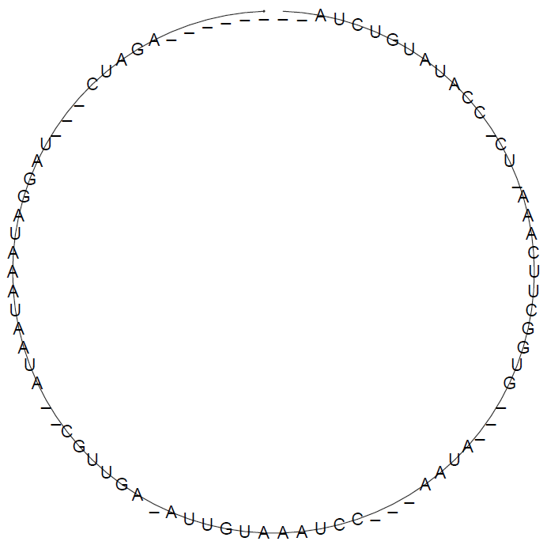
RNAalifold

Slide 46
Simultaneous folding and alignment

Slide 47
Approaches
The reference approach: Sankoff’s algorithm (1985)
  Algorithmic approach: dynamic programming
  Complexity : n^{3k} for k séquences of length n
Two implementations (with constraints)
  Foldalign (Gorodkin, Heyer, Stormo 1997, Havgaard, Lyngso, Stormo, Gorodkin 2005)
  Dynalign (Mathews, Turner 2002)
Heuristics based on this algorithm :
  LocaRNA (http://rna.informatik.uni-freiburg.de:8080/LocARNA.jsp).

Slide 48
Principes généraux
Entrée : plusieurs séquences (non alignées)
Objectif : maximiser (autant que possible) un score tenant compte à la fois de l’alignement et de l’énergie de la structure.
Sortie : un alignement et une structure secondaire commune

Slide 49
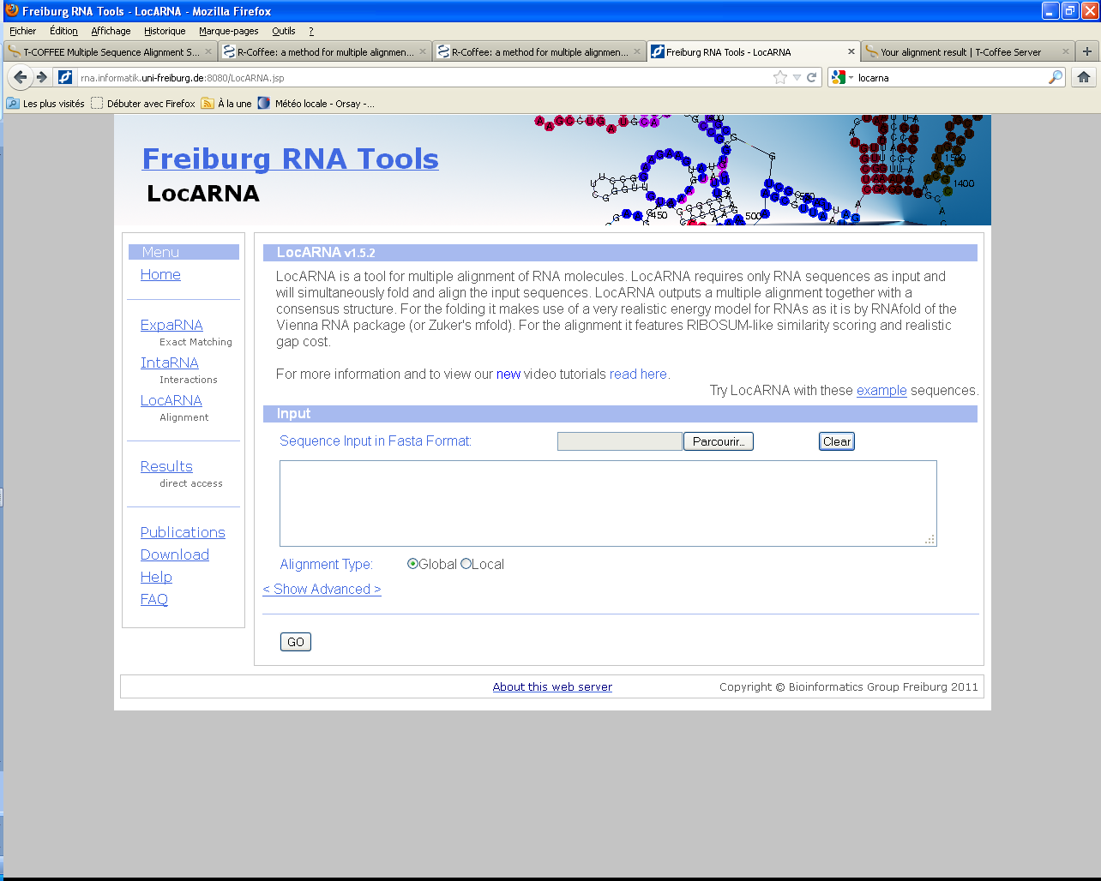
LocARNA
Une heuristique basée sur l’algorithme de Sankoff.

Slide 50
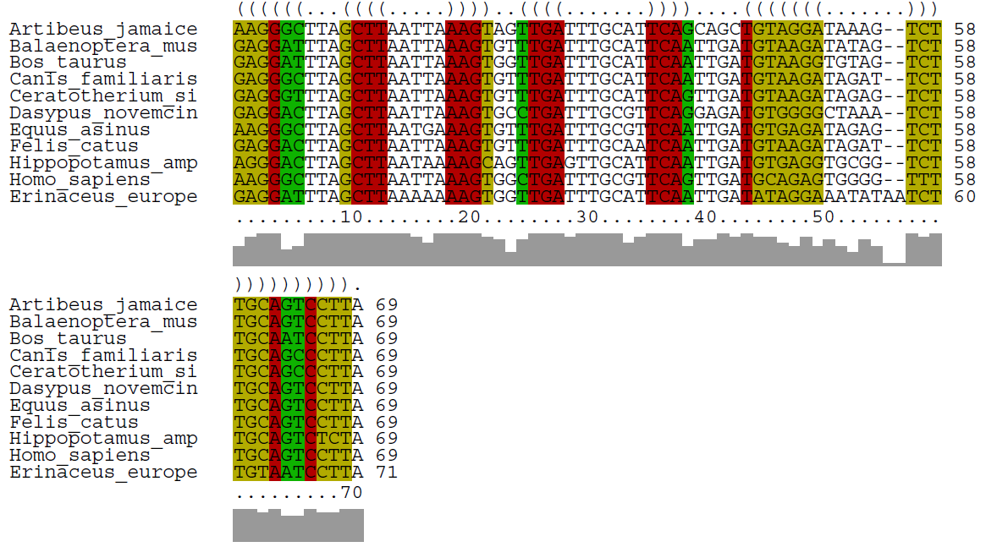
LocARNA : tRNA Alanine

Slide 51
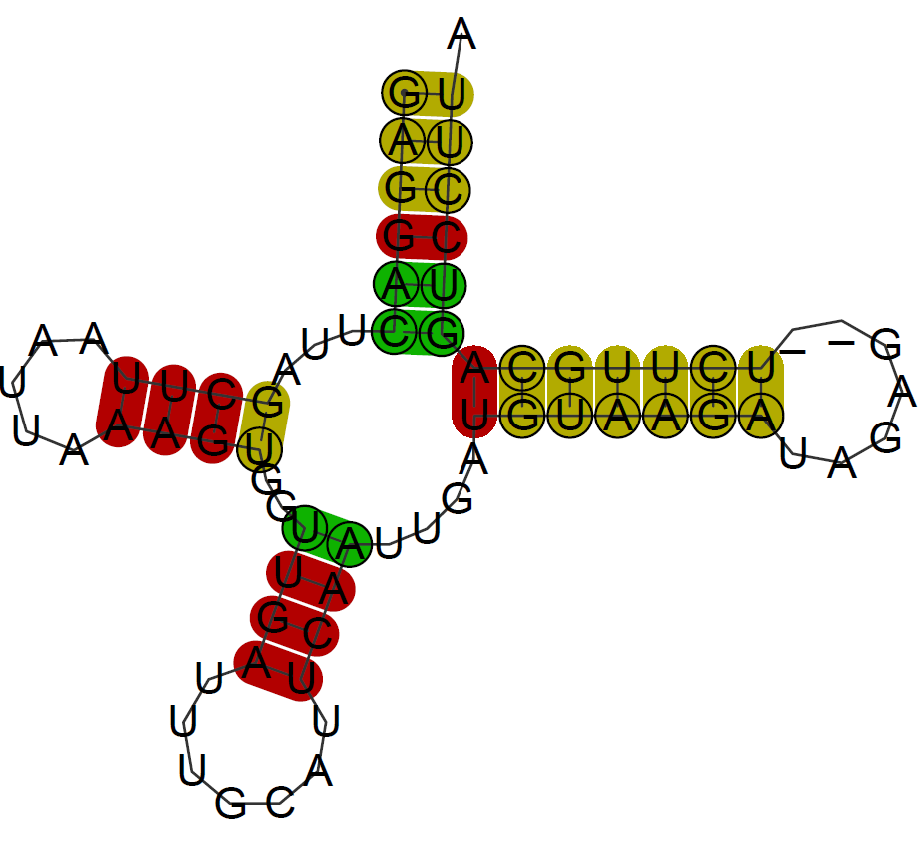
LocARNA : tRNA Alanine

Slide 52
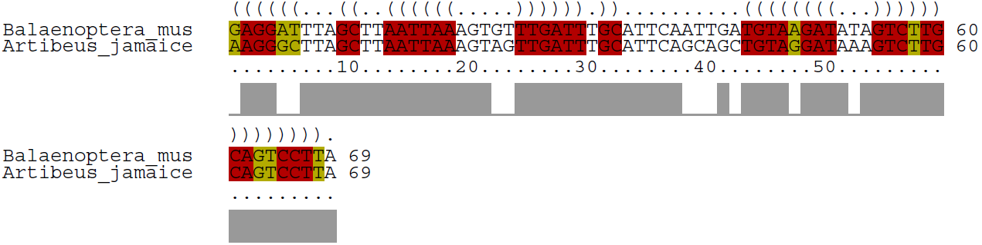
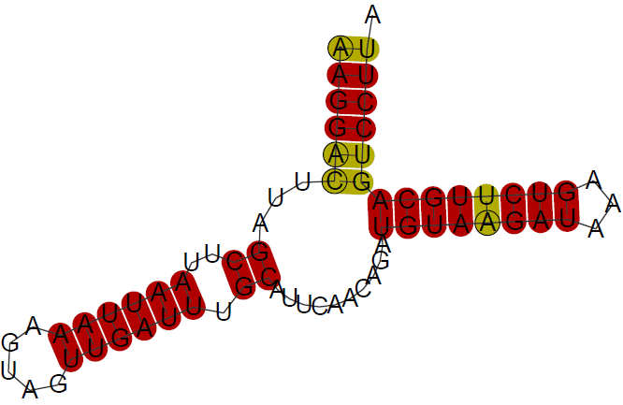
LocARNA : tRNA Alanine – 2 sequences

Slide 53
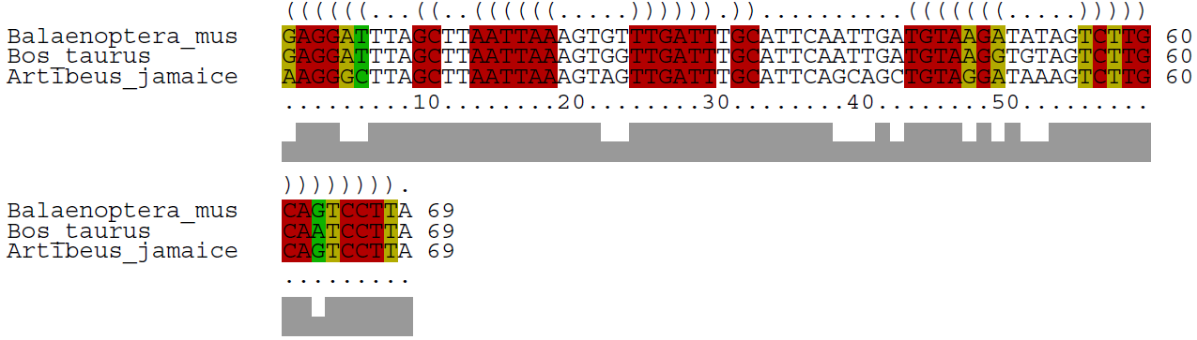
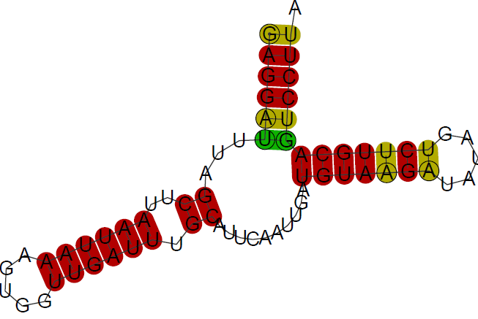
LocARNA : tRNA Alanine – 3 sequences

Slide 54
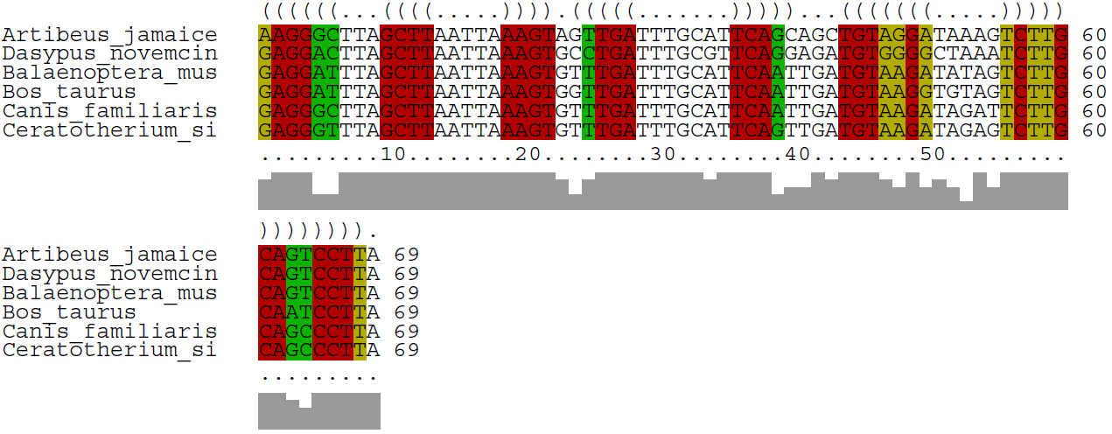
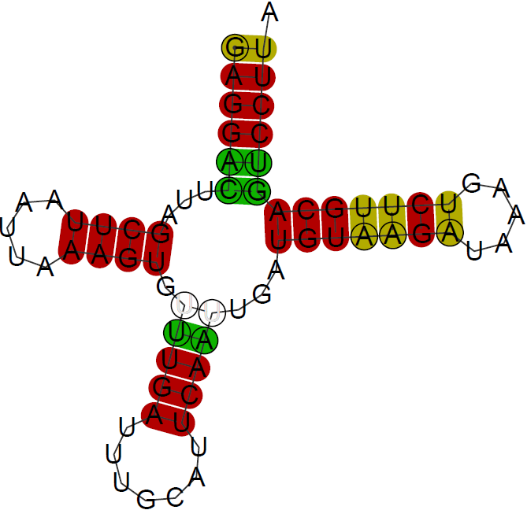
LocARNA : tRNA Alanine – 6 sequences

Slide 55
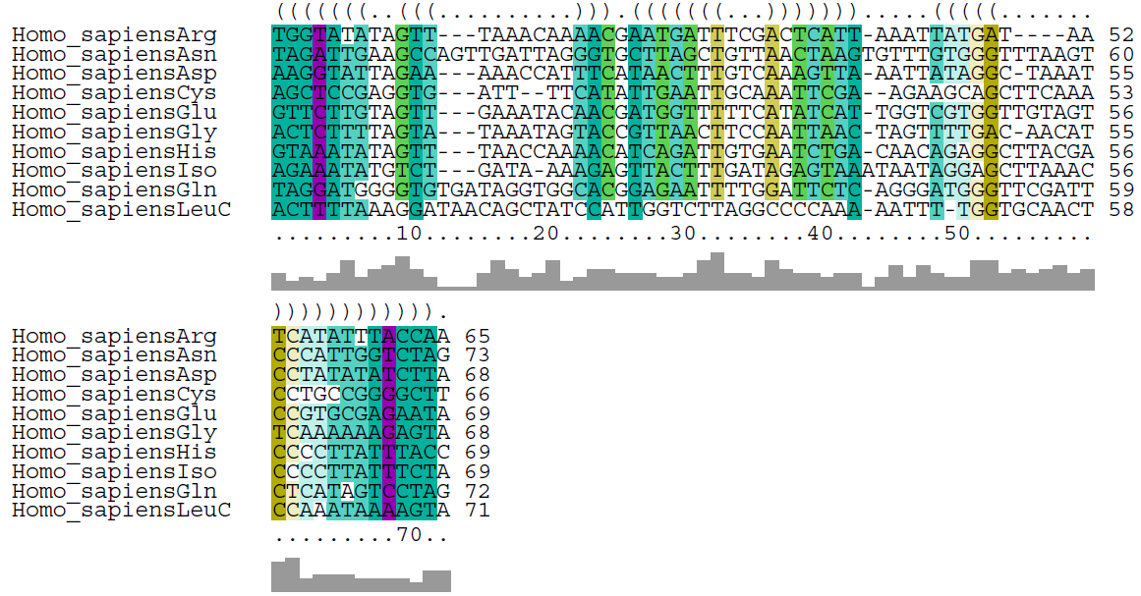
LocARNA : tRNA H. sapiens

Slide 56
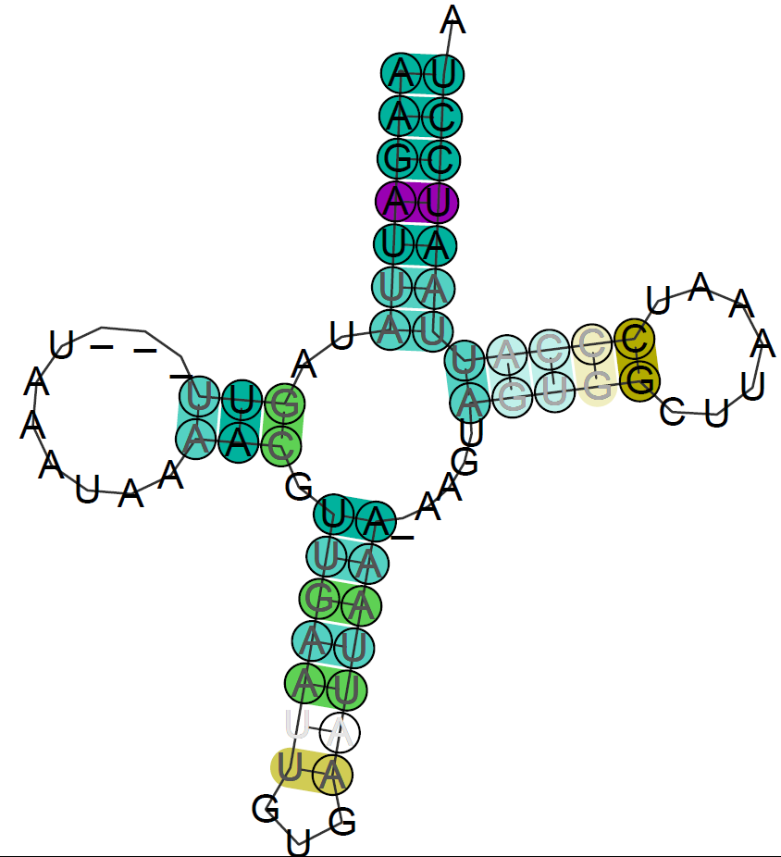
LocARNA : tRNA H. sapiens

Slide 57
Folding then alignment

Slide 58
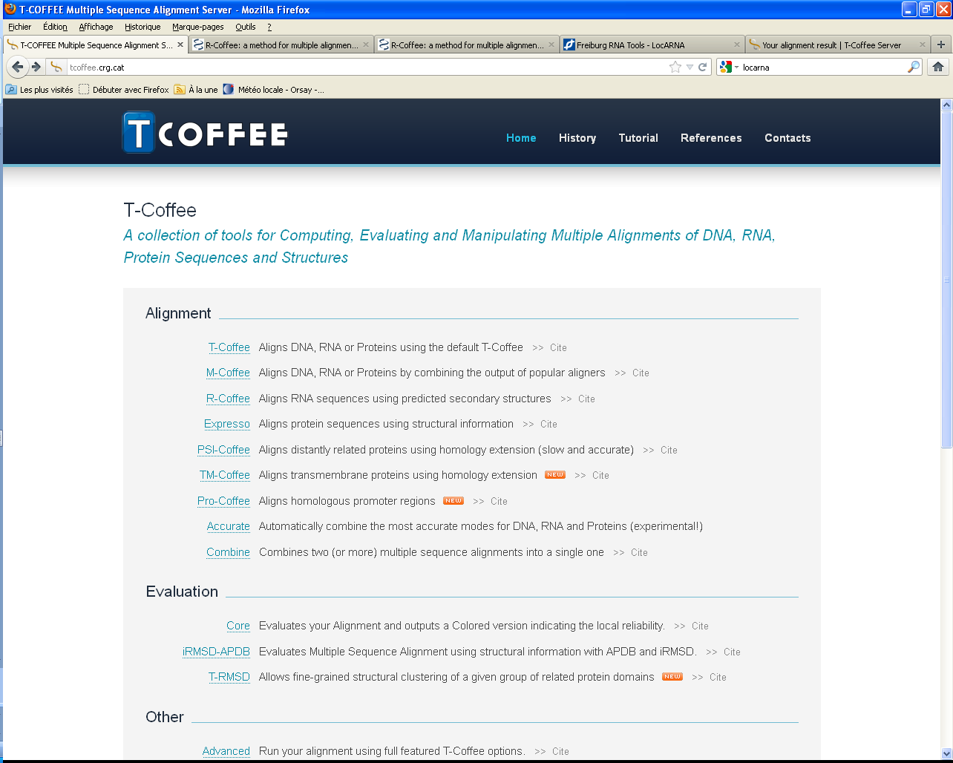
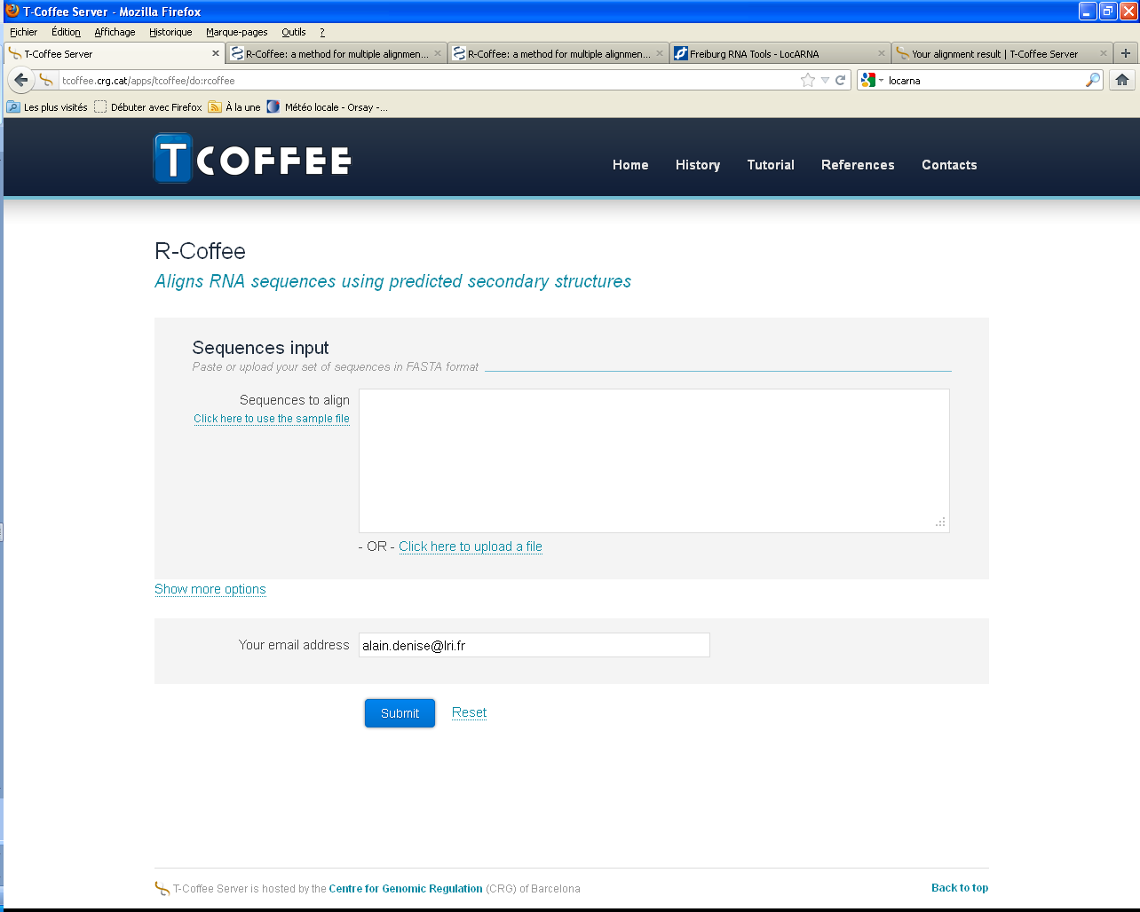
R-Coffee

Slide 59
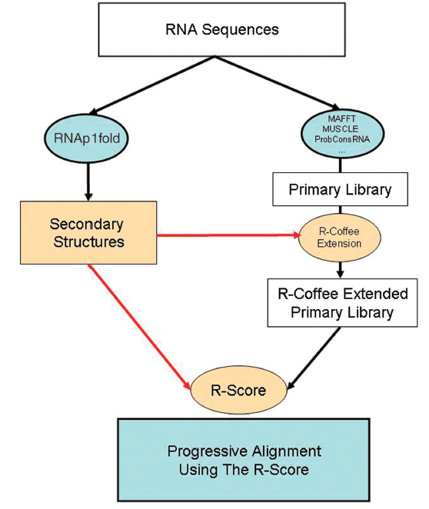
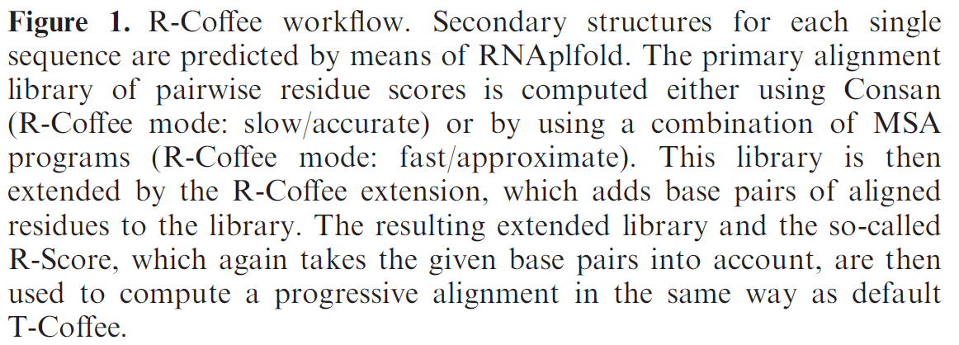
R-Coffee : Pipeline

Slide 60
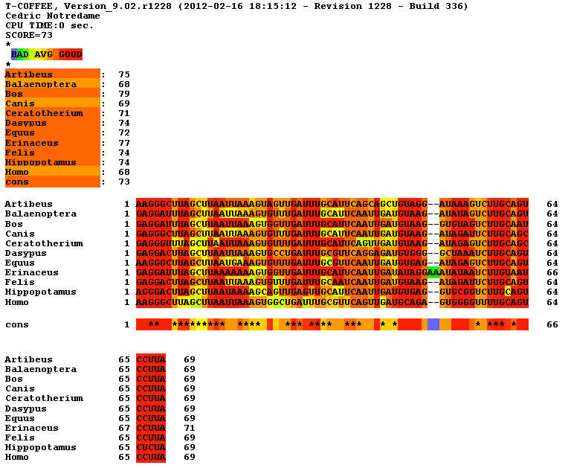
R-Coffee : tRNA Alanine

Slide 61
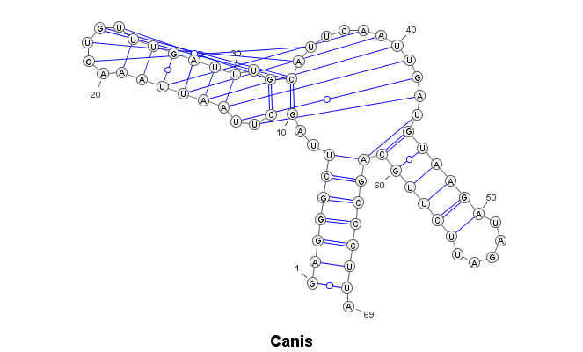
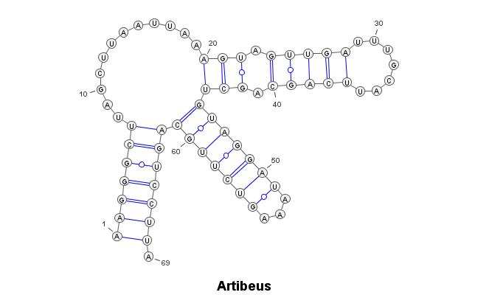
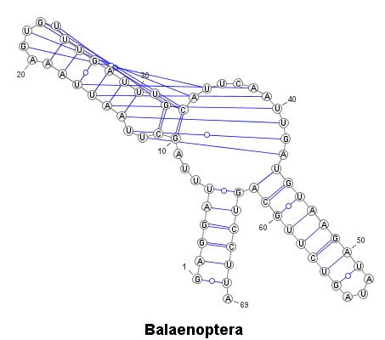
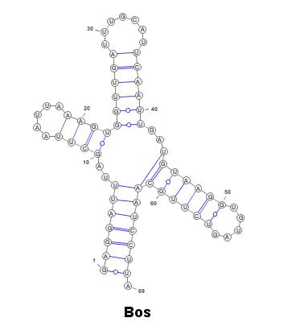

R-Coffee : tRNA Alanine – repliements individuels

Slide 62
Alignement ClustalW (donné par R-Coffee)
CLUSTAL W (1.83) multiple sequence alignment
Artibeus AAGGGCUUAGCUUAAUUAAAGUAGUUGAUUUGCAUUCAGCAGCUGUAGG--AUAAAGUCUUGCAGUCCUUA 69
Balaenoptera GAGGAUUUAGCUUAAUUAAAGUGUUUGAUUUGCAUUCAAUUGAUGUAAG--AUAUAGUCUUGCAGUCCUUA 69
Bos GAGGAUUUAGCUUAAUUAAAGUGGUUGAUUUGCAUUCAAUUGAUGUAAG--GUGUAGUCUUGCAAUCCUUA 69
Canis GAGGGCUUAGCUUAAUUAAAGUGUUUGAUUUGCAUUCAAUUGAUGUAAG--AUAGAUUCUUGCAGCCCUUA 69
Ceratotherium GAGGGUUUAGCUUAAUUAAAGUGUUUGAUUUGCAUUCAGUUGAUGUAAG--AUAGAGUCUUGCAGCCCUUA 69
Dasypus GAGGACUUAGCUUAAUUAAAGUGCCUGAUUUGCGUUCAGGAGAUGUGGG--GCUAAAUCUUGCAGUCCUUA 69
Equus AAGGGCUUAGCUUAAUGAAAGUGUUUGAUUUGCGUUCAAUUGAUGUGAG--AUAGAGUCUUGCAGUCCUUA 69
Erinaceus GAGGAUUUAGCUUAAAAAAAGUGGUUGAUUUGCAUUCAAUUGAUAUAGGAAAUAUAAUCUUGUAAUCCUUA 71
Felis GAGGACUUAGCUUAAUUAAAGUGUUUGAUUUGCAAUCAAUUGAUGUAAG--AUAGAUUCUUGCAGUCCUUA 69
Hippopotamus AGGGACUUAGCUUAAUAAAAGCAGUUGAGUUGCAUUCAAUUGAUGUGAG--GUGCGGUCUUGCAGUCUCUA 69
Homo AAGGGCUUAGCUUAAUUAAAGUGGCUGAUUUGCGUUCAGUUGAUGCAGA--GUGGGGUUUUGCAGUCCUUA 69
** ********* **** *** **** *** * * * *** * * **

Slide 63

Alignement → Structure (par RNAalifold)

Slide 64

R-Coffee : tRNA H. sapiens

Slide 65
Alignement ClustalW (donné par R-Coffee)
CLUSTAL W (1.83) multiple sequence alignment
Homo UGGUAUAUAGUUUAAACAAAA---CGAAUGAUUUCGA-CUCAUUAAAUU-AUGA--UAA-UC-AUAU-UUACCAA 65
Homo_1 UAGAUUGAAGCCAGUUGAUUAGGGUGCUUAGCUGUUA-ACUAAGUGUUUGUGGGUUUAAGUCCCAUU-GGUCUAG 73
Homo_2 AAGGUAUUAGAAAAACCAUU---UCAUAACUUUGUCA-AAGUUAAAUUA-UAGGCUAAAUCCUA-UA-UAUCUUA 68
Homo_3 -AGCUCCGAGG-UGAUUUUC---AUAUUGAAUUGCAA-AUUCGAAGAAG-CAGCUUCAAACCUG-CC-GGGGCUU 66
Homo_4 UAGGAUGGGGUGUGAUAGGUGGCACGGAGAAUUUUGG-AUUCUCAGGGA-UGGGUUCGAUUCUC-AUAGUCCUAG 72
Homo_5 GUUCUUGUAGUUGAAAUACA---ACGAUGGUUUUUCA-UAUCAUUGGUC-GUGGUUGUAGUCCGUGC-GAGAAUA 69
Homo_6 ACUCUUUUAGUAUAAAUAGUA---CCGUUAACUUCCA-AUUAACUAGUU-UUGACAACAUUC-AAAA-AAGAGUA 68
Homo_7 GUAAAUAUAGUUUAACCAAAA---CAUCAGAUUGUGA-AUCUGACAACA-GAGGCUUACGACCCCUU-AUUUACC 69
Homo_8 AGAAAUAUGU-CUGAUAAAAG---AGUUACUUUGAUAGAGUAAAUAAUA-GGAGCUUAAACCCCCUU-AUUUCUA 69
Homo_9 ACUUUUAAAGGAUAACAGCUA-UCCAUUGGUCUUAGG-CCCCAAAAAUU-UUGGUGCAACUCCAAAU-AAAAGUA 71
* *

Slide 66

Alignement → Structure (par RNAalifold)

Slide 67
Conclusion / Discussion

Slide 69
Conclusion / Discussion
From single sequence:
  There is more to life than mfold and RNAfold.
  Consider using basepair probabilities!
  Secondary structure can be automatically extracted from 3D models.
  If pseudoknots are suspected, try alternative tools
From several homologuous sequences
  For close homology, sequence then alignment may work.
  Simultaneous folding and alignment performs better in general
  More (homologuous!) sequences, better results, longuest running time!

Slide 70
The End.

Slide 71
1. From sequence alignment

Slide 72
Une approche heuristique : Carnac
Recherche des tiges-boucles candidates dans chaque séquence, indépendamment
Recherche de « points d’ancrage » : régions très conservées entre les 2 séquences
Sélection des tiges « alignables »
Repliement simultané « à la Sankoff » de chaque paire de tiges alignables

Slide 73
Application : tRNA Alanine
>Artibeus jamaicensis
AAGGGCTTAGCTTAATTAAAGTAGTTGATTTGCATTCAGCAGCTGTAGGATAAAGTCTTGCAGTCCTTA
>Balaenoptera musculus
GAGGATTTAGCTTAATTAAAGTGTTTGATTTGCATTCAATTGATGTAAGATATAGTCTTGCAGTCCTTA
>Bos taurus
GAGGATTTAGCTTAATTAAAGTGGTTGATTTGCATTCAATTGATGTAAGGTGTAGTCTTGCAATCCTTA
>Canis familiaris
GAGGGCTTAGCTTAATTAAAGTGTTTGATTTGCATTCAATTGATGTAAGATAGATTCTTGCAGCCCTTA
>Ceratotherium simum
GAGGGTTTAGCTTAATTAAAGTGTTTGATTTGCATTCAGTTGATGTAAGATAGAGTCTTGCAGCCCTTA
>Dasypus novemcinctus
GAGGACTTAGCTTAATTAAAGTGCCTGATTTGCGTTCAGGAGATGTGGGGCTAAATCTTGCAGTCCTTA
>Equus asinus
AAGGGCTTAGCTTAATGAAAGTGTTTGATTTGCGTTCAATTGATGTGAGATAGAGTCTTGCAGTCCTTA
>Erinaceus europeus
GAGGATTTAGCTTAAAAAAAGTGGTTGATTTGCATTCAATTGATATAGGAAATATAATCTTGTAATCCTTA
>Felis catus
GAGGACTTAGCTTAATTAAAGTGTTTGATTTGCAATCAATTGATGTAAGATAGATTCTTGCAGTCCTTA
>Hippopotamus amphibius
AGGGACTTAGCTTAATAAAAGCAGTTGAGTTGCATTCAATTGATGTGAGGTGCGGTCTTGCAGTCTCTA
>Homo sapiens
AAGGGCTTAGCTTAATTAAAGTGGCTGATTTGCGTTCAGTTGATGCAGAGTGGGGTTTTGCAGTCCTTA

Slide 74

Carnac - 3 séquences

Slide 75

Carnac - 6 séquences

Slide 76

Carnac - 11 séquences

Slide 77
Application : tRNA H.sapiens Arg
>Homo sapiens Arg, True Structure
TGGTATATAGTTTAAACAAAACGAATGATTTCGACTCATTAAATTATGATAATCATATTTACCAA
(((((.(..((((.....)))).(((((.......)))))....(((((...)))))).))))).
>Homo sapiensArg TGGTATATAGTTTAAACAAAACGAATGATTTCGACTCATTAAATTATGATAATCATATTTACCAA
>Homo sapiensAsn
TAGATTGAAGCCAGTTGATTAGGGTGCTTAGCTGTTAACTAAGTGTTTGTGGGTTTAAGTCCCATTGGTCTAG
>Homo sapiensAsp
AAGGTATTAGAAAAACCATTTCATAACTTTGTCAAAGTTAAATTATAGGCTAAATCCTATATATCTTA
>Homo sapiensCys
AGCTCCGAGGTGATTTTCATATTGAATTGCAAATTCGAAGAAGCAGCTTCAAACCTGCCGGGGCTT
>Homo sapiensGln
TAGGATGGGGTGTGATAGGTGGCACGGAGAATTTTGGATTCTCAGGGATGGGTTCGATTCTCATAGTCCTAG
>Homo sapiensGlu
GTTCTTGTAGTTGAAATACAACGATGGTTTTTCATATCATTGGTCGTGGTTGTAGTCCGTGCGAGAATA
>Homo sapiensGly
ACTCTTTTAGTATAAATAGTACCGTTAACTTCCAATTAACTAGTTTTGACAACATTCAAAAAAGAGTA
>Homo sapiensHis
GTAAATATAGTTTAACCAAAACATCAGATTGTGAATCTGACAACAGAGGCTTACGACCCCTTATTTACC
>Homo sapiensIso
AGAAATATGTCTGATAAAAGAGTTACTTTGATAGAGTAAATAATAGGAGCTTAAACCCCCTTATTTCTA
>Homo sapiensLeuCun
ACTTTTAAAGGATAACAGCTATCCATTGGTCTTAGGCCCCAAAAATTTTGGTGCAACTCCAAATAAAAGTA

Slide 78

Carnac - 10 séquences

Slide 79

RNAz

